Slide 1
Comparison of vowel detection methods.
Yash Bhatia 2020101007
Laksh Balani 2020102019
Ishanya Sethi 2020102014

Slide 2
Introduction
Vowels are long duration, periodic and high energy sound units in a speech utterance
Vowel Onset Point (VOP) are the instants of starting of a vowel.
Vowel End Point (VEP) are the instants of ending of a vowel.
Both of these are equally important for accurate detection of vowels.
The frequency response of the vocal-tract system as well as the excitation source information are better manifested within the vowels
A vowel sound unit may be viewed as consisting of three regions viz. onset, steady and offset regions.
The change in signal energy and periodicity at the VOPs is quite sharp and comparatively higher.
Signal magnitude maintains a nearly constant value within the steady regions.
The signal decays slowly around VEPs

Slide 3
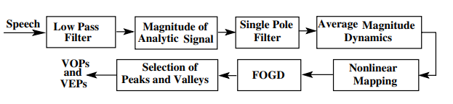
Detection of vowel onset and offset points using average magnitude dynamics(AMD)
The speech signal is first processed through a low-pass filter to preserve the signal components corresponding to 0–2500 Hz frequency band. Then, the analytic signal xa(n) of the low-pass filtered is constructed by using the Hilbert transform
At each time instant, the differences between L preceding and succeeding sample values are computed. The mean of L difference values (nonlocal slopes) will represent the AMD at that time instant.
Significant transition points in NL-AMD are then convolved by convolving it with a Gaussian window having a standard deviation one sixth of the window length.

Slide 4
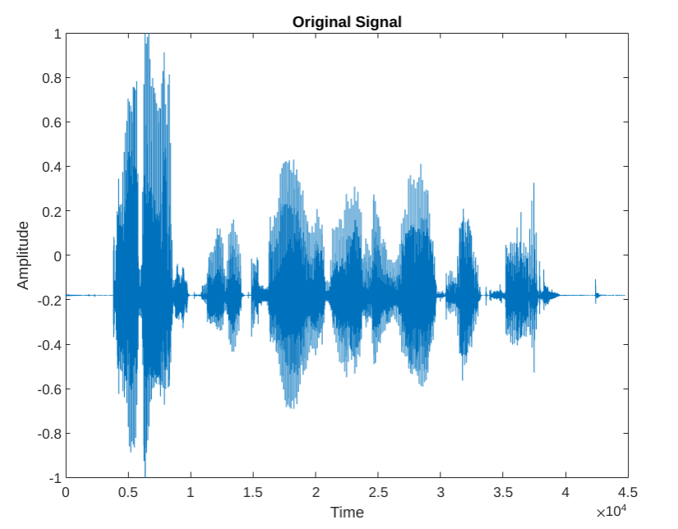

Slide 5
Passing through low pass filter
Firstly, the speech signal is processed through a low-pass filter to preserve the signal components corresponding to 0–2500 Hz frequency band. For most of the vowels, the signal energy is predominantly concentrated in the considered frequency band. The low-pass filtering will help in suppressing the signal energy due most of the high frequency sound units.

Slide 6
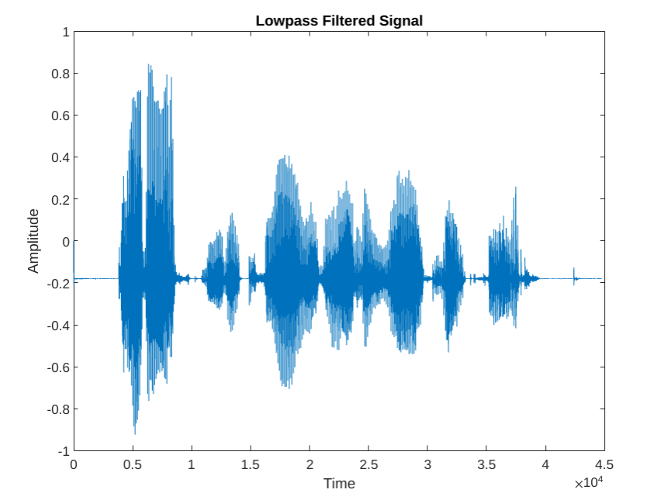

Slide 7

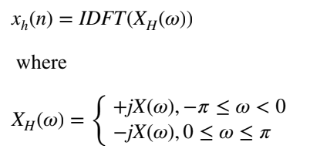

2. Magnitude of Analytic Signal
Using Hilbert Transform, the analytic signal of the low-passed speech signal is constructed. The magnitude of the analytic signal is known as the Hilbert envelope (HE). The HE will enhance the time varying nature of the filtered speech signal x(n). The equations are :
Where xh(n) is the Hilbert transform of x(n).
X(ω) is the discrete Fourier transform (DFT) of x(n). IDFT refers to inverse of DFT. The magnitude of the analytic signal xa(n) is given above.

Slide 8
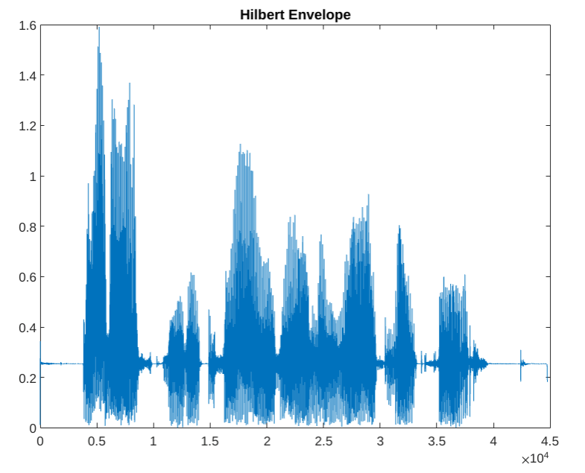

Slide 9


Single Pole Filtering
The Hilbert envelope (HE) of a signal is then passed through a Single Pole filter. The HE ensures that the output is an increasing function of time. The stability of the filter is ensured by resetting the filter output to zero after a period of time. The equation of the filter and output are given by:
And

Slide 10
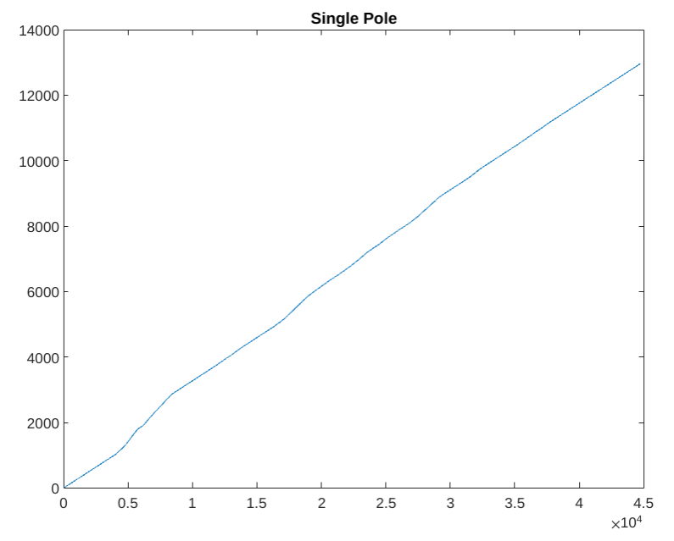

Slide 11
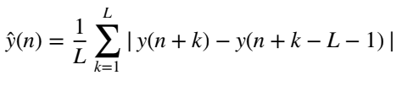
Taking the AMD(Average Magnitude Dynamics)
For each sample shift, the filter output is then analysed in frames having 2L + 1 sample points. It is analysed from X-L to X+L. The mean of L difference values (nonlocal slopes) will represent the AMD at that time instant. Due to the higher magnitude of the vowels, the AMD values will be more in these regions as compared to other sound units. On the other hand, if the signal magnitudes are small or repetitive (i.e., periodic) over a period of time, then AMD will be nearly constant. AMD is computed using the given formula :

Slide 12
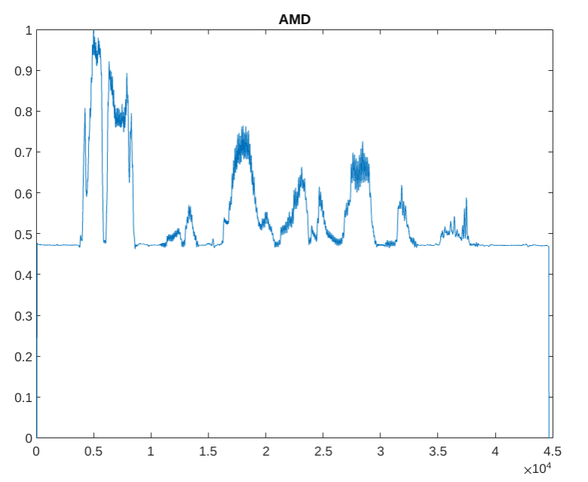

Slide 13
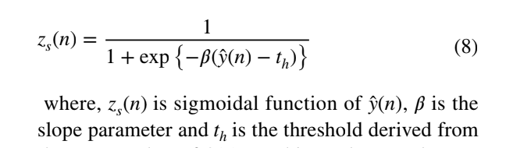

Mapping the AMDs non-linearly
The AMDs at each time instant are then non-linearly mapped by using sigmoidal function to sharpen the transitions and suppress the variations in the higher magnitude regions. The sigmoidal function is given as :

Slide 14
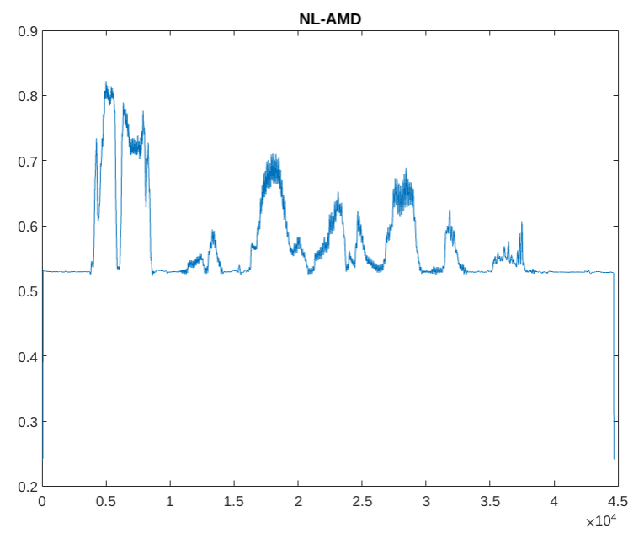

Slide 15
FOGD
The significant transition points in NL-AMD are then detected by convolving it with a 100 ms long first-order difference of Gaussian window (FOGD) having a standard deviation one sixth of the window length.
Selection of peaks and Valleys
The peaks and the valleys are detected by considering sum of magnitude at those points. If sum of the magnitudes is above a predefined threshold, the peaks and corresponding valleys are hypothesized as the VOPs and VEPs, respectively.

Slide 16
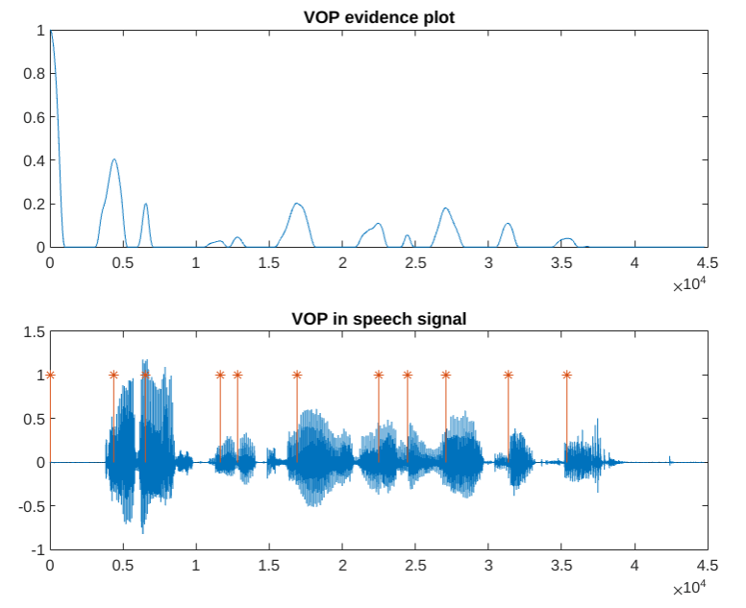

Slide 17
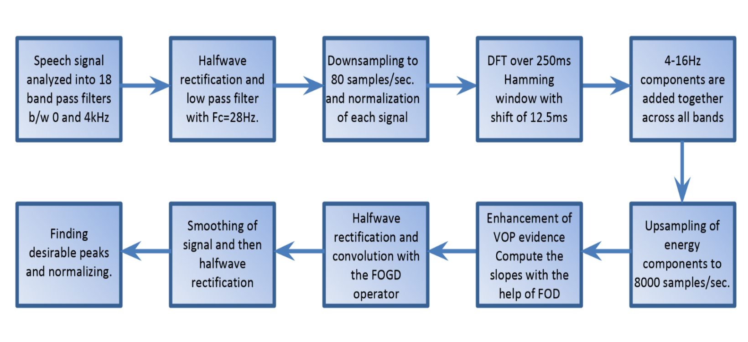
VOP Detection using Modulation Spectrum Energy
Modulation components refer to the slowly varying temporal envelope components in speech. The temporal envelope of speech is dominated by low-frequency components of several Hz. A representation of this type has compelling parallels to the dynamics of speech production, in which the articulators move at rates of 2–12 Hz.

Slide 18
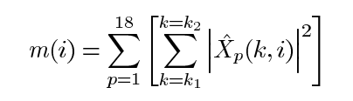

Modulation Spectrum
The modulations of the normalized envelope signals are analyzed by computing the DFT over 250-ms Hamming windows with shift of 12.5 ms, in order to capture the dynamic properties of the signal. Finally, the 4–16 Hz components are added together, across all critical bands. Mathematically the modulation transfer function energies are expressed as
k1=4 Hz and k2=16 Hz and w(n) is the hamming window.

Slide 19
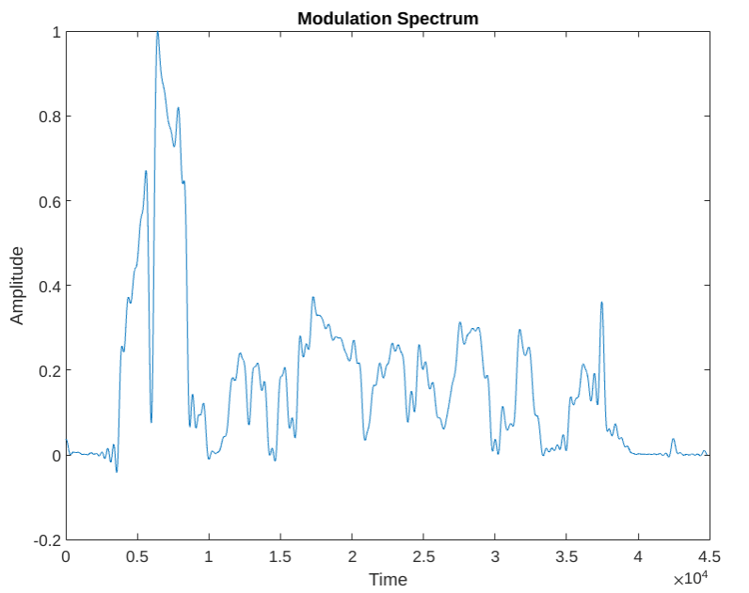

Slide 20
Enhancement of Modulation Spectrum
Since we got the energy distribution now, we need to further enhance our energy spectrum to remove close peaks and smoothen the signal. The change in VOP is further enhanced by computing its slope using FOD (first order differential).
These values are then convolved with FOGD operator (first order gaussian differentiator) and the output is the VOP evidence. Thus our VOP evidence plot show us the various vowel onset points in our speech signal.
The peak in the VOP evidence plot selected on a threshold basis indicates the location of the VOP.

Slide 21
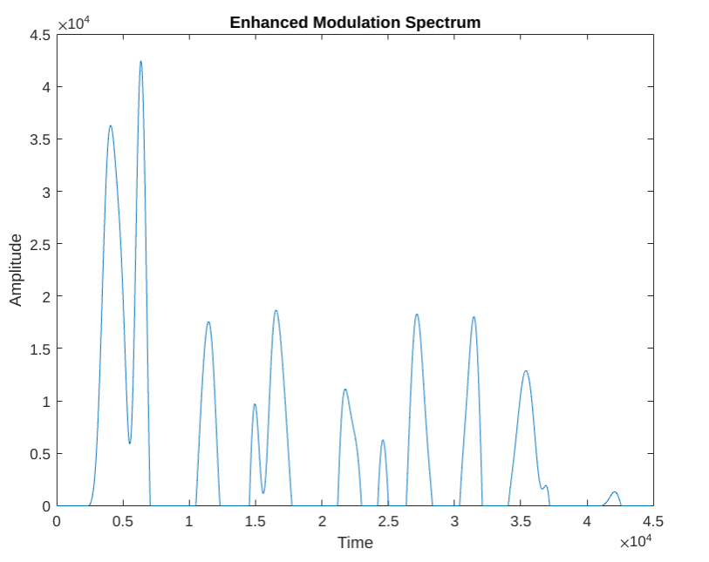

Slide 22
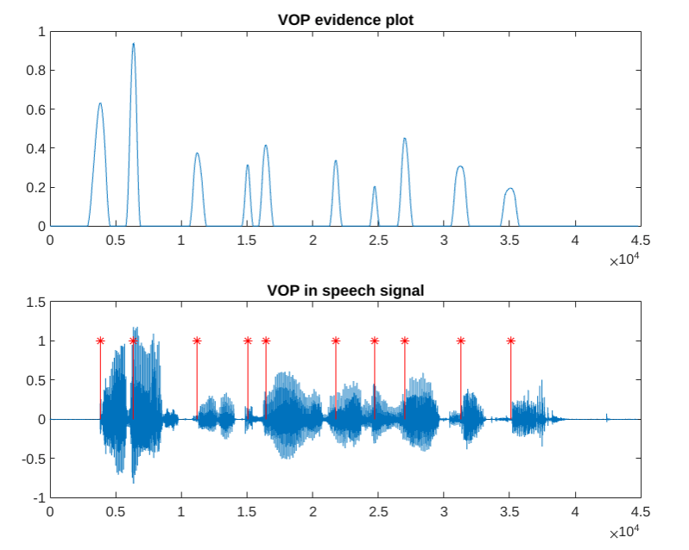

Slide 23
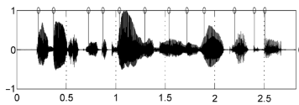
Manually Marked VOPs
Manually marked VOPs for the same audio signal:
There are 12 VOPs in the above plot.
Plot from research paper VOP_ref1

Slide 24
Comparison of both methods
Number of VOPs Detected:
10 using average magnitude dynamics(AMD)
10 using Modulation Spectrum Energies
The VOPs detected using Modulation Spectrum Energies are slightly delayed due to the filters used in the MATLAB code.
The method using AMD gives a peak at t=0. This is a falsely detected VOP. It is due to calculations at initial points of the signal.
Both the methods give 9 common VOPs (slightly delayed).
The method using Modulation Spectrum Energies gives a spurious VOP

Slide 25
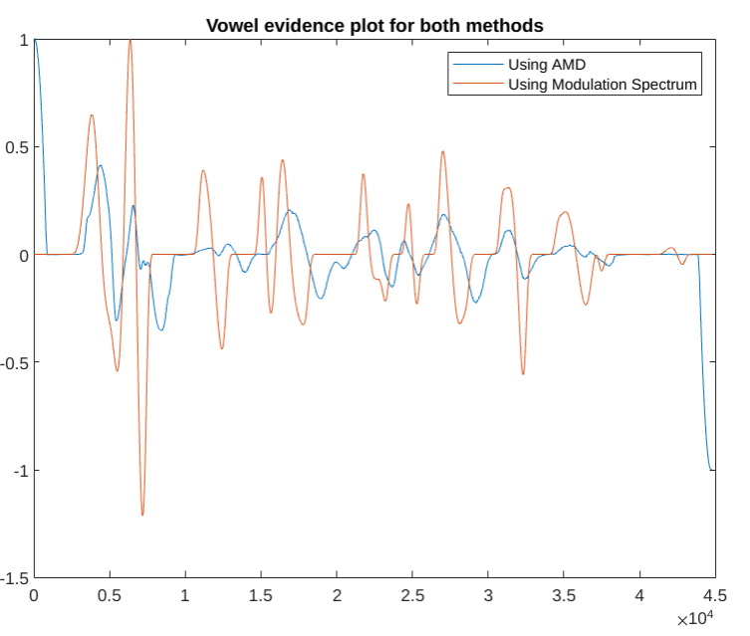

Slide 26
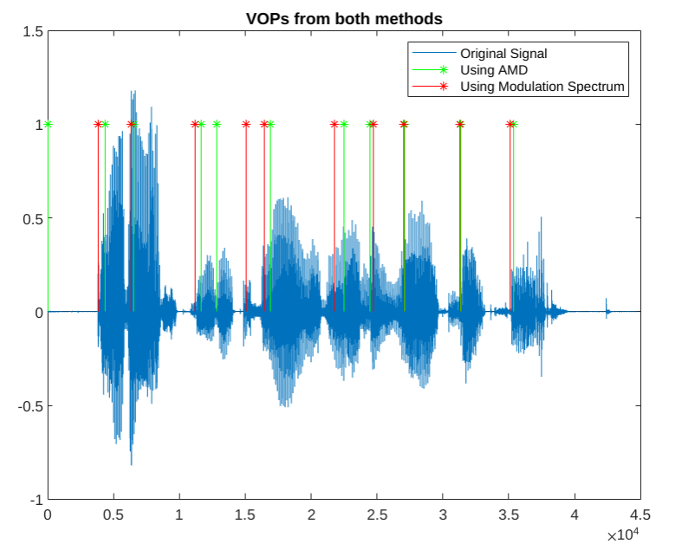

Slide 27
Contribution
Laksh Balani : Single pole filtering, first order gaussian differentiation (FOGD), detection of modulation spectrum
Yash Bhatia : Low pass filtering, non linear mapping of AMD and enhancement of modulation spectrum
Ishanya Sethi : Plotting the VOPs by finding peaks, and comparison of the hilbert and VOP plots obtained

Slide 28
References
Vowel Onset Point Detection Using Source, Spectral Peaks, and Modulation Spectrum Energies by S. R. Mahadeva Prasanna, Member, IEEE, B. V. Sandeep Reddy, and P. Krishnamoorthy, Student Member, IEEE
An efficient approach for detecting vowel onset and offset points in speech signal by Sarmila Garnaik Avinash Kumar Gayadhar Pradhan Kabiraj Sethi

Slide 29
Thank You

