Slide 1

Data de-duplication using checksum and cloud databases
Comp 8147 – Advanced Database concepts
Presented by – group 30
MEMbers :
Amandeep singh Sawhney (105218568)
Gurpreet singh (105192019)
Lakshdeep Singh (105210335)
Mehak taluja (110013132)
Under the guidance of :
Dr.kalyani selvarajah

Slide 2

OUTLINE
01
Introduction
References
07
02
Problem
Conclusion and Future Scope
06
03
Existing System
05
04
Technologies Used
Work Flow

Slide 3
INTRODUCTION
A cloud database is a database that typically runs on a cloud computing platform, and access to the database is provided as a service.
Database services take care of scalability and high availability of the database. There are 2 primary methods to run a DB in the cloud:
Virtual Machines - Cloud platforms allow users to purchase virtual-machine instances for a limited time, and one can run a database on such virtual machines.
Database-as-a-service (DBaaS) - With a database as a service model, application owners do not have to install and maintain the database themselves. Instead, the database service provider takes responsibility for installing and maintaining the database.

Slide 4
PROBLEM
Redundant data has been a problem for decades. It is problematic because:
Increases the size of the database unnecessarily.
Causes data inconsistency
Decreases efficiency of the database
May cause data corruption
If data has to updated, then we need to do it at more than one place.
Therefore, we are going to be using the checksum method for data deduplication, that too in cloud databases for increased scalability, agility, resilience, fault tolerance and availability.

Slide 5
EXISTING SYSTEM - Application–aware Local-Global (ALG) source deduplication scheme
2) Application aware deduplicator-
Generates chunk fingerprints in hash engine and performing data redundancy check in application-aware indices in both local client and remote cloud for the data chunks.
1) File Size Filter –
Small files are first filtered out by for efficiency reasons, and backup data streams are broken into chunks
3) Metadata -
For the file containing chunk it is updated to the point to the location of the existing chunk if similar data is found. If there is no similar data further it can check for the global deduplication.

Slide 6

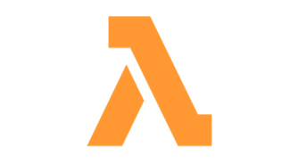
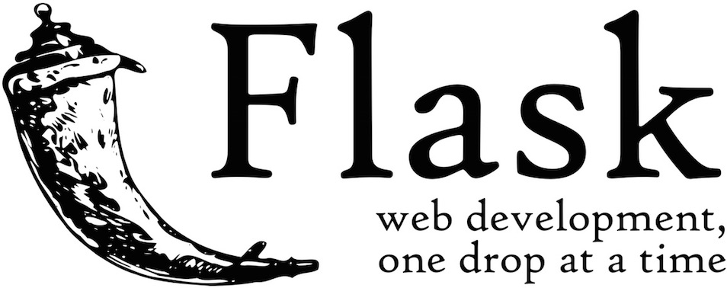
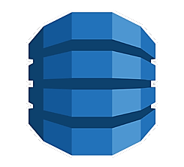
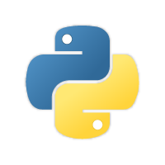

TECHNOLOGIES USED
Lambda
Flask
DynamoDB
Amazon Web Services
Python

Slide 7
WORK FLOW OF THE SYSTEM
Setup DynamoDB on AWS to accept incoming and outgoing traffic
Continue until user doesn’t want to upload any more files..
A
F
Execute the Python Script on Lambda and choose the file to upload to DB – serverless code
If no match found, push the file to DynamoDB else raise an error
B
E
C
D
Checksum of the file is calculated
Match checksum generated by script to DynamoDB existing files

Slide 8
We have implemented a data de-duplication system using cloud databases and Python. We have tried to keep our classroom learning in mind while working on the project.
During the development phase, we faced few obstacles but through Zoom calls and teamwork were able to resolve them. We became good friends during this fun development phase.
In the future, we would like to implement features such as caching of most used files, implement a hybrid architecture of local + cloud, and research even better algorithms / techniques.
Implementation
Teamwork
Future Scope
Conclusion

Slide 9
References
01
03
05
AWS official website
https://aws.amazon.com/free/
Flask documentation –
https://flask.palletsprojects.com/
Python documentation :
https://www.python.org/doc/
02
04
06
DynamoDB documentation –
https://aws.amazon.com/dynamodb/
Cloud Computing overview:
https://aws.amazon.com/what-is-cloud-computing/
Lambda documentation:
https://docs.aws.amazon.com/lambda/index.html

Slide 10

Thank You! Any questions?

