Slide 1
Insights from Kickstarter Dataset (2012-2013)
Analyzing Project Trends and Success Factors
Presented by: Laksh Dugar
Date: 27-08-2024

Slide 2

Overview of Kickstarter
Founded in 2009, Kickstarter is a crowdfunding platform that empowers creators to fund their projects through contributions from backers. It has become a vital tool for artists, designers, and entrepreneurs to launch innovative ideas and gauge market interest.

Slide 3

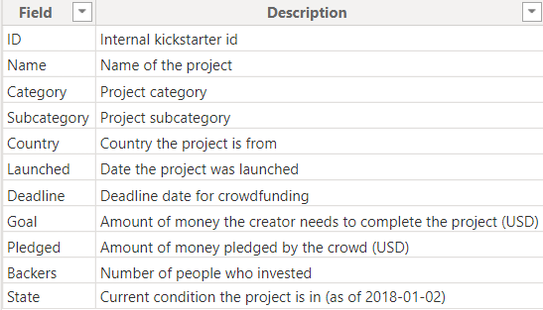
Data Description
Dataset Overview:
Total Projects: 41,000 (2012) and 45,000 (2013) indicating a healthy growth trend.
Categories: 15 main categories and 152 subcategories.
Key Fields:
ID, Name, Category, Subcategory, Country, Launched, Deadline, Goal, Pledged, Backers, State.

Slide 4
Project Trends (2012-2013)
Growth in Projects:
A slight increase in total projects from 2012 to 2013 indicates growing interest in crowdfunding.
Investment Insights:
Low investment in categories like Photography and Dance. - Potential areas for innovation or marketing efforts to attract backers.
High investment in Games, Film & Video, Design, and Technology - booming industries during this period, highlighting where backers are focusing their interests.

Slide 5
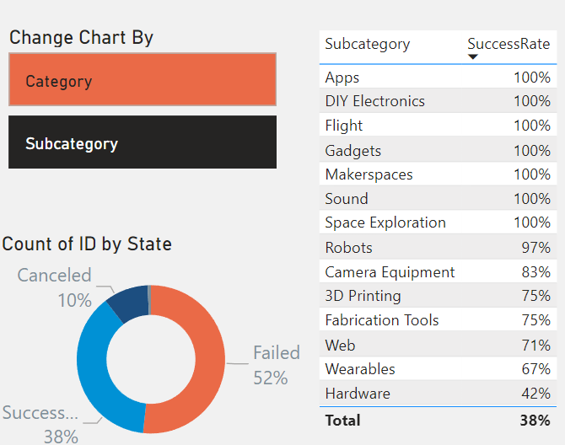
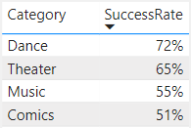
Success Factors
Successful Categories:
Dance and Theatre show high success rates (72% and 65%), indicating strong community support for creative projects.
Technology subcategories such as Apps, Space Exploration and Gadgets have 100% success rates, suggesting high demand and backer confidence in these areas.

Slide 6
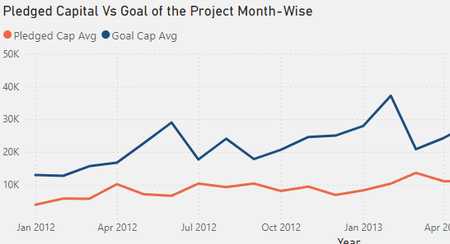
Backer Dynamics
Impact of Backers:
The number of backers significantly impacts a project's success. Projects that secured 47 backers or more within the first 31 days had a 3.56x higher chance of success. This highlights the importance of early engagement and building a community around the project.
Average Pledged Amount:
Gaming Hardware has the highest pledged amount at $12.4 million.

Slide 7
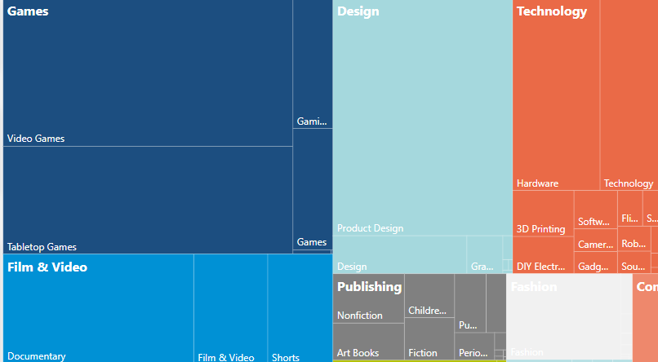
Market Demand Insights
Project Outcomes:
Highest suspended projects in Design, highest cancelled in Games, and highest successful in Games (87M pledged).
Pledged to Goal Ratio:
Significant increase in pledged amounts after December 2012.
High-Performing Categories:
Projects in the Games, Film & Video, and Technology categories consistently attracted more funding and backers. Specifically, Games accounted for a significant portion of the total funds raised, indicating a strong market interest during this period.
Low-Performing Categories:
Categories like Photography, Dance, and Journalism received less attention and funding. This could be due to a lower perceived value or interest from backers, suggesting that creators in these categories may need to innovate or enhance their marketing strategies to attract support.

Slide 8
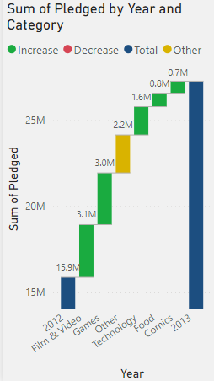
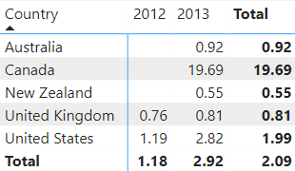
Comparative Analysis (2012 vs 2013)
Overall increase in pledged amounts, total projects, and backers.
New demographics entering the market (NZ, CAN, AUS).
Geographic Insights
The United States led in the number of projects, but it also had the highest number of failed projects. Conversely, countries like Canada and New Zealand showed potential for growth despite having fewer projects. This indicates that while the U.S. market is saturated, there may be opportunities for expansion in less tapped regions

Slide 9
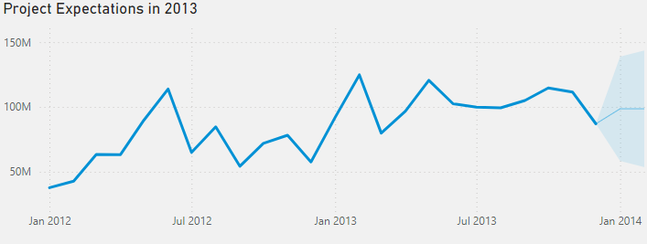
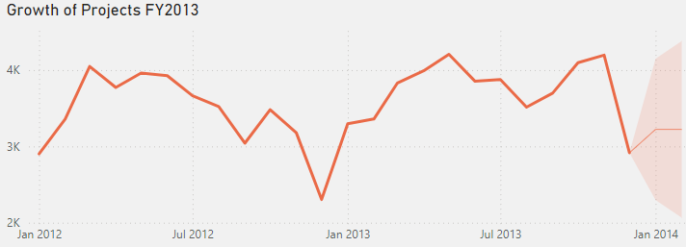
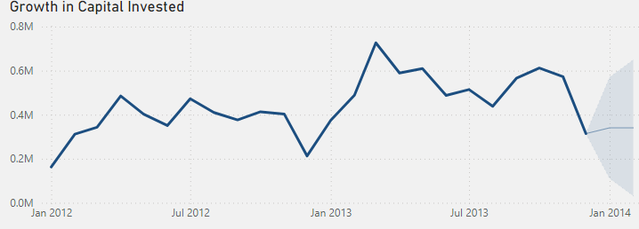
Projections for 2014
Future Trends:
Expected steady increase in backers and new project initiatives.
Potential growth in Canada despite low project numbers.

Slide 10

Conclusion
The Kickstarter platform shows varied success based on category and backer engagement.
Understanding these trends can help creators strategize for future projects.

