Slide 1

IT2060 Operating Systems and System Administration
Lecture 09 Process Synchronization

Slide 2
Process Synchronization
Background
The Critical-Section Problem
Semaphores
Classic Problems of Synchronization
Monitors

Slide 3
Background
Processes can execute concurrently
May be interrupted at any time, partially completing execution
Concurrent access to shared data may result in data inconsistency
Maintaining data consistency requires mechanisms to ensure the orderly execution of cooperating processes
Illustration of the problem: Suppose that we wanted to provide a solution to the consumer-producer problem that fills all the buffers. We can do so by having an integer counter that keeps track of the number of full buffers. Initially, counter is set to 0. It is incremented by the producer after it produces a new buffer and is decremented by the consumer after it consumes a buffer.

Slide 4
Producer
while (true) { /* produce an item in next produced */
while (counter == BUFFER_SIZE) ;
/* do nothing */
buffer[in] = next_produced;
in = (in + 1) % BUFFER_SIZE;
counter++;
}

Slide 5
Consumer
while (true) {
while (counter == 0)
; /* do nothing */
next_consumed = buffer[out];
out = (out + 1) % BUFFER_SIZE;
counter--;
/* consume the item in next consumed */
}

Slide 6
Race Condition
counter++ could be implemented as register1 = counter register1 = register1 + 1 counter = register1
counter-- could be implemented as register2 = counter register2 = register2 - 1 counter = register2
Consider this execution interleaving with “count = 5” initially:
S0: producer execute register1 = counter {register1 = 5} S1: producer execute register1 = register1 + 1 {register1 = 6} S2: consumer execute register2 = counter {register2 = 5} S3: consumer execute register2 = register2 – 1 {register2 = 4} S4: producer execute counter = register1 {counter = 6 } S5: consumer execute counter = register2 {counter = 4}

Slide 7
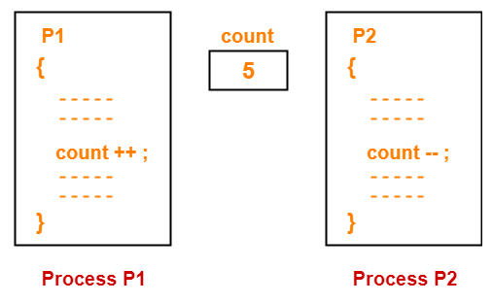
Race condition
Race condition is a situation where several processes access and manipulate the same data concurrently.
The outcome of the execution depends on particular order in which the access takes place.
In order to prevent race condition on counter, we need to ensure that only one process at a time can be manipulating counter
We need some form of process synchronization.

Slide 8
Critical Section Problem
Consider system of n processes {p₀, p₁, … p_{n-1}}
Each process has critical section segment of code
Process may be changing common variables, updating table, writing file, etc
When one process in critical section, no other may be in its critical section
Critical section problem is to design protocol to solve this
Each process must ask permission to enter critical section in entry section, may follow critical section with exit section, then remainder section

Slide 9
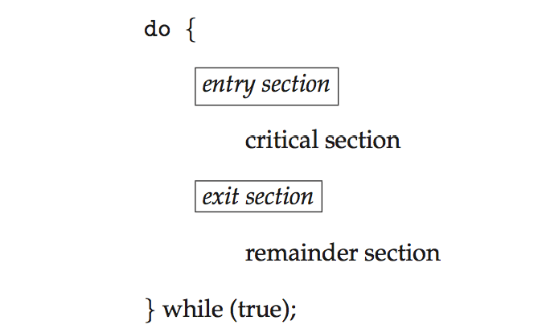
Critical Section
General structure of process P_{i}

Slide 10
Solution to Critical-Section Problem
1. Mutual Exclusion - If process P_{i} is executing in its critical section, then no other processes can be executing in their critical sections
2. Progress - If no process is executing in its critical section and there exist some processes that wish to enter their critical section, then the selection of the processes that will enter the critical section next cannot be postponed indefinitely
3. Bounded Waiting - A bound must exist on the number of times that other processes are allowed to enter their critical sections after a process has made a request to enter its critical section and before that request is granted

Slide 11
Solution (cont.)
Simplest solution:
Each process disables all interrupts just after entering its critical section and re-enables them just before leaving it.
Not wise, because enabling/disabling interrupt is a privileged instruction.
Solution in kernel mode:
Preemptive kernel: a process can be preempted while running in the kernel mode
Otherwise, the kernel is nonpreemptive kernel: allows the process to run until it exits kernel mode, blocks, or voluntarily yields CPU.
Nonpreemptive kernel is free from race conditions on kernel data structure
However preemptive kernel is more responsive and suitable for real time system.

Slide 12
Solution for two processes, P₀ and P₁ Software-based
ALGORITHM 1
var turn: (0 .. 1); // Initially turn = 0; turn = i means P_{i} can enter its CS
Process P_{i} Process P_{j}
repeat repeat
while turn ≠ i do no-op; while turn ≠ j do no-op;
Critical Section Critical Section
turn = j; turn = i;
Remainder Section Remainder Section
until false; until false;
Satisfies mutual exclusion, but not progress requirement.
If turn = 0, P₁ cannot enter its CS even though P₀ is in its RS.
Taking turn is not good when one process is slower than other.
Busy waiting: continuously testing a variable waiting for some value to appear
not good since it wastes CPU time

Slide 13
Solution for two processes (cont. ) Software-based
ALGORITHM 2
// Initially flag[0] = flag[1] = false; flag[i] = true means P_{i} wants to enter its CS
var flag: array [0 .. 1] of boolean;
Process P_{i} Process P_{j}
repeat repeat
flag[i] = true; flag[j] = true;
while flag[j] do no-op; while flag[i] do no-op;
Critical Section; Critical Section;
flag[i] = false; flag[j] = false;
Remainder Section; Remainder Section;
until false; until false;
Satisfy mutual exclusion, but violates the progress requirement:
T₀: P₀ sets flag[0] = true.
T₁: P₁ sets flag[1] = true.
→ P₀ and P₁ are looping in their respective while.

Slide 14
Solution for two processes (cont. ) Software-based
// Peterson’s solution: Combine shared variables of Algorithms 1 and 2
Process P_{i} Process P_{j}
repeat repeat
flag[i] = true; flag[j] = true;
turn = j; turn = i;
while (flag[j] and turn = j) do no-op; while (flag[i] and turn =i) do no-op;
critical section critical section
flag[i] = false; flag[j] = false;
remainder section remainder section
until false; until false;
Solves the critical-section problem for two processes.
It meets all the three requirements
Proof: need to show that:
Mutual exclusion is preserved.
The progress requirement is satisfied.
The bounded waiting time requirement is met.
For detailed proof, read the textbook.

Slide 15
Bakery Algorithm
The solution to the critical section problem for n processes by Leslie Lamport
Before entering its critical section, each process receives a number.
The holder of the smallest number enters the critical section.
If processes P_{i} and P_{j} receive the same number, if i < j, then P_{i} is served first; else P_{j} is served first.
Notation (ticket#, process id#)
(a, b) < (c, d) if a < c or if a = c and b < d.
max (a₀, …, a_{n-1}) is a number k such that k ≥ a_{i} for i = 0, …, n-1.
shared data
var choosing: array[0..n-1] of boolean;
number: array [0 .. n-1] of integer;
data structures are initialised to false and 0, respectively

Slide 16
Bakery Algorithm (contd.)
Process P_{i}
repeat
choosing[i] = true;
number[i] = max (number[0], number[1], …, number[n-1]) +1;
choosing[i] = false;
for j = 0 to n-1 do
begin
while choosing[j] do no-op;
while number[j] ≠ 0 and (number[j], j) < (number[i], i) do no-op;
end;
critical section
number[i] = 0;
remainder section
until false

Slide 17
Synchronization Hardware
There is no guarantee that the software-based solution will work correctly in all computer architectures.
The simple solution to critical section problem: disable interrupt while a shared variable is being modified.
This solution is not feasible in multiprocessor. Why?
Use special hardware instructions such as Test-and-Set and Swap.
Test-and-set or Swap is an atomic instruction: it can not be interrupted until it completes its execution
// Swapping instruction is done atomically
procedure Swap (var boolean: a, b)
var boolean: temp;
begin
temp = a;
a = b;
b = temp;
end;
// Test and set the content of a word atomically
function Test-and-Set (var boolean: target)
begin
Test-and-Set = target;
target = true;
end;

Slide 18
Semaphore
Synchronization tool that provides more sophisticated ways (than Mutex locks) for process to synchronize their activities.
Semaphore S – integer variable
Can only be accessed via two indivisible (atomic) operations
wait() and signal()
Originally called P() and V()
Definition of the wait() operation
wait(S) {
while (S <= 0)
; // busy wait
S--;
}
Definition of the signal() operation
signal(S) {
S++;
}

Slide 19
Semaphore Usage
Counting semaphore – integer value can range over an unrestricted domain
Binary semaphore – integer value can range only between 0 and 1
Same as a mutex lock
Can solve various synchronization problems
Consider P₁ and P₂ that require S₁ to happen before S₂
Create a semaphore “synch” initialized to 0
P1:
S₁;
signal(synch);
P2:
wait(synch);
S₂;
Can implement a counting semaphore S as a binary semaphore

Slide 20
Semaphore Implementation
Must guarantee that no two processes can execute the wait() and signal() on the same semaphore at the same time
Thus, the implementation becomes the critical section problem where the wait and signal code are placed in the critical section
Could now have busy waiting in critical section implementation
But implementation code is short
Little busy waiting if critical section rarely occupied
Note that applications may spend lots of time in critical sections and therefore this is not a good solution

Slide 21
Semaphore Implementation with no Busy waiting
With each semaphore there is an associated waiting queue
Each entry in a waiting queue has two data items:
value (of type integer)
pointer to next record in the list
Two operations:
block – place the process invoking the operation on the appropriate waiting queue
wakeup – remove one of processes in the waiting queue and place it in the ready queue
typedef struct{
int value;
struct process *list;
} semaphore;

Slide 22
Implementation with no Busy waiting (Cont.)
wait(semaphore *S) {
S->value--;
if (S->value < 0) { add this process to S->list;
block();
}
}
signal(semaphore *S) {
S->value++;
if (S->value <= 0) { remove a process P from S->list;
wakeup(P);
}
}

Slide 23
Classical Problems of Synchronization
Classical problems used to test newly-proposed synchronization schemes
Bounded-Buffer Problem
Readers and Writers Problem
Dining-Philosophers Problem

Slide 24
Bounded-Buffer Problem
n buffers, each can hold one item
Semaphore mutex initialized to the value 1
Semaphore full initialized to the value 0
Semaphore empty initialized to the value n

Slide 25
Bounded Buffer Problem (Cont.)
The structure of the producer process
do {
... /* produce an item in next_produced */
...
wait(empty);
wait(mutex);
... /* add next produced to the buffer */
...
signal(mutex);
signal(full);
} while (true);

Slide 26
Bounded Buffer Problem (Cont.)
The structure of the consumer process
Do {
wait(full);
wait(mutex);
... /* remove an item from buffer to next_consumed */
...
signal(mutex);
signal(empty);
... /* consume the item in next consumed */
... } while (true);

Slide 27
Readers-Writers Problem
A data set is shared among a number of concurrent processes
Readers – only read the data set; they do not perform any updates
Writers – can both read and write
Problem – allow multiple readers to read at the same time
Only one single writer can access the shared data at the same time
Several variations of how readers and writers are considered – all involve some form of priorities
Shared Data
Data set
Semaphore rw_mutex initialized to 1
Semaphore mutex initialized to 1
Integer read_count initialized to 0

Slide 28
Readers-Writers Problem (Cont.)
The structure of a writer process
do { wait(rw_mutex);
... /* writing is performed */
...
signal(rw_mutex);
} while (true);

Slide 29
Readers-Writers Problem (Cont.)
The structure of a reader process
do { wait(mutex); read_count++; if (read_count == 1)
wait(rw_mutex);
signal(mutex);
... /* reading is performed */
...
wait(mutex); read count--; if (read_count == 0)
signal(rw_mutex);
signal(mutex);
} while (true);

Slide 30
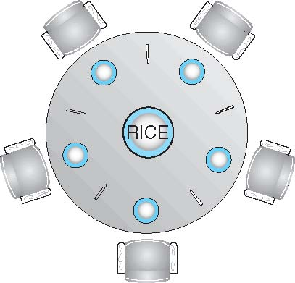
Dining-Philosophers Problem
Philosophers spend their lives alternating thinking and eating
Don’t interact with their neighbors, occasionally try to pick up 2 chopsticks (one at a time) to eat from bowl
Need both to eat, then release both when done
In the case of 5 philosophers
Shared data
Bowl of rice (data set)
Semaphore chopstick [5] initialized to 1

Slide 31
Problems with Semaphores
Incorrect use of semaphore operations:
signal (mutex) …. wait (mutex)
wait (mutex) … wait (mutex)
Omitting of wait (mutex) or signal (mutex) (or both)
Deadlock and starvation are possible.

Slide 32
Monitors
A high-level abstraction that provides a convenient and effective mechanism for process synchronization
Abstract data type, internal variables only accessible by code within the procedure
Only one process may be active within the monitor at a time
But not powerful enough to model some synchronization schemes
monitor monitor-name
{
// shared variable declarations
procedure P1 (…) { …. }
procedure Pn (…) {……}
Initialization code (…) { … }
}
}

Slide 33
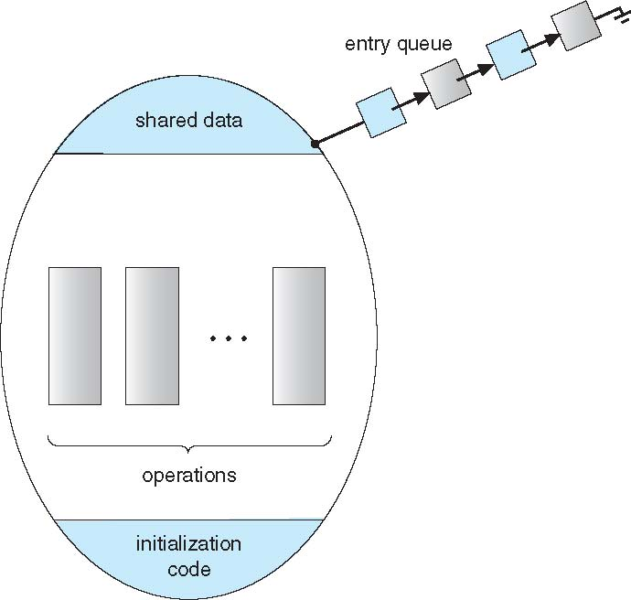
Schematic view of a Monitor

Slide 34
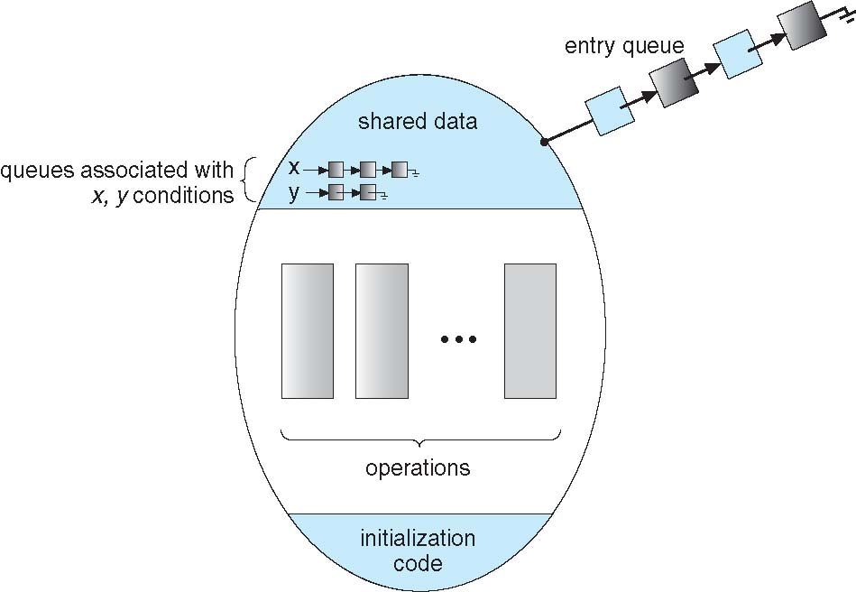
Monitor with Condition Variables

Slide 35
End of Lecture 9

