Slide 1

CS648 Gale Shapley Algorithm
Lakshika, Vanshika Gupta
Instructor: DR. Surender baswana

Slide 2
Theoretical Analysis

Slide 3
Introduction
Gale Shapley Algorithm is a very popular algorithm for stable matching problem.

Slide 4

Time Complexity
Gale Shapley Algorithm is a very popular algorithm for stable matching problem.
The time complexity of this deterministic algorithm is $O(n^{2}).$

Slide 5
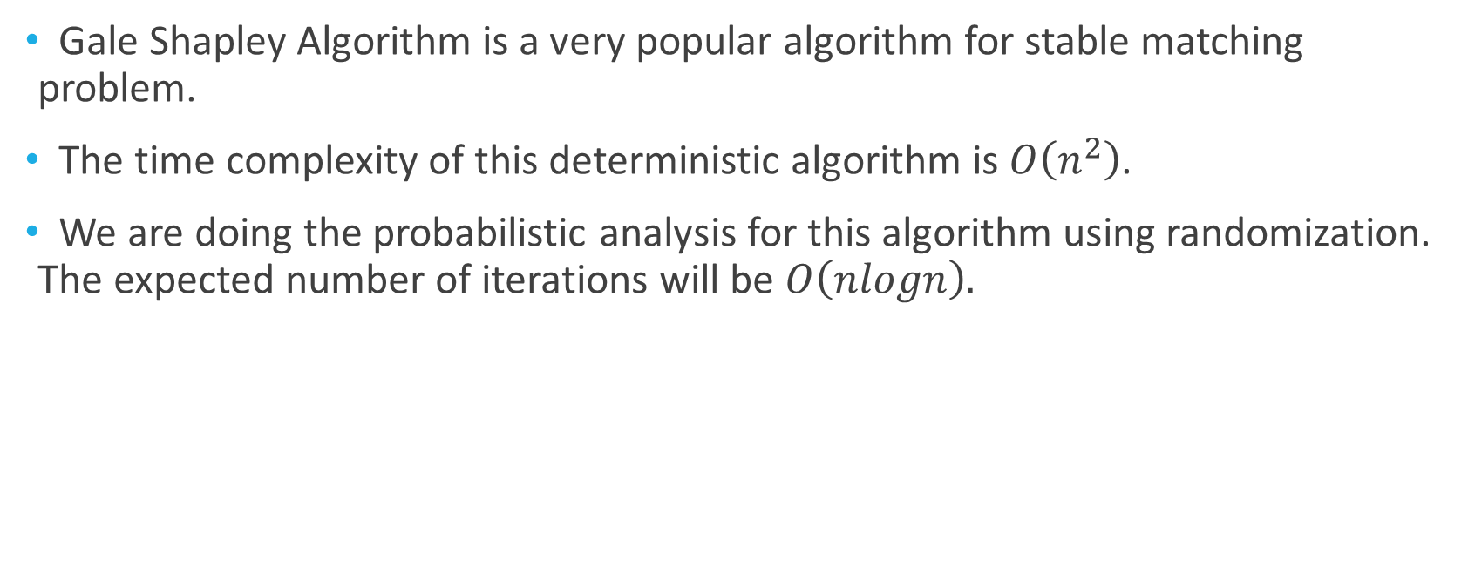
Time Complexity
Gale Shapley Algorithm is a very popular algorithm for stable matching problem.
The time complexity of this deterministic algorithm is $O\left(n^{2}\right)$.
We are doing the probabilistic analysis for this algorithm using randomization. The expected number of iterations will be $O\left(nlogn\right).$

Slide 6
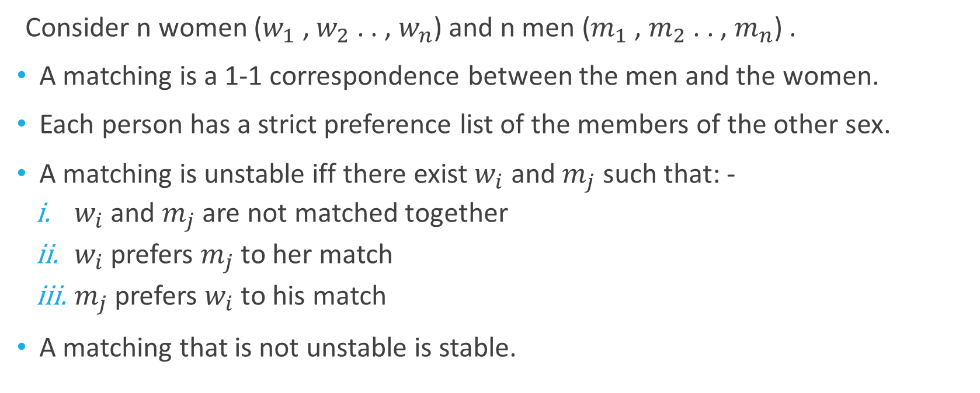
The Stable Matching Problem
Consider n women ($w_{1}$ , $w_{2}$ . . , $w_{n}$) and n men ($m_{1}$ , $m_{2}$ . . , $m_{n}$) .
A matching is a 1-1 correspondence between the men and the women.
Each person has a strict preference list of the members of the other sex.
A matching is unstable iff there exist $w_{i}$ and $m_{j}$ such that: -
$w_{i}$ and $m_{j}$ are not matched together
$w_{i}$ prefers $m_{j}$ to her match
$m_{j}$ prefers $w_{i}$ to his match
A matching that is not unstable is stable.

Slide 7
Probabilistic Analysis of Deterministic Algorithm
The algorithm is still deterministic.

Slide 8
Probabilistic Analysis of Deterministic Algorithm
The algorithm is still deterministic.
The main objective here is to do the probabilistic analysis of this algorithm.

Slide 9
Probabilistic Analysis of Deterministic Algorithm
The algorithm is still deterministic.
The main objective here is to do the probabilistic analysis of this algorithm.
In the gale shapley algorithm, randomness in input is introduced by choosing the preference list of each man and woman randomly uniformly and independent of others.

Slide 10
Probabilistic Analysis of Deterministic Algorithm
The algorithm is still deterministic.
The main objective here is to do the probabilistic analysis of this algorithm.
In the gale shapley algorithm, randomness in input is introduced by choosing the preference list of each man and woman randomly uniformly and independent of others.
So, the input is random and then we analyse the expected time complexity.

Slide 11
Modification of Algorithm for theoretical analysis
A simplified modification of the Gale-Shapley algorithm: -

Slide 12
Modification of Algorithm for theoretical analysis
A simplified modification of the Gale-Shapley algorithm: -
At each iteration, a man proposes to a woman selected uniformly at random from all n women, regardless of previous rejections.

Slide 13
Modification of Algorithm for theoretical analysis
A simplified modification of the Gale-Shapley algorithm: -
At each iteration, a man proposes to a woman selected uniformly at random from all n women, regardless of previous rejections.
Notably, the revised algorithm generates more proposals due to the inclusion of some "wasted" rejections. Consequently, the expected running time serves as an upper bound on the original algorithm's runtime.

Slide 14
Modification of Algorithm for theoretical analysis
A simplified modification of the Gale-Shapley algorithm: -
At each iteration, a man proposes to a woman selected uniformly at random from all n women, regardless of previous rejections.
Notably, the revised algorithm generates more proposals due to the inclusion of some "wasted" rejections. Consequently, the expected running time serves as an upper bound on the original algorithm's runtime.
This modification however does not alter the algorithm's outcome, as a man rejected by a woman will face rejection again upon proposing to her in subsequent iterations.

Slide 15

Expected Number of Proposals
Theorem: If the preference lists are chosen randomly uniformly, the expected number of proposals in the Gale-Shapley algorithm is $O(n log n)$.

Slide 16

Expected Number of Proposals
Theorem: If the preference lists are chosen randomly uniformly, the expected number of proposals in the Gale-Shapley algorithm is $O(n log n)$.
Proof: The algorithm terminates once all women have received at least one proposal.

Slide 17
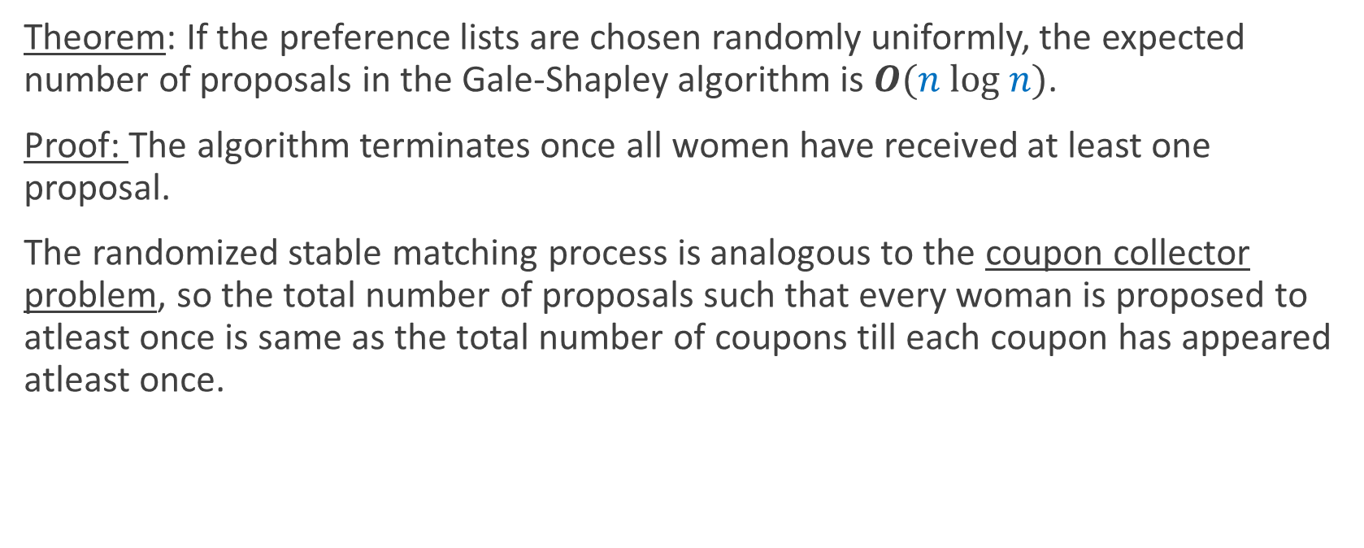
Expected Number of Proposals
Theorem: If the preference lists are chosen randomly uniformly, the expected number of proposals in the Gale-Shapley algorithm is $O(n log n)$.
Proof: The algorithm terminates once all women have received at least one proposal.
The randomized stable matching process is analogous to the coupon collector problem, so the total number of proposals such that every woman is proposed to atleast once is same as the total number of coupons till each coupon has appeared atleast once.

Slide 18
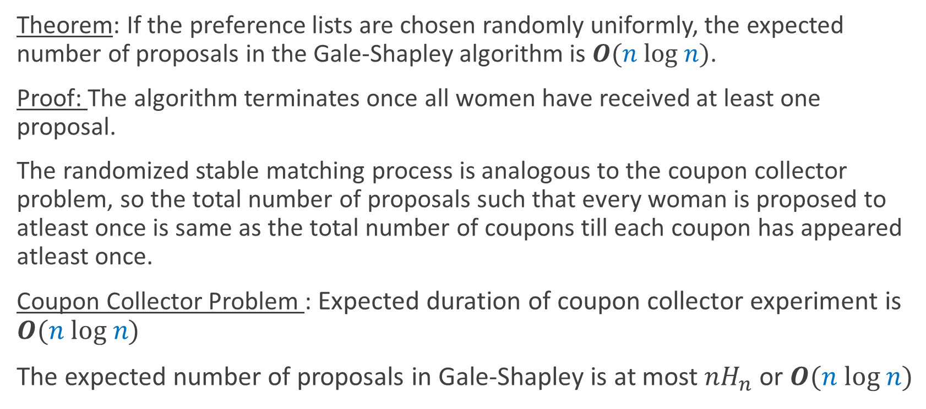
Expected Number of Proposals
Theorem: If the preference lists are chosen randomly uniformly, the expected number of proposals in the Gale-Shapley algorithm is $O(n log n)$.
Proof: The algorithm terminates once all women have received at least one proposal.
The randomized stable matching process is analogous to the coupon collector problem, so the total number of proposals such that every woman is proposed to atleast once is same as the total number of coupons till each coupon has appeared atleast once.
Coupon Collector Problem : Expected duration of coupon collector experiment is $O(n log n)$
The expected number of proposals in Gale-Shapley is at most $nH_{n}$ or $O(n log n)$

Slide 19
Analytical Analysis

Slide 20
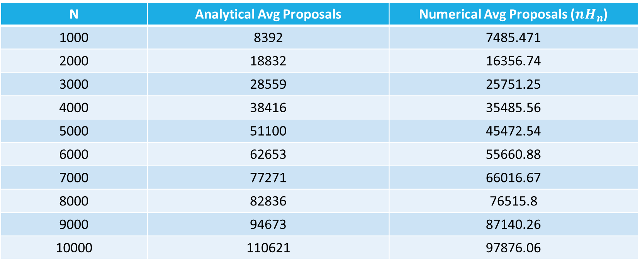
Comparison of Numerical and Analytical Analysis
N | Analytical Avg Proposals | Numerical Avg Proposals (${nH}_{n}$)
1000 | 8392 | 7485.471
2000 | 18832 | 16356.74
3000 | 28559 | 25751.25
4000 | 38416 | 35485.56
5000 | 51100 | 45472.54
6000 | 62653 | 55660.88
7000 | 77271 | 66016.67
8000 | 82836 | 76515.8
9000 | 94673 | 87140.26
10000 | 110621 | 97876.06
For 100 randomly generated samples for each N

Slide 21
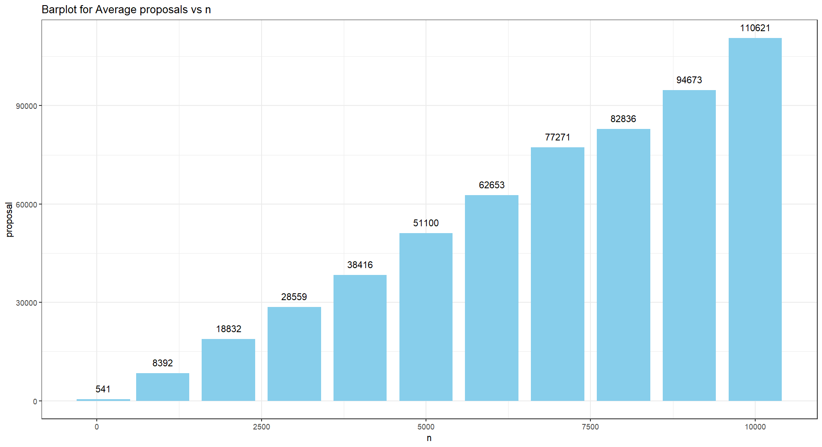

Slide 22
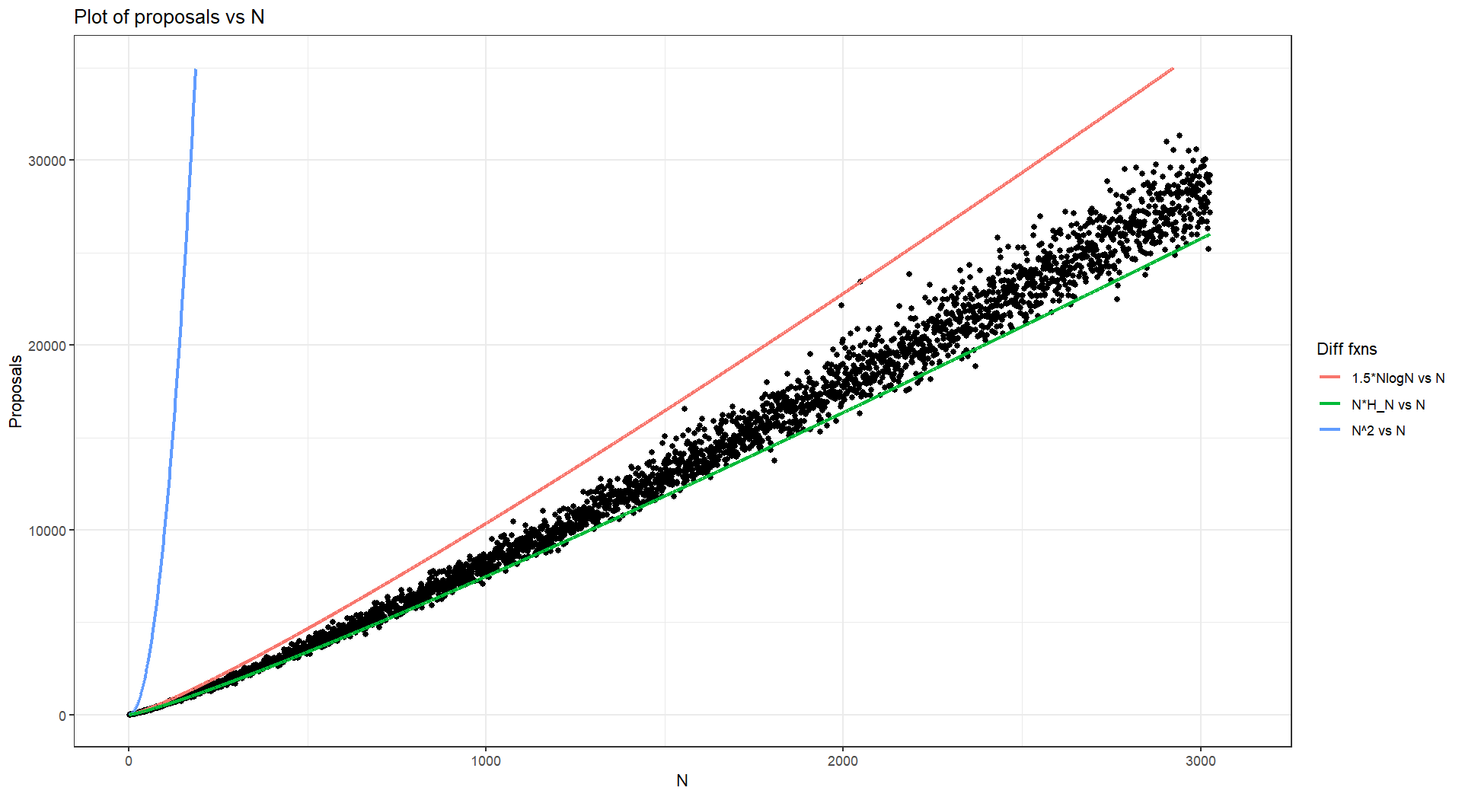

Slide 23
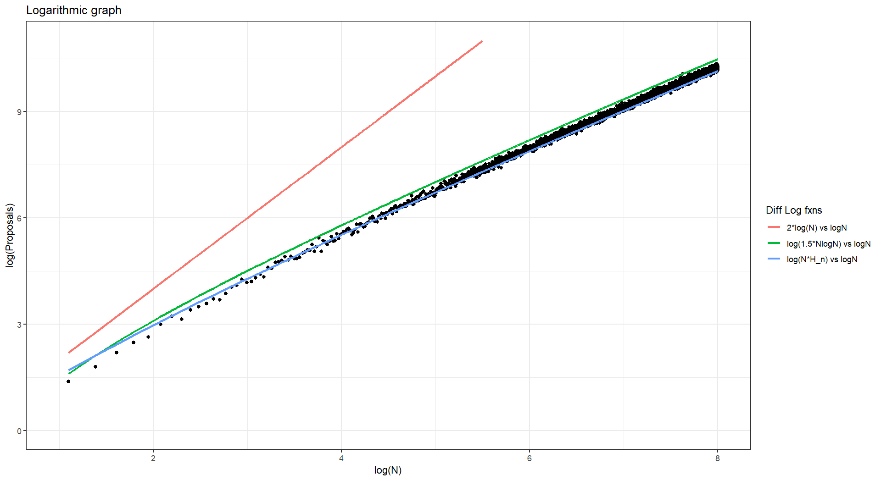

Slide 24
Number of Proposals for the Algorithm
N | Average Proposals | Worst Case Proposals | Standard Deviation
10 | 25.08 | 51 | 6.880513
100 | 540.411 | 1211 | 125.0827
1000 | 8207 | 17819 | 1386.656
10000 | 110621.1 | 168432 | 15507.23
For 1000 randomly generated samples for each N = 10, 100, 1000
For 100 randomly generated samples for N = 10000

Slide 25
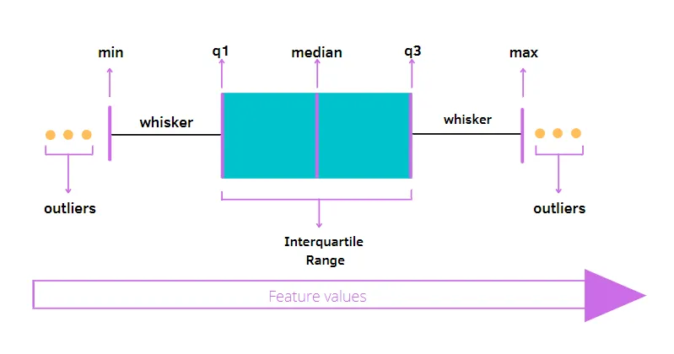
Boxplot

Slide 26
Boxplot
The line splitting the box in two represents the median value. This shows that 50% of the data lies on the left hand side of the median value and 50% lies on the right hand side.
The left edge of the box represents the lower quartile; it shows the value at which the first 25% of the data falls up to.
The right edge of the box shows the upper quartile; it shows that 25% of the data lies to the right of the upper quartile value.
The values at which the horizontal lines stop at are the values of the upper and lower values of the data.
The single points on the diagram show the outliers.

Slide 27
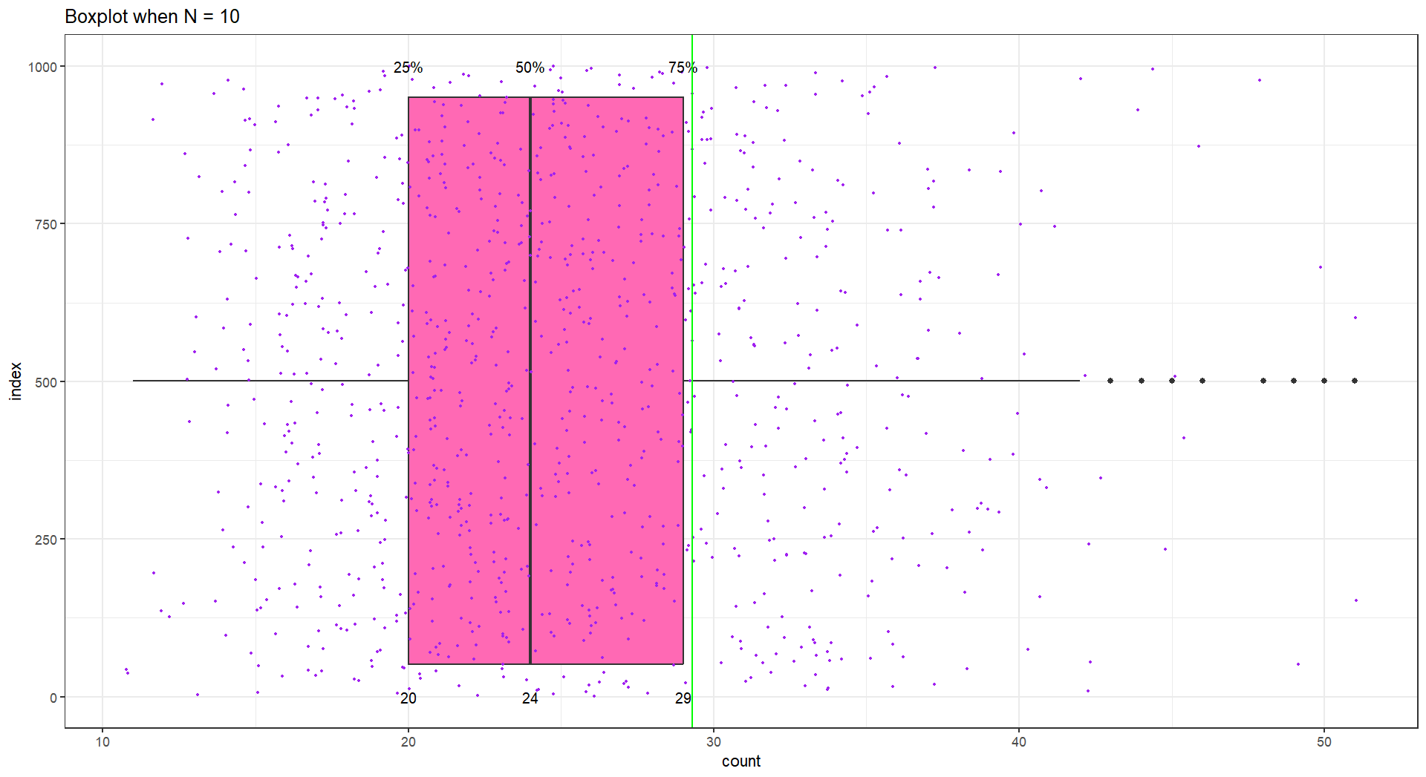

Slide 28
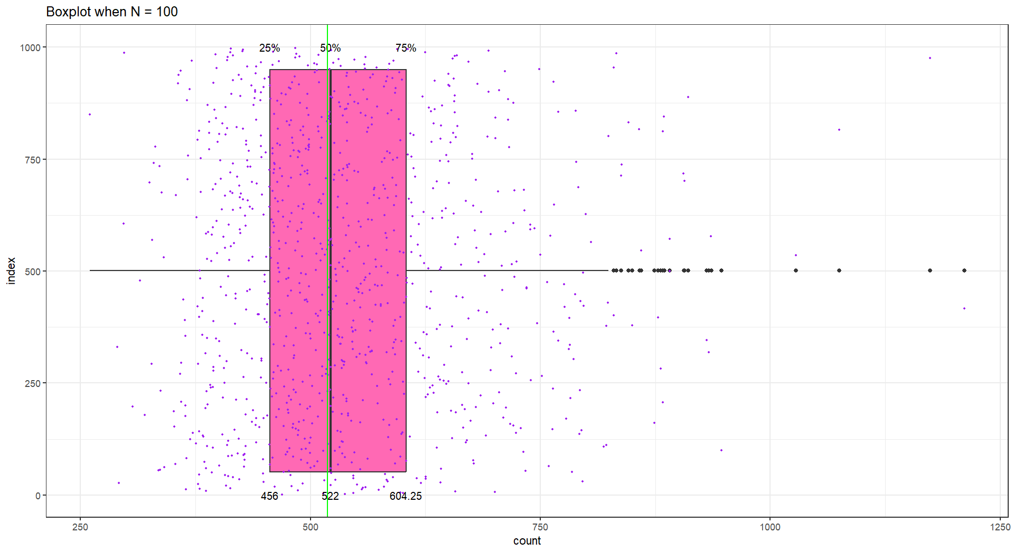

Slide 29
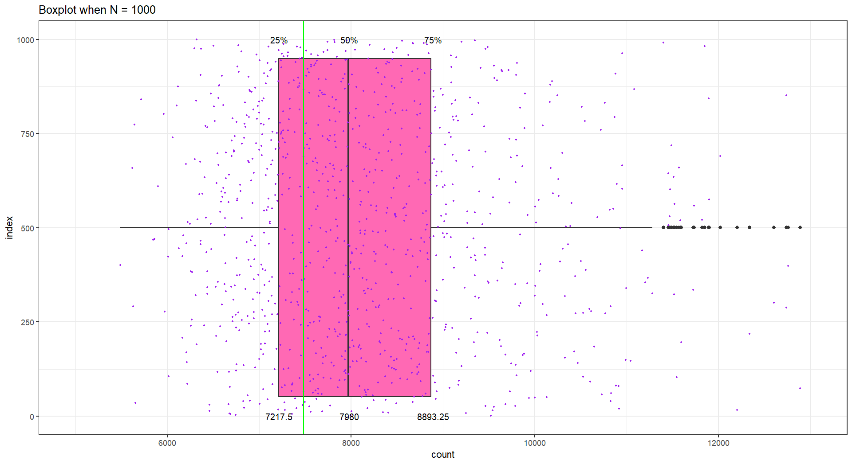

Slide 30
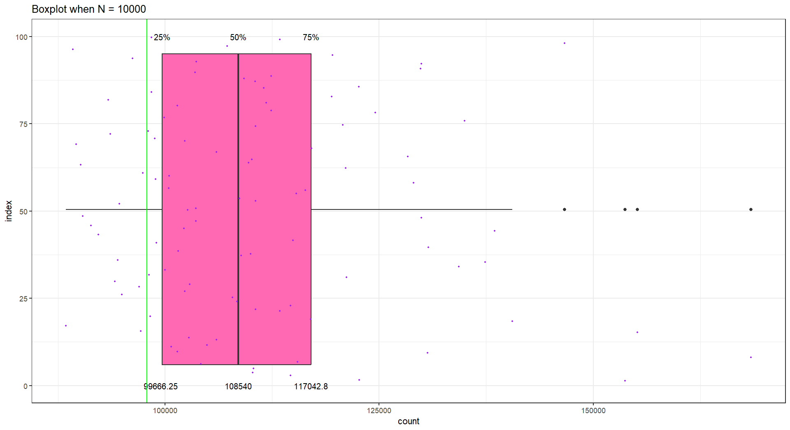

Slide 31
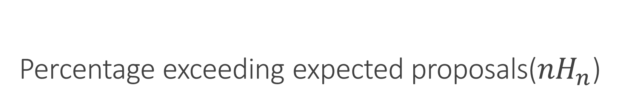
Percentage exceeding expected proposals(${nH}_{n}$)
Average proposals exceeded by(%) | N = 10 | N = 100 | N = 1000 | N = 10000
10 | 15.2 | 33.6 | 42.5 | 52
20 | 7.9 | 22.4 | 23 | 24
50 | 1.1 | 5.2 | 3.4 | 3
100 | 0 | 0.3 | 0.2 | 0
For 1000 randomly generated samples for each N = 10, 100, 1000
For 100 randomly generated samples for N = 10000

Slide 32
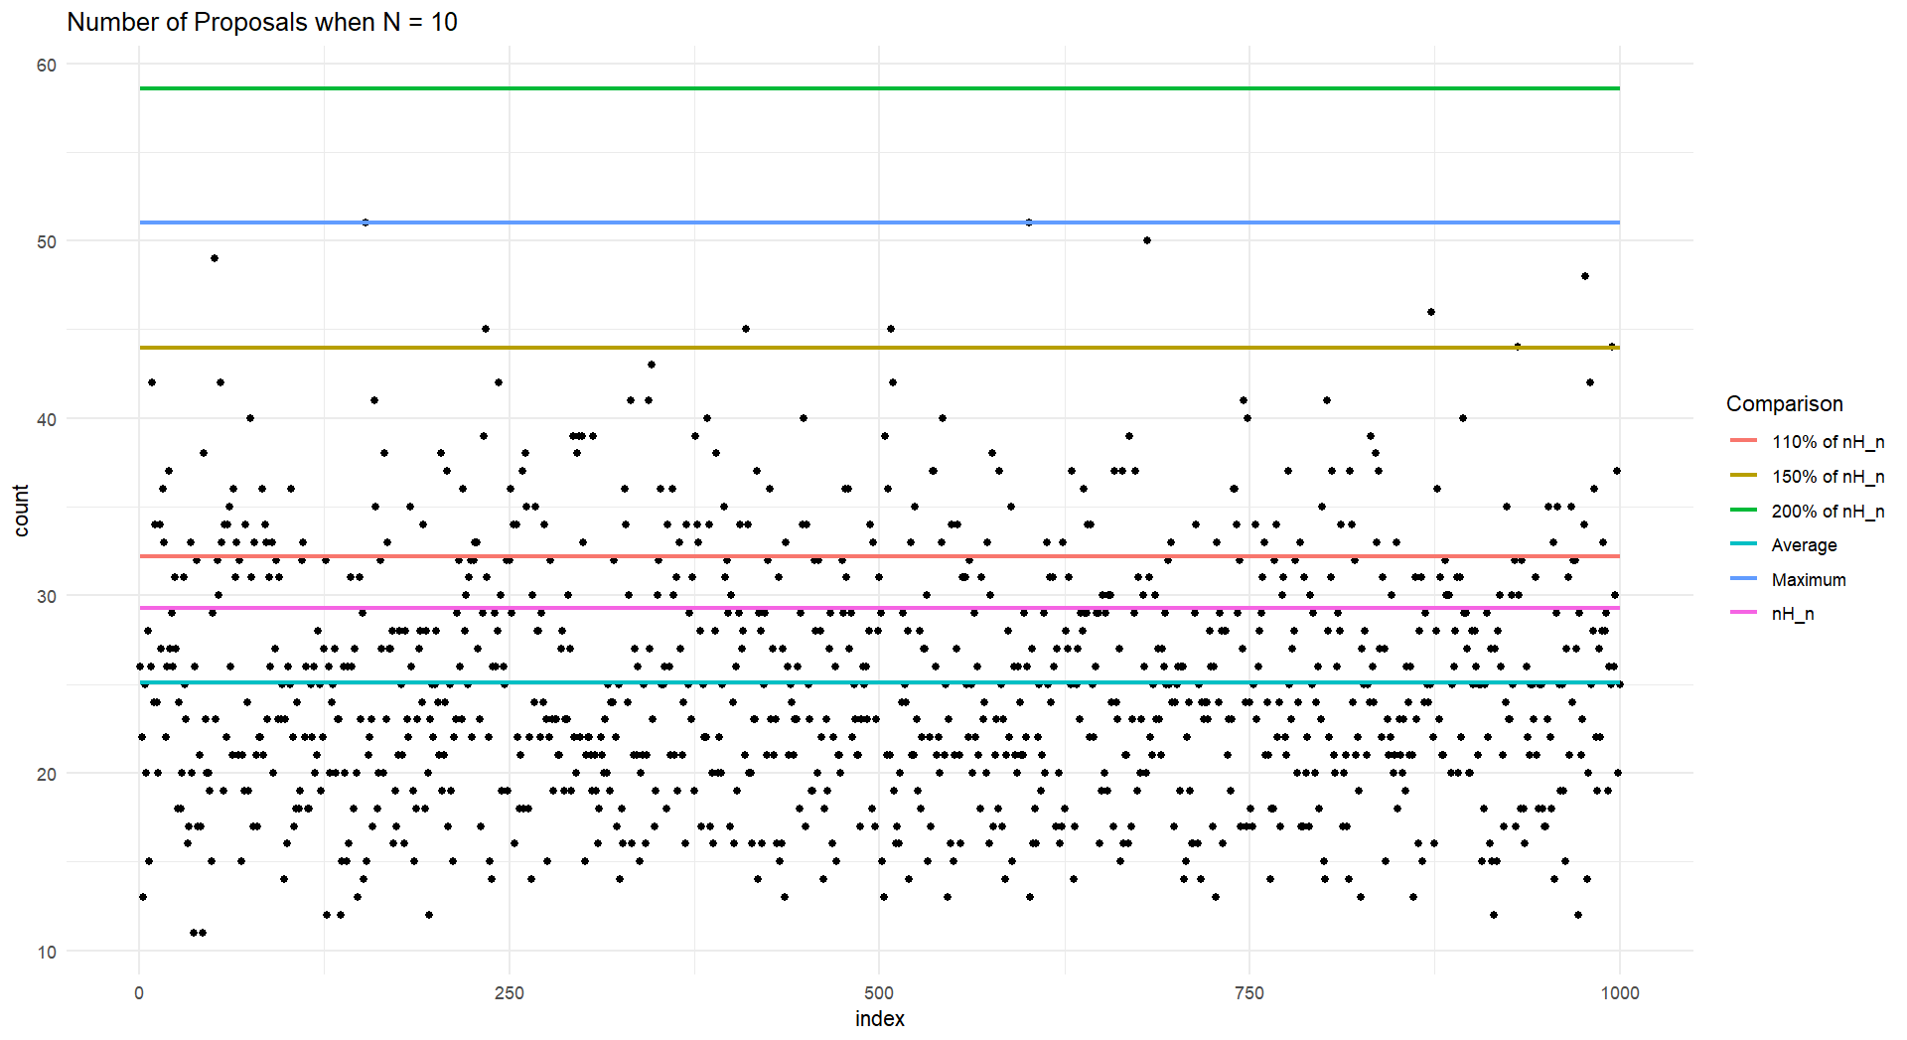

Slide 33
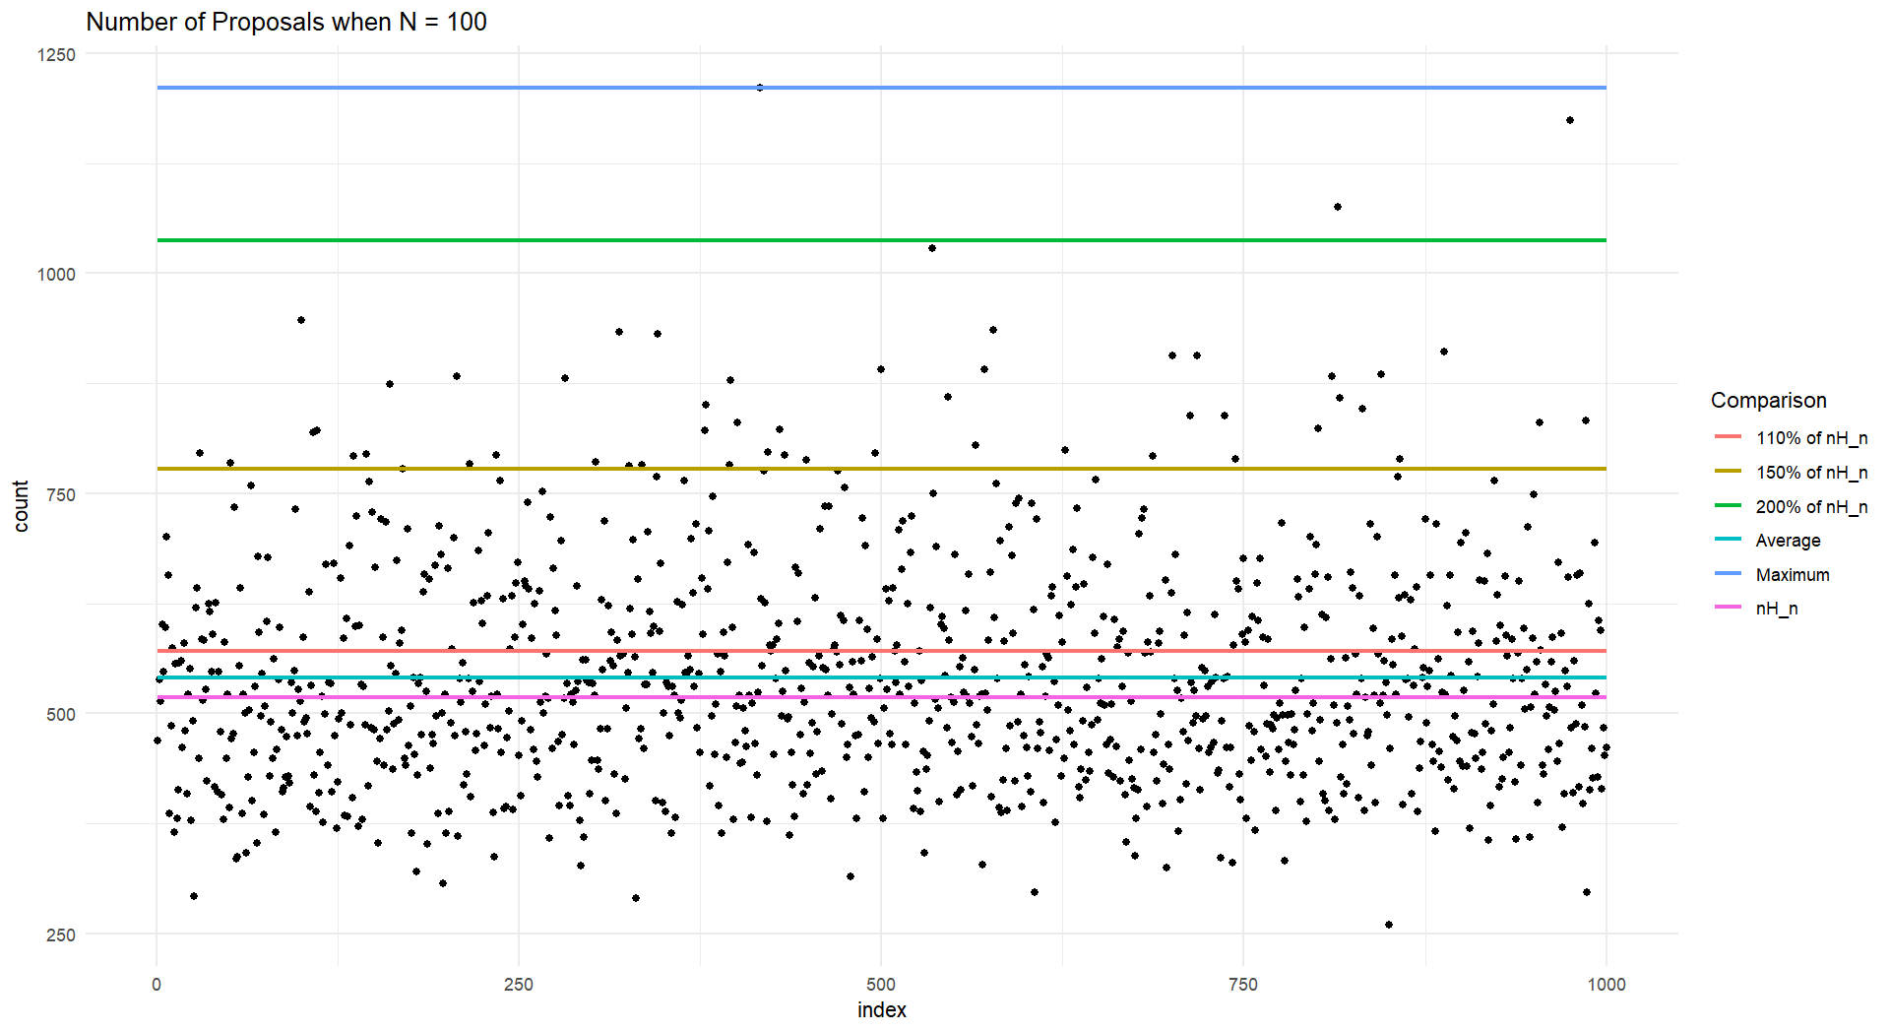

Slide 34
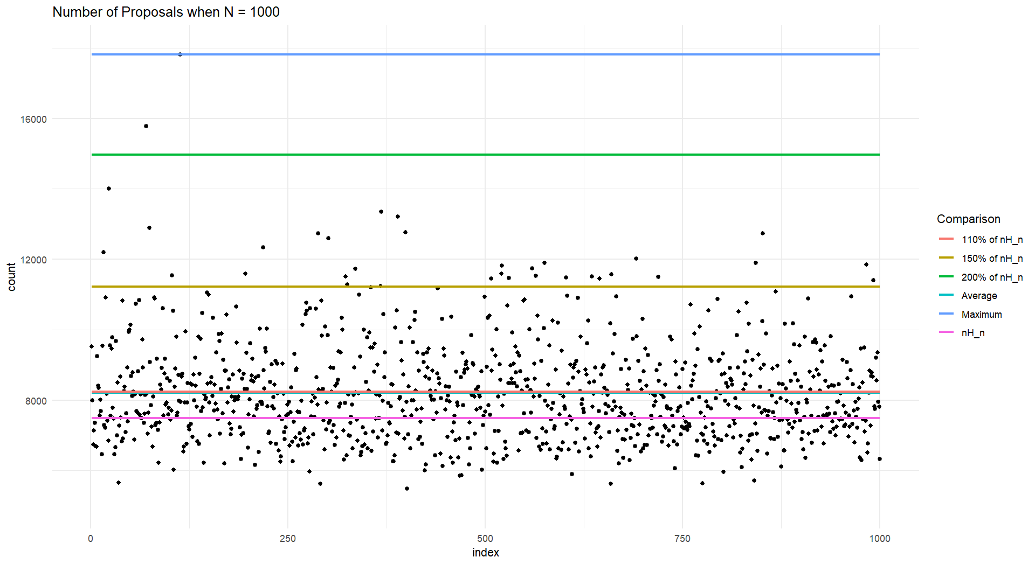

Slide 35
