Slide 1

Category Prediction: MEntal Health disorders in Research Paper ABSTRACTS
DTi/ELG 5125:
Group 9 (Sheryl, Lenish & Lakshika)

Slide 2

Mental health Disorders: ABSTRACT Classification
2 Datasets: Research Paper Abstracts of Mental Health Disorders from PubMed database.
Five categories: Clinical Depression, Bipolar Disorder, Anxiety Disorder, Post-Traumatic Stress Disorder and Schizophrenia
Experimented with 100 words and 75 words per partition.
Challenge: A large number of new research papers are added to PubMed daily. But you do not have the time to go through them manually and identify the relevant papers for your studies.
Solution: We developed a solution to extract published mental health research paper abstracts in PubMed and classify them based on the abstracts.

Slide 3
Process and techniques followed
Data preprocessing and cleansing (1000 abstracts) 200 partitions per category, 100 words per partition
Abstract tokenization, Feature Engineering (TF-IDF and bi-grams)
Applying models SVM, Random Forest, MultinomialNB, Naïve Bayes, XGBoost, k-NN and SGD
Applying BERT Model
Error Analysis (Confusion Matrix and Misclassified Abstract Analysis)
Performance Evaluation (Classification Report and Confusion Matrix)
Bias and Variance (Training and test errors)

Slide 4
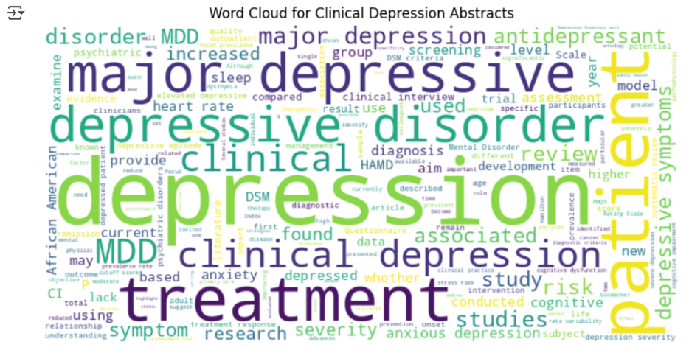
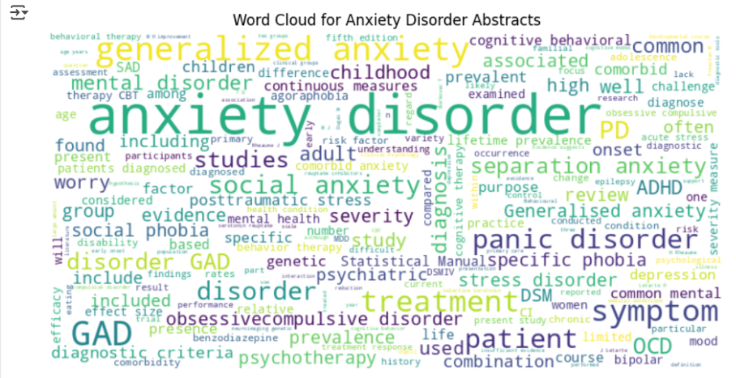
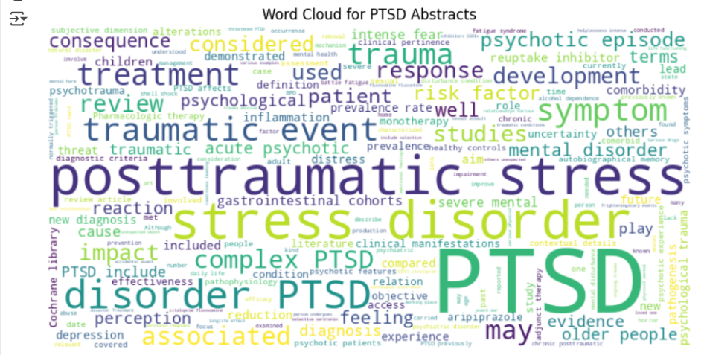
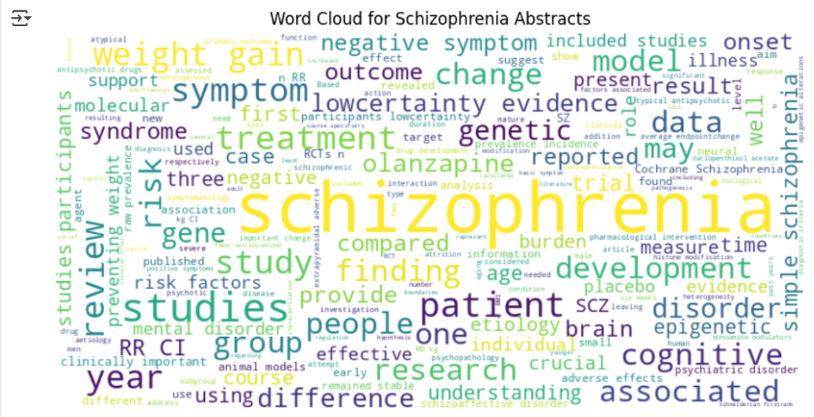
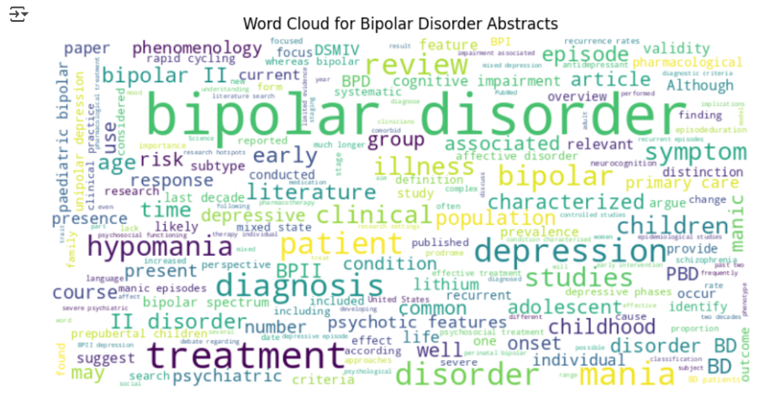
Features: Word clouds for Disorders

Slide 5
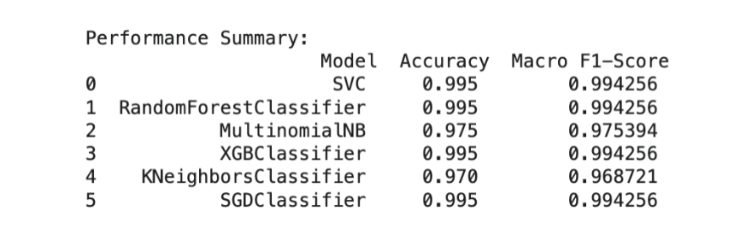
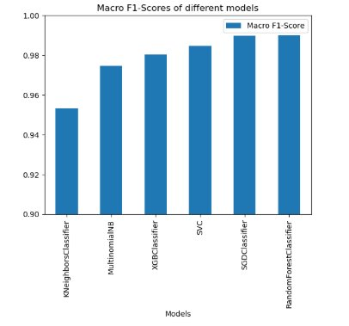
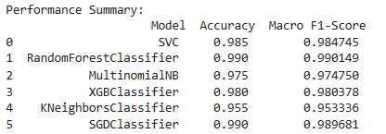
Key outcomes: model evaluation
Best performing models for the two datasets and Macro F1 Score:
100 words – SVM, Random Forest, XGBoost and SGD – 99.4% Macro F1 Score
75 words - Random Forest – 99% Macro F1 Score

Slide 6
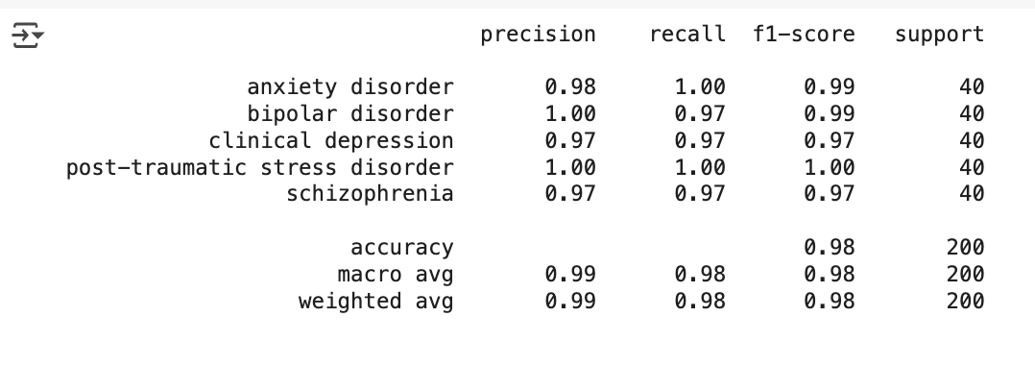
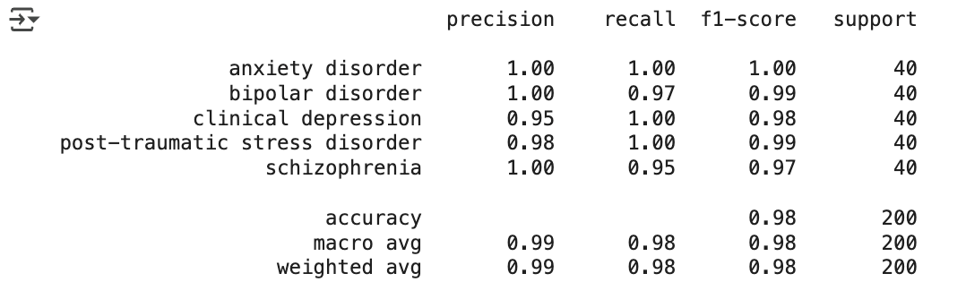
BERT Performance ANALYSIS
BERT Model performance – 99% macro f1-score avg
Computationally expensive
Requires large volumes of data to be useful
100 words:
75 words:
CHAMPION MODEL BASED ON OUR DATASETS:
RANDOM FOREST CLASSIFIER

Slide 7
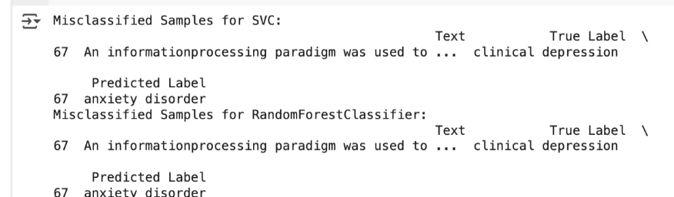
Error Analysis INSIGHTS
Technique: We analyzed the Confusion Matrices and drilled into
specific abstracts with erroneous prediction labels (100 words dataset)
Champion Model:
Insight 1: Some papers focus on two or more mental health disorders in the analyzed categories. E.g.: clinical depression and anxiety
Other Models:
Insight 2: Some mental health disorders have similar impacts and often
have similar words, such as clinical depression and bipolar disorder (both cause depression).
Insight 3: Some papers analyze the relationship of one mental health disorder to another such as schizophrenia to bipolar disorder.
Insight 4: Generalized words were included in the top features or words generated for prediction, in the Word Clouds, such as patient’, ‘treatment’, ‘major’, ‘patient' etc.

Slide 8
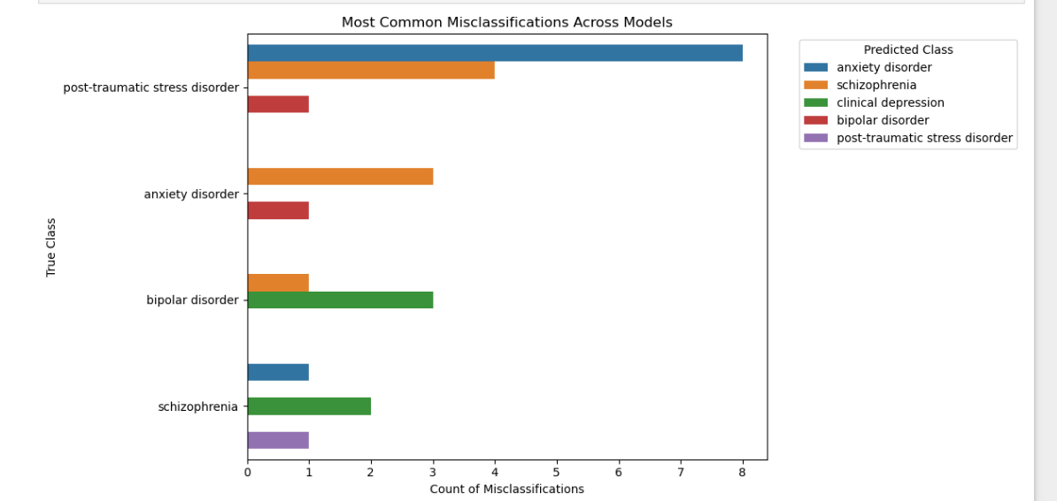
TRENDS in misclassifications
From the 75 words per abstract dataset, we identified more errors or misclassifications.

Slide 9
Conclusion
The use of longer abstracts (100 vs 75 words) is favorable for higher accuracy.
Be aware of the complexities of research papers involving two or more mental health disorder categories.
Disorder symptoms, impacts overlap across different mental health categories can result in misclassifications of certain categories.
The champion model for our specific datasets was Random Forest Classifier.
For smaller datasets using classical models can be more efficient and computationally cheaper than deep learning approaches.

