Slide 1
Text Classification on Sentiments
Infosys SpringBoard Internship Project
Presenter
Lakshita M
Mentor
Sudheer Kumar Y

Slide 2
01
Problem Statement
Introduction to Text classification and Business use cases
02
About Dataset and Data Preprocessing
Overview of given dataset and techniques on Text preprocessing
CONTENTS
03
Modeling Approach
High-level view of the building model process
04
Model Used and Hyperparameter Tuning
Discussion on various ML classification algorithms and GridSearchCV
05
Modeling Results and Future Scope
Output Analysis from jupyter notebook and Resolution for the project

Slide 3
01
Problem Statement and Business Use Cases
Lets Understand the need for Text classification on Sentiments and potential advantages of it

Slide 4
Problem Statement
Difficulties faced by engineers without Text classification
Difficulte to Analyze Large volume of Customer Reviews
Market Research and
Opinion Mining
Constant Brand Monitoring and
Social Listening
Businesses struggle to manually analyze large volumes of customer reviews, feedback emails, and social media comments to understand overall sentiment and identify areas for improvement.
Traditional market research methods like surveys can be time-consuming and expensive. It can be difficult to gauge public opinion on a large scale.
Companies need to stay informed about how their brand is perceived online across social media, news articles, and forums. Manually monitoring these vast amounts of data is difficult.

Slide 5




Buisness Usecases
Text classification is a technique that allows businesses to organize and analyze unstructured data like emails, and legal documents
Categorize
service
requests
Reputation
management
Sentiment
analysis
Product
analysis

Slide 6
02
Overview of Dataset and Text preprocessing
Understanding the provided dataset is essential and basic step for any Data scientist 🤓

Slide 7
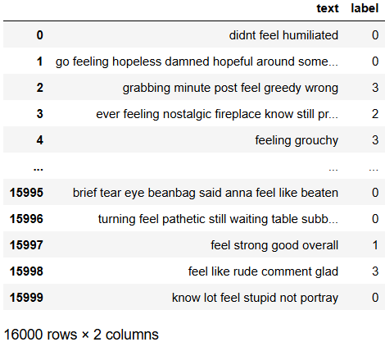
Overview of Dataset
Dataset contains various customer reviews on social media platform
Memory usage up to
250.1+ KB with
16000 rows × 2 columns
“label” Column as
Target variables
with labels as
0:'sadness' ,1:'joy' ,
2:'love'3:'anger',
4:'fear', 5:'surprise'
Main feature as
text column
Contains class imbalance
with class split of
{0,1,2,3,4,5}
29%:34%:8%:14%:8%:3%

Slide 8
Text Preprocessing
Cleaning the data is essential for building any models
Aa
< >
Lower Case
Expand slangs
and contractions
Remove HTML tags
Remove URLs
🗑️
$%#
Remove Punctuations
and special characters
Remove stop words
Stemming
Lemmatization

Slide 9
03
WorkFlow of Model
Lets depicts how the project is implemented!

Slide 10
Modeling Approach
Project flow for Text classification
On data into three sets as training (70%), testing (20%), and validation (10%). Train model for text classification
Text Vectorization convert textual data into numerical features for ML models. (TFIDF)
Feature Engineering
Training Models
EDA along Text Preprocessing
Handling Class Imbalance
Result Analysis
To avoid uneven distribution of classes, where some classes have significantly fewer examples than others leads to biased models
Confusion matrix, depicts data points correctly classified for each class and reveals potential biases. , classification reports providing metrics like precision, recall, and F1-score model's effectiveness for each class,
Understand class distribution, text length variations, and identify any missing values or outliers on dataset .and Cleans and prepares the text data

Slide 11
04
Classification algorithms and HyperParameter Tuning
Understanding ML classification models and different Parameter values for tuning

Slide 12
Models Used and Hyperparameter Tuning
Hyperparameter tuning helps us to find the best scoring model with suitable parameters
Regularization parameter(C)
Support Vector Machine
Maximizes margin for robust classification
Logistic Regression
n_neighbors
n_estimator(
Number of Trees)
Predicts class probabilities for text data
Grid
SearchCV
eXtreme Gradient Boosting
Scalable and powerful ensemble of decision trees
Light Gradient Boosting
Fast and efficient gradient boosting algorithm
learning_rate
max_depth
Random Forest
Combines multiple randomized decision trees for robust predictions

Slide 13
05
Model Results and Future Scope
Choosing Best model via result analysis

Slide 14
Model Results
Based on the classification report the accuracy of each models are depicted below

Slide 15
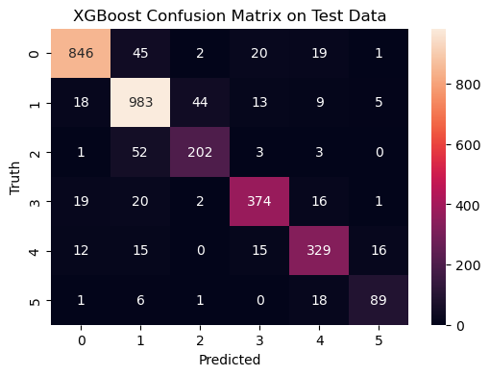
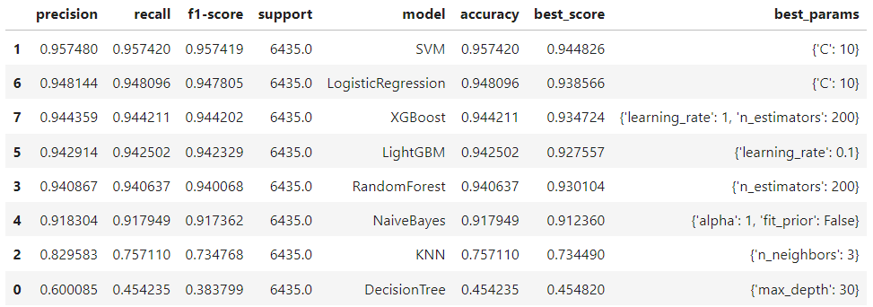
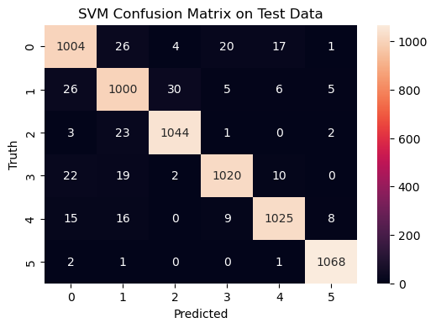
Model Results
Confusion Matrix Discussion and Report Understanding
ML Classifiers with score values and its Best Parameters.

Slide 16

Recommendation
Future Scope of the project and possible resolutions
Deep Learning Advancements
Multiple algorithms in a chain of events, automatically provide meaningful representations for text mining
Multi-Modal Sentiment Analysis
Incorporating audio, video, or image data alongside text for a more holistic understanding of sentiment or classification tasks
Transfer Learning with Domain Adaptation
With pre-trained models on general text data and fine-tuning them on your specific domain dataset, saving time and resources.

Slide 17
THANK YOU
Thank you infosysSpringboard for the wonderful opportunity to show case our work!

