Slide 1
Summer Internship Presentation
Frontend Development Internship at YuvaIntern
Role: Junior Frontend Developer Intern
Presented by: Lakshit Saroha
B.Tech Computer Science & Engineering | IILM
Certificate No.: YI/2026/205028/447196
Certificate issued: October 11, 2026
Notes:
Good morning everyone. Today I am going to present my summer internship experience at YuvaIntern. I completed the internship in the role of Junior Frontend Developer Intern. In this presentation, I will explain the internship context, frontend development concepts, relevant technologies, development workflow, learning outcomes and future scope.

Slide 2
Internship Overview
Organization: YuvaIntern
Internship Role: Junior Frontend Developer Intern
Domain: Frontend Development
Internship Type: Summer Internship
Duration: [TO BE ADDED FROM INTERNSHIP RECORD]
The Certificate of Experience confirms successful completion of the internship.
Professional qualities recognized: dedication, professionalism, willingness to learn and grow, integrity and commitment.
Notes:
This slide gives an overview of my internship. The certificate confirms my role as a Junior Frontend Developer Intern at YuvaIntern and confirms successful completion. It also highlights professional qualities such as dedication, professionalism, willingness to learn, integrity and commitment.

Slide 3
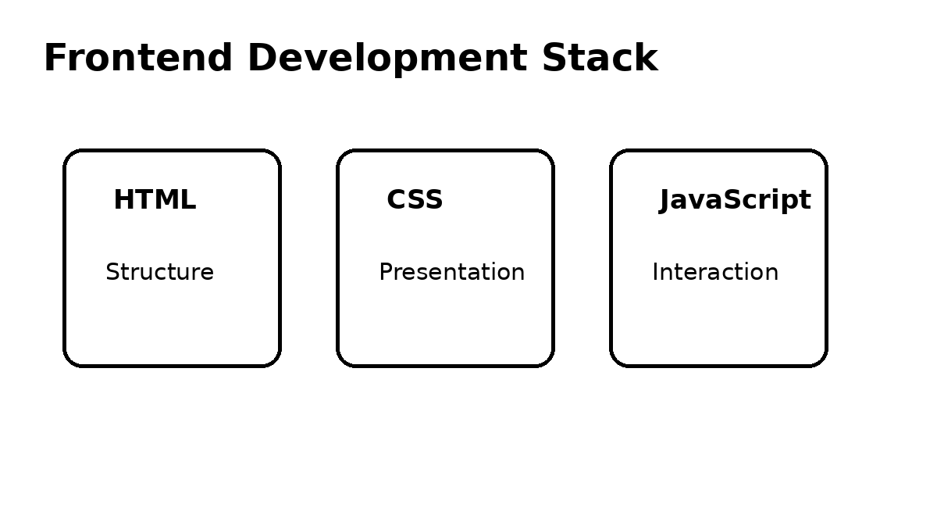
Understanding Frontend Development
Frontend development focuses on the part of a website or web application that users see and interact with.
HTML provides the basic structure and organizes webpage content.
CSS controls presentation, layout, spacing, typography and visual appearance.
JavaScript adds interaction and dynamic behavior.
Responsive design helps interfaces adapt to different screen sizes.
Together, these concepts form an important foundation for modern web development.
Notes:
Frontend development is the user-facing side of web development. HTML creates the structure, CSS controls the appearance and JavaScript adds interaction. Responsive design is important because users access websites from desktops, tablets and mobile devices.

Slide 4
Role: Junior Frontend Developer Intern
The role is an entry-level learning position focused on frontend development.
Typical responsibilities may include understanding webpage structure and modifying user interfaces.
A junior developer may work with HTML, CSS and JavaScript concepts.
Testing and debugging are important parts of frontend development.
Developers also need to understand feedback and improve their work.
Exact internship tasks should be added from the student's actual internship records.
Notes:
As a Junior Frontend Developer Intern, the focus is generally on learning and applying frontend-development concepts. Typical activities can include working with interfaces, styling, testing and debugging. I have kept these as typical responsibilities because the certificate does not list my exact day-to-day tasks.

Slide 5
Technologies & Tools Relevant to the Internship
HTML — creates the structure of webpages and organizes content.
CSS — manages layouts, styling, spacing and responsive presentation.
JavaScript — supports interactive and dynamic webpage behavior.
Responsive Web Design — helps pages work across different screen sizes.
Browser Developer Tools — useful for inspection, testing and debugging.
Git / Version Control — commonly used to track and manage code changes.
Actual technologies used: [TO BE CONFIRMED FROM INTERNSHIP RECORDS].
Notes:
These are technologies and tools relevant to the frontend-development domain. HTML, CSS and JavaScript are the core technologies. Responsive design and browser developer tools are also important. Git is commonly used for version control. The exact tools used during my internship should be confirmed from my internship records.

Slide 6
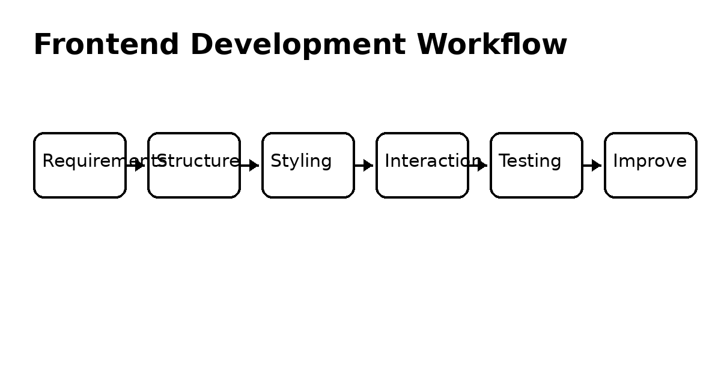
Frontend Development Workflow
1. Understand the requirement and expected user interface.
2. Create the basic page structure.
3. Apply styling and arrange the layout.
4. Add interaction where required.
5. Test the interface on different screen sizes.
6. Debug issues and improve the final interface.
Notes:
A simple frontend workflow starts with understanding the requirement. Then the developer creates the structure, applies styling and adds interaction. Testing and debugging are important before considering the interface complete. This cycle may be repeated to improve the result.

Slide 7
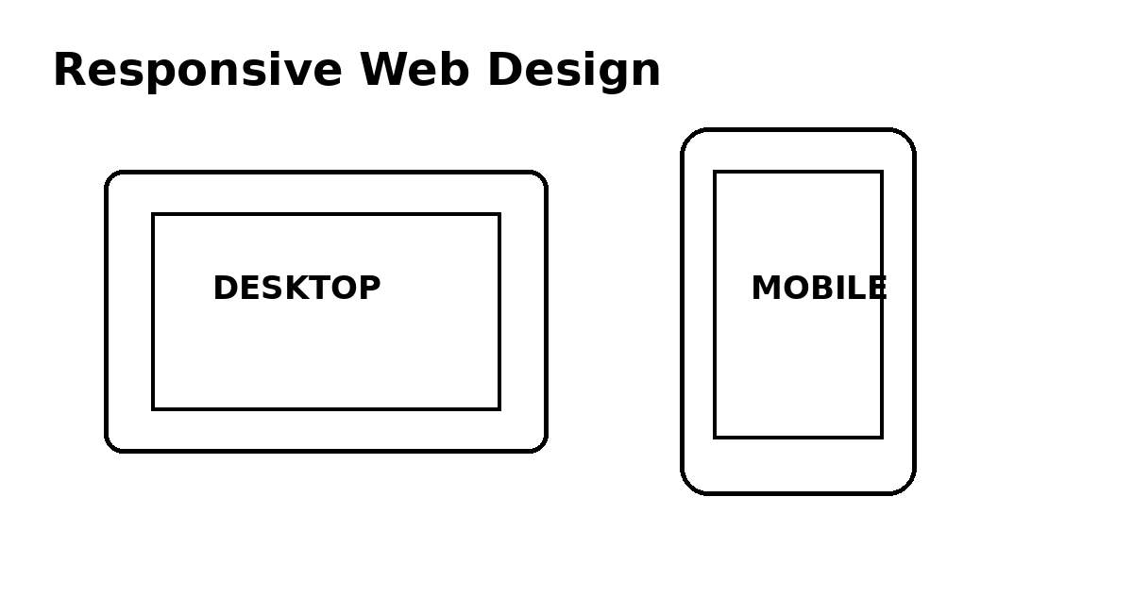
Responsive Design & User Experience
Modern websites should provide a usable experience on different devices.
Responsive layouts can adjust columns, spacing, images and text according to screen size.
Mobile-friendly design improves accessibility and usability.
Consistent navigation and readable content help users understand the interface.
Testing at different screen sizes helps identify layout problems.
Notes:
Responsive design means that a website should adapt to different screen sizes. A layout that looks good on a desktop may need changes for a mobile screen. Testing different sizes helps developers find and fix these issues.

Slide 8
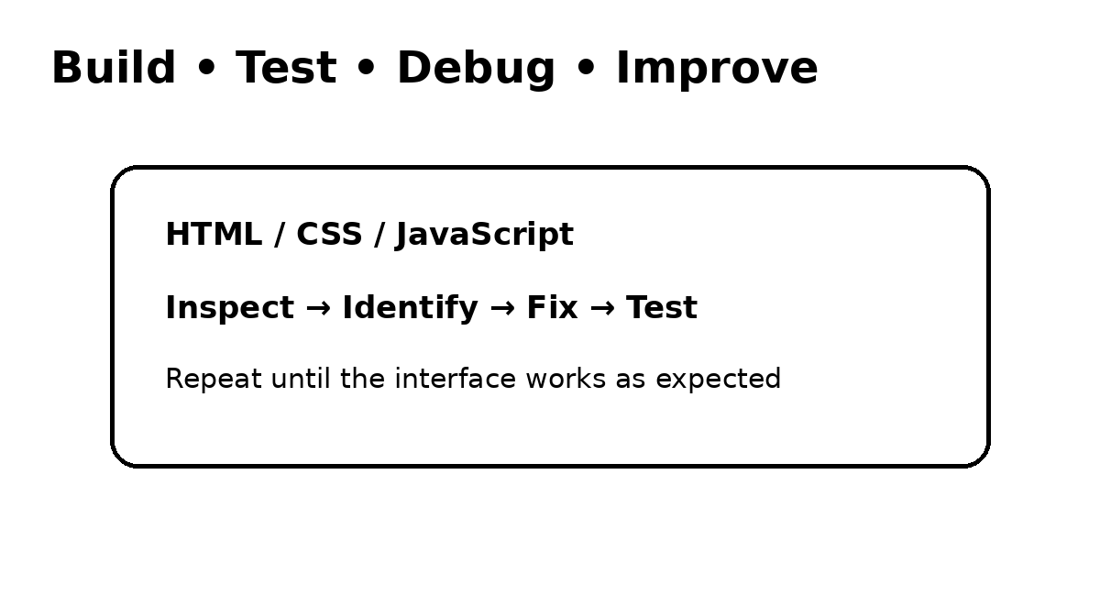
Testing, Debugging & Improvement
Frontend development requires repeated testing after changes.
Browser Developer Tools can help inspect elements and identify problems.
A useful debugging process is: reproduce the issue, inspect the code, identify the cause, fix it and test again.
Small, controlled changes make it easier to understand what solved the problem.
Regular testing improves reliability and user experience.
Notes:
Testing and debugging are important because frontend errors can affect how users see or interact with a webpage. A systematic process is useful: reproduce the problem, inspect the code, identify the cause, make a change and test again.

Slide 9
Skills & Professional Growth
Technical learning areas: webpage structure, styling, responsive design, UI development and debugging.
Problem-solving helps in identifying the cause of technical issues.
Communication and teamwork are important when working with mentors or a development team.
Time management helps organize learning and development activities.
The certificate specifically recognizes dedication, professionalism, integrity, commitment and willingness to learn and grow.
Notes:
The internship is not only about technical skills. Professional skills are equally important. My certificate specifically recognizes dedication, professionalism, integrity, commitment and willingness to learn and grow. These qualities are useful for building a strong foundation for a software-development career.

Slide 10
Challenges & Future Scope
Common frontend challenges include responsive layouts, browser differences and debugging errors.
Organizing CSS and understanding existing code can also require practice.
Future learning can include advanced JavaScript and modern frontend frameworks.
Other areas include TypeScript, API integration, accessibility and performance optimization.
Long-term growth can also lead toward full-stack development.
Notes:
Frontend development has several challenges, especially while learning. Responsive layouts, browser compatibility and debugging require practice. In the future, I can continue learning advanced JavaScript, frameworks, TypeScript, APIs, accessibility and performance optimization. These are future learning areas, not claims about technologies already completed.

Slide 11
Conclusion
The internship provided valuable exposure to the frontend-development domain.
It helped connect academic computer-science learning with practical web-development concepts.
The experience emphasizes continuous learning and professional discipline.
Dedication, professionalism, integrity and commitment are important alongside technical skills.
Future learning in advanced web technologies can support continued career growth.
THANK YOU
Notes:
To conclude, the internship provided valuable exposure to frontend development and professional learning. It reinforced the importance of continuous improvement and responsible work. I look forward to developing stronger technical skills and learning advanced web technologies in the future. Thank you.

