Slide 1
Employee Data Analysis using Excel
STUDENT NAME: LAKSHMI GH
REGISTER NO:422200883
DEPARTMENT:III B.Com(ISM)
COLLEGE:SHRI KRISHNASWAMY COLLEGE FOR WOMEN

Slide 2
PROJECT TITLE EMPLOYEE ATTRITION ANALYSIS USING EXCEL DASHBOARDS
Notes:
EMPLOYEE ATTRITION ANALYSIS USING EXCEL DASHBOARDS

Slide 3


AGENDA
Problem Statement
Project Overview
End Users
Our Solution and Proposition
Dataset Description
Modelling Approach
Results and Discussion
Conclusion
3/21/2024 Annual Review

Slide 4

PROBLEM STATEMENT
Objective: To develop an interactive and insightful Excel dashboard that allows HR and management teams to analyze, understand, and make data-driven decisions regarding employee attrition rates. The dashboard should provide comprehensive visualizations and metrics to facilitate effective decision-making and strategic planning.
Background: High employee attrition rates can significantly impact organizational performance, including increased recruitment costs, loss of institutional knowledge, and disruption of team dynamics. To mitigate these effects, it’s crucial for organizations to analyze attrition patterns, identify underlying causes, and implement strategies to improve employee retention.

Slide 5

PROJECT OVERVIEW
.
Project Objective: To design and implement an interactive Excel dashboard that enables HR and management teams to analyze employee attrition effectively. The dashboard will provide visual insights into attrition trends, departmental breakdowns, and demographic factors, facilitating data-driven decision-making to enhance employee retention strategies.
Scope: The project involves creating an Excel-based dashboard that consolidates and visualizes employee attrition data. The dashboard will include various interactive elements to help users explore and understand attrition patterns and trends.

Slide 6

WHO ARE THE END USERS?
1. Human Resources (HR) Team
2. Executive Leadership
3. Department Managers
4. Organizational Development Specialists
5. Employee Relations Specialists
6. Business Analysts
7. Board Members

Slide 7

OUR SOLUTION AND ITS VALUE PROPOSITION
Comprehensive Data Integration:
Data Aggregation: Consolidates data from HRIS, employee surveys, performance records, and other relevant sources into a unified format.
Interactive Visualizations:
Trend Analysis: Dynamic line charts or area charts to illustrate attrition trends over time, highlighting fluctuations and seasonal
User-Friendly Interactivity:
Filters and Slicers: Allow users to customize views by filtering data based on criteria such as date range, department, or employee role.
Dynamic Charts: Ensure that visualizations update in real-time based on selected filters for a tailored analysis experience.
Drill-Down Capabilities: Enable users to delve deeper into specific data points to uncover underlying causes and patterns.
Actionable Insights and Recommendations:
Key Metrics: Provide essential KPIs such as overall attrition rate, average tenure, and department-specific turnover rates.
User Guide: Detailed documentation to help users navigate and utilize the dashboard effectively.
.

Slide 8
Dataset Description
1. Employee Information:
Employee ID: A unique identifier for each employee (e.g., EMP001, EMP002).
Name: Employee's full name.
Department: Department in which the employee works (e.g., Sales, HR, Engineering).
Job Title: Employee's job title or role (e.g., Software Engineer, Sales Manager).
Location: Geographical location of the employee (e.g., New York, San Francisco).
Gender: Employee's gender (e.g., Male, Female, Non-Binary).
Date of Birth: Employee's date of birth (for demographic analysis).
Date of Joining: The date when the employee joined the organization.
Date of Leaving: The date when the employee left the organization (if applicable).
Employment Status: Current employment status (e.g., Active, Left, Retired).
2. Employment Tenure:
Tenure: The length of time the employee has been with the organization (calculated from the Date of Joining to the Date of Leaving or the current date if still employed).
3. Attrition Details:
Reason for Leaving: The primary reason for the employee's departure (e.g., Voluntary Resignation, Retirement, Termination, Layoff).
Exit Interview Feedback: Any qualitative feedback provided during exit interviews (if available).
Last Position Held: The last job title or role before leaving.

Slide 9

THE "WOW" IN OUR SOLUTION
1. Interactive and Dynamic Visualizations
Real-Time Data Interaction: Users can interact with live data through slicers and filters, allowing for customized views and up-to-the-minute insights. For instance, adjusting a filter to show attrition rates by department will dynamically update all related charts and tables.
Dynamic Charts and Graphs: Visualizations such as line charts, bar charts, and pie charts automatically adjust based on selected criteria, providing real-time updates and clearer insights into trends and patterns.
2. Comprehensive and Customizable Dashboards
Tailored Views: The dashboard offers customizable layouts that can be adjusted to focus on specific metrics or areas of interest, such as departmental attrition or demographic trends
3. Advanced Data Analysis Capabilities
Predictive Analytics: Incorporate basic predictive models to forecast future attrition trends based on historical data, helping anticipate potential challenges and plan proactive strategies.
Scenario Analysis: Users can test different scenarios (e.g., the impact of a new retention program) by adjusting variables and seeing potential outcomes in real time.
3/21/2024 Annual Review
9

Slide 10
MODELLING
Data Sources:
HRIS Data: Employee demographics, job titles, departments, dates of joining and leaving.
Performance Data: Performance ratings, promotions.
Engagement Data: Survey results, engagement scores.
Compensation Data: Salary, bonuses.
Training Data: Training programs attended, skill development.
Data Structure:
Employee Table: Contains basic employee information.
Attrition Table: Records of employee departure details.
Performance Table: Performance ratings and feedback.
Compensation Table: Salary and bonuses information.
Training Table: Details of training programs attended.
10

Slide 11
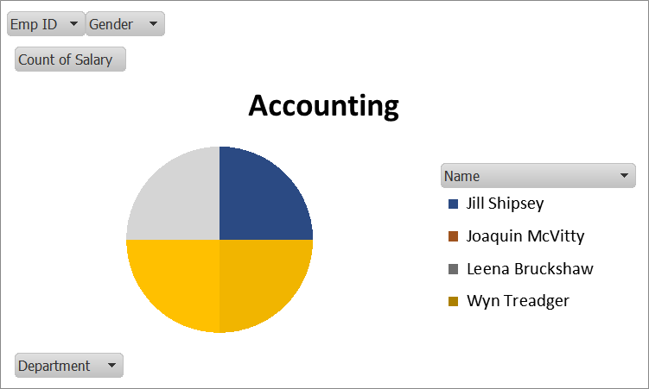
RESULTS
11

Slide 12
conclusion
Identification of Attrition Trends:
The dashboards have clearly highlighted trends in employee attrition over time. We observed peak periods of turnover and identified seasonal patterns, if any, which could be linked to external factors or internal changes.
Demographic Insights:
Analysis of demographic data, such as age, tenure, department, and job role, revealed significant patterns. For example, higher attrition rates were noted among certain age groups or specific departments, pointing to potential areas for targeted intervention.

