Slide 1


Mobile Development
thusitha@crowderia.se

Slide 2

I.P.V.T.P.M Jayalath
University of Colombo School of Computing
B.Sc. Computer Science
Crowderia
#involve with Game , Mobile and Web development
thusitha@crowderia.se | tel: 0703757012

Slide 3
What is mobile development
Technologies and platforms
Web App and Native Apps
What we doing today
To-do App
Overview

Slide 4

Mobile Development

Slide 5

Mobile Development

Slide 6
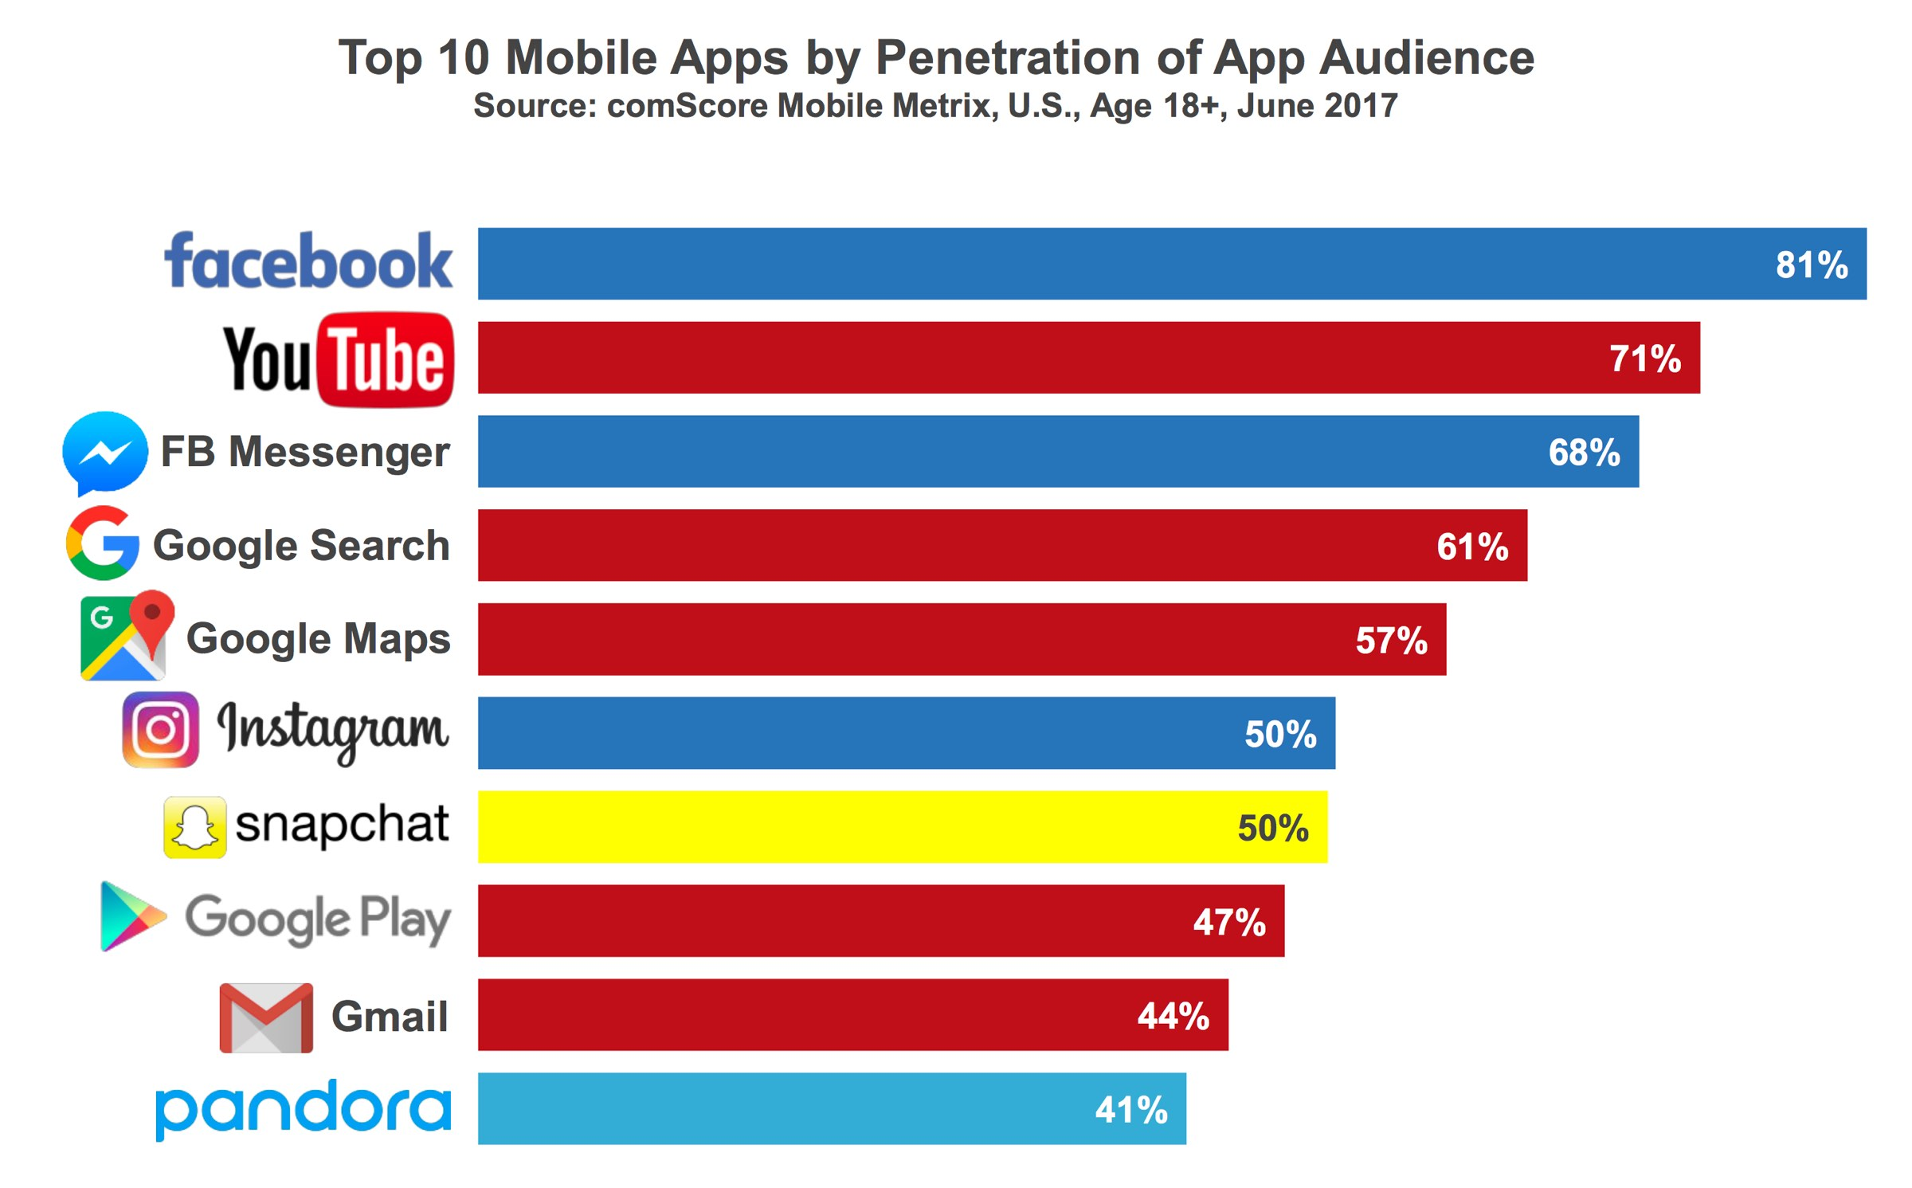
Most popular apps 2017

Slide 7
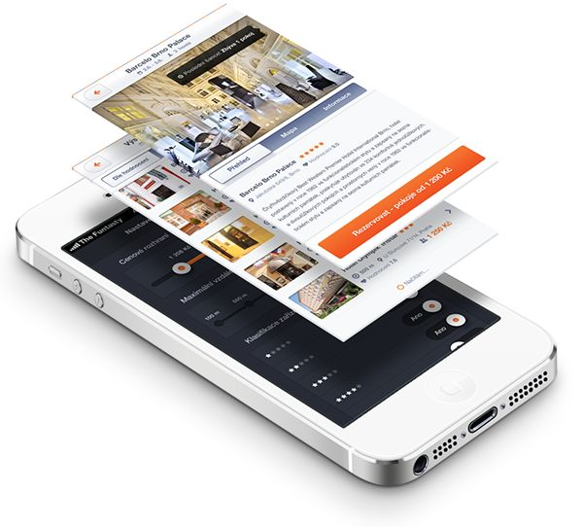

Now a days BIG PLAYERS

Slide 8


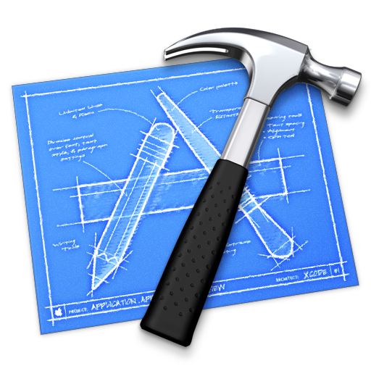



OS Specific IDE

Slide 9

Is that all?

Slide 10

Native and Hybrid Development

Slide 11



Frameworks that Lead On Industry

Slide 12
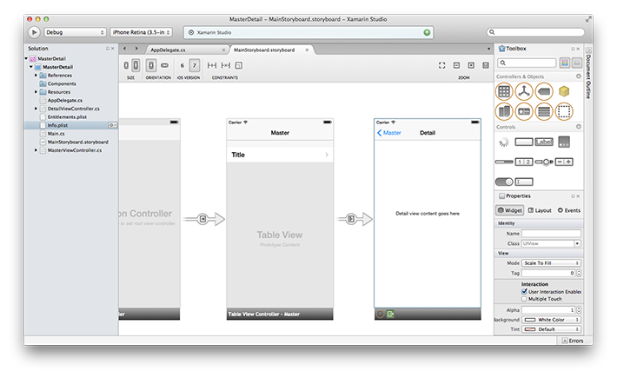
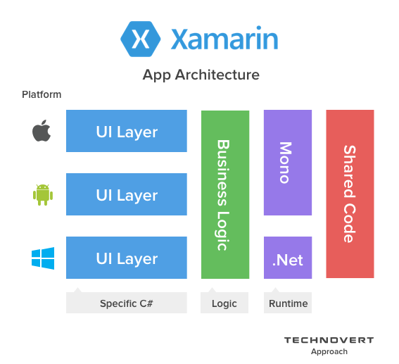
Xamarin

Slide 13
Witch one is the best?

Slide 14
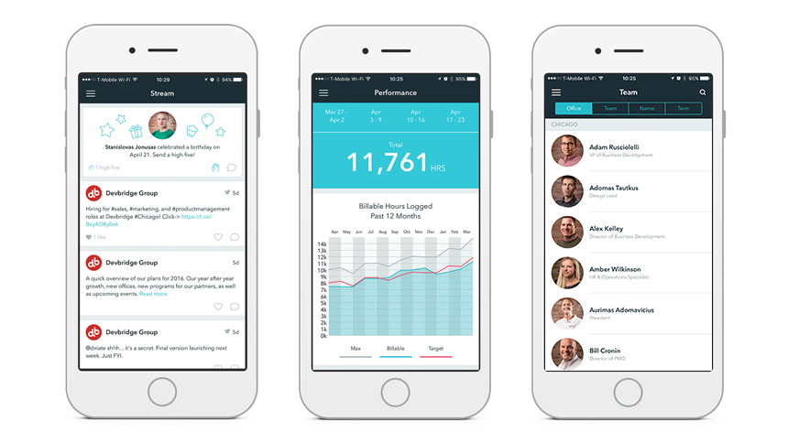
What is React?
React is a JavaScript library for building user interfaces.
A key concept in React is that of a component.
A component is a particular piece of the user
interface, such as this Facebook input field.

Slide 15
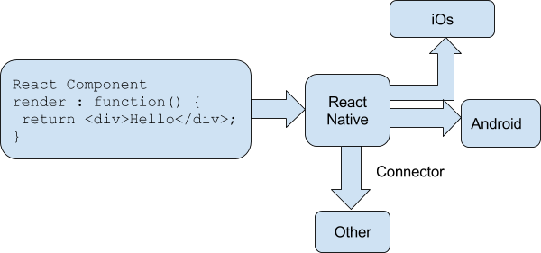
React Native
How Does React Native Work?
The Virtual DOM
In React, the Virtual DOM acts as a layer between the developer’s description of how things ought to look,
and the work done to actually render your application onto the page.
This connector help to create React with an
interface into the host platform’s native UI elements.

Slide 16
To-do app
What is to-do app
Technologies
Platforms
Setup environment

Slide 17






Project Environment setup
Tools and technologies that we are working with

Slide 18
Ref
CrowdSolution -> https://github.com/CrowderiaSolution/react-native-expo-boilerplate
NodeJS -> https://nodejs.org/en/
Eslint -> https://eslint.org/
Babel -> https://babeljs.io/
Expo -> https://expo.io/
Android Studio -> https://developer.android.com/studio/index.html
Xcode -> https://developer.apple.com/xcode/
Promises -> https://ponyfoo.com/articles/understanding-javascript-async-await
React Native -> https://facebook.github.io/react-native/
Firebase -> https://firebase.googleblog.com/2016/01/the-beginners-guide-to-react-native-and_84.html
What is react -> https://wetalkit.xyz/react-native-what-it-is-and-how-it-works-e2182d008f5e

Slide 19
THANK YOU!
www.crowderia.com

Slide 20
www.crowderia.com
Head Office
R & D Center
Branch Office
Crowderia AB, Övre Slottsgatan 9A
753 12 Uppsala
Sweden.
Crowderia (Pvt) Ltd, No.84/21, 5th Lane,
Nawala,
Sri Lanka.
Crowderia, 38, Kerrie Road, Oatlands,
NSW 2117,
Australia.

