Slide 1

DATA
STRUCTURE

Slide 2
FILE ORGANISATION
TOPICS-
DIRECT (OR RANDOM) FILE ORGANISATION
DIRECT(OR RANDOM) FILE OPERATIONS
ADVANTAGES AND DISADVANTAGES
INDEXED SEQUENTIAL FILE ORGANISATION (ISAM)
OPERATION OF INDEX SEQUENTIAL FILE
ADVANTAGES AND DIS ADVANTAGES
CHOICES OF FILE ORGANISATION

Slide 3
TOPIC 1: DIRECT (OR RANDOM) FILE ORGANISATION
DEFINITION-
It offers an effective way to organize data when there is a need to access individual records directly. In a direct file, a transformation or mapping is made from the key of a record to the address of the storage location. One mechanism used. for generation this transformation is called a hashing algorithm In the previous section, we studied the hashing algorithm and collision resolution techniques. Direct files are stored on DASD (Direct Access storage Devices)

Slide 4
DIRECT (OR RANDOM) FILE OPERATION
Creation of direct files:
For creating a direct file, a hashing algorithms and collision handling algorithm must be specified by programmer. Using the given hashing algorithm, the primary key value of input record is translated into physical address and then the record is written into the location corresponding to the physical address. This process continues until all the input records have been written to the storage medium.
Retrieving from direct file(searching):
To retrieve (or search or read) a record from a direct WD user must supply the primary key value of that record. Using the given hashing algorithm, the primary Key value is translated into physical address and program retrieves the record from that address. there is no record at that address, then If desired record is not present in the file. If there is a record other than the desired record at the transformed address, the specified collision method is used to retrieve the desired record.
Updating the direct file:
To add, delete or modify the record, primary key value of the record is translated into physical address using hashing algorithm first. The three updating operation are-
Addition of new record
Deletion of an existing record
Modification of a record

Slide 5
ADVANTAGES AND DISADVANTAGES OF DIRECT FILE ORGANISATION
Advantages-
Simplicity: Direct file organization is straightforward and easy to implement, making it suitable for simple applications.
Sequential access: Since records are stored sequentially, it's efficient for applications that primarily access data in a sequential manner, such as batch processing.
Minimal overhead: There's minimal overhead in terms of organizing and maintaining the file structure, as compared to more complex organization methods.
Disadvantages-
Inefficient for random access: Direct file organization is not efficient for random access of records, as it requires scanning through the entire file to locate a specific record.
Limited search capabilities: Without an index or key, searching for specific records can be slow and inefficient.
Poor performance with large datasets: As the file size grows, the time required to search for records increases proportionally, leading to decreased performance.

Slide 6
TOPIC 2: INDEXED SEQUENTIAL FILE ORGANISATION
DEFINITION-
ISAM (Indexed sequential access method) is an advanced sequential file organization method. In this case, records are stored in the file with the help of the primary key. For each primary key, an index value is created and mapped to the record. This index contains the address of the record in the file.
If a record has to be obtained based on its index value, the data block’s address is retrieved, and the record is retrieved from memory.

Slide 7
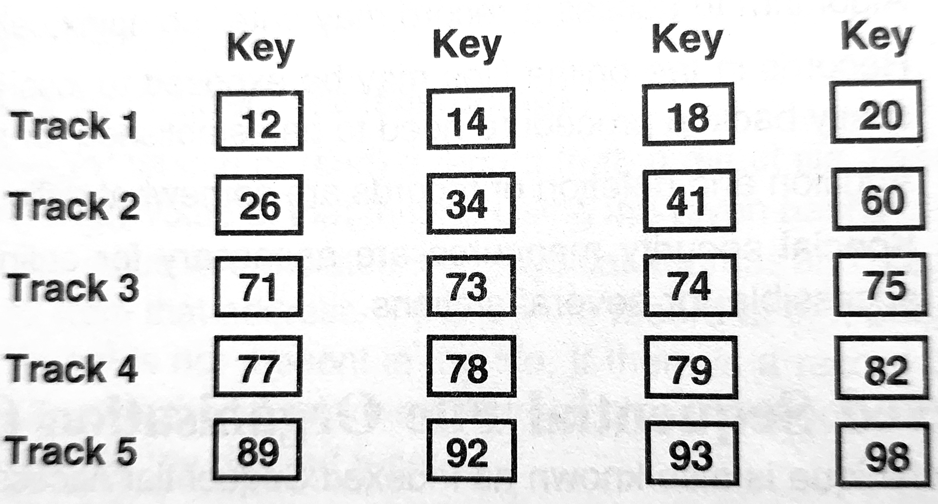
OPERATION OF INDEX SEQUENTAIL FILE
To understand the processing of an indexed sequential file. Let us consider an example. Suppose we have 20 records with primary key values stored in different tracks. Note that each record has a unique key & that records are in order by key

Slide 8
The track index for the above arrangement is shown in the table. The track index contains the value of the highest key on each track.
Track no. | Highest key on track
1 | 20
2 | 60
3 | 75
4 | 82
5 | 98

Slide 9
OPERATIONS
Creating indexed sequential file :When an indexed sequential file is(1)created all records are written into the prime area in sequence by key. The indexes are generated at this time.
Retrieving from indexed sequential file :Suppose it is desired to read(2)record 79. One way to access this record is to sequentially read the records in a file until record 79 is found. This may be a very slow process .A faster way of finding record 79 is to use the track index. The highest key of track 3 is 75, & the highest key on track 4 is 82. Therefore, if record 79 exist, it must be on track 4. Consequently, the next step is to read track 4 to find record 79.Using the track index does not eliminate sequential searching., it just reduces the magnitude of the task. Instead of searching a large file of records, we are able to search a table that points toward the desired record location.
Updation:
Modification-Modification is similar to the retrieval process. The indexes are used to find the desired record & the new record is written on the top of the old one.
Deletion-A deletion from the file is also straight straight forward. The indexes are used to find the desired record, and a special mark is inserted into the record to indicate that it has been deleted.
Insertion-Insertion to an indexed sequential file are quite troublesome because the key order of the file must be maintained.

Slide 10
ADVANTAGES AND DISADVANTAGES
ADVANTAGES-
Can be processed both randomly as well as sequentially as needed.
Very suitable for urgent & ad-hoc information retrieval.
It permits more efficient use of sequential processing approach, particularly institution where activity of files is high.
It permits quick access to records when the activity is only the fraction of the total workload.
DISADVANTAGES-
Takes additional storage space for index files i.e. less efficient in use of storage space.
indices need to be designed carefully.
Slower than direct access.
Its implementation requires expensive software resources.

Slide 11
TOPIC 3
CHOICE OF FILE ORGANISATION METHODS
METHODS
Sequential or random processing-Many data processing applications are sequential in nature e.g. Payroll requires processing all employee records in an organization. Therefore, sequential processing would be the best method by making use of sequentially organized files. In some applications particularly real time, jobs, sequential processing is of no use. For example, an application such as air/railway booking seats or updating bank pass books require random access to files So naturally, direct access files should only be used.
File activity ratio- In many applications, every record may not be processed. Only a small portion of the whole file may be processed. The file activity ratio is defined as
number of record accessed in one run
total number of records in the file

Slide 12
Access type-The order in which records are accessed is very important. If the file activity ratio is high and the order of processing is random, then the sequential access method is of no use. Only direct access files can give good performance.
Frequency of reference-In many applications, only a very small percent of records is referenced frequently. For example, in an airline reservation system. Most activities such as cancellation of seats, bookings, enquiries involve only 5% records of next day flights. Here, direct access files should be used.
Response time-If records are referenced frequently it is desirable that they should be located quickly. If the application is such that quick response to queries is required then again the relevant records should be located quickly. Thus, in both cases fast response is required. Since the storage device and file organization affect the response time, high speed direct access storage devices with direct access files should be used.
Volatility-This refers to the number of additions/deletion made to e file over a period of time In most applications new records are inserted and old records are deleted. A file with high rate of additions/deletions is called highly volatile. File volatility ratio is defined as follows
no. of addition + no. of deletions
number of records in the file

Slide 13
When high volatility is expected, sequential organization is the best incase. fast response time is also required then direct access files/Index sequential sell can be used but these files have to be reorganized periodically which may be quite time consuming.
File size-If the file size is small and only single record is to be searched , sequential search is best. However, if the file is very large spanning many volumes Jo storage devices, a sequential search for a single record could be time consuming.
THANKS
Submitted to:
Prageesha maam
Submitted by:
Arman---07
Navjot---20
Lakshit---35

