Slide 1

Global Surveillance and Forensic System for Protecting Pharmaceutical Distribution Supply Chain
Presenter : Laksh Lumba
MS in Information Systems
Northeastern University

Slide 2
to stop illegitimate drugs from infiltrating the drug distribution supply chain. investigating drug counterfeit crimes. Building a Robust Communication AND DATA KNOWLEDGE SHARING SYSTEM. Enable Patient, Pharmacist, DOCTOR, HOSPITAL to report to LAW Enforcement AGECNCIES. ALLOW PHARMA TO Fulfill MEDICATION ORDER to TRUSTED LICENSED PARTNERS. CAPTURE RECORD of MOVEMENT OF PRODUCT BETWEEN VARIOUS SUPPLY CHAIN. MAINTAIN DRUG INVENTORY AND HISTORY OF ILLIGIMATE PRODUCT. IMMIDITIATE NOTIFICATION OF SUSPECT PRODUCT. MAINTAIN PROPER LICENSE TO PHARMA AND DISTRIBUTORS.
OBJECTIVE

Slide 3
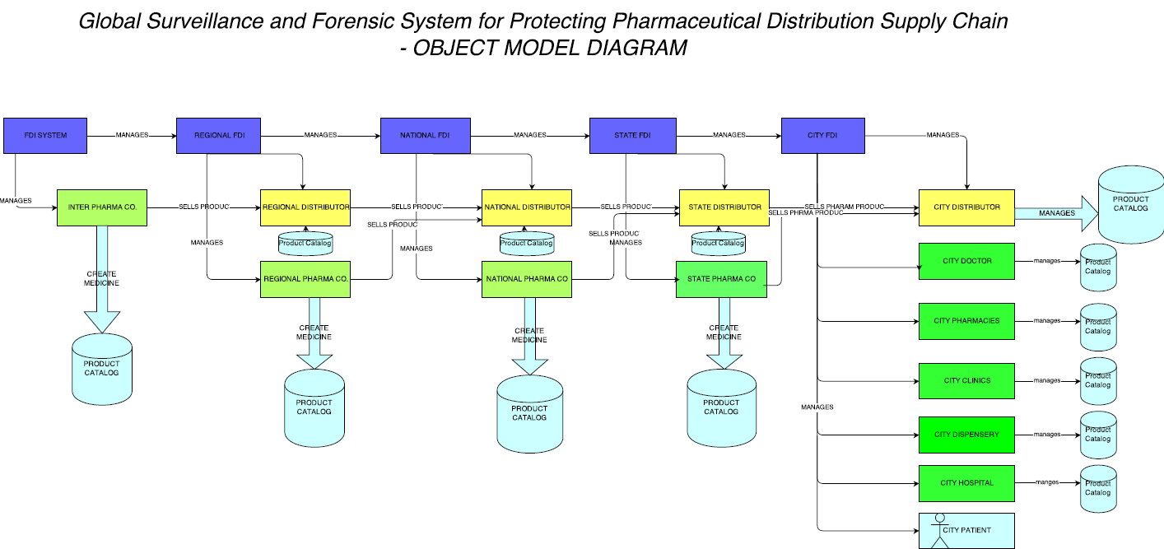
WORK FLOW MODEL

Slide 4
BASIC OBJECT MODEL
State Law Agency(ECOSYSTEM)
NETWORK
CITY DISTRIBUTORS DIRECTORY(ENTERPRISE DIRECTORY)
CITY LAW AGENCY
STATE PHARMA CO.
ENTERPRISE
CITY DISTRIBUTOR
PHARMACY
CLINIC
Organization
HOSPITAL
DISPENSARY
PATIENT
USER ACCOUNT DIRECTORY
WORK QUEUE
PERSON DIRECTORY
USER ACCOUNT
WORK REQUEST
PERSON
ROLE
PERSON
ADDRESS

Slide 5
USE CASE (LAW AGENCY)
GLOBAL LAW AGENCY
-MANAGE INTERNATIONAL PHARMACEUTICAL COMPANY.
# REGISTER NEW INTERNATIONAL PHARMACEUTICAL COMPANY.
# TRACK MEDICINE.
# Manage License.
# MANAGE PHARMA COMPANY REQUEST.
-MANAGE REGIONAL LAW ENFORCEMENT AGENCIES.
# REGISTER REGIONAL LAW AGENCY.
# MANAGE REQUEST.
REGIONAL LAW AGENCY
- MANAGE REGIONAL PHARMACEUTICAL COMPANY.
- MANAGE NATIONAL LAW ENFORCEMENT AGENCIES.
- MANAGE REGIONAL DISTRIBUTORS.
- create CASE (SEND REQUEST TO GLOBAL AGENCY).
- UPDATE CONATCT.

Slide 6
USE CASE (LAW AGENCY) CONTINUED…….
NATIONAL LAW AGENCY
- MANAGE NATIONAL PHARMACEUTICAL COMPANY.
- MANAGE STATE LAW ENFORCEMENT AGENCIES.
- MANAGE NATIONAL DISTRIBUTORS.
- create CASE (SEND REQUEST TO REGIONAL AGENCY).
- UPDATE CONATCT.
STATE LAW AGENCY
- MANAGE STATE PHARMACEUTICAL COMPANY.
- MANAGE CITY LAW ENFORCEMENT AGENCIES.
- MANAGE STATE DISTRIBUTORS.
- create CASE (SEND REQUEST TO NATIONAL AGENCY).
- UPDATE CONATCT.
CITY LAW AGENCY
- MANAGE CITY ORGANIZATIONS(PHARMACIES, HOSPITALs, PATIENT & DOCTORS).
- MANAGE STATE DISTRIBUTORS.
- create CASE (SEND REQUEST TO STATE AGENCY).
- UPDATE CONATCT.

Slide 7
USE CASE (PHARMACEUTICAL COMAPANY)
INTERNATIONAL PHARMACEUTICAL COMPANY
- CREATE REQUEST TO GLOBAL LAW AGENCY.
- MANAGE REGIONAL DISTRIBUTORS.
REGIONAL PHARMACEUTICAL COMPANY
- CREATE REQUEST TO ASSIGNED REGIONAL LAW AGENCY.
- MANAGE NATIONAL DISTRIBUTORS.
NATIONAL PHARMACEUTICAL COMPANY
- CREATE REQUEST TO ASSIGNED NATIONAL LAW AGENCY.
- MANAGE STATE DISTRIBUTORS.
STATE PHARMACEUTICAL COMPANY
- CREATE REQUEST TO ASSIGNED STATE LAW AGENCY.
- MANAGE CITY DISTRIBUTORS.
COMMON FEATURES
-MANAGE DRUG INVENTORY
-UPDATE CONTACT

Slide 8
USE CASE (DISTRIBUTORS)
REGIONAL DISTRIBUTOR
- MANAGE NATIONAL DISTRIBUTORS.
- REQUEST TO REGIONAL LAW AGENCY.
NATIONAL DISTRIBUTOR
- MANAGE STATE DISTRIBUTORS.
- REQUEST TO NATIONAL LAW AGENCY.
STATE DISTRIBUTOR
- MANAGE CITY DISTRIBUTORS.
- REQUEST TO STATE LAW AGENCY.
CITY DISTRIBUTOR
- MANAGE CITY ORGANIZATION.
- REQUEST TO CITY LAW AGENCY.
COMMON FEATURES
- MANAGE DRUG INVENTORY.
- sHOP PRODUCT.
- REQUEST MORE PRODUCT.
- UPDATE CONTACT.

Slide 9
USE Case (CITY ORGANIZATIONS)
PHARMACY
HOSPITAL
DISPENSARY
CLINICs
Doctors
COMMON FEATURES
- MANAGE DRUG INVENTORY.
- sHOP PRODUCT.
- REQUEST MORE PRODUCT.
- UPDATE CONTACT.
- REPORT CASE AGAINST PRODUCT.
- REGISTER PATIENT.

Slide 10
USE CASE (PATIENT)
BUY PRODUCT
REPORT AGAINST PRODUCT
UPDATE CONTACT

Slide 11
Logging MECHANISM -helps in Troubleshooting during Production. -HELPS IN DEBUGGING THE CODE.
SPECIAL FEATURES
FULL FORENSIC AND DISTRIBUTION SYSTEM ON GLOBAL SCALE. -GLOBAL FDI SYSTEM MANAGES GLOBAL PHARMA COMPANY. -REGIONAL FDI MANAGES REGIONAL DISTRIBUTORS AND REGIONAL PHARMA COMPANY.
-NATIONAL FDI MANAGES NATIONAL DISTRIBUTORS AND NATIONAL PHARMA COMPANY.
-STATE FDI MANAGES STATE DISTRIBUTORS AND STATE PHARMA COMPANY.
-STATE FDI MANAGES CITY DISTRIBUTORS AND CITY ORGANIZATIONS.
FULL ORDERING LIFE CYCLE includes ORDERING ,INVOICE, DELIVERY AND CANCEL ORDER.
SPECIAL VALIDATION.(EXTENSIVE USE OF COLOR)
NOTIFICATION MAIL TO PHARAMA COMPANY.
GENERATION OF INVOICE IN PDF FORM.
PRODUCT REQUEST CAN BE ARRANGED BASED ON THE FOLLOWING ATTRIBUTES:
-PRIORITY(CRITICAL, HIGH, MEDIUM, LOW)
-QUANTITY OF PRODUCT.
-REQUESTED DATE.

Slide 12
THANK YOU!

