Slide 1

Web Based Test Automation Framework
SEP 2018
layyakannu@paypal.com

Slide 2


Topics Overview
Introduction
Tool Features
Story Board & Dev Timeline
Todays Situation & Tomorrows Spot
Useful Links
Current Tool Status & What’s Next?
Expected Outcome & Metrics

Slide 3
Goal and Objective
Description
Centralized Solution for Testcase Management & Automation, Rule ( file-based ) operations such as deployments and validations.
Remove all local Dependencies.
Test and Automate by ‘In-Sprint’ & ‘On The Go’ Approaches.
Centralized Test Management and 100% reusability and scalability of Tests.
Faster Test Validations, wider E2E Automation support and QA Sign-Offs.
No More Time Consuming Manual Process and Deployments.

Slide 4
Todays Situation vs Tomorrows Spot!

Slide 5
Todays Situation
Different Test Automation management by individual teams breaking E2E continuity.
Numerous Automation frameworks for different Layers such as UI, API or Batch.
Time Consuming Post Processing and Manual Stage Deployments (Error Prone).
Less Rule validation Testcase Automations.
Manual Stage Log validations and Verification of expected Rule fire and patterns.
Dependency on Pluto-DC New Instance Setup if broken or Busy.
Adding a RBO variable to a new Checkpoint manually.
Sample Confluence Pages for Manual Steps:
https://engineering.paypalcorp.com/confluence/display/alfaromeo/Setting+up+DC
https://engineering.paypalcorp.com/confluence/display/alfaromeo/Inserting+dynamic+domains+in+DC+-+Steps
https://engineering.paypalcorp.com/confluence/display/~asarvade/RRDS_File+based+Rule+deployment

Slide 6
What we bring in? – Our Tomorrows Spot
Project’s entire Test Automation is under one-roof and is in Cloud\Server.
Automation Support of all Test Layers such as UI, API, DB, Batch, etc.
History of downloadable Reports for all the Test related to project.
100% Reusability of Testcase & Steps, Scalability and easy maintenance of Tests.
Fast E2E Test, Workflow validations and one click Regression support.
Upload Rule Jar, Post Process, Stage Deploy and Start Component in few seconds.
Validate Stage logs for any patterns directly from UI.
Creation of your own New Pluto-DC Instance on click of a button.
Automated Process of adding a RBO variable to a New Checkpoint.

Slide 7
Tool Features & Story Board

Slide 8
Tool Features
Dashboard
Automation
Test Case
Test Suite
Test Reports
Post Process & Stage Deployment
Rule Workflow
Rule Details
Rule Fire Validation
Rule-Case Mapping
Configuration
Project Settings
User Permission Settings
Component Settings
Setup Pluto-DC
RBO Update

Slide 9
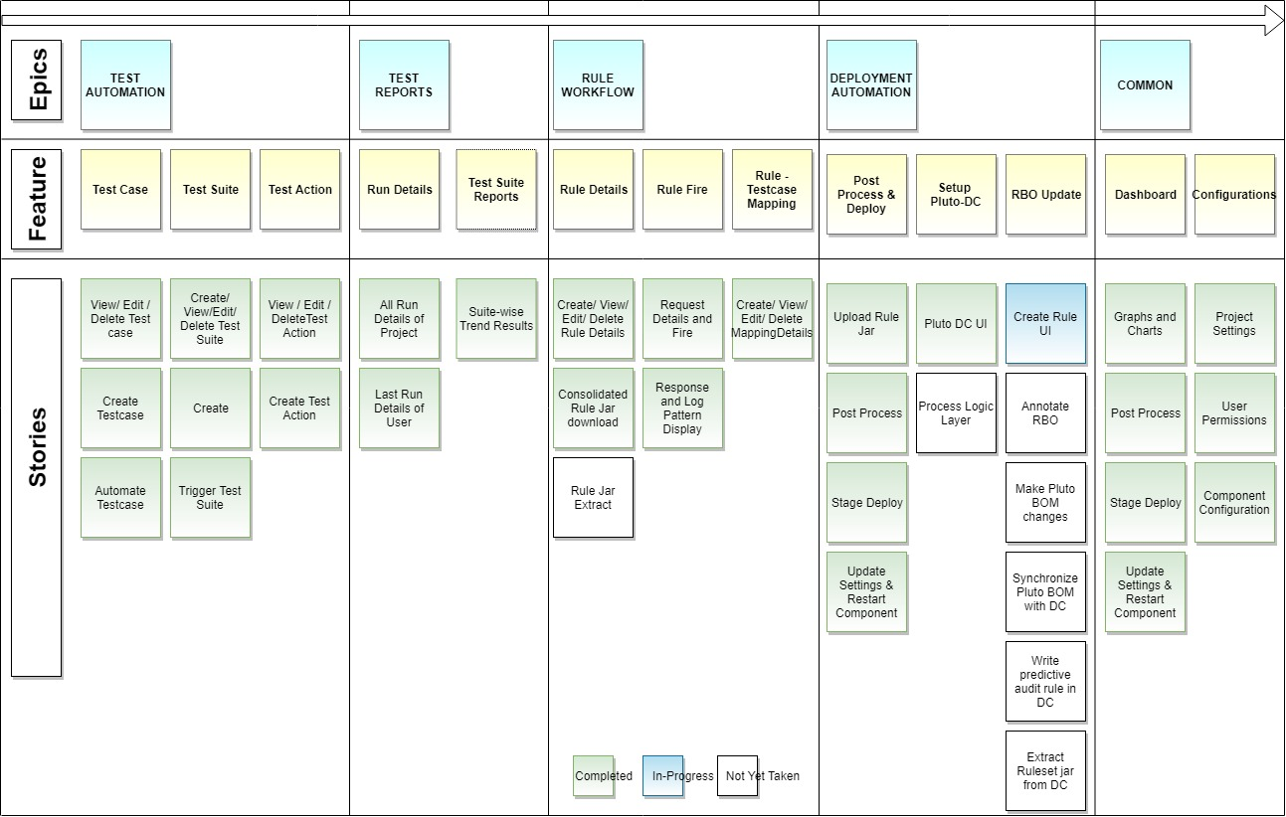
Story Board

Slide 10
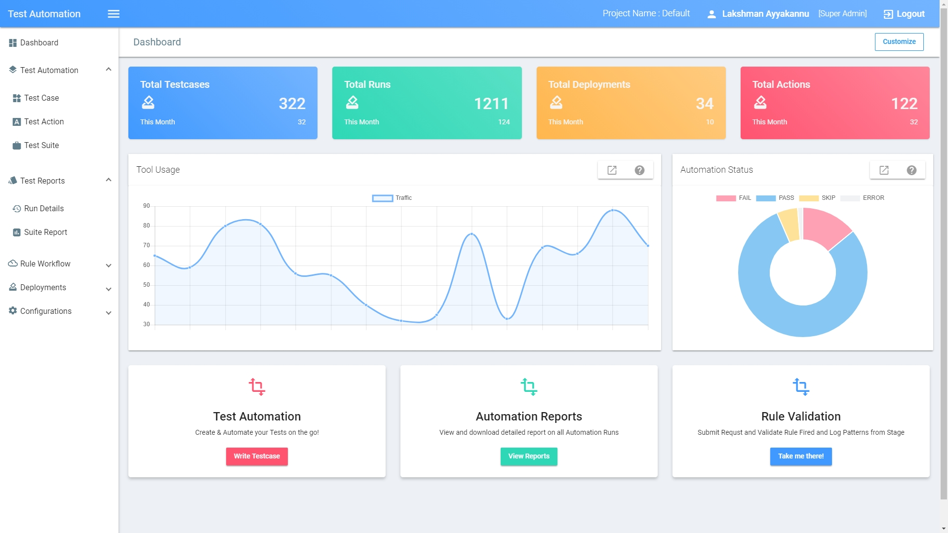
Tool Snapshot

Slide 11
Technical Stack, Outcome Metrics & Current Status

Slide 12
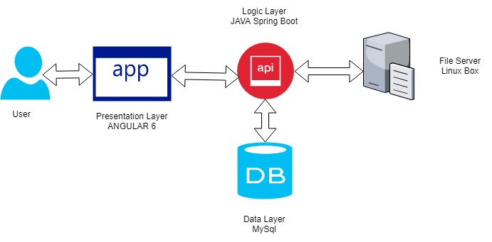
Tech Stack
Tool is designed as 3 Tier Application
Representation Layer – Web UI
Created using Latest Angular 6.
Theme based on Angular Material.
Logic Layer (Testing As A Service) - Spring Boot
a. DB to UI Communication through Java Project
b. Java Hybrid Test Automation framework using JAVA 9 and Spring Boot.
Data Layer
MySQL Database for storing all necessary information.
Architecture

Slide 13
Expected Outcome and Metrics – Per Sprint

Slide 14
Outcome Metrics For Quarter

Slide 15
Expected Outcome in Brief
Resource productivity Increase by through cut-down of Manual deployment and Monitoring supports.
Test and Automation coverage done In-Sprint with ‘On-The-Go’ Approach, increasing the FT Automation coverage more than 90%.
Interactive UI with intelligence to record Testcases with minimal inputs from user reducing Test and Automation development Time.
Any Time Regression support where client team can trigger various test and workflow and sign-off their requirement without our waited support.
Improves Client Teams Support service and self (including Case creations, transitions, workflow tests, E2E Execution and deployments).
Rule Management(Rule Jars, RBOs, Stages) done centralized to the client teams thus reducing the dependency on the team.

Slide 16
Tool’s Current Status
Test Automation feature up and ready to use for UI, API and DB related cases.
Post Process and Rule Jar Deployment is fully functional and available to all users.
Dashboard, Rule Workflow feature up and ready.
User Authentication and Permission feature has been implemented
What’s Next?
Goal is to get a basic version of the application out into the hands of the users to make sure that we’re on the right track and identify the highest-priority things to do next
Setup go/URL.
Dedicated Servers for the Tool and CI-CD Jobs to be Setup.
Confluence Page on the Tool to be created.
With end user inputs, enhancements, Bugs and optimization to be take care of.

Slide 17
For Contacts & Feedbacks
Dixit, Niraj Kumar - nidixit@paypal.com
Ayyakannu, LAKSHMAN - layyakannu@paypal.com
Angusamy, Gowri Shankar - gangusamy@paypal.com
Thank You

