Slide 1

Tool Features
SEP 2018
Notes:
Consumer Risk & Digital Help Experiences

Slide 2


Tool Features
Dashboard
Setup Pluto-DC
RBO Update
Post Process & Deployment
Rule Fire Validation
Rule Details
Disputes
Create Dispute
Transit Dispute
Dispute Details
Automation
Test Case
Test Suite
Reports
E2E Execution

Slide 3
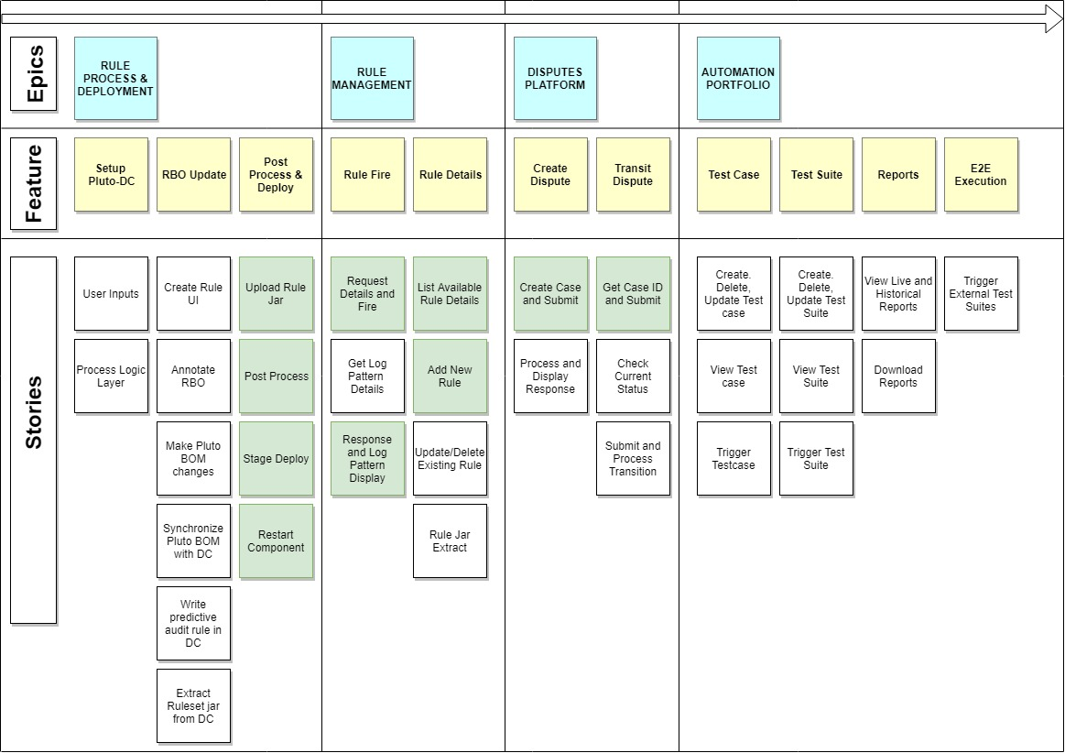
Story Board

Slide 4
Dashboard
Flex display on new features and enhancements in Tool with descriptions.
Each Menu/Feature as a Card Box for easy User navigation.
Charts on Automation Status, Testcase Counts and other Analytics & Metrics.

Slide 5
Setup-DC
Provision for the user to Create a New instance of Pluto-DC on click of a button.
Host name will be updated in the oracle network config files
DB schemas , users and privileges will be updated
Latest DB dump will be copied to the instance and imported to DC
Listener and Oracle will be restarted after the config changes

Slide 6
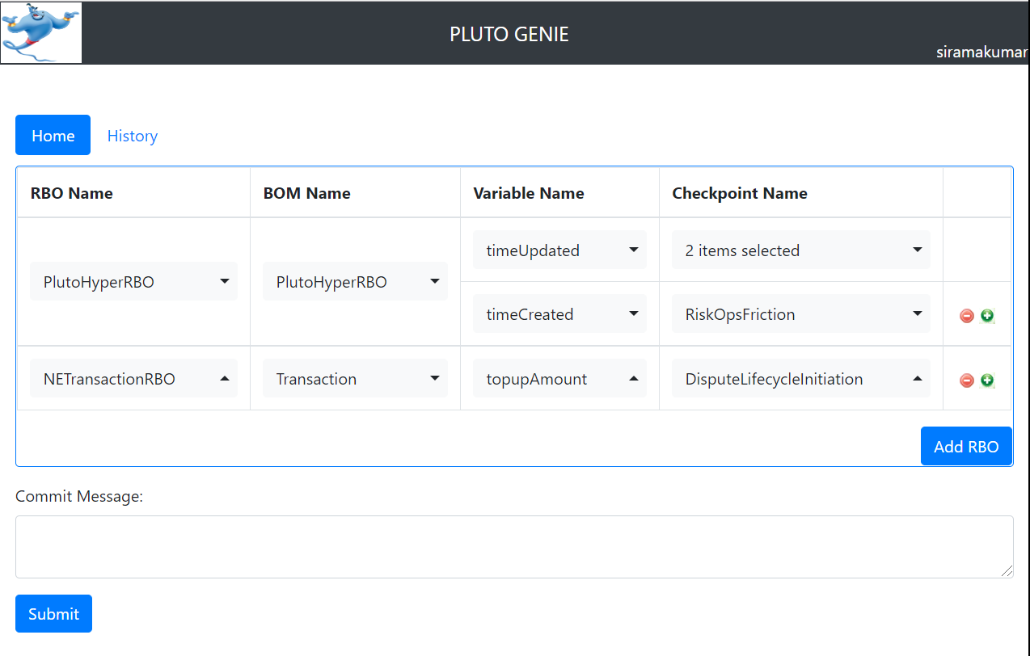
RBO Update
With RBO Update Tool, add an RBO variable to a new Checkpoint with few clicks.
Not only can you update the code, this tool also predictively writes rules for all the BOM objects that use the RBO.
And finally, it also generates a Pluto DC Rule-App jar for you to proceed with Testing.

Slide 7
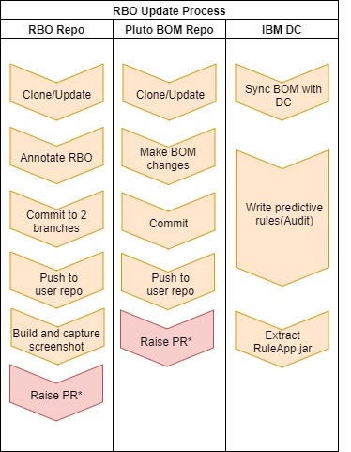
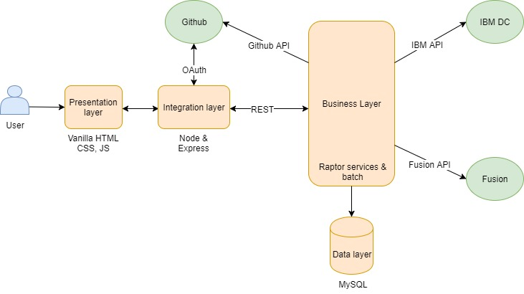
High Level Process
Architecture

Slide 8
Post Process & Deploy Rule Jar
Upload your Rule Jar and do Post Process against the listed Pluto-DC and compatible RBO versions (Choose or Upload).
Property file creations for your component are Automated.
Copy Rule Jar to the provided Stage and Re-Start your component along with any component setting changes.

Slide 9
Rule Fire
Submit HTTP Request with URL, Request Type, Payload and other necessary info and Tool displays the Response along with the searched Log Patterns from the Log path of user stage.
Request can be saved and converted to a Testcase by clicking ‘Add Testcase’ button where additional information are entered by the user.

Slide 10
Rule Details
Provides consolidated details of all Rules [Also used for Regression].
Add Rule Details such as Rule Name, ID, Description, Component Rule, etc.
Update/Delete an existing Rules.
User can create their test data/scenario based on the displayed rules.
Given a Rule Jar, Tool Provides the available Rules inside it by extracting the jar and reading the IRL files.

Slide 11
Disputes
Create Dispute
Provision to Create a New Dispute based on inputs such as Stage Name, Dispute Type, Reason Code and Transaction ID.
User can also Create Users along with a Transactions and directly create a case for the Transaction in single go.
On Submission, Tool outputs Case ID, Current state and other Details.
Transit Dispute
As Case ID as input, Tool checks for the current state and validity of the case and provides possible Transition states.
On Submission, Tool outputs Transition Status and other details.
User can test the dispute flows E2E.

Slide 12
Test Automation
Test Case
Add your Testcase with necessary Information. Example. Checkpoint Validation Testcase – 1. Input { URL, Type, Payload } 2. Output Validation {Response – each Elements & Log Patterns} 3. Test Data.
Edit/Delete/Trigger your Testcase.
Test Suite
Create New Test Suite and Tag you above created Testcases and schedule them.
Edit/Delete/Trigger your Test Suite.
Reports
View your live and historical reports of Testcase and Test suites with precise information.
Share the Report through Email and Download the same.
E2E Execution
Test Suites apart from the Tool can be also be triggered and reports can be view within the tool on completion.

Slide 13
THANK YOU

