Slide 1

Rule Management, Disputes & Automation
SEP 2018

Slide 2

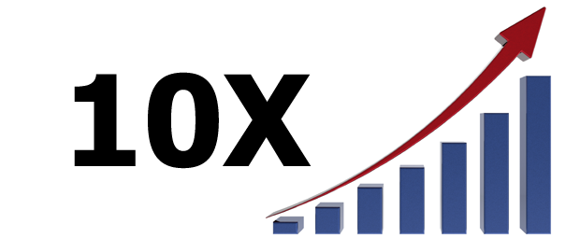
Topics Overview
Introduction
Tool Features
Story Board & Dev Timeline
Todays Situation & Tomorrows Spot
Useful Links
Current Tool Status & What’s Next?
Expected Outcome & Metrics

Slide 3
Introduction

Slide 4
Goal and Objective
Description
One Stop Solution for all Rule Based Operations, RBO Update, Disputes/Case Management and Test Automation.
Remove Any Dependencies.
No More Time Consuming Manual Process and Deployments.
Faster Validations and QA Sign-Offs.
Test and Automate with ‘On The Go’ Approach.
Wider E2E Test Support.

Slide 5
Todays Situation vs Tomorrows Spot!

Slide 6
Todays Situation
Dependency on Pluto-DC New Instance Setup if broken or Busy.
Adding a RBO variable to a new Checkpoint manually.
Time Consuming Post Processing and Manual Stage Deployments.
Less Rule Based Testcase Automations.
Manual Stage Log validations and verification of expected Rule fire.
Time consuming dispute creation and transitions by importing project and opening Attack client tool.
Adhoc Time consuming support to client and neighbor Teams.
Sample Confluence Pages for Manual Steps:
https://engineering.paypalcorp.com/confluence/display/alfaromeo/Setting+up+DC
https://engineering.paypalcorp.com/confluence/display/alfaromeo/Inserting+dynamic+domains+in+DC+-+Steps
https://engineering.paypalcorp.com/confluence/display/~asarvade/RRDS_File+based+Rule+deployment

Slide 7
What we bring in? – Our Tomorrows Spot
Creation of your own New Pluto-DC Instance on click of a button.
Automated Process of adding a RBO variable to a New Checkpoint.
Upload Rule Jar, Post Process, Stage Deploy and Start Component in few seconds.
Submit HTTP Request and Validate expected Response and Rule fire in Same Page without Stage Login.
User friendly centralized UI Based Dispute Creations and Transition support.
Available to All, where user can perform their desired operations.
Fast E2E, Workflow validations, Test Automation and Regression support.

Slide 8
Tool Features, Story Board & Timelines

Slide 9
Tool Features
Dashboard
Setup Pluto-DC
RBO Update
Post Process & Stage Deployment
Rule Fire Validation
Rule Details
Disputes
Create Dispute
Transit Dispute
Dispute Details
Automation
Test Case
Test Suite
Reports
E2E Execution

Slide 10
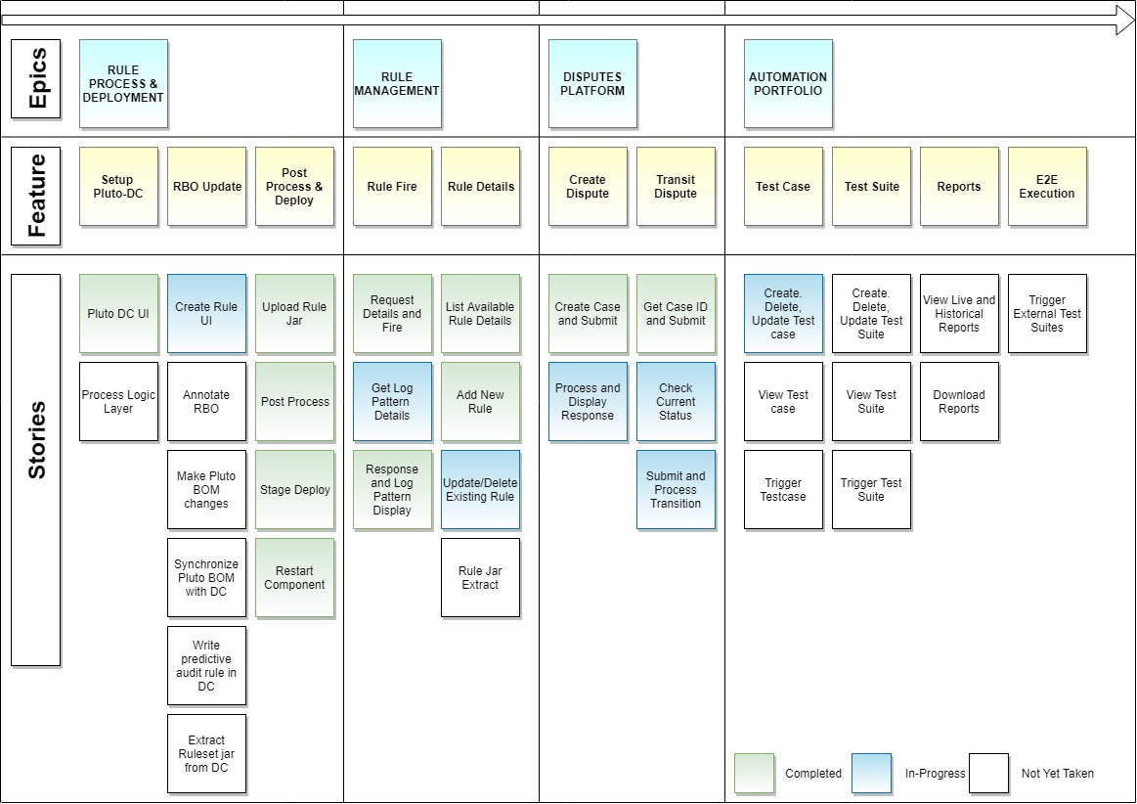
Story Board

Slide 11
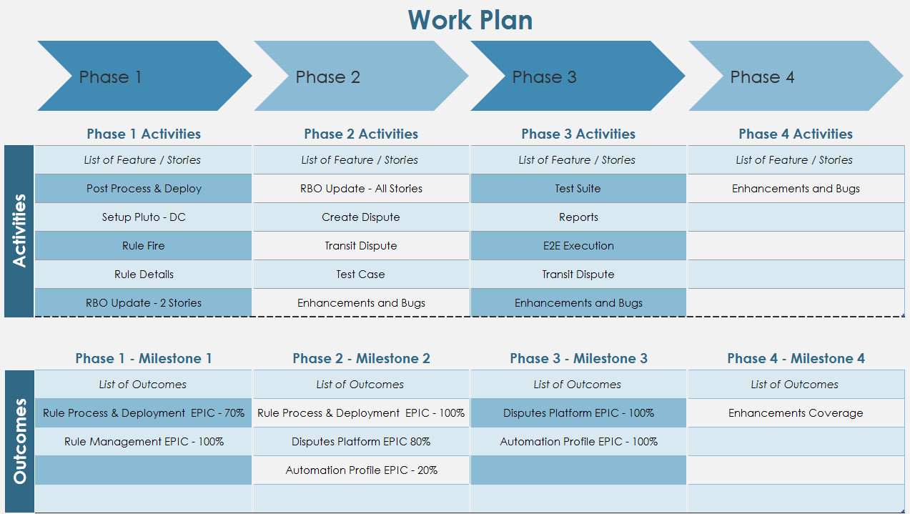
Project Phase ( MVP )
The goal is to get a simple version of the solution out into the hands of the users to make sure that we’re on the right track and identify the highest-priority things to do next

Slide 12
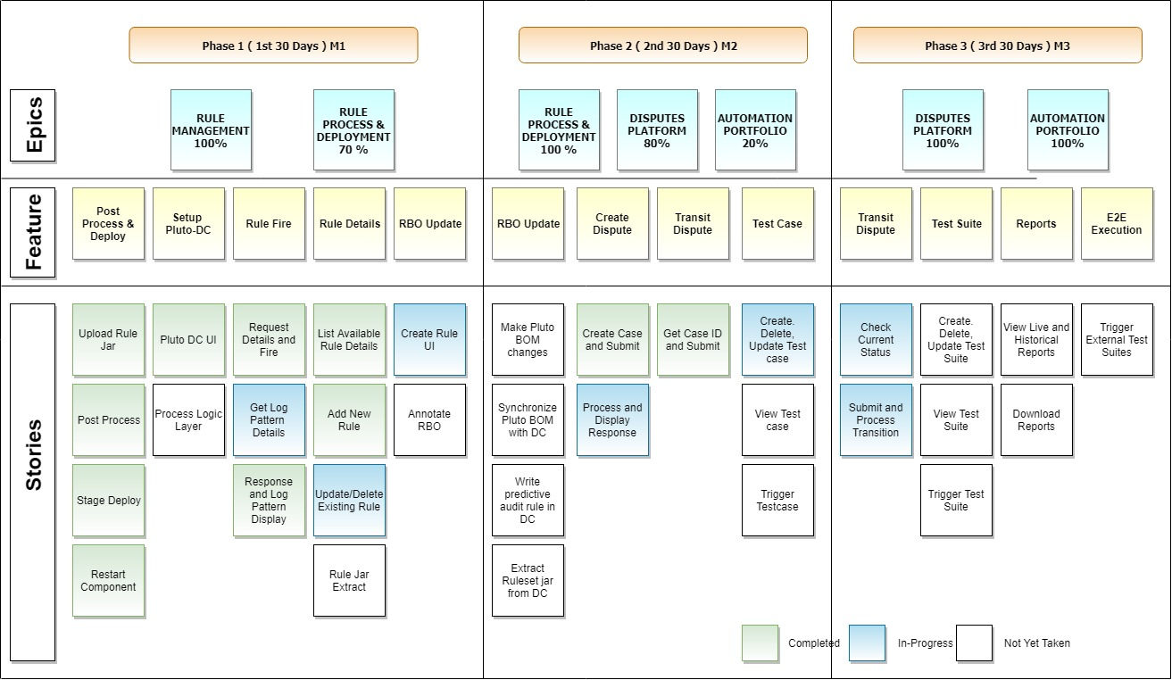
Story-wise Delivery Timeline / Plan

Slide 13
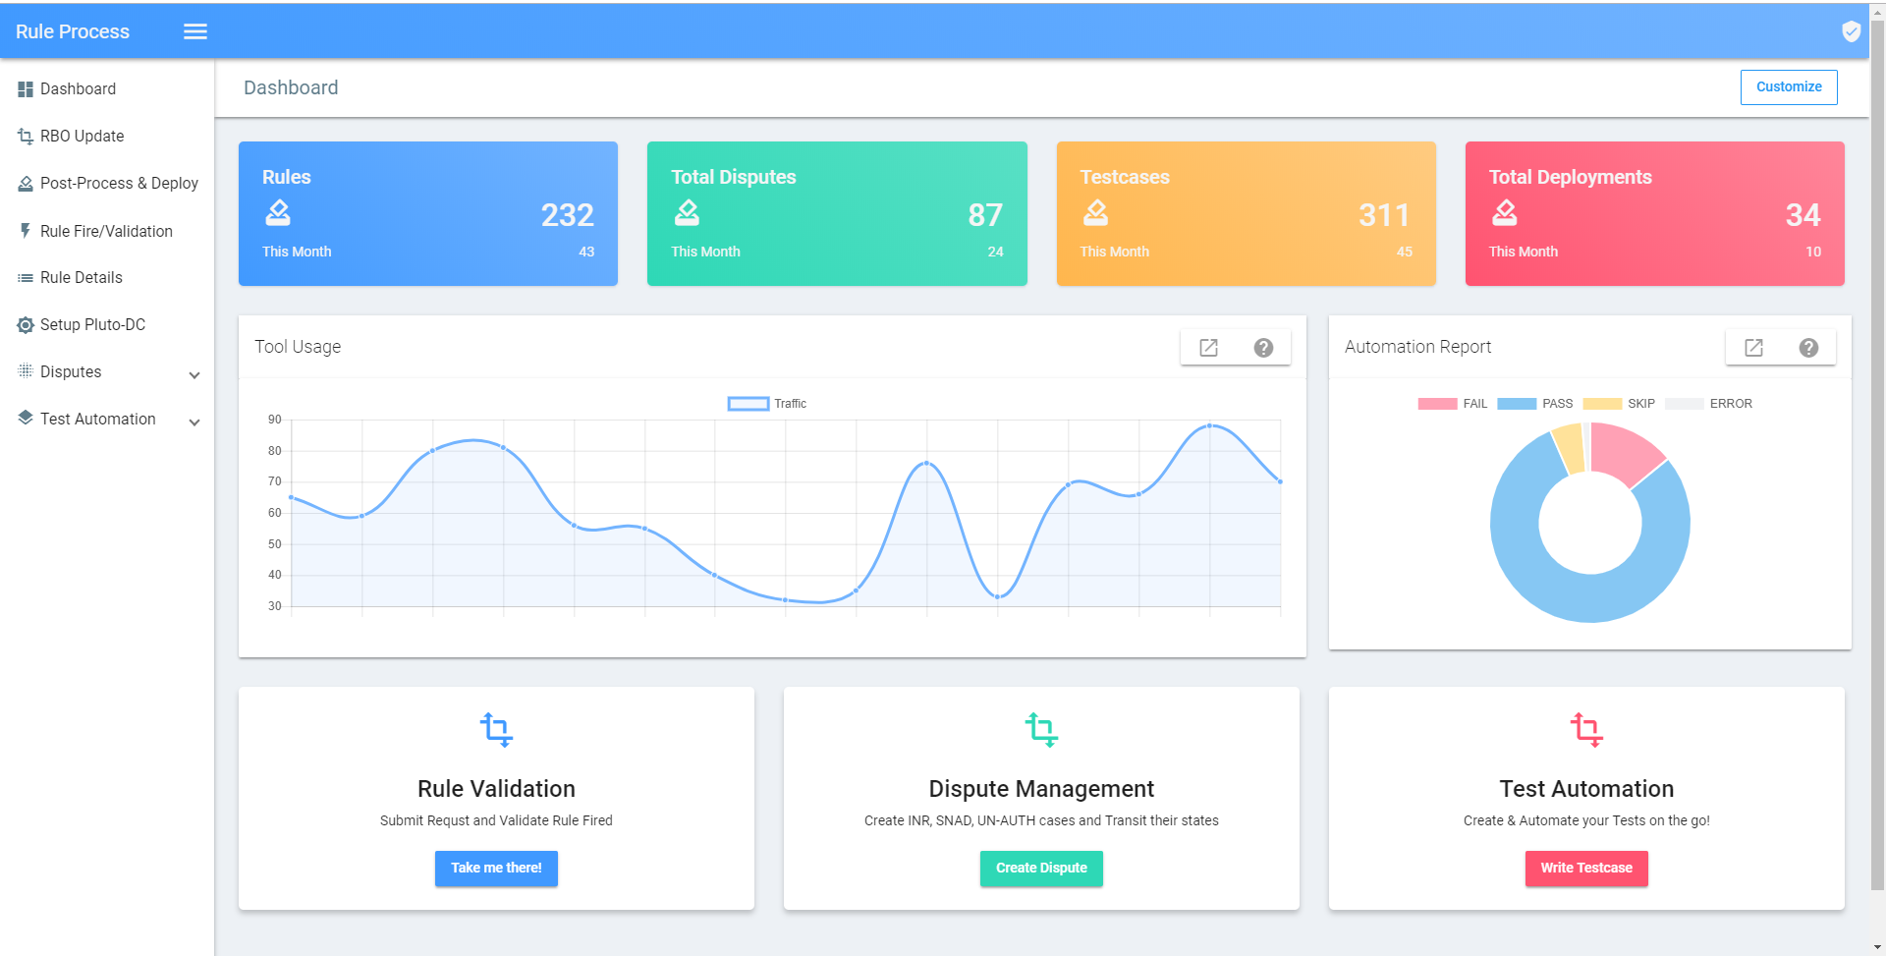
Tool Snapshot

Slide 14
Technical Stack, Outcome Metrics & Current Status

Slide 15
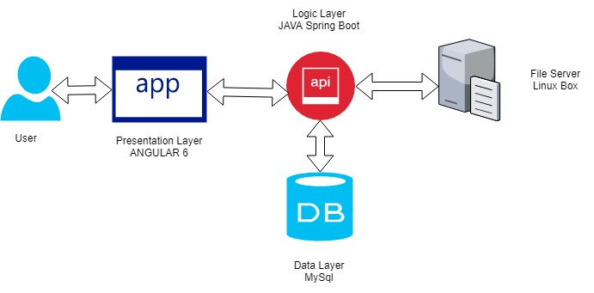
Tech Stack
Tool is designed as 3 Tier Application
Representation Layer – Web UI
Created using Latest Angular 6.
Theme based on Angular Material.
Logic Layer
Created using JAVA 9 and Spring Boot.
Data Layer
MySQL Database for storing all necessary information.
Architecture

Slide 16
Expected Outcome and Metrics – Per Sprint

Slide 17
Outcome Metrics For Quarter
Productivity Increase

Slide 18
Expected Outcome in Brief
Resource productivity Increase by through cut-down of Manual deployment and Monitoring supports.
Improves Client Teams Support service and self (including Case creations, transitions, workflow tests, E2E Execution and deployments).
Rule Management(Rule Jars, RBOs, Stages) done centralized to the client teams thus reducing the dependency on the team.
Test and Automation coverage done In-Sprint with ‘On-The-Go’ Approach, increasing the FT Automation coverage more than 90%.
Interactive UI with intelligence to record Testcases with minimal inputs from user reducing Test and Automation development Time.
Any Time Regression support where client team can trigger various test and workflow and sign-off their requirement without our waited support.

Slide 19
Tool’s Current Status
Post Process and Rule Jar Deployment is fully functional and available to all users.
UI Layer Ready for – Dashboard, Rule Fire, Rule Details, Disputes, Setup DC and RBO Update
Logic Layer for Rule Details, Rule Fire(Partial), Disputes(Partial).
What’s Next?
Goal is to get a simple version of the solution out into the hands of the users to make sure that we’re on the right track and identify the highest-priority things to do next
Deliver each feature of different EPICs in their respective Planned Phases.
With end user inputs, enhancements, Bugs and optimization to be take care of.
Confluence Page on the Tool to be created.
Dedicated Servers for the Tool and CI-CD Jobs to be Setup.
Setup go/URL.

Slide 20
Useful Links
Rules Tool
http://10.239.61.239:4201/
https://github.paypal.com/layyakannu/rule-process-tool
Thank You

