Slide 1
MASK DETECTION AND FACE RECOGNITION
Krishna Kant Bishnoi (ENG19CS0147)
Kaushal Yadav (ENG19CS0139)
Lakshman Parihar M ( ENG19CS0152)
Ujjawal Kumar (ENG19CS0342)
Vivek Kumar Mishra (ENG19CS0365)

Slide 2
PROJECT PRESENTATION OUTLINE
Abstract
Introduction
Problem Statement
Project Objectives
Methodology
Solution Proposed
Diagrams
Implementation
Testing
Conclusion & Limitations

Slide 3

Abstract
The project aims to detect the presence of face mask on human faces and also recognize the human face who is not wearing mask. The name of the recognized face without mask in addition to date and time will be noted in the excel sheet which will be accessed by the authority admin.
The authority admin can then charge the penalty on the human. This will certainly help to lower the number of people not wearing mask and also lower the chances of getting COVID in institution members.

Slide 4
Introduction
Solution Proposed
Motivation
Introduction
The goal of project is to determine if there are any faces without mask in the image or video. If there are faces without mask, then they will be recognized.
The main idea of this project is to recognize the faces without mask and add their names in the excel sheet.
This will certainly help to lower the number of people not wearing mask and also lower the chances of getting COVID in institution members.

Slide 5

Problem Statement
After the breakout of the worldwide pandemic COVID-19, there arises a severe need of protection mechanisms in order to prevent the spread of disease. From the very basic hygiene standards to the treatments in the hospitals, people are doing all they can for their own and the society’s safety; face masks are one of the personal protective equipment’s. People wear face mask once they step out of their homes and authorities strictly ensure that people are wearing face masks while they are in groups and public places. The basic aim of this project is to detect the presence of face mask on human faces on live streaming video and also recognize the face of human who is not wearing mask.
It is now mandatory for every human to wear mask at public places, still there are some people who don’t follow this rule. Earlier, government issued guideline which stated that person not wearing mask will have to pay a fine of few rupees; which in turn resulted in decreasing the number of people not wearing mask.

Slide 6
Project Objectives
To develop a Mask Detection and Face Recognition System.
01
To develop a deep learning model that will train on the dataset to detect masks.
To develop a a system which can detect Face masks and Faces using Deep Learning.
02
05
To design a system which will create everyday excel files with name of person seen without mask.
03
04
To develop a a system which will recognize faces without masks.

Slide 7
Methodology
STEP 1
STEP 3
STEP 5
Record a video to ensure that every human is appeared in the video.
STEP 2
Apply deep learning algorithm CNN for mask detection.
Create an excel sheet with name of person, date and time.
STEP 4
Apply deep learning algorithm CNN for face detection module. Detect all human faces and output coordinates.
Apply deep learning face recognition algorithm for face recognition.

Slide 8



Solutions Proposed
The system detects the faces with masks and recognizes the faces without masks.
The name of students recognized without masks are jotted down in excel sheet. Charge fine on the students recognized without masks.
This will decrease the number of people without masks and keep the institution safe.

Slide 9
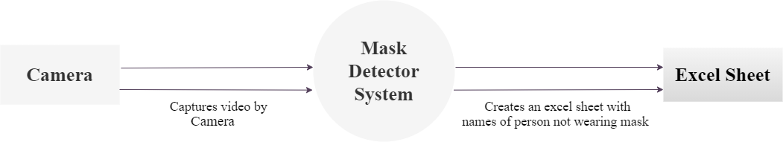
Diagram
0-level DFD

Slide 10
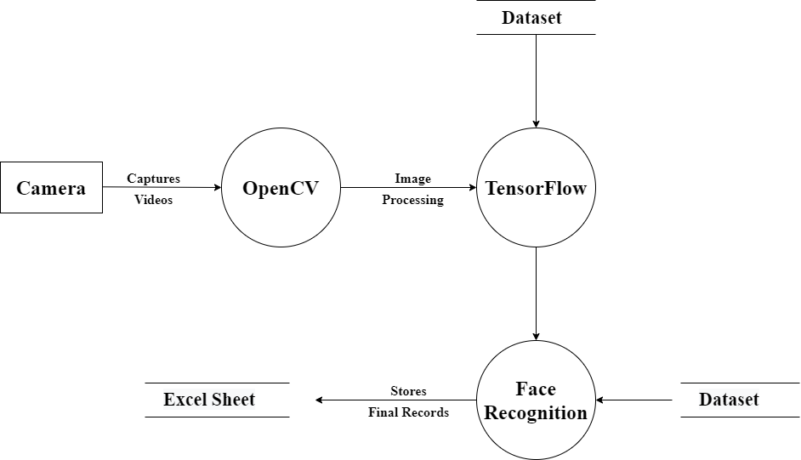
1-level DFD

Slide 11
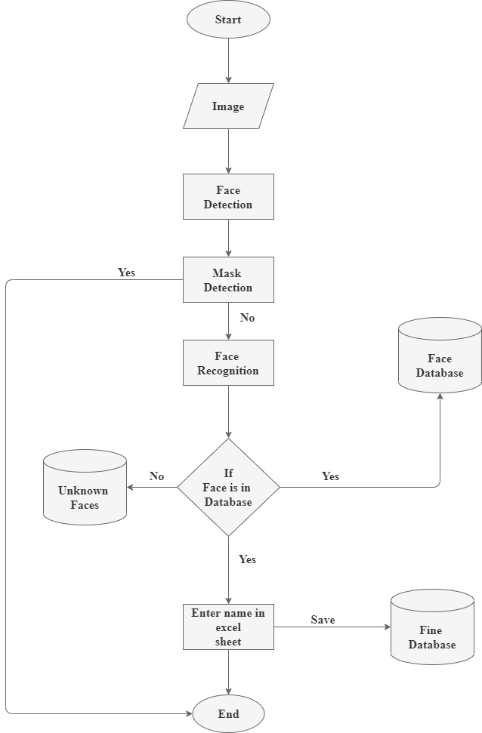
Flowchart

Slide 12
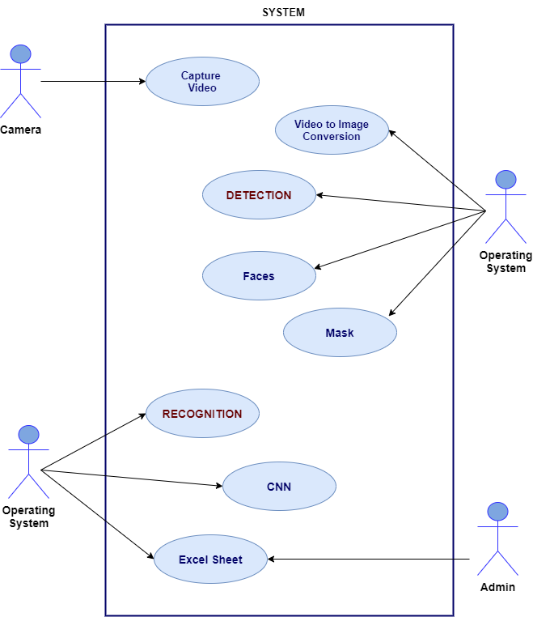
Use Case Diagram

Slide 13
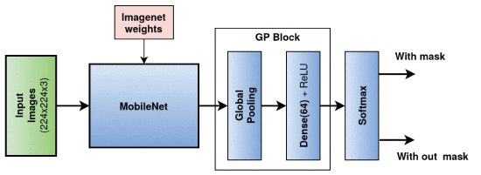
MobileNet CNN Architecture
Average
Pooling
Dense(128) + ReLU

Slide 14
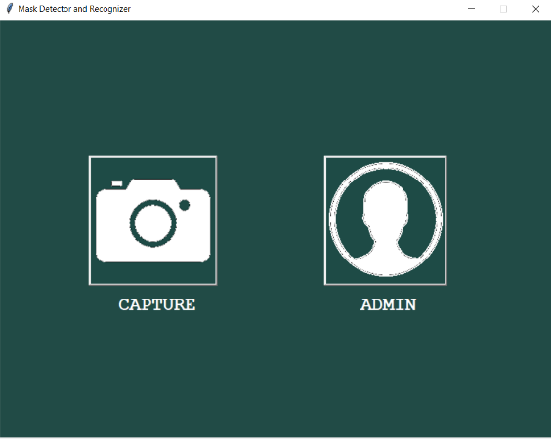
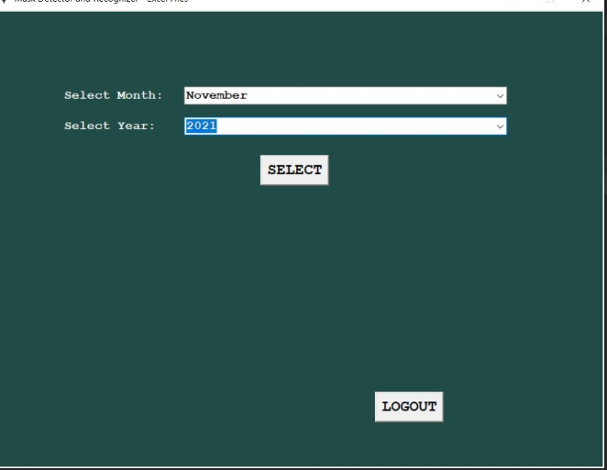
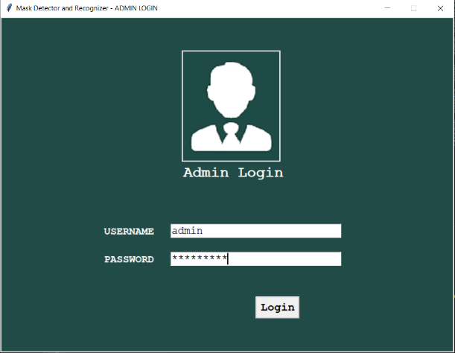
Implementation
Some Screen Shots of our work

Slide 15
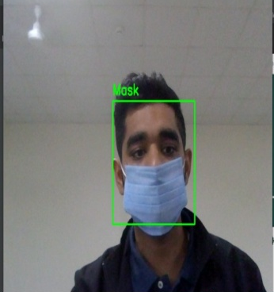
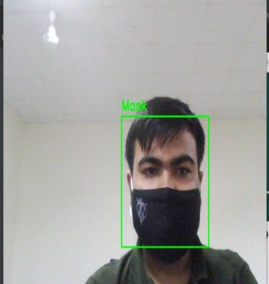
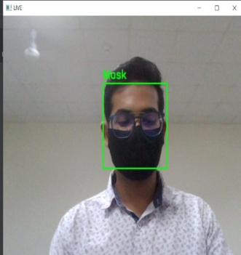
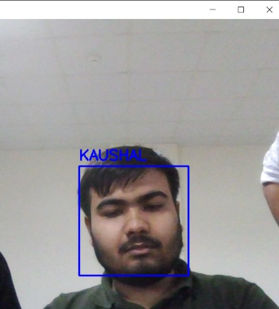
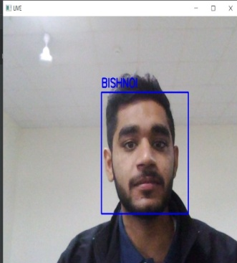
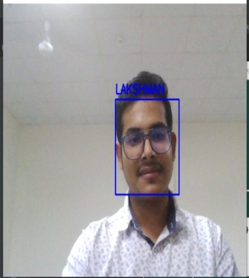
Implementation
Some Screen Shots of our work

Slide 16

Testing
Testing is the process of evaluation of a system to detect differences between given input and expected output and also to assess the feature of the system. Testing assesses the quality of the product. It is a process that is done during the development process.
The texting method used here is Black Box Testing. It is carried out to test functionality of the program. It is also called ‘Behavioral’ testing. The tester in this case, has a set of input values and respective desired results. On providing input, if the output matches with the desired results, the program is tested ‘ok’, and problematic otherwise.

Slide 17

Conclusion
and
Limitations
Conclusion
Mask Detection and Face recognition project is used to detect face masks and recognize faces without mask in the institution.
The recognized faces without masks will be noted into an excel sheet and will only be visible to admin.
Limitations
Working will be little slow because frameworks used need high-processing hardware & GPU.
If the face is not clearly visible, then it is difficult to recognize.
Admin has to manually add new face dataset.

Slide 18

THANK YOU

