Slide 1
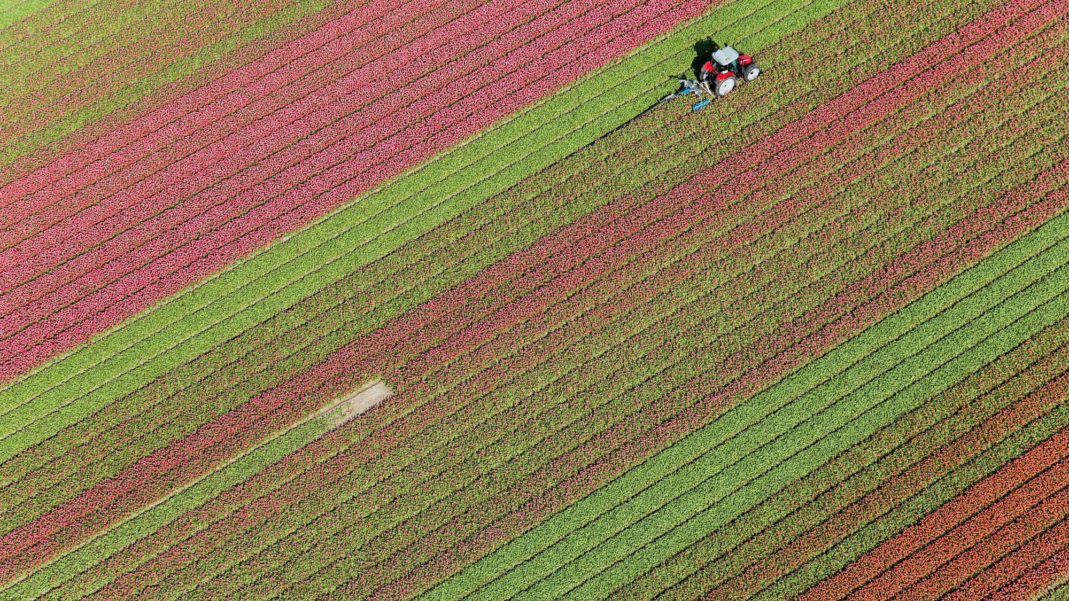
Optimizing Agriculture Production

Slide 2


DATA SCIENCE
Under guidance of
Dr. Revathi V
Team 14
Lakshman Parihar m (ENG19CS0152)
Kaushal Yadav (ENG19CS0139)
Krishna Kant Bishnoi (ENG19CS0147)

Slide 3


Agenda
Abstract
Introduction
Problem statement
Proposed methodology
Requirements
Factors helping to grow crops

Slide 4

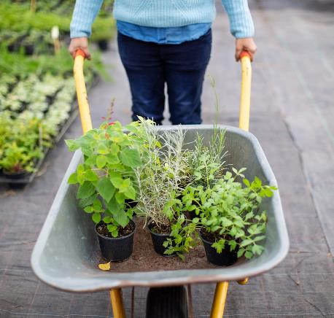
Abstract
As we all know that agriculture depends largely on the nature of soil and the climatic conditions and many a times, we face unpredictable changes in climate like, non-seasonal rainfall or heat waves or fluctuations in humidity levels, etc. and all such events cause a great loss to our farmers and farming, because of which they are not able to utilize their agricultural land to it's fullest. So to solve all such problems, we have build a Machine Learning Model by the virtue of which we can help farmers, optimize the agricultural production, because this predictive model will help them understand that for a particular soil & given climatic condition, which crop will be best suitable for the harvest.

Slide 5
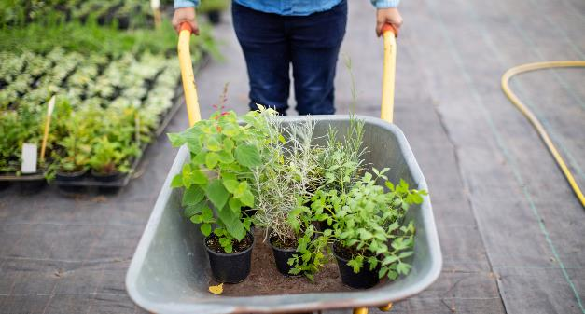
There are 7 key factors that we’ve taken into account which will help us in determining, exactly which crop should be grown and at what period of time, viz. Amount of Nitrogen, Phosphorus and Potassium in soil, Temperature in degree Celsius, Humidity, pH and Rainfall in mm.
Tools used: Python & Jupyter Notebook Libraries used: Numpy, Pandas, Seaborn, Matplotlib, ipywidgets and sklearn.
Machine Learning Algorithms used: Clustering Analysis and Logistic Regression.

Slide 6
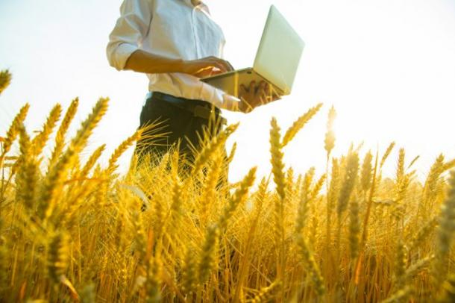
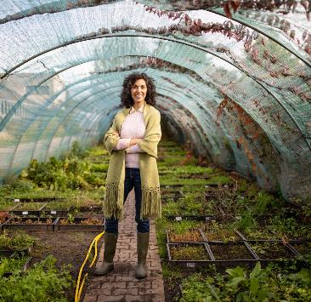
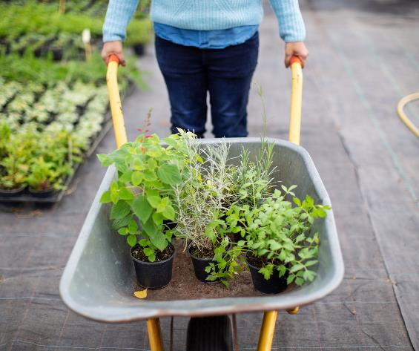
Introduction
Agriculture is the science and art of cultivating plants and livestock.
The history of agriculture began thousands of years ago.
Future agriculture will use sophisticated technologies such as robots, temperature and moisture sensors, aerial images, and GPS technology.
These advanced devices and precision agriculture and robotic systems will allow farms to be more profitable, efficient, safe, and environmentally friendly.

Slide 7
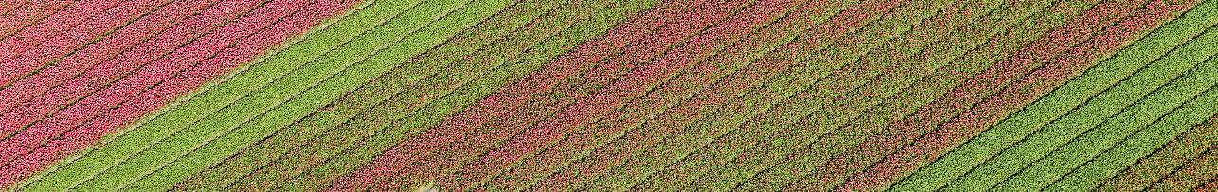
Problem Statement
Build a predictive model so as to suggest the most suitable crops to grow based on the available climate and soil conditions

Slide 8
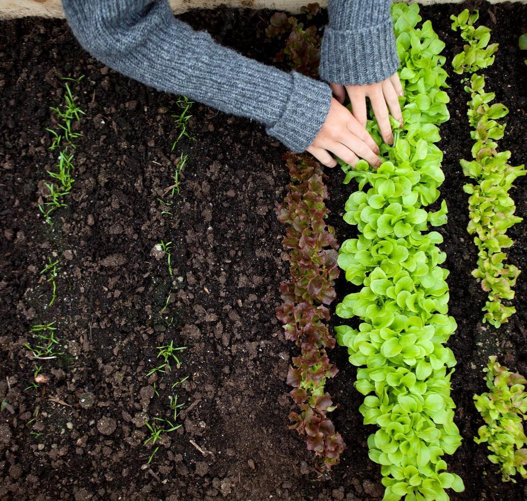
Proposed methodology
Analysing and finding the optimal climatic condition and essential nutrients to plant and grow crops.
Using Unsupervised learning technique, clustering the crops based on hidden pattern in it.
Predicting the classifications of crop using Popular supervised learning method.
Verifying the prediction result using metrics like Confusion matrix and classification report.
Finally, Finding the optimal requirements for particular crops to check the models accuracy.

Slide 9


hardware requirements
Any operating system (windows , MacOS etc)
minimum RAM --> 8GB
minimum CPU --> 4 cores-8 thread
SSD --> 512GB

Slide 10
Software requirements
programming languages --> Python
jupyter notebook

Slide 11
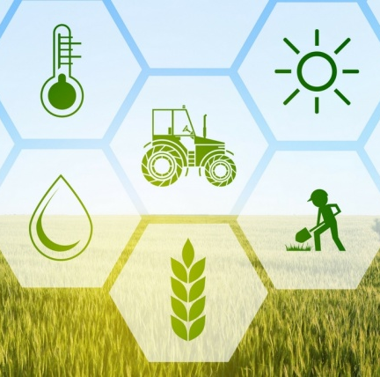

Factors helping to grow crops
N - ratio of Nitrogen content in soil
P - ratio of Phosphorous content in soil
K - ration of Potassium content in soil
Temperature - temperature in degree Celsius
Humidity - relative humidity in %
ph - ph value of the soil
Rainfall - rainfall in mm

Slide 12
Conclusion:
Traditionally, judgment based on experience has been the basis for planning in agriculture, but increased specialization and the adoption of capital intensive production systems have stimulated the development of more formal planning methods based on the construction and analysis of a mathematical model. Improving agricultural productivity is important in order to improve farmer incomes, and it requires increases in yield, better productivity through the efficient utilization of resources, reduction in crop losses, and ensuring that farmers receive fair prices for output, thus our model helps farmers to choose the right crop for certain climatic conditions

Slide 13

Business Implications of the Project
Finding optimal requirements to cultivate a crop will help us to get high yield and good profit with lesser effort.
By data analysis, we can get insights like,
  Optimal temperature for every crop.
  Optimal N, K, P level for every crop.
  Required rainfall for each crop.
  Required temperature and ph level for every crop.

Slide 14
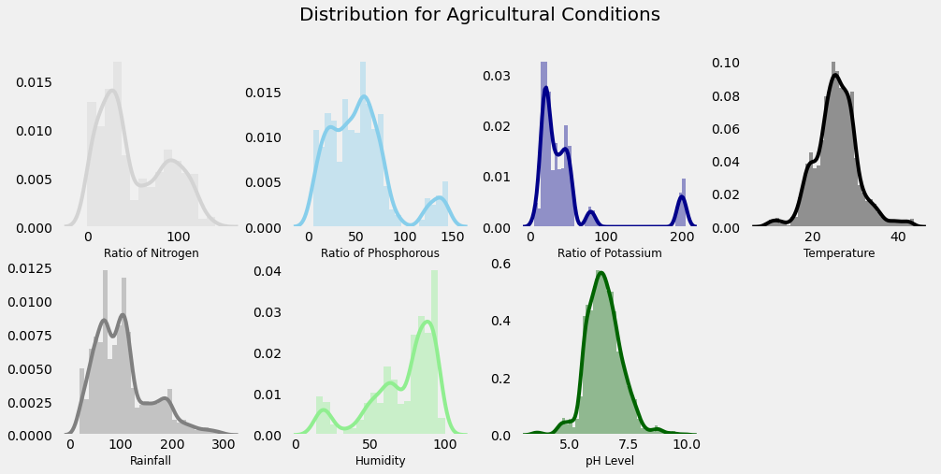
Data Analysis to find optimal requirments
Separately finding average requirements to cultivate all the crops.
Finding Min, Max, Avg value of each requirements which helps growing crops.
Finding which Summer, Winter, and Rainy crops and the required nutrients for each of them along with climatic condition.

Slide 15
Predictive Modelling Building
Initially splitting the dataset into inputs (x) and targets (y).
Splitting the dataset into Train and test set.
Using Logistic Regression to do the predictions of the Crops.
  It employs the use of the sigmoid function that can take any real-valued number and map it into a probability value between 0 and 1 to predict the output class.
  There are two types of logistic regression: Binary and Multinomial.
    Binary Logistic Regression deals with two categories whereas multinomial deals with three or more categories.

Slide 16
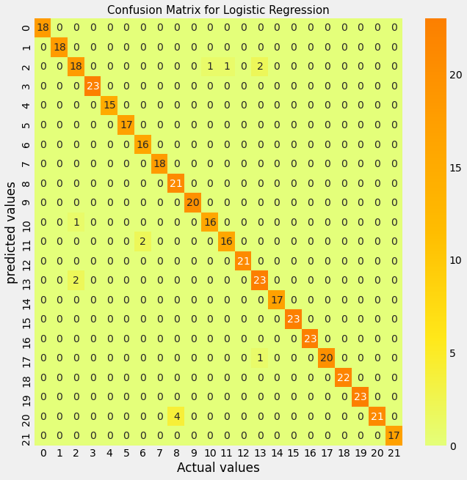
Prediction Result Analysis
Confusion Matrix
Through the Confusion Matrix we can see that the most of the predictions are correct.
By this we came to know that the selected Logistic Regression for the Prediction performed really Good.
16

Slide 17
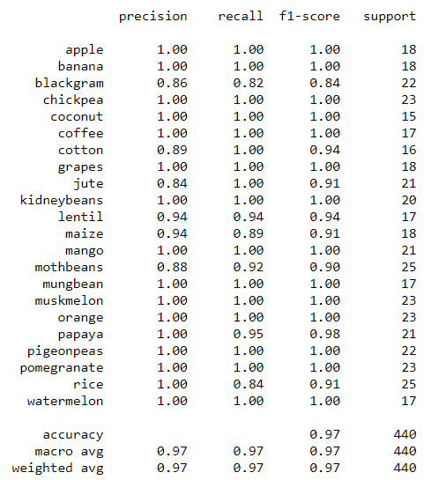
Prediction Result Analysis →
Classification Report
From the classification Report we can see that the used Logistic regression performed really well and we got the accuracy as 97%.
17

Slide 18
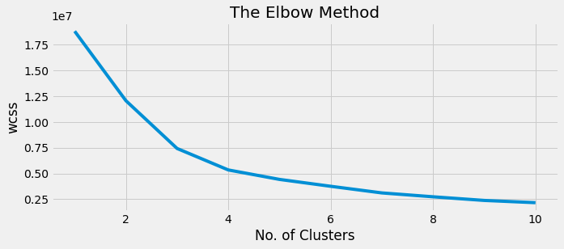
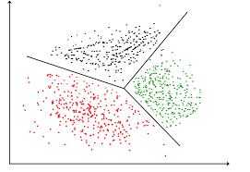
Clustering the similar Crops
Creating Clusters based on the input essential requirements using K-Means clustering algorithm.
Finding optimal cluster value using Elbow method
Determining the number of Clusters within the Dataset.
Based on the given conditions implementing Hard Clustering.

Slide 19


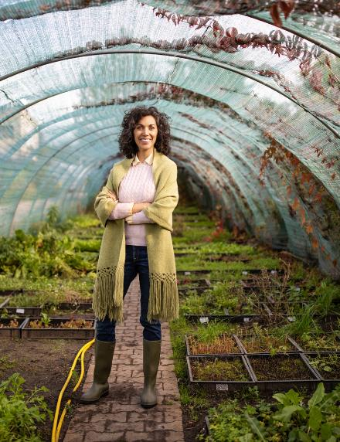
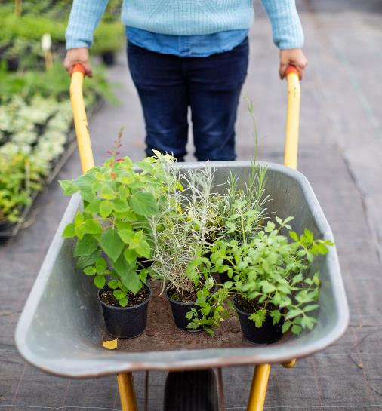

Thank You

