Slide 1
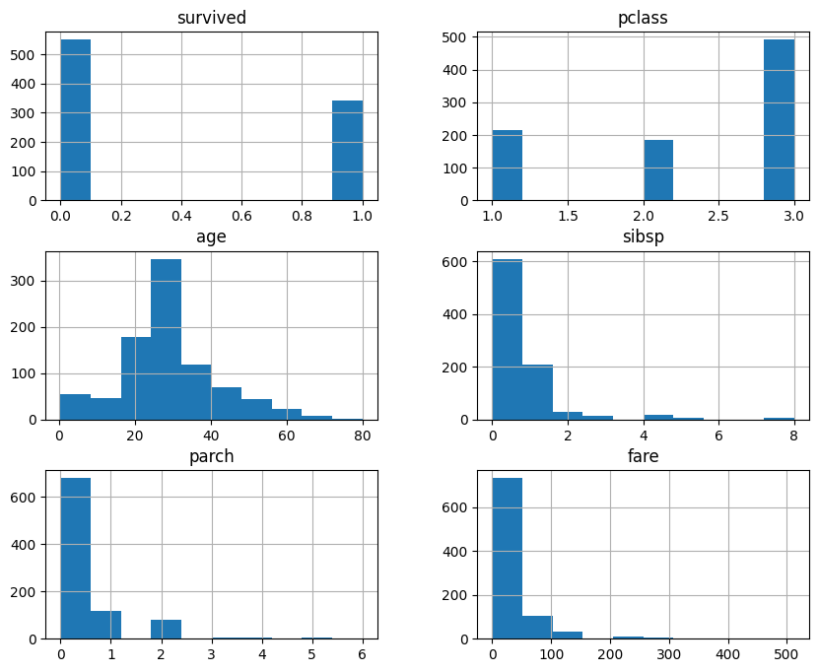
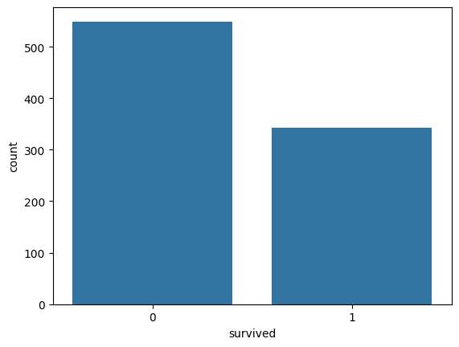
Titanic Dataset – Exploratory Data Analysis Dashboard

Slide 2
