Slide 1

Apache Lucene
Notes:
Originally developed by Doug Cutting

Slide 2
What is Lucene ?
A Powerful and popular Java Information Retrieval Library.
Makes it easy to add full-text search capability to an application or website.
Lucene is simply a search library, and you’ll need to handle the other components of a search application (crawling, document filtering, runtime server, user interface, administration, etc.) yourself as your application requires.
Notes:
mature, free, open-source project implemented in Java; it’s a project in the Apache Software Foundation, licensed under the liberal Apache
Software License.
Lucene is a software library, not a full-featured search application
While it’s written in Java, thanks to its popularity and the determination of zealous developers, there are now a number of ports or
integrations to other programming languages (C/C++, C#, Ruby, Perl, Python, PHP, etc.).
Under the hood there are sophisticated, state of the art Information Retrieval techniques quietly at work.
Lucene is an Information Retrieval library, not a ready-to-use standalone product, and that it most certainly does not contain a web
crawler, document filters or a search user interface.

Slide 3
Lucene Vs Data Bases
Lucene doesn’t care about the source of the data, its format, or even its language, as long as you can derive text from it.
Can index data stored in databases,
Gives full-text search capabilities that many databases don’t provide.
No notion of schema
Requires denormalized content during indexing.
Can’t have PK-FK relationships etc
Notes:
This means you can index and search data stored in files: web pages on remote web servers, documents stored in local file systems, simple text files, Microsoft Word documents, XML or HTML or PDF files, or any other format from which you can extract textual information.
you can index and search email messages, mailing-list archives, instant messenger chats, your Wiki pages …
XML can describe a recursive document structure by nesting tags
within one another. A database can have an arbitrary number of joins, via primary and secondary keys,
relating tables to one other.
Open source projects that build on Lucene, like Hibernate Search, Compass, LuSQL, DBSight,
Browse Engine and Oracle/Lucene integration each have different and interesting approaches for handling
this denormalization.

Slide 4
Steps Involved
Index Creation - Based on the documents added (Uses Inverted Index)
Search the index for the query
Lucene has its own mini-language for performing searches
The Lucene query language allows the user to specify which field(s) to search on, which fields to give more weight to (boosting), the ability to perform boolean queries (AND, OR, NOT) and other functionality.
Results are ranked by either the relevance to the query or by an arbitrary field such as a document's last modified date.
Notes:
indexing: processing the original data into a highly efficient cross-reference lookup in order to facilitate rapid searching

Slide 5
Open-Source Crawlers
Nutch has a high-scale crawler that’s suitable for discovering content by crawling Web sites.
Grub (http://www.grub.org), a popular open-source web crawler
Heritrix, the Internet Archive’s open-source crawler
Apache Droids project
Aperture (http://aperture.sourceforge.net) has support for crawling web sites, file systems and mail boxes and extracting and indexing text

Slide 6
Lucene Documents
Typically consists of several separately named fields with values, for example title, body, abstract, author, url, etc.
Run document filters to extract text from such content, before creating the search engine document.
Inject boosts to individual documents and fields that are deemed more or less important.
Note: Lucene does not provide any document filters, although Lucene has a sister project at Apache, Tika, which handles document filtering very well.
Notes:
Document unit is decided by the user.
Perhaps you’d like your press releases to come out ahead of all other documents, all things being equal? Perhaps recently modified documents are more important than
older documents? Boosting may be done statically (per document and field) at indexing time, or dynamically during searching

Slide 7
Stemmer, Spell checker & Highlighter
Users can design and customize the indexing process
Often a stemmer, such as Dr Martin Porter’s Snowball stemmer is used to derive roots from words (for example runs, running, run all map to “run”).
Spell Checking
Lucene has a spellchecker component
Providing dynamic excerpts (sometimes called summaries) with hit highlighting is also important
Lucene has a highlighter package, for producing dynamic summaries and highlighting hits.
Notes:
Lucene itself provides no facilities for scaleout. However, both Solr and Nutch and others, which build additional search engine functionality on top of Lucene

Slide 8
DOCUMENT ANALYSIS
converting raw text into terms
Terms => most fundamental indexed representation
Analyzer
Tokenizes text by performing any number of operations on it, which could include
extracting words
discarding punctuation
removing accents from characters
lowercasing (also called normalizing)
removing common words
reducing words to a root form (stemming) or
changing words into the basic form (lemmatization)
*Note:
Choosing the right analyzer is a crucial development decision with Lucene
Language is one factor, because each has its own unique features
Another factor to consider is the domain
Notes:
An analyzer is an encapsulation of the analysis process.
Terms are the primitive building blocks for searching.
different industries have different terminology,
acronyms, and abbreviations that may deserve attention. Although we present many of the considerations
for choosing analyzers, no single analyzer will suffice for all situations.

Slide 9
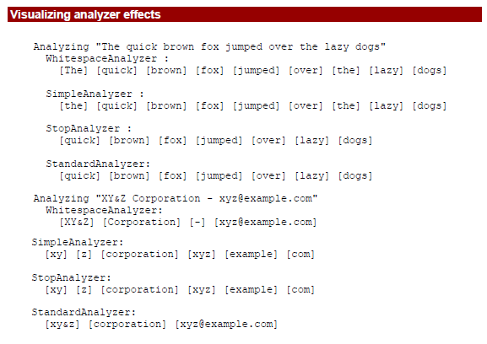
Visualizing Analyzer Effects
Notes:
WhitespaceAnalyzer, as the name implies, simply splits text into tokens on whitespace
characters and makes no other effort to normalize the tokens.
􀂃 SimpleAnalyzer first splits tokens at non-letter characters, then lowercases each token. Be
careful! This analyzer quietly discards numeric characters.
􀂃 StopAnalyzer is the same as SimpleAnalyzer, except it removes common words (called stop
words, described more in section XXX). By default it removes common words in the English
language (the, a, etc.), though you can pass in your own set.
􀂃 StandardAnalyzer is Lucene’s most sophisticated core analyzer. It has quite a bit of logic to
identify certain kinds of tokens, such as company names, email addresses, and host names. It also
lowercases each token and removes stop words.
StandardAnalyzer - Tokenizes based on a sophisticated grammar that recognizes e-mail
addresses, acronyms, Chinese-Japanese-Korean characters,
alphanumerics, and more; lowercases; and removes stop words
ENGLISH_STOP_WORDS = {
"a", "an", "and", "are", "as", "at", "be", "but", "by",
"for", "if", "in", "into", "is", "it", "no", "not", "of", "on", "or", "such",
"that", "the", "their", "then", "there", "these",
"they", "this", "to", "was", "will", "with"
};
Parsing versus analysis: when an analyzer isn’t appropriate

Slide 10
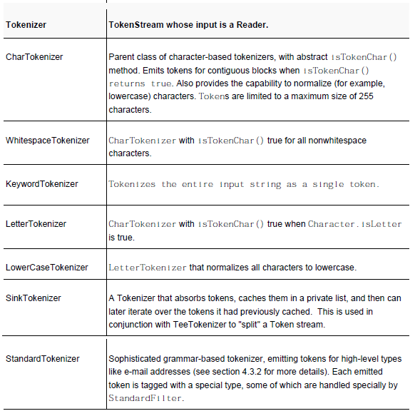
Analyzer building blocks provided in Lucene’s core API - Tokenizers
Notes:
Taking advantage of the TokenFilter chaining pattern, you can build complex analyzers from simple
Tokenizer/TokenFilter building blocks. Tokenizers start the analysis process by churning the
character input into tokens (mostly these correspond to words in the original text).

Slide 11
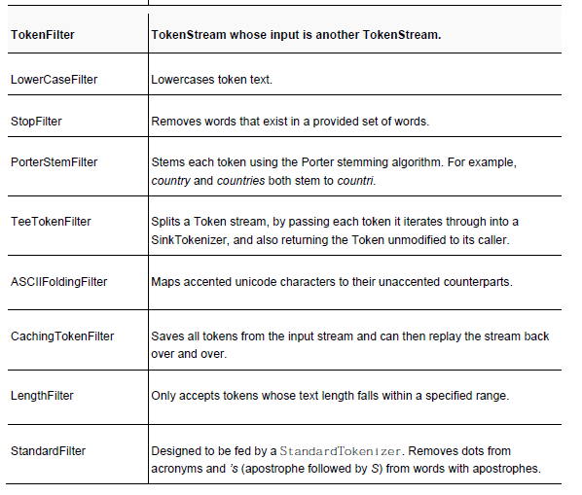
Analyzer building blocks provided in Lucene’s core API - TokenFilters
Notes:
TokenFilters then take over the remainder of the analysis, initially wrapping a Tokenizer and successively wrapping nested
TokenFilters.

Slide 12
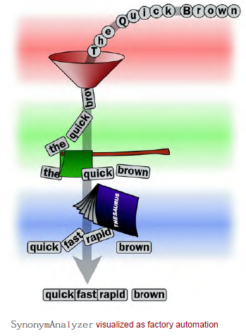
Handling Synonyms & aliases
Using SynonymAnalyzer

Slide 13
Stemming analysis
PorterStemFilter
Is not the built-in analyzer
Porter stemming algorithm created by Dr. Martin Porter
Various forms of a word are reduced to a common root form.
Ex: breathe, breathes, breathing and breathed => breath.
There are many stemming algorithms implemented in Lucene
Snowball algorithm (also created by Dr. Porter)
Kstem algorithm
Notes:
The Porter stemmer is one of many stemming algorithms.

Slide 14
Language analysis issues
Lucene supports analyzing text in various languages
Use language detection packages
Ensure character-set encoding is proper
There are options for mixing multiple languages in one index
Stop-word lists and stemming algorithms to be specific to the language of the text being analyzed.
Many language-specific analyzers, under contrib/analyzers dir.
These analyzers generally employ language-specific stemming and stop-word removal.
SnowballAnalyzer family of stemmers => supports many European languages
Asian languages, such as Chinese, Japanese, and Korean (also denoted as CJK), generally use ideograms rather than an alphabet to represent words.
built-in StandardAnalyzer recognizes some ranges of the Unicode space as CJK characters and tokenizes them individually
CJKAnalyzer and ChineseAnalyzer =>suitable for Asian language analysis and available in lucene sandbox
Notes:
Internally, Lucene stores all characters in the standard UTF-8 encoding.
Java language Internationalization tutorial - http://java.sun.com/docs/books/tutorial/i18n/intro/
Unicode Char set - http://www.joelonsoftware.com/articles/Unicode.html
only basic building-block support provided by Lucene
http://snowball.tartarus.org/texts/introduction.html

Slide 15
SEARCH QUERY
This is the process of consulting the search index and retrieving the documents matching the Query, sorted in the requested sort order.
Abstraction
Searching involves very complex inner workings of the search engine and Lucene abstracts under a surprisingly simple API.
Customization
Lucene is also wonderfully extensible at this point, so if you’d like to customize how results are gathered, filtered, sorted, etc

Slide 16
Data Models
Pure Boolean Model
Documents either match or do not match the provided query, and no scoring is done
No relevance scores associated with matching documents; a query simply identifies a subset of the overall corpus as matching the query.
Vector Space Model
Both queries and documents are modeled as vectors in a very high dimensional space, where each unique term is a dimension.
Relevance, or similarity, between a query and a document is computed by a vector distance measure between these vectors.
Lucene’s approach combines the vector space and pure Boolean models.
Notes:
Probabilistic Model
Computes the probability that a document is a good match to a query using a full probabilistic approach.

Slide 17
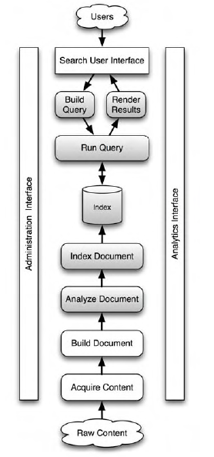
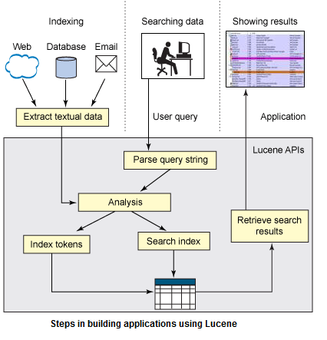
Searching Process
Notes:
other components are best covered by complementary
open-source software or by your own custom application logic.
Many open-source document filters exist, for deriving textual content from binary document types.

Slide 18
Core indexing classes
IndexWriter class => Central component of the indexing process.
This class creates a new index or opens an existing one, and then adds, removes or updates documents in the index.
Directory class => Represents the location of a Lucene index. It’s an abstract class that allows its subclasses to store the index as they see fit.
FSDirectory => holds data in file system
RAMDirectory => holds all its data in memory
Notes:
implementation is therefore useful for smaller indices that can be fully loaded in memory and can be
destroyed upon the termination of an application. Because all data is held in the fast-access memory and
not on a slower hard disk, RAMDirectory is suitable for situations where you need very quick access to
the index, whether during indexing or searching.

Slide 19
Core indexing classes
Analyzer class
specified in the IndexWriter constructor
Is in charge of extracting those tokens out of text that should be indexed, and eliminating the rest.
Analyzer is an abstract class, but Lucene comes with several implementations of it. Some of them deal
with skipping stop words
some deal with conversion of tokens to lowercase letters, so that searches aren’t case-sensitive; and so on.
Document class
represents a collection of fields
Each Document in an index contains one or more named fields, embodied in a class called Field.
Each field has a name and corresponding value.
Notes:
for each text file we find, we create a new instance of the Document class, populate it with Fields (described next), and add that Document to
the index, effectively indexing the file.
. A Document is simply a container for multiple Fields, which is the class that actually holds the textual content to be indexed.
Analyzer extracts tokens and related information, such as token frequency, from the text content.

Slide 20
SEARCHING
IndexSearcher => to searching what IndexWriter is to indexing.
central link to the index that exposes several search methods.
It offers a number of search methods
The simplest takes a Query object and an int topN count as parameters and returns a TopDocs object.
A typical use of this method looks like this:
TopDocs class => a simple container of pointers to the top N ranked search results
Records the int docID as well as the float score.
IndexSearcher searcher = new IndexSearcher("/tmp/index");
Query q = new TermQuery(new Term("contents", "lucene"));
TopDocs hits = searcher.search(q, 10);
searcher.close();
Notes:
You can think of IndexSearcher as a class that opens an index in a read-only mode.
Records the int docID (which you can use to retrieve the document)

Slide 21



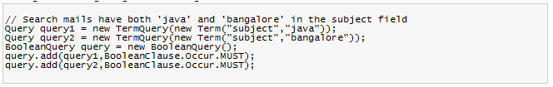
Query Types
TermQuery
RangeQuery
PrefixQuery
BooleanQuery
Notes:
Lucene comes with a number of concrete Query subclasses.
setBoost(float), which enables you to tell Lucene that certain sub-queriesshould have a stronger contribution to the final relevance than other sub-queries.
Range Query :
Terms are ordered lexicographically within the index, allowing for straightforward searching of terms
within a range.
In range query Square brackets denote an inclusive range, and curly brackets denote an exclusive range.

Slide 22
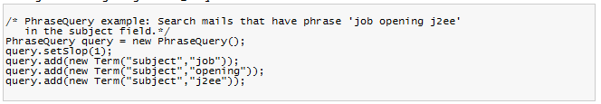
Query Types
PhraseQuery
WildCardQuery
FuzzyQuery
QueryParser
Notes:
An index by default contains positional information of terms, as long as you did not create pure Boolean
fields by indexing with the omitTermFreqAndPositions option (described in section 2.2.1).
PhraseQuery uses this information to locate documents where terms are within a certain distance of one
another.
Two standard wildcard characters are used: * for zero or more characters, and ? for zero or one character.

Slide 23
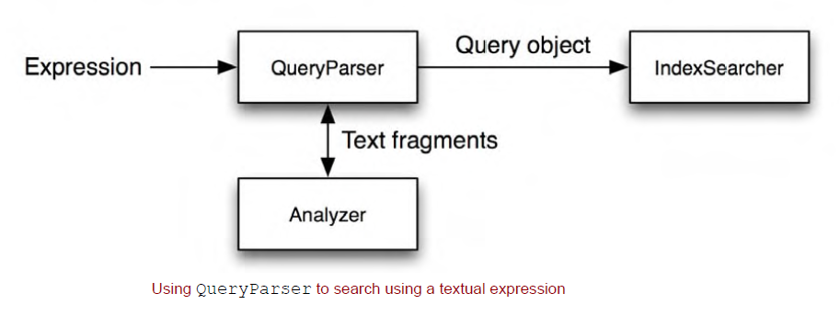
Using Query Parser
Notes:
QueryParser is useful for parsing human-entered query strings. You can use it to parse user-entered query expressions into a Lucene query object, which can be passed to IndexSearcher's search method. It can parse rich query expressions. QueryParser internally converts a human-entered query string into one of the concrete query subclasses. You need to escape special characters such as *, ? with a backslash (\). You can construct Boolean queries textually using the operators AND, OR, and NOT.

Slide 24
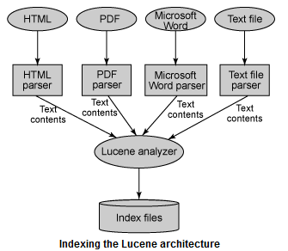
Lucene Indexing
Notes:
During indexing, the text is first extracted from the original content and used to create an instance of
Document, containing Field instances hold the content. The text in the fields is then analyzed, to
produce a stream of tokens. Finally, those tokens are added to the index in a segmented architecture.

Slide 25
Lucene Indexing
The combination of an original source of tokens followed by the series of filters that modify the tokens produced by that source, together make up the Analyzer.
Lucene stores the input in a data structure known as an inverted index.
Advantages of this data structure:
efficient use of disk space
quick keyword lookups
Notes:
You are also free to build up your own analyzer by chaining together Lucene’s token sources and filters, or your
own, in customized ways.
The analysis process produces a stream of tokens that are then written into the files
in the index.
This structure is optimized for providing quick answers to “which documents contain word X?”

Slide 26
Adding documents to an index
addDocument(Document)
adds the Document using the default analyzer, which you specified when creating the IndexWriter, for tokenization
addDocument(Document, Analyzer)
adds the Document using the provided analyzer for tokenization. But be careful! In order for searches to work correctly you need the analyzer used at search time to “match” the tokens produced by the analyzers at indexing time.

Slide 27
Remove documents from an index
deleteDocuments(Term)
deletes all documents containing the provided term
deleteDocuments(Term[])
deletes all documents containing any of the terms in the provided array
deleteDocuments(Query)
deletes all documents matching the provided query
deleteDocuments(Query[])
deletes all documents matching any of the queries in the providedarray
Notes:
the deletes are not done immediately. Instead, they are buffered in memory, just like the added documents, and periodically flushed to disk.

Slide 28
Updating documents in the index
ETag HTTP header
Can be used to detect changes to web documents crawled from a web server
updateDocument(Term, Document)
first deletes all documents containing the provided term and then adds the new document using the writer’s default analyzer.
updateDocument(Term, Document, Analyzer)
does the same, but uses the provided analyzer instead of the writer’s default analyzer.
Notes:
An ETag, or entity tag, is part of HTTP, the protocol for the World Wide Web. It is one of several mechanisms that HTTP provides for web cache validation, and which allows a client to make conditional requests. This allows caches to be more efficient, and saves bandwidth, as a web server does not need to send a full response if the content has not changed.

Slide 29
Field Options
Indexing
Index.ANALYZED
Index.NOT_ANALYZED
Term vectors
To Find similar documents
Terms + frequency information is stored in a document
Notes:
When Lucene builds the inverted index, by default it stores all necessary information to implement the
Vector Space model. This model requires the count of every term that occurred in the document, as well
as the positions of each occurrence (needed for phrase searches).
Field.setOmitTermFreqAndPositions(true)
Store.NO – do not store the value. This is often used along with Index.ANALYZED to index a
large text field that doesn’t need to be retrieved in its original form.

Slide 30
Term vectors
TermVector.YES
To record the unique terms that occurred, and their counts, in each document, but do not store any positions or offsets information.
TermVector.WITH_POSITIONS
To record the unique terms and their counts, and also the positions of each occurrence of every term, but no offsets.
TermVector.WITH_OFFSETS
To record the unique terms and their counts, with the offsets (start & end character position) of each occurrence of every term, but no positions.
TermVector.WITH_POSITIONS_OFFSETS
To store unique terms and their counts, along with positions and offsets.
TermVector.NO
Do not store any term vector information.
Notes:
4th argument to the Field constructor:

Slide 31
Compression
Lucene includes a helpful utility class, CompressionTools, that can compress and decompress byte arrays.
Supports Variable Byte Enconding
Note:
While this will save space in your index, depending on how compressible the content is, it will slow down indexing and searching.
If the field values are small, compression is rarely worthwhile.
Notes:
Under the hood it simply uses Java’s builtin java.util.Zip classes. You can use this to
compress values before storing them in Lucene.

Slide 32
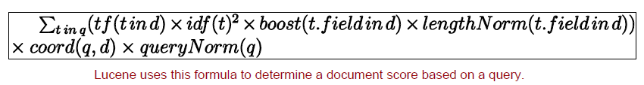
Understanding Lucene Scoring
How Lucene scores document matches to a query?
Similarity scoring formula
measure the similarity between a query and each document that matches the query.
The score is computed for each document (d) matching each term (t) in a query (q).
This score is the raw score, which is a floating-point number >= 0.0.
Notes:
Typically, if an application
presents the score to the end user, it’s best to first normalize the scores by dividing all scores by the
maximum score for the query. The larger the similarity score, the better the match of the document to
the query. By default Lucene returns documents reverse-sorted by this score, meaning the top
documents are the best matching ones.

Slide 33
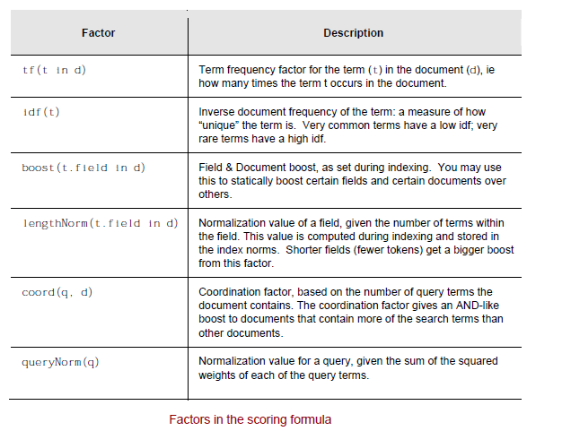
Factors in the Scoring Formula
Notes:
The default value of field boosts, logically, is 1.0. During indexing, a Document can be assigned a boost, too.
queryNorm factor => Queries themselves can have an impact on the document score. Boosting
a Query instance is sensible only in a multiple-clause query; if only a single term is used for searching,
boosting it would boost all matched documents equally. In a multiple-clause boolean query, some
documents may match one clause but not another, enabling the boost factor to discriminate between
matching documents. Queries also default to a 1.0 boost factor.
Most of these scoring formula factors are controlled and implemented as a subclass of the abstract
Similarity class.

Slide 34

Working of phrase queries
An index by default contains positional information of terms
omitTermFreqAndPositions option can be used to turn it off
Phrase Query Scoring
Phrase queries are scored based on the edit distance needed to match the phrase.
More exact matches count for more weight than sloppier ones.
Notes:
PhraseQuery uses this information to locate documents where terms are within a certain distance of one
another.
The inverse
relationship with distance ensures that greater distances have lower scores.

Slide 35

Working of Fuzzy queries
Matches terms similar to a specified term
The Levenshtein distance algorithm (also known as edit distance algorithm) determines how similar terms in the index are to a specified target term
It measures similarity between two strings, where distance is measured as the number of character deletions, insertions, or substitutions required to transform one string to the other string.
Notes:
http://en.wikipedia.org/wiki/Levenshtein_Distance

Slide 36
“Sounds like” querying
Using MetaphoneReplacementAnalyzer
An analyzer to convert words to a phonetic root using an implementation of the Metaphone algorithm from the Jakarta Commons Codec project.
There are algorithms available such as Soundex.
Also can find and display two phrases that sound similar yet are spelled completely differently.
In practice, it’s unlikely you’ll want sounds-like matches except in special places; otherwise, far too many undesired matches may be returned.
sounds-like feature would be great for situations where a user misspelled every word and no documents were found, but alternative words could be suggested.

Slide 37
Filtering a search
Mechanism of narrowing the search space, allowing only a subset of the documents to be considered as possible hits.
search-within-search features => search within a previous set of results
There are several built-in Filter implementations:
PrefixFilter => matches only documents containing terms in a specific field with a specific prefix.
RangeFilter => matches only documents containing terms within a specified range of terms.
FieldCacheTermsFilter => matches documents containing specific terms.
QueryWrapperFilter => uses the results of query as the searchable document space for a new query.
CachingWrapperFilter => a decorator over another filter, caching its results to increase performance when used again.
Security filters => constrains documents with security in mind
ChainedFilter => Found in Lucene sandbox, allows for complex chaining of filters
Notes:
Users can write their own custom filters. Writing custom filters allows external data to factor into search constraints.

Slide 38
Custom scoring using function queries
Users can override the lucene’s default scoring function
package org.apache.lucene.search.function allows the user to programmatically customize how each document is scored.

Slide 39
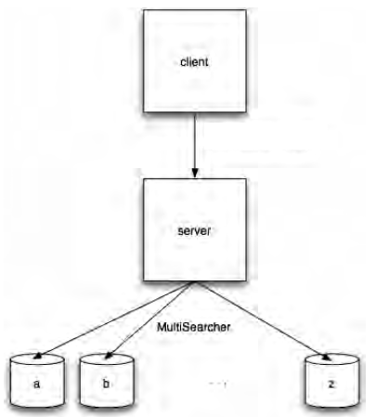
Searching across multiple Lucene indexes
MultiSearcher class
In high-volume usage of Lucene, search architecture may partition sets of documents into different indexes
need to search across them using a single query with search results interleaving documents from different indexes
ParallelMultiSearcher class
Used for multithreaded searching
Spins a new thread for each Searchable and waits for them all to finish, when the search method is invoked
Notes:
With MultiSearcher, all indexes can be searched with the results merged in a specified (or descendingscore)
Order
Using MultiSearcher is comparable to using IndexSearcher, except that you hand it an
array of IndexSearchers to search rather than a single directory
performance gains using ParallelMultiSearcher greatly depends on your
architecture.

Slide 40
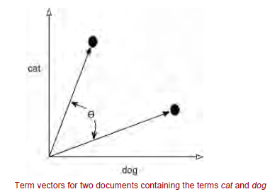

Cosine Scoring
A term vector is a collection of term-frequency pairs
Query can also be represented as vector
Angle gives how close two vectors (documents) are.
This technique can also be used for recommendations.
Notes:
Retrieving term vectors for a field in a given document by ID requires a call to an IndexReader method:
TermFreqVector termFreqVector = reader.getTermFreqVector(id, "subject");

Slide 41
Extracting document text with Tika
Tika
A package to extract text from the documents to be indexed
Was added to the Lucene umbrella in October 2008
http://lucene.apache.org/tika
Relies on external open-source projects and libraries
Alternatives:
Aperture open-source project
Supports wide variety of document formats and is able to extract text content and metadata
Aperture also provides crawling support (Tika doesn’t)
Stellent’s filters (now part of Oracle)
KeyView filters (now part of Autonomy)
Notes:
If you are unlucky, you must instead accept the surprisingly wide plethora of document formats that are popular today such as Outlook, Word,
Excel, PowerPoint, Visio, Flash, PDF, Open Office, RTF, HTML and even archive file formats like Tar and Zip.
Aperture - hosted by SourceForge at http://aperture.sourceforge.net
there are numerous individual open-source parsers out there for handling document types. It’s entirely
possible your document type already has a good open-source parser that simply hasn’t yet been integrated with
Tika.

Slide 42
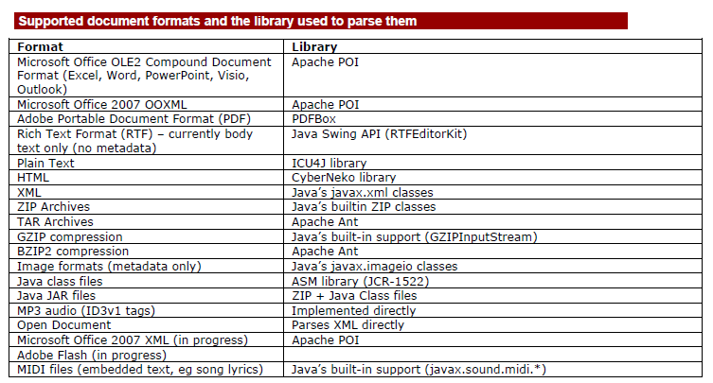
Document formats supported by Tika

Slide 43
Highlighting query terms
Giving end users some context around hits from their searches is friendly and, more important, useful.
Often a brief glimpse of the surrounding context of the search terms is enough to know if that result is worth investigating further
dynamic fragmenting
picking a few choice sentences out of a large text that best match the search query
Static abstract or summary
summary for each document
gives a worse user experience because it’s static
Lucene’s highlighter package helps to achieve this.

Slide 44
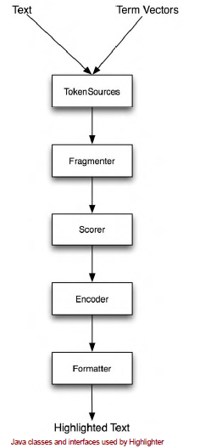
HighLighter Components

Slide 45
Spell correction
Spellchecker package tackles it
Part of lucene sandbox
Works with one term at a time
Identify potential suggestions, find out score of each potential suggestion to decide whether they should be presented to the user
Need a dictionary of terms
Hard to find such dictionaries that will exactly match your search domain
Solution : Derive dictionary from search index
Notes:
You will need a source dictionary of “valid” words.
Hard to find such dictionaries that will exactly match your search domain and it’s even harder to keep such a dictionary current over time.
A more powerful means of deriving a dictionary is to
use your search index to gather all unique terms seen during indexing from a particular field.
This is the approach used by spellchecker.

Slide 46
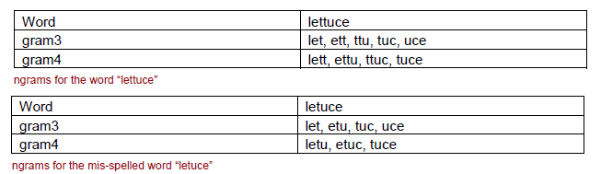
Spell correction
Enumerating suggestions
phonetic approach, such as the “sounds like” matching
Another approach, which is the one used by spellchecker, is to use letter ngrams to identify similar words.
spellchecker module handles all this ngram processing
Notes:
Using this approach, the ngrams for all words in the dictionary are indexed into a separate spellchecker index.
Since many of the ngrams are shared (“let”, “tuc”, “uce” and “tuce”) the correct word “lettuce” will be returned with a high relevance score

Slide 47
Synonyms from WordNet
WordNet
A system developed at Princeton University’s Cognitive Science Laboratory, driven by Psychology Professor George Miller, illustrates the net of synonyms
Represents word forms that are interchangeable, both lexically and semantically
Lucene sandbox has wordnet package (org.apache.lucene.wordnet.*)
WordNet synonym database can be churned into a Lucene index
This allows for rapid synonym lookup—for example, for synonym injection during indexing or querying
Notes:
Google’s define feature (type define: word as a Google search, and see for yourself) often refers users to the online WordNet
system, allowing you to navigate word interconnections
Download and expand the the Prolog version of WordNet, currently distributed as the file
WNprolog-3.0.tar.gz from the WordNet site at http://www.cogsci.princeton.edu/~wn.
The custom SynonymAnalyzer can easily hook into WordNet synonyms using the SynonymEngine interface

Slide 48
Spatial Lucene
local search
Local search is the use of specialized search techniques that allow users to submit geographically constrained searches against a structured database of local business listings
Lucene now contains a sandbox package to enable local search, called spatial lucene
Example: If you need to find 'shoe stores' that exist within 10 miles of location X, then spatial lucene will do that.
Notes:
While by no means a full GIS (geographical information system) solution, spatial lucene supports these
functions:
􀂃 Radial based searching, for example "show me only restaurants within 2 miles from a specified
location". This defines a filter covering a circular area.
􀂃 Sorting by distance, so locations closer to a specified origin are sorted first.
􀂃 Boosting by distance, so locations closer to a specified origin receive a larger boost.

Slide 49
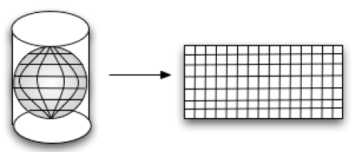
Indexing Spatial Data
To use spatial lucene, locations in the documents must be geo-coded.
“13 Massachusetts Ave" or “the Louvre” must be translated into its corresponding latitude and longitude.
Some methods for geo-coding are described at http://www.gissearch.com/geocode.
Reference: IBM Developer works article “Location-aware search with Apache Lucene and Solr”.
Notes:
There are two common projections. The first is the sinusoidal projection
(http://en.wikipedia.org/wiki/Sinusoidal_projection), which keeps an even spacing of the projection.
However, it will cause a distortion of the image, giving it a "pinched" look. The second projection is the
Mercator projection (http://en.wikipedia.org/wiki/Mercator_projection), used because it gives a regular
rectangular view of the globe.

Slide 50
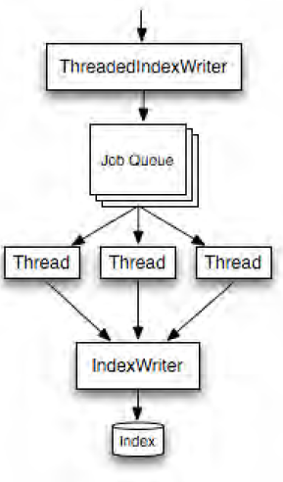
Improving performance
Use threads for indexing
Use threads for searching
Disk Space Usage
An index with only a single pure indexed, typical text field will be about 1/3rd of the total size of the original text.
an index that has stored fields and term vectors with offsets and positions, with numerous deleted documents plus an open reader on the index, with an optimize running, can easily consume 10X the total size of the original text!

Slide 51
Using Lucene from other programming languages
Solr
client/server architecture exposing access from many programming languages.
Translates Lucene’s Java-only API into a very friendly network protocol, it’s very easy to create clients in different programming languages that then speak this network protocol
SolRuby, SolPHP, SolPython , SolPerl, SolJSON, SolrJS, SolForrest, SolrSharp, Solrnet, SolColdFusion
Lucene.Net - Lucene.Net is a native port of Lucene to C#.
Clucene (C++) - is Ben van Klinken’s open-source port of Lucene to C++
Lucy
PyLucene (Python)
Ferret (Ruby)
Zend Framework - full open-source object-oriented web application framework, implemented entirely in PHP 5.
PHP Bridge - he PHP runtime can invoke methods on Java classes through the PHP Bridge.
Refer to http://wiki.apache.org/lucene-java/LuceneImplementations
Notes:
Today, Lucene is the de facto standard open-source IR library. Although Java is certainly a very popular
programming language, not everyone uses it. Many people prefer dynamic languages (Python, Ruby, Perl, PHP,
etc.).

Slide 52
Testing and Benchmarking
Set up a simple repeatable test that allows you to measure the specific metrics you want to improve
The test should accurately reflect your application
Can use the framework in contrib/benchmark
An excellent tool for creating and running repeatable performance tests
Has support for multiple runs of each test, changing Lucene configuration parameters, measuring metrics, and printing summary reports of the full test run.

Slide 53
Evaluating search quality
Using precision and Recall
Precision measures what subset of the documents returned for each query were relevant.
Recall measures what percentage of the relevant documents for that query was actually returned.
Recent additions to the benchmark framework, under the quality package, allows to measure recall and precision.
set of queries, where each query lists the documents that are relevant to it.
Binary: a given document from the index is either relevant or not
Notes:
Based on TREC corpus http://trec.nist.gov/data/docs_eng.html

Slide 54
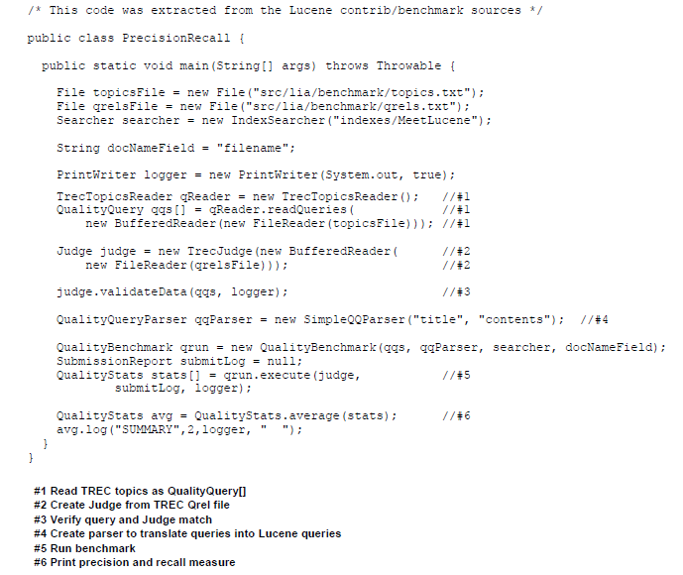
Sample code
Notes:
QualityBenchmark tests the queries by running them against
a provided IndexSearcher. It returns and array of QualityStats, one each for each of the queries
QualityStats.average method computes and reports precision and recall

Slide 55
References
http://www.wikivs.com/wiki/Lucene_vs_Sphinx
http://nicholaschase.com/2010/09/25/comparing-the-apache-solr-and-sphinx-search-platforms/
http://sphinxsearch.com/docs/2.0.4/
http://www.lucenetutorial.com/lucene-in-5-minutes.html
http://www.lucenetutorial.com/lucene-query-syntax.html
http://www.lucenetutorial.com/basic-concepts.html
http://www.ibm.com/developerworks/opensource/library/os-apache-lucenesearch/index.html
http://www.ibm.com/developerworks/opensource/library/wa-lucene/index.html
Manning Lucene in Action, 2nd Edition

