Slide 1
SENTIMENTAL Analysis
CAPSTONE PROJECT
Presented By:
Kesavarapu Lakshman
Aditya College of Engineering
ECE

Slide 2
OUTLINE
Problem Statement
Proposed System/Solution
System Development Approach (Technology Used)
Algorithm & Deployment
Result
Conclusion
Future Scope
References

Slide 3
Problem Statement
Example: With the rapid growth of online platforms for sharing opinions and reviews, restaurants often rely on the customer feedback to improve their services and attract a new customers.
Analyzing the sentiment of these reviews can provide valuable insights into customer satisfaction.

Slide 4
Proposed Solution
The proposed system aims to address the challenge of predicting the positive and negative review of restaurant customers. This involves leveraging data analytics and machine learning techniques to forecast demand patterns accurately. The solution will consist of the following components:
Data Collection:
Gather historical data on customer reviews of restaurant, including time, date, location, and other relevant factors.
Data Preprocessing:
Clean and preprocess the collected data to handle missing values, outliers, and inconsistencies.
Machine Learning Algorithm:
Implement a machine learning algorithm, such as a time-series forecasting model (e.g., ARIMA, SARIMA, or LSTM), to predict Sentimental Analysis on customer reviews based on historical patterns.
Deployment:
Develop a user-friendly interface or application that provides real-time predictions for Sentimental Analysis on customer reviews.
Deploy the solution on a scalable and reliable platform, considering factors like server infrastructure, response time, and user accessibility.
Evaluation:
Assess the model's performance using appropriate metrics such as Mean Absolute Error (MAE), Root Mean Squared Error (RMSE), or other relevant metrics.
Fine-tune the model based on feedback and continuous monitoring of prediction accuracy.

Slide 5
System Approach
1. System Requirements
Hardware Requirements
Processor: Intel i5 or above
RAM: 8GB or more
Storage: SSD with at least 20GB free space
Software Requirements
Operating System: Windows 10, macOS, or Linux
Python Environment: Python 3.7 or above
IDE: Jupyter Notebook, VSCode, or PyCharm

Slide 6
System Requirements
2. Libraries Required to Build the Model
Data Manipulation
Pandas: For handling and processing the dataset
NumPy: For numerical computations
Visualization
Matplotlib: For plotting graphs and charts
Seaborn: For advanced visualization
Contractions: For expanding contractions in text
Emoji: For handling emojis in text
Model Building
scikit-learn: For machine learning algorithms and tools
TfidfVectorizer: For converting text data into TF-IDF feature vectors
MultinomialNB: For the Naive Bayes classifier
train_test_split: For splitting the dataset into training and testing sets
accuracy_score and classification_report: For evaluating the model's performance

Slide 7
System Requirements
2. Libraries Required to Build the Model
Text Preprocessing
nltk: For natural language processing tasks like tokenization, stemming, lemmatization, and stop word removal
BeautifulSoup: For cleaning HTML tags from the reviews
contractions: For expanding contractions in text
emoji: For handling emojis in text

Slide 8
Algorithm & Deployment
Algorithm Selection:
The chosen algorithm for sentiment analysis is the Multinomial Naive Bayes classifier. This algorithm is suitable for text classification tasks like sentiment analysis due to its simplicity, efficiency with high-dimensional data (like TF-IDF vectors), and ability to handle multi-class classification tasks.
Data Input:
Cleaned and preprocessed text reviews from the dataset.
Converted into TF-IDF (Term Frequency-Inverse Document Frequency) vectors using “TfidfVectorizer”
Training Process:
Training Data:
The dataset is split into training and testing sets using `train_test_split`.
The `TfidfVectorizer` converts the textual data into numerical features (TF-IDF vectors).
The Multinomial Naive Bayes model (`MultinomialNB`) is trained on the TF-IDF vectors and corresponding sentiment labels (`Liked` column in the dataset).

Slide 9
Algorithm & Deployment
Training Process:
Techniques Employed:
Cross-Validation: Although not explicitly shown in the provided code, cross-validation can be used to evaluate model performance and tune hyperparameters if necessary.
Hyperparameter Tuning: Adjusting parameters such as alpha (smoothing parameter) in `MultinomialNB` to optimize model performance.
Prediction Process:
Prediction Data:
New reviews or unseen data are preprocessed using the same preprocessing steps (lowercasing, punctuation removal, stop words removal, etc.) and converted into TF-IDF vectors using the pre-fitted `TfidfVectorizer`.
Real-time Data Inputs:
During the prediction phase, real-time reviews can be preprocessed and fed into the trained model to predict their sentiment (positive or negative).

Slide 10
Result
Model Performance Metrics
Accuracy: 80%
Classification Report
 | Precision | Recall | F1-score | Support
Negative | 0.76 | 0.85 | 0.80 | 96
Positive | 0.85 | 0.75 | 0.80 | 104
Accuracy | -- | -- | 0.80 | 200
Macro avg | 0.80 | 0.80 | 0.80 | 200
Weighted avg | 0.81 | 0.80 | 0.80 | 200

Slide 11
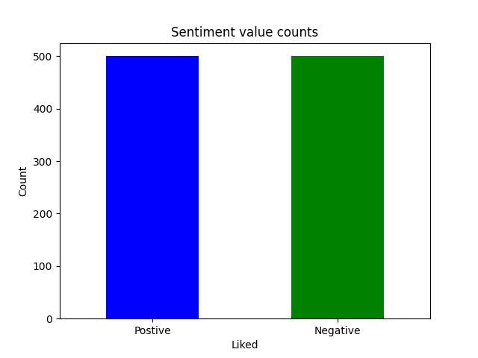
Result
Sentimental Value Count:

Slide 12
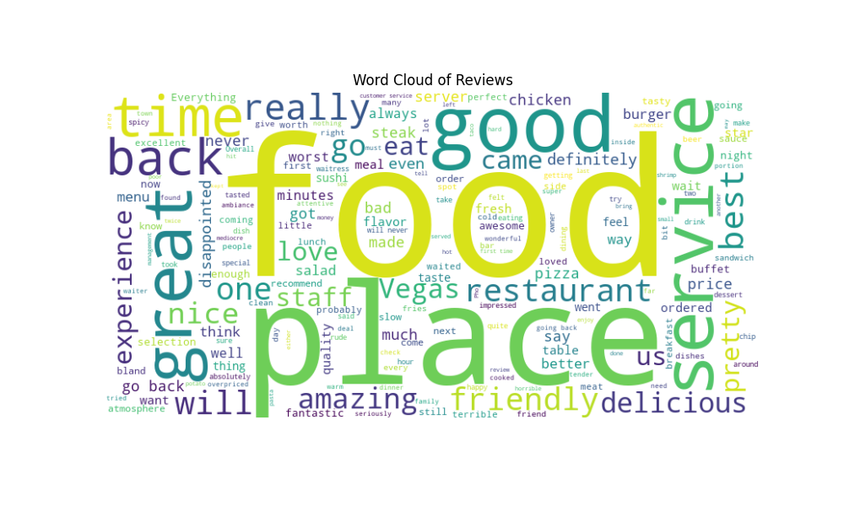
Result
Word Cloud of Review:

Slide 13
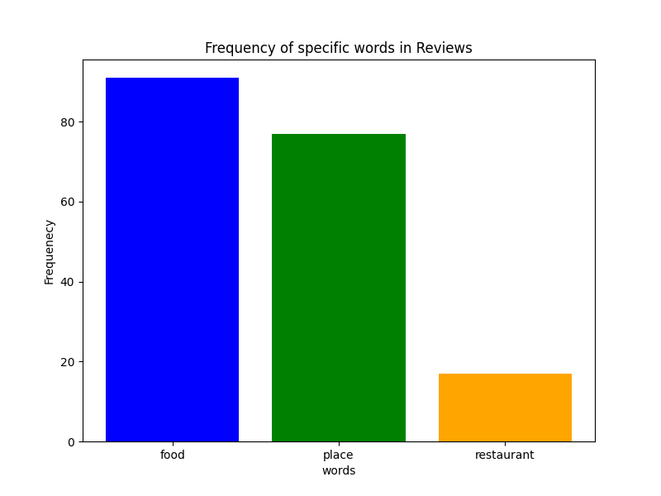
Result
Frequency of specific words in Reviews:

Slide 14
Result
Sample Inputs/Outputs:
Positive Review:
Negative Review:

Slide 15
Conclusion
The sentiment analysis model developed in this project effectively classifies restaurant reviews as positive or negative, providing valuable insights into customer satisfaction. Through comprehensive data preprocessing, visualization, and model evaluation, the project demonstrates a robust approach to understanding and leveraging customer feedback for service improvement.
Model Performance:
Achieved an accuracy of around 80%.
Balanced precision, recall, and F1-scores for both positive and negative reviews.
Effectiveness:
Accurately classifies positive and negative reviews.
Provides real-time analysis for immediate insights.
Helps restaurants improve customer satisfaction by understanding feedback.

Slide 16
Future scope
Multi-language Support: Extend the model to handle reviews in multiple languages.
Advanced Algorithms: Experiment with deep learning models like LSTM and BERT for improved accuracy.
Data Expansion: Use larger, more varied datasets from multiple review sites.
Real-Time Analysis: Create a system to monitor and analyze reviews as they come in.

Slide 17
References
ChatGPT
Stack Overflow
Gemini
YouTube
Quora

Slide 18
THANK YOU

