Slide 1
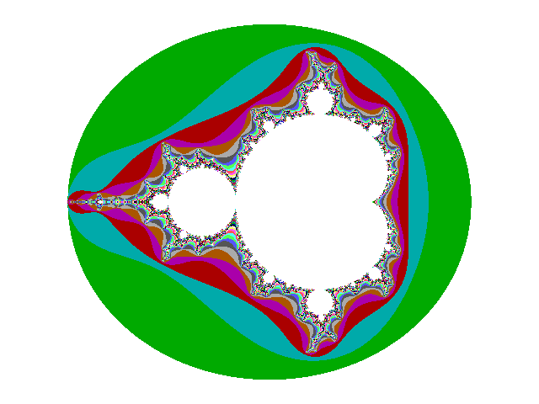
Fractals
10-18 Fractal Geometry Methods

Slide 2
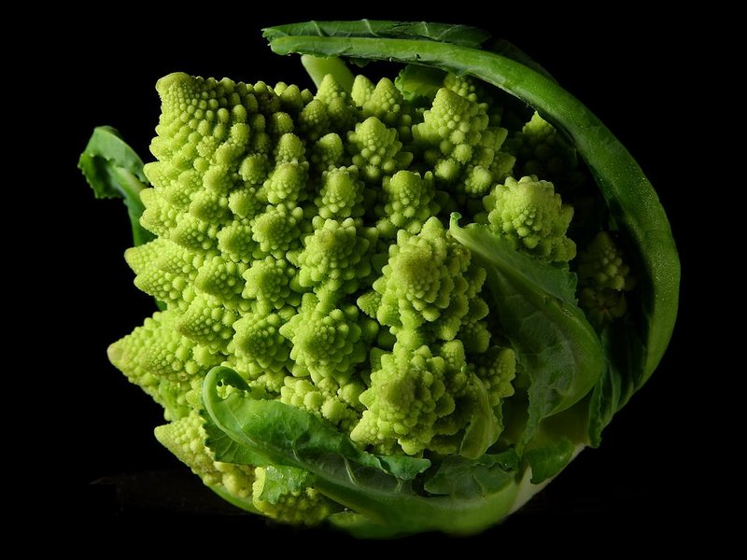
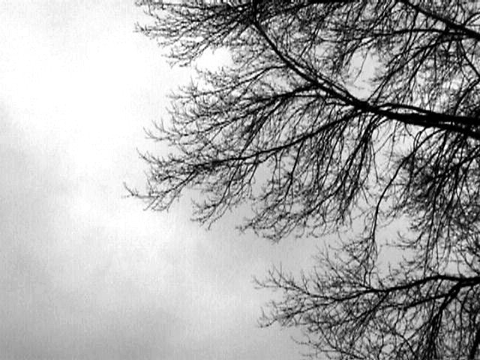
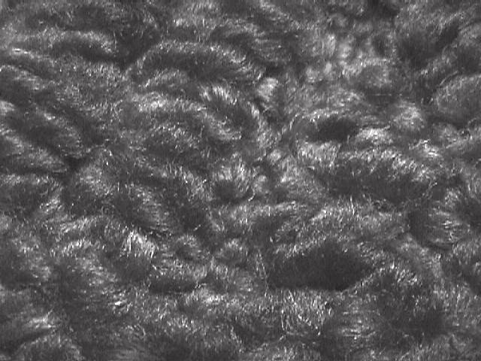
Few Fractal Images

Slide 3

FRACTALS
What is a fractal ?
Let’s see what we can come up with...

Slide 4
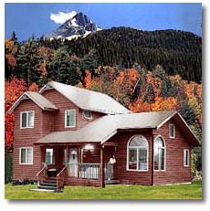
Look the house in this photo. Do you see any recognizable shapes?
Even a semicircle!
A triangle
A rectangle
Perhaps a square
All familiar shapes from Euclidean Geometry
A parallelogram

Slide 5
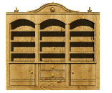
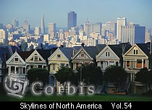
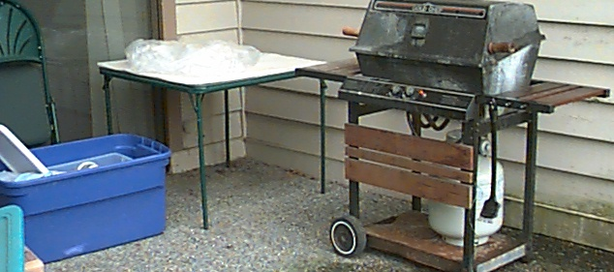
Many man-made objects are made up of Euclidean shapes

Slide 6
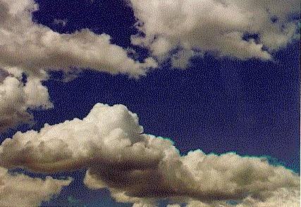
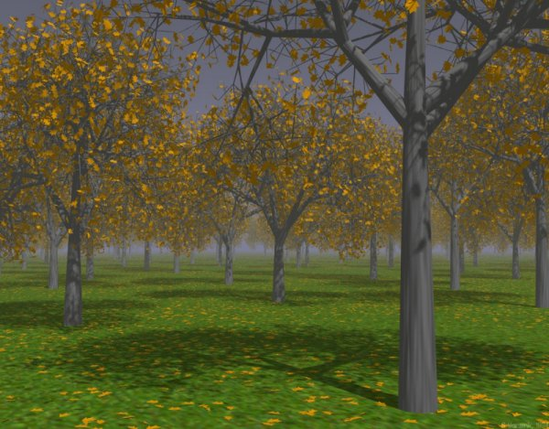
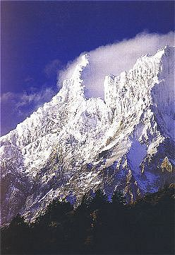
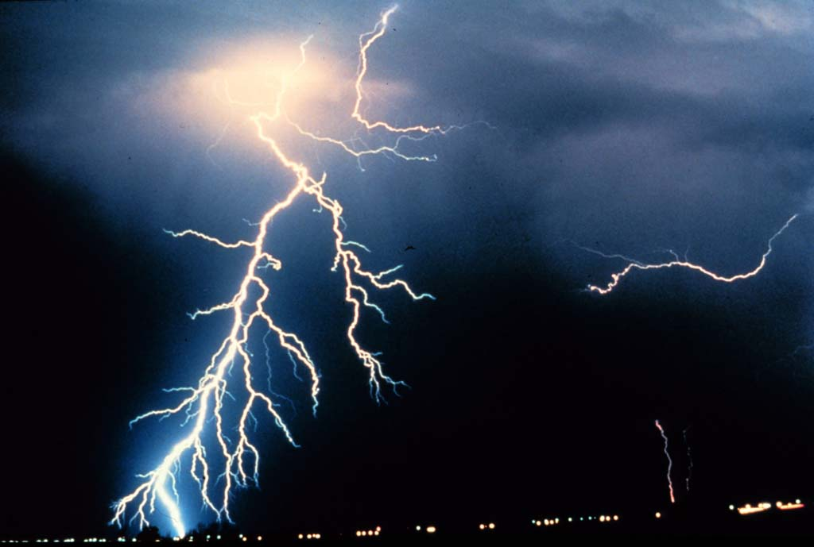
But what about these familiar things from the natural world?
Can they be easily described with Euclidean shapes?
I don’t think so...

Slide 7
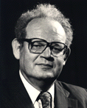
“Why is geometry often described as ‘cold’ or ‘dry’? One reason lies in its inability to describe the shape of a cloud, a mountain, a coastline, or a tree. Clouds are not spheres, mountains are not cones, coastlines are not circles, and bark is not smooth, nor does lightning travel in a straight line.”
Benoit Mandelbrot, the father of fractal geometry, from his book The Fractal Geometry of Nature, 1982.

Slide 8
So what is a fractal?
Good question… not even the great Benoit Mandelbrot has come up with a definitive definition.
But here are five properties which most fractals have:
Fractals have infinite detail on arbitrarily small scales or at every point.
Fractals have some sort of self-similarity.
Fractals are usually defined by simple recursive processes.
Fractals are too irregular to be described in traditional geometric language.
Fractals have fractal dimension.
We will begin to gain an understanding through few examples.

Slide 9
Simple Definition
In very simple terms, fractals are geometrical figures that are generated by starting with a very simple pattern that grows through the application of rules.
In many cases, the rules to make the figure grow from one stage to the next involve taking the original figure and modifying it or adding to it.
This process can be repeated recursively (the same way over and over again) an infinite number of times.

Slide 10
Fractal signals: theory
Most popularly known fractals are two-dimensional “beautiful pictures” (Mandelbrot, Julia sets Koch snowflake, Serpinski triangle, “ferns” etc.) exhibiting complex structure at every scale and self-similarity: zoom any fragment of it with any resolution and get a picture which resembles the whole set.
Functions may also be fractal, i.e. have fractal graphs. Such functions are non-smooth, do not have a derivative at any point.

Slide 11
Example of fractal function
Weierstrass function: , a = 0.5, b = 3.

Slide 12
Fractal signals: applications
The study of fractal functions (i.e. those whose plots exhibit fractal properties) has proved important in several scientific domains. The examples of processes described by such functions include
  the heartbeat oscillations;
  the speech signals;
  the network traffic;
  Solar wind;
  the stock index charts etc.

Slide 13
Classification of Fractals
Self-similar fractals
Self-affine fractals
Invariant fractal sets

Slide 14
Self-similar fractals
The name sounds complex but the idea is very simple. What self-similarity means is that each small portion, when magnified, can reproduce exactly a larger portion.
Self similar fractals have parts that are scaled-down versions of the entire object.
Same scaling factor s can be used for all subparts or different ‘s’ for different scaled down parts of an object.
If we apply random variations to the scaled down subparts, the fractal is said to be statistically self similar.
It is commonly used to model trees, shrubs, and other plants.

Slide 15
Self-affine fractals
Self affine fractals have parts that are formed with different scaling parameters, Sx, Sy, Sz in different coordinate directions.
We can also include random variations to obtain statistically self-affine fractals.
Terrain, water, and clouds are modeled.

Slide 16
Invariant fractal sets
Invariant fractal sets are formed with nonlinear transformations.
This class of fractals includes self squaring fractals, such as the Mandelbrot set, which are formed with squaring functions in complex space.

Slide 17
Fractal Dimension
The detail variation in a fractal object can be described with a number D, called the fractal dimension.
It is a measure of the roughness, or fragmentation of the object.
More jagged objects have larger fractal dimensions.

Slide 18
Box Dimension

Slide 19
Box Dimension

Slide 20
Self-Similarity Dimension

Slide 21
Self-Similarity Dimension

Slide 22
Geometric Construction of Deterministic Self-similar Fractals

Slide 23

Let’s take a look at a famous fractal and how it can be created. Let’s begin with an equilateral triangle. Our iteration rule is:
For each triangle, join the midpoints of the sides and then remove the triangle formed in the middle.
And so forth, until...
Stage 2
Stage 1
Stage 0
This fractal is called the Sierpinski Triangle
Stage n

Slide 24
Let’s look at the Sierpinski triangle in terms of the properties of fractals.
Wow! What incredible detail!
We will see what this means after another few slides.
For each triangle, join the midpoints of the sides and then remove the triangle formed in the middle.
Magnify by a factor of 4 to get...
It’s exactly the same!
Self-Similarity
A figure is self-similar if a part of the figure contains on a smaller scale an exact copy of the figure itself. If we were to choose a portion of the figure, and blow it up to the same size as the figure, you would see an exact copy!
Traditional Geometry Inadequate
While the figure appears recognizable, the Sierpinski triangle is not a triangle!
Fine Structure
If you zoom in on any portion, you see incredible detail at a smaller scale.
Simple Recursive Process
Our iteration rule was simple, short, and sweet!

Slide 25
I mentioned earlier that the Sierpinski triangle is not really a Euclidean triangle. Let’s uncover some evidence of this…
Let’s say that the length of a side of the Stage 0 triangle is 1 unit.
Let’s look at the perimeter of the bounded area at each stage...
Stage 0
Stage 1
Stage 2
3
27/4
?
9/2
Perimeter =
Perimeter =
?
Perimeter =
?
The sequence of perimeter values is 3, 9/2, 27/4, …
What type of sequence is this?
Yes, it is geometric...with a common ratio r= 3/2.
As you know, a geometric sequence with | r |>1 approaches infinity.
So, the Sierpinski triangle is a figure with infinite perimeter, enclosed in a triangle of perimeter 3. Odd, don’t you think?
The length of the side of one of the small triangles at Stage 2 is ¼.
So the perimeter of one of the small triangles is ¾.
There are nine triangles, so…
The length of the side of one of the small triangles at Stage 1 is 1/2.
So, the perimeter of one of the small triangles is 3/2.
There are three triangles, so...

Slide 26
Now let’s consider the area enclosed by the Sierpinski triangle.
Let’s say that the area of the Stage 0 triangle is 1 unit.
Stage 0
Stage 1
Stage 2
?
Area = 1
Area =
3/4
Area =
9/16
?
The sequence of area values is 1, 3/4, 9/16, …
What type of sequence is this?
Yes, it is geometric...with a common ratio r= 3/4.
As you know, a geometric sequence with | r |<1 approaches zero.
So, the Sierpinski triangle is a figure with zero area and infinite perimeter!
Totally wacky!!! This is clearly completely alien to traditional geometry.
The area of one of the small triangles at Stage 2 is 1/4 of the area of each small triangle at Stage 1.
So, the area of one of the small triangles is 1/4 of 1/4, or 1/16.
There are nine triangles, so...
The area of each of the small triangles in Stage 1 is 1/4 of the area of the Stage 0 triangle.
There are three small triangles, so...

Slide 27
Let’s consider another well known fractal called the Koch Curve.
The iteration rule for this fractal is:
For each segment, remove the middle third and replace it with an upside-down V which has sides the same length as the removed piece.
Stage 3
Stage 1
Stage 2
Stage 5
Stage 0
Stage 4

Slide 28
If we put three Koch curves together, we get...
The Koch Snowflake!

Slide 29
Let’s look at just one more. Our iteration rule will involve replacing each segment with a shape like this --
What will this fractal look like?
Stage 5
Stage 4
Stage 3
Stage 6
Stage 1
Stage 8
Stage 0
Stage 2
Stage 7
It’s the Sierpinski Triangle!
Generated by a different recursive process than the first time we encountered it.

Slide 30
Geometric Construction of Statistically Self-Similar Fractals

Slide 31
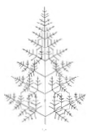
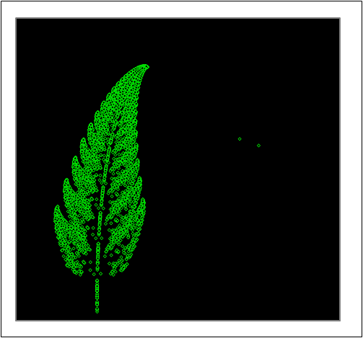
Example

Slide 32
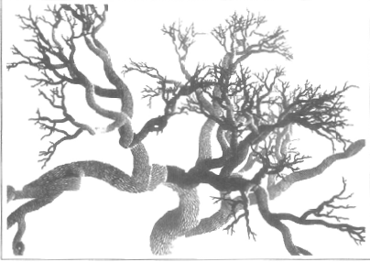

Slide 33
Thank You

