Slide 1
INFORMATICA 8.6

Slide 2
INFORMATICA 8.6:
-- Informatica is a ETL Tool
-- Informatica is a product of Informatica Corporation
-- It is a GUI based Tool
-- The base language used to design this tool is JAVA
-- Informatica first version released in 1993
-- Informatica versions 4.7,5.0,6.0,7.1.1,8.1.1,8.5 and 8.6
Informatica is released with two flavors.
1. Informatica Power Center
2. Informatica Power Mart

Slide 3
INFORMATICA :
Informatica is an Integrated tool set to DESIGN
to RUN
to MONITOR
to ADMINISTRATOR
the plan of Data Acquisition known as mapping.

Slide 4
POWER CENTER COMPONENTS:
When we install an Informatica power center, the following components gets installed.
POWER CENTER CLIENTS
POWER CENTER REPOSITORY
POWER CENTER INTEGRATED SERVICES
POWER CENTER ADMIN CONSOLE
POWER CENTER WEB SERVICES
SAP BW SERVICES

Slide 5
INFORMATICA ARCHITECTURE
Servers/Services
Client Tools
REPOSITORY SERVICE
SOURCE EMP
REPOSITORY MANAGER
-USER NAME/PASSWORD PRIVILAGES-AUTHENTICATION
DESINGER
ETL-PROGRAM –GUI –MAPING
WORKFLOW MANAGER
SESSION (ASSOCIATE MAPPING)
WORKFLOW MONITOR
INTEGRATION SERVICE
REPOSITORY INFORMATICA SYSTEM TABLES
TARGET EMP
Session log file

Slide 6
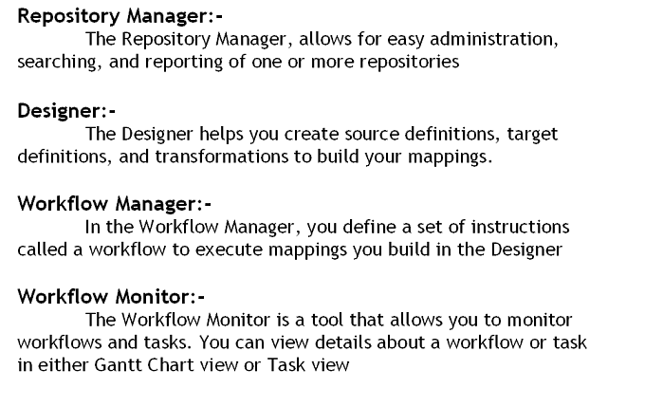

Slide 7
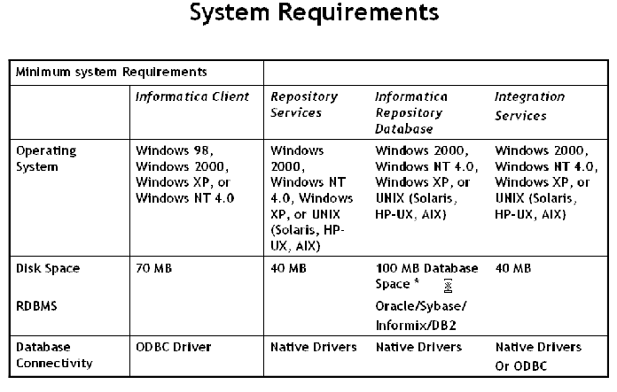

Slide 8
DESIGNER contains the following windows:
SOURCE ANALYZER
TARGET DESIGNER
MAPPING DESIGNER
MAPPLET DESIGNER
TRANSFORMATION DEVELOPER

Slide 9
Transformation:
It’s an object which allows defining the business logic for processing the data.
Transformations are categorized into 2 types:
1. Active Transformation
2. Passive Transformation

Slide 10
Active Transformation:
A transformation which can affect the number of rows or change the number of rows when the data is moving from source to target is known as Active Transformation.
EXAMPLE:
Filter Transformation
Joiner Transformation
Aggregator Transformation
Passive Transformation:
While data moving from source to target which doesn’t affect the number of rows is known as Passive Transformation.
EXAMPLE :
Expression Transformation

Slide 11
PORT:
A Port defines column of a table or file
Types of Ports:
Input Port:
A Port which can receive the data is known as Input Port. Symbolically it is represented as ‘I’.
Output Port:
A port which can provide the data is known as Output Port. It is symbolically represented as ‘O’.

Slide 12
1. FILTER TRANSFORMATION
This is one type of Active Transformation which allows filtering the data based on given condition.
Filter Transformation supports single target to send the data. It is used to perform data cleansing activities. It evaluates each input record and returns either TRUE or FALSE.
TRUE → Input records satisfied with given condition
FALSE → Input records doesn’t satisfied with given condition
Use filter transformation as close to source as possible for better performance. This makes sense, because number of rows to go through other transformation will be less.

Slide 13
2. SORTER TRANSFORMATION
Sorter Transformation is a connected and an Active Transformation. It allows to sort data either in ascending or descending order according to a specified field. Also used to configure for case-sensitive sorting, and specify whether the output rows should be distinct.

Slide 14
3.SEQUENCE GENERATOR TRANSFORMATION
Sequence Generator transformation is a Passive and Connected Transformation. It is used to create unique primary key values or cycle through a sequential range of numbers or replace missing keys.
A surrogate key is a sample generated sequence number which is to be treated as primary keys. It is used in maintaining full history in the target table.
It has two output ports to connect transformations. By default it has following two fields (You cannot add ports to this transformation).
CURRVAL: CURRVAL is the NEXTVAL value plus one or NEXTVAL plus the Increment by value.
NEXTVAL: NEXTVAL port generates a sequence of numbers by connecting it to a transformation or target.

Slide 15
4. RANK TRANSFORMATION
Rank transformation is an Active and Connected Transformation. It is used to select the top or bottom rank of data.
It has 4 ports to connect transformation
Input Ports (I)
Output Ports (O)
Variable Port (V)
Rank Port (R)
A rank port defines a column based on which rank is calculated. A variable port stores the data temporarily. Rank Transformation is created by default with rank index output port.
The following properties can be set for identifying the ranks.
Top/Bottom
Number of Ranks
Dense Ranking: It is a process of calculating ranks based on group of records.

Slide 16
5. ROUTER TRANSFORMATION
Router is an Active and Connected Transformation. It is similar to filter transformation. The only difference is, filter transformation not capture the data that do not meet the condition where as router has an option to capture the data that do not meet the condition. It is useful to test multiple conditions.
The router transformation is created with two types of groups.
Input Group --It receives the data from source
Output Group –It provides the data to the target
There are two types of output groups:
User defined output groups
Default
A user defined output group allows defining conditions. The record which doesn’t match the any of conditions are captured by default output group.
Difference between Filter and Router Transformation:
1. Single Condition Multiple Condition
2. Single Target Multiple Targets
3. Rejects cannot be captured Rejects can be captured using default group

Slide 17
6. AGGREGATOR TRANSFORMATION
Aggregator transformation is an Active and Connected transformation. This transformation is useful to perform calculations such as averages and sums (mainly to perform calculations on multiple rows or groups).
Example: AVG(SAL), SUM(SAL),COUNT(SAL),MIN(SAL) AND MAX(SAL)
Difference between Expression and Aggregator T/R
Expression T/R | Aggregator T/R
1. Passive Transformation | 1. Active Transformation
2. Expressions are calculated for each record | 2. Expressions are calculated for group of record
3. Non-Aggregate functions | 3. Aggregate functions

Slide 18
7.EXPRESSION TRANSFORMATION
Expression Transformation is a Passive and Connected transformation. This can be used to calculate values in a single row before writing to the target.
For example, to calculate discount of each product and concatenate first and last names or to convert date to a string field.
Example:
HRA=SAL*0.2, TAX=SAL*0.3

Slide 19
JOINER TRANSFORMATION
Joiner Transformation is an Active and Connected transformation. This can be used to join two sources coming from two different locations or from same location. For example, to join a flat file and a relational source or to join two flat files or to join a relational source and a XML source.
In order to join two sources, there must be at least one matching port. While joining two sources it is a must to specify one source as a master and the other as detail.

Slide 20
8.JOINER TRANSFORMATION (Cont..)
The joiner transformation supports the following types of joins:
* Normal
* Master Outer
* Detail Outer
    * Full Outer
→ Normal join discards all the rows of data from the master and detail source that do not match, based on the condition.
(Matched records for both tables)
→ Master outer join discards all the unmatched rows from the master source and keeps all the rows from the detail source and the matching rows from the master source
(Matched and Unmatched from Detailed side+ only matched from Master side)
→ Detail outer join keeps all rows of data from the master source and the matching rows from the detail source. It discards the unmatched rows from the detail source.
(Matched and Unmatched from Master side+ only matched from Detail side)
→ Full outer join keeps all rows of data from both the master and detail sources.
(Matched and Unmatched from both sides)

Slide 21
9.STORED PROCEDURE TRANSFORMATION
Stored Procedure transformation is a Passive and Connected & Unconnected transformation. It is useful to automate time-consuming tasks and it is also used in error handling, to drop and recreate indexes and to determine the space in database, a specialized calculation etc.
The stored procedure must exist in the database before creating a stored procedure transformation, and the stored procedure can exist in a source, target, or any database with a valid connection to the informatics server. Stored Procedure is an executable script with SQL statements and control statements, user-defined variables and conditional statements.

Slide 22
10.UNION TRANSFORMATION
This is one type of Active Transformation which allows combining the data from multiple sources into a single output pipeline with matched metadata.
Union transformation supports heterogeneous data sources for combining the data.
Union T/R functions as UNION All set operator which combining the data from multiple result sets.
UNION → Eliminates duplicates
UNION ALL → Allows duplicates
Union T/R is created with 2 types of groups
  Input Group → it receives the data from source.
  Output Group → it provides the data for further processing OR to the target for loading.

Slide 23
11. FLAT FILE TRANSFORMATION
It is an ASCII text fields which are saved with extension .txt and .dat
There are 2 types of flat files.
1. Delimited Flat File
2. Fixed Width Flat File
Delimited: In a delimited flat file each field or column separated by some special characters such as comma, semi-colon, tab and space.
The default delimited is comma (,).
Example:
CNO, CNAME, AMOUNT
100, RAM, 5000
101, SUBBU, 4000
102, RAHUL, 6000
Fixed Width: A record is defined with continuously length which needs to be break to define the metadata.

Slide 24
ETL TESTING TECHNIQUES

Slide 25
Types of ETL Testing techniques:
During ETL application testing, we test for the following:
Data Completeness
Data Transformation
Data Quality
Performance and Scalability
Integration Testing
User-acceptance Testing
Regression Testing

Slide 26
Data Completeness:
Ensures that all expected data is loaded.
Data Transformation:
Ensures that all data is transformed correctly according to business rules and/or design specifications.
Data Quality:
Ensures that the ETL application correctly rejects, substitutes default values, corrects or ignores and reports invalid data.

Slide 27
Performance and scalability:
Ensures that data loads and queries perform within expected time frames and that the technical architecture is scalable
Integration Testing:
Ensures that the ETL process functions well with other upstream and downstream processes.

Slide 28
User-acceptance Testing:
Ensures the solution meets users current expectations and anticipates their future expectations
Regression Testing:
Ensures existing functionality remains intact each time a new release of code is completed

