Slide 1
ETL TESTING CONCEPTS

Slide 2
TESTING LIFE CYCLE
1. Documents acquiring
Functional specification document.
Overall system design document
Database design specification document and Data Model Diagrams.
2. Prepare Test Plan
3. Prepare Test cases for SOURCE and TARGET tables, Record Count of
source and target tables and ETL Validation.
4. Prepare the QA environment and deploy the build script in QA
Environment.
5. Prepare test data.
6. Different types of testing
a) Sanity Testing. b) Functional Testing for all components
c) Regression Testing. d) Integration/End to End testing.
7. QA Signoff
Test summary Reports
Defect summary Report.
Database scripts with deployment scripts
Work Flow build information
Performance summary report

Slide 3
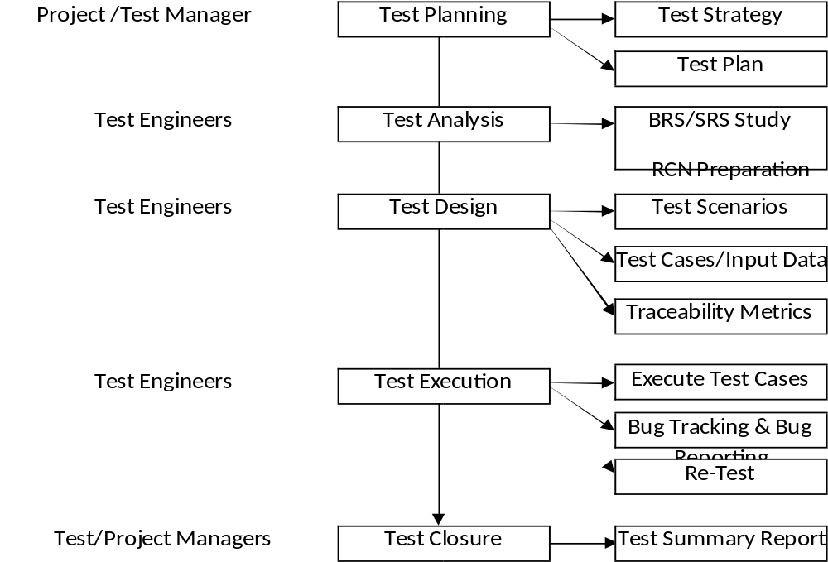
SOFTWARE TESTING LIFE CYCLE

Slide 4
TEST PLAN TEMPLATE
1.0 Objectives
2.0 Scope
2.1 In scope
2.1.1 Features to be tested
2.1.2 Types of testing applicable
2.2 Out scope
2.2.1 Features not to be tested
2.2.2 Types of testing is not applicable
3.0 Approach
3.1 Test analysis Approach
3.2 Test design Approach
3.3 Test execution approach
3.4 Defect management Approach
4.0 Resources
4.1 Hardware resources
4.2 Software resources
4.3 Human resources
5.0 Schedules
6.0 Entry criteria & Exit criteria
6.1 Entry criteria
6.2 Exit Criteria
7.0 Deliverables
7.1 Test Scenarios
7.2 Test Cases
7.3 Traceability Metrics
7.4 Defects

Slide 5
TYPES OF ETL TESTING
Constraint testing
Data validation testing
Sanity Testing
Source and Target Record count testing
Functional Testing
Duplicate Check testing
Log information testing
Incremental Loading testing
Historical process data testing
Partial Data Loading testing
Regression testing
End-to-End Testing
ETL Performance testing

Slide 6
CONSTRAINT TESTING
Table level validations : Verify the following validations at table level.
1. All table names
2. Column names for each table.
3. Column types for each table.
4. Whether a column allows NULL or not.
5. Default definitions.
Keys and Indexes: Verify the following keys with design specification.
1. Primary Key for each table (Every table should have primary key).
2. Foreign keys.
3. Column data types between Primary key and foreign key column
and that are present different tables.

Slide 7
ETL DATA VALIDATION TESTING
1. MISSING DATA (NULL VALUES)
2. DATA TYPE VALIDATION ( PASSING NON NUMERIC ON NUMERIC FIELD)
3. FIELD LENGTH VALIDATAIONS ( PASSING VALUE FIELD LENGTH > DEFINED
FIELD LENGH)
4. NO.OF COLUMNS VALIDATION ( PASSING RECORD WITH MORE NO.OF COLUMN
VALUES THAN DEFINED COLUMNS ON TABLE)
5. FORMATS (DATE FORMATS (ACTUAL DATE :DD/MM/YYYY) DATA PASSED
YYYY/DD/MM,
6. SSN WITH SEPERATORS AND DATA PASSED WITH OUT SEPERATORS 123-45-
2389 DATA PASSED AS 123452389)
7. PADDING OF DATA
8. ORDER OF SEQUENCE FOR COLUMNS
9. JUNK DATA (?,'' and special characters)
10. NAME FILED IS MANDATORY ON DATA WE DID NOT PASS NAME
11. DATE FIELD SAYS DOB NOT > CURRENT DATE . BUT WE PASS TOMORROW'S
DATE.

Slide 8
SOURCE AND TARGET RECORD COUNT TESTING
Record count verification in Source as per the business rule.
SELECT COUNT(*) FROM
(SELECT DEPTNO,AVG(SAL),MAX(SAL),MIN(SAL),SUM(SAL) FROM EMP
GROUP BY DEPTNO)
2. Record count verification in Target
SELECT * FROM TRG_AGGR
3. Data verification in Source as per the business rule.
SELECT DEPTNO,AVG(SAL),MAX(SAL),MIN(SAL),SUM(SAL) FROM EMP
GROUP BY DEPTNO
4. Data verification in Target
SELECT * FROM TRG_AGGR
Minus Query:
SELECT * FROM EMP
MINUS
SELECT * FROM TRG_EMP;
SELECT COUNT(*) FROM EMP
MINUS
SELECT COUNT(*) FROM TRG_EMP;
SELECT MAXSAL FROM BINDU.TRG_AGGR
MINUS
SELECT MAXS FROM (SELECT MAX(SAL) MAXS FROM EMP GROUP BY DEPTNO ORDER BY 1);
SELECT COUNT(*) FROM BINDU.TRG_AGGR
MINUS
SELECT COUNT(*) FROM (SELECT MAX(SAL) MAXS FROM EMP GROUP BY DEPTNO ORDER BY 1)

Slide 9
ETL PERFORMANCE TESTING
Database Server: TwinFin-12 series, V5.0.8 P7 or higher
Load Server: Pentium Dual Core 4 CPU, 2GB Memory, 1 TB Disk, Red Hat Linux, physical machine
Proximity: Database Server and Load Server within the same Data Center
Connectivity: Dual bonded gigabit dedicated connection between Load Server and Database Server
Data Load | Expected E2E Run Expected E2E Run Time
30 GB | Less than 4 hours
60 GB | Less than 5 hours
100 GB | Less than 6 hours

Slide 10
SQL QUERY OPTIMIZATION TECHNIQUES
Use views and stored procedures instead of heavy-duty queries.
This can reduce network traffic, because your client will send to server only stored procedure or view name (perhaps with some parameters) instead of large heavy-duty queries text. This can be used to facilitate permission management also, because you can restrict user access to table columns they should not see.
Try to use constraints instead of triggers, whenever possible.
Constraints are much more efficient than triggers and can boost performance. So, you should use constraints instead of triggers, whenever possible.
Try to use UNION ALL statement instead of UNION, whenever possible.
The UNION ALL statement is much faster than UNION, because UNION ALL statement does not look for duplicate rows, and UNION statement does look for duplicate rows, whether or not they exist.
Try to avoid using the DISTINCT clause, whenever possible.
Because using the DISTINCT clause will result in some performance degradation, you should use this clause only when it is necessary.

Slide 11
SQL QUERY OPTIMIZATION TECHNIQUES
Try to avoid the HAVING clause, whenever possible.
The HAVING clause is used to restrict the result set returned by the GROUP BY clause. When you use GROUP BY with the HAVING clause, the GROUP BY clause divides the rows into sets of grouped rows and aggregates their values, and then the HAVING clause eliminates undesired aggregated groups. In many cases, you can write your select statement so, that it will contain only WHERE and GROUP BY clauses without HAVING clause. This can improve the performance of your query.
Try to restrict the queries result set by using the WHERE clause.
This can results in good performance benefits, because SQL Server will return to client only particular rows, not all rows from the table(s). This can reduce network traffic and boost the overall performance of the query.
Try to restrict the queries result set by returning only the particular columns from the table, not all table's columns.
This can results in good performance benefits, because SQL Server will return to client only particular columns, not all table's columns. This can reduce network traffic and boost the overall performance of the query.

Slide 12
SQL PROCEDURE Testing
Test Coverage Criterion: Each and every procedure must be tested at least once.
Individual Procedures test: Verify the following things and compare them with design specification document.
Whether a stored procedure is installed in database
Stored Procedure name
Parameter names, parameter types and the number of parameters.
Check is that appropriate comments has been used in the procedure.
Outputs:
When output is zero (o rows affected)
Output contains many records.
Write simple queries to see if a stored procedure populates right data.
Parameters:
Check the parameters if they are required.
Call stored procedure with valid data.
Make each parameter invalid a time and run a procedure and see is that
giving appropriate user informative message or not.
Return Values:
When a stored procedure returns a 0, it is successful execution.
When fails, a non zero value must be returned.

Slide 13
ROLES AND RESPONSIBILITIES:
Involved in Understanding the business requirements
Identification of the Scope and Test plan preparation
ETL Test Scripts Preparation based on the Business and Mapping logic
Executing the test cases, Reporting bugs and Requirement walk through Daily interaction with the client & onshore team about status and execution plan Involved in Understanding the requirements and preparing the test plan Performing functional, System and Regression testing to make sure application is meeting all the requirements .
Running SQL Scripts to verify the Source and target are matching
Executing the stored procedure when passing the valid/invalid parameters.
Testing the result by preparing SQL queries for source and target for each scenario in functional spec.
Preparation of database and ETL test cases according to assigned module.
Data validation using Database tools.
Written test cases based on business requirements and rules.
Developed SQL using the source to target matrix document and functional specifications.

Slide 14
ROLES AND RESPONSIBILITIES
Analyze the result and log the defects in bug tracking tool.
Preparing the ETL Test Cases and Executing the Test Cases.
Preparing the Test Data. Involved in validating the data .
Involved in the Data Cleansing.
Involved in ETL,BI and END-END Scenarios.
Coordinating with testing team onsite to test ETL jobs.
Involved in System testing for Reports.
Involved in Peer-Reviews on Test Cases prepared.
Identifying the Defects and tracking them using Quality Center
Attended Design reviews, Requirement reviews.
Involved in ETL process data quality and testing.
Testing the data as per requirements and preparing the Test data.
Participating in design reviews, and assisting with allocation of functionality to Executing the ETL Jobs with the test data Functional/Regression testing .
Currently involved in creating test Cases.
Ability to validate the completeness, integrity and accuracy of data.
Ability to develop and analyze data mapping documents

