Slide 1



Hadoop and Hive
&

Slide 2
Outline
Introduction to Hadoop
Hadoop Framework Components
Workflow of a Hadoop Cluster
Word Count Code Sample
Hadoop Configuration
Hortonworks Data Platform
Fault Tolerance in Hadoop
Introduction to Hive
HiveQL Queries
Why Hadoop

Slide 3
What is Hadoop?
Hadoop is an open source implementation of MapReduce.
Its native API is written in Java
You can write mappers and reducers as Java method
It is more than just a Map Reduce Implementation, helping in large storage using HDFS.
The Hadoop system takes care of parallelization on distributed Memory machines.
Notes:
• Hadoop is one of the most popular environment to work with Big data and to solve Big data problems.
• The Hadoop framework itself is mostly written in the Java programming language, with some native code in C and command line utilities written as shell-scripts
• All the modules in Hadoop are designed with a fundamental assumption that hardware failures (of individual machines, or racks of machines) are common and thus
should be automatically handled in software by the framework. (Fault Tolerence)
Hadoop allows you to store large amount of data on clusters of low cost commodity hardware (HDFS Rack Structures)
Hadoop Provides you the capability to process that distributed data using simple programming model (HIVE)

Slide 4
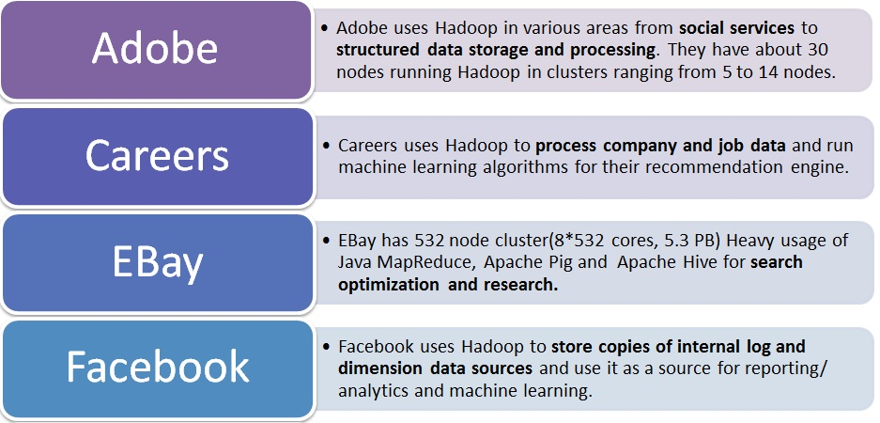
What is it used For?
Searching
Logs Processing
Data Warehouse
Video and Image Analysis

Slide 5
Outline
Introduction to Hadoop
Hadoop Framework Components
Workflow of a Hadoop Cluster
Word Count Code Sample
Hadoop Configuration
Hortonworks Data Platform
Fault Tolerance in Hadoop
Introduction to Hive
HiveQL Queries
Why Hadoop

Slide 6
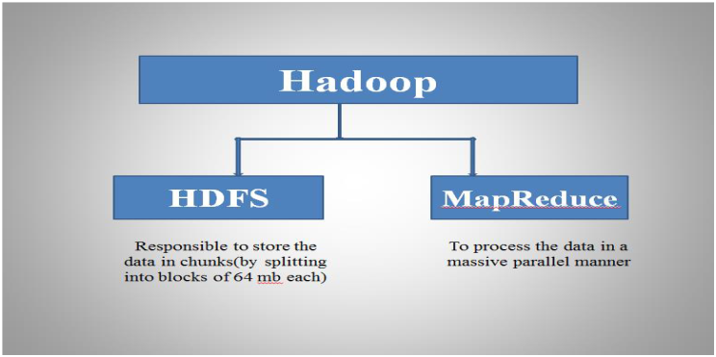
Components
Notes:
HDFS – Storage
MapReduce – Processing
HCatalog – Meta Data
HIVE – Querying the Data
PIG – Data Optimizations

Slide 7
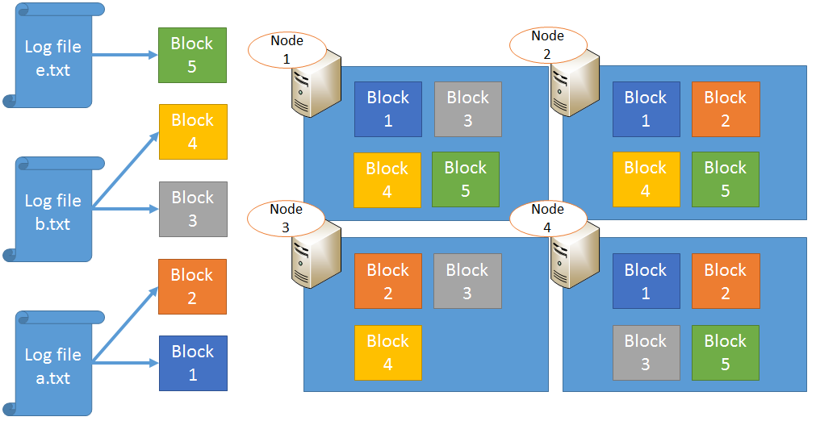
Hadoop Distributed File System(HDFS)
Notes:
• HDFS is responsible for distributing the data across the DataNodes
• HDFS does the administrative jobs like addition of the nodes from cluster , removal of the nodes from cluster
• HDFS is also responsible to do the recovery of DataNodes

Slide 8
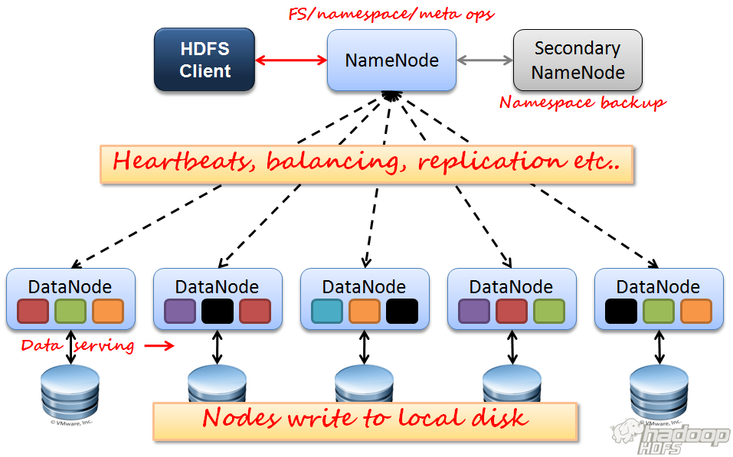
HDFS Components
Notes:
Name Node: It is the admin / master of the system.
• It manages the blocks which are present on the Data Node.
• Name Node stores the meta-data and it runs on high quality hardware.
• It is single entry point for any of the failures happening in Hadoop Cluster.
Data Node: These are the slaves which are deployed on each machine.
• This is the place where actual data is stored.
• It is responsible for serving read and write requests for the clients.
• Each Data Node holds a part of the overall data and processes the part of the data which it holds.
Backup Node: This is responsible for performing periodic checkpoints. In the event of NameNode failure, you can restart the NameNode using the checkpoint.

Slide 9
Map Reduce
Conceptually, MapReduce works in 4 steps:
The Mapper or Map phase, takes a collection of data and convert it in to another set of data, where individual elements are broken into <key,value> pairs.
The Reducer or Reduce phase , takes the output from the map as input and those <key,value> pairs into smaller set of <key,value> pairs as an output.

Slide 10
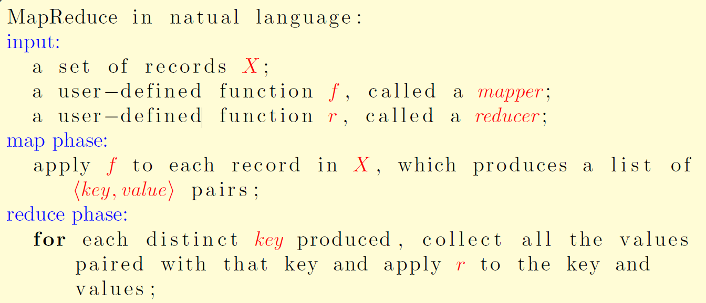
Map Reduce Algorithm

Slide 11
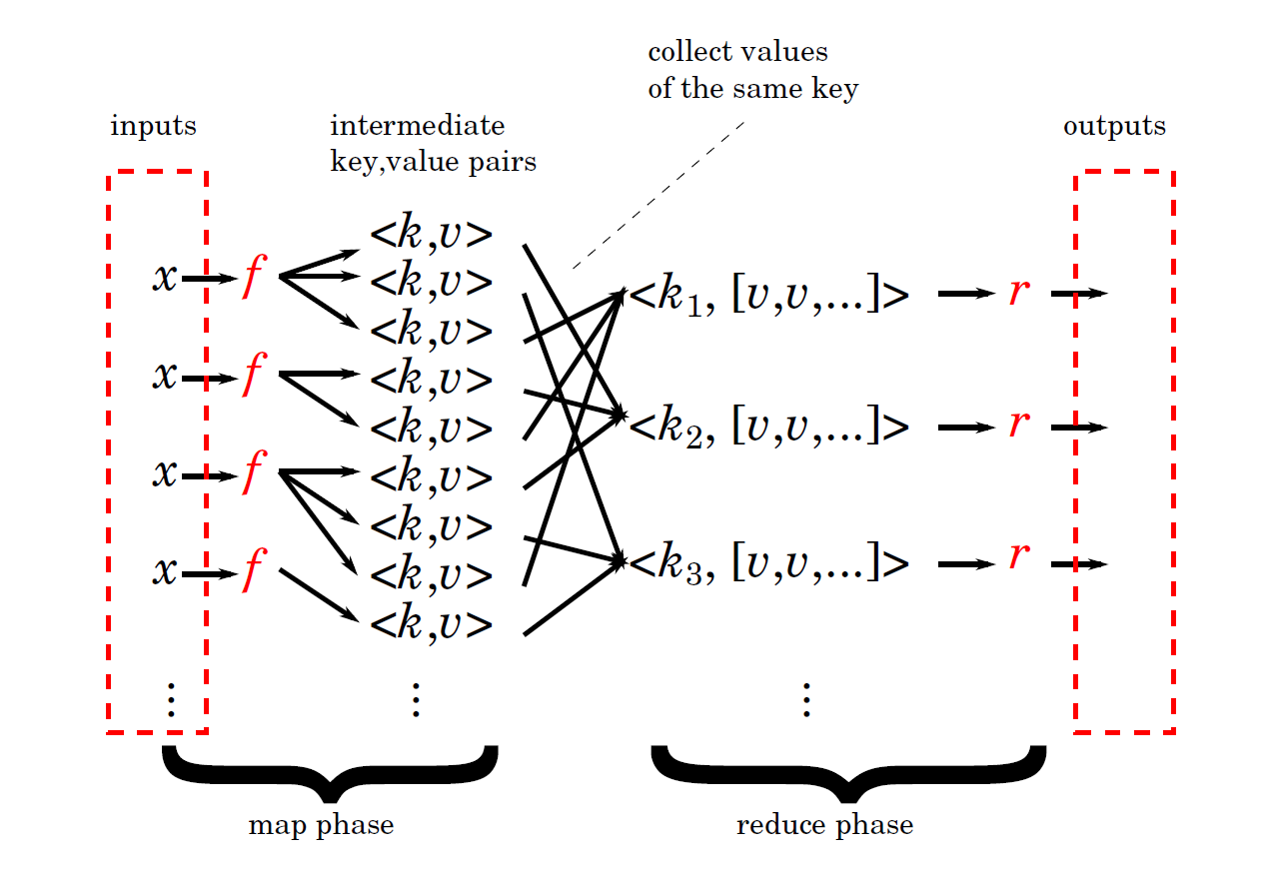
Map Reduce Intuition

Slide 12
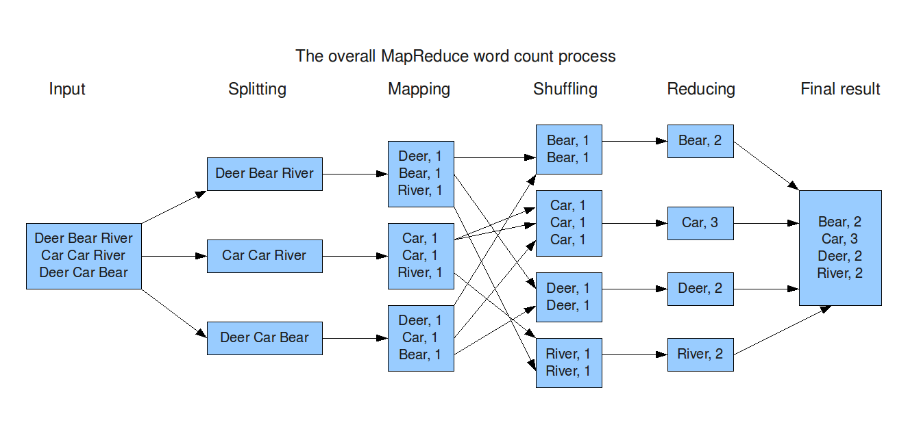
Map Reduce Example Word Count
Input: Given a number of text documents
Output: Word and Number of its occurrences pair list from all the documents.

Slide 13
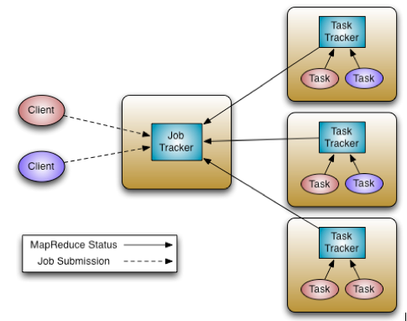
Map Reduce Components
Notes:
• JobTracker: It is the service in Hadoop which send map reduce tasks to specific nodes in the cluster, ideally the nodes that have the data, or at least are in the same rack.
• TaskTrackers: TaskTrackers are the slaves which are deployed on each machine. They are responsible for running the map and reduce tasks as instructed by the JobTracker.
• JobHistoryServer: JobHistoryServer is a daemon that serves historical information about completed applications.

Slide 14
Outline
Introduction to Hadoop
Hadoop Framework Components
Workflow of a Hadoop Cluster
Word Count Code Sample
Hadoop Configuration
Hortonworks Data Platform
Fault Tolerance in Hadoop
Introduction to Hive
HiveQL Queries
Why Hadoop

Slide 15
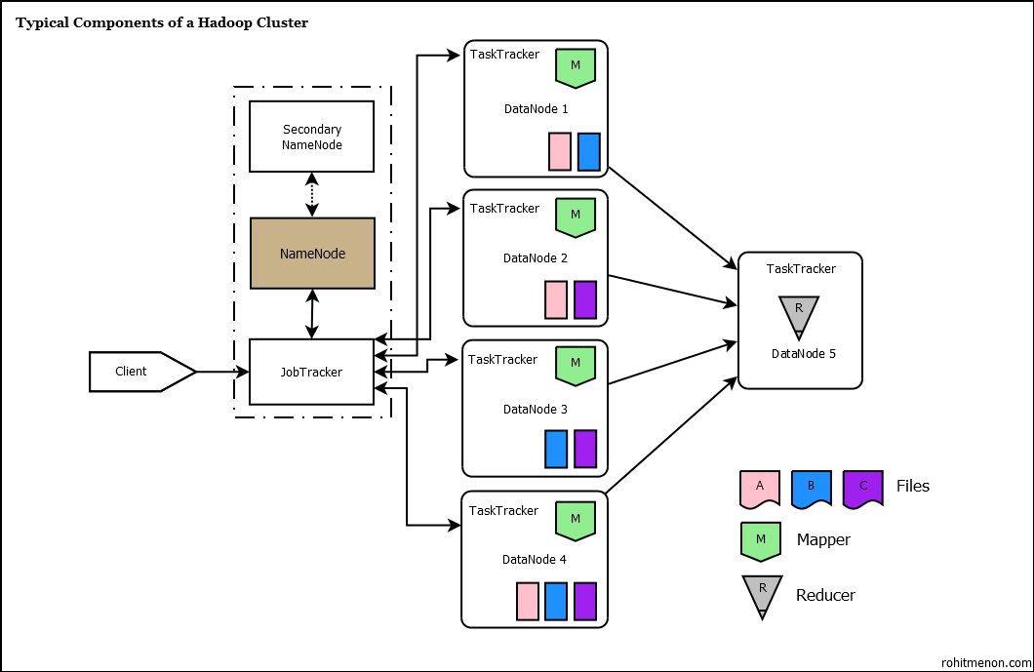
Workflow of a Hadoop Cluster
Notes:
When Client applications submit map reduce jobs to the Job tracker. The JobTracker talks to the Name node to determine the location of the data The JobTracker locates Tasktracker nodes with available slots at or near the data. The JobTracker submits the work to the chosen Tasktracker nodes. The TaskTracker nodes are monitored. If they do not submit heartbeat signals often enough, they are deemed to have failed and the work is scheduled on a different TaskTracker When the work is completed, the JobTracker updates its status. Client applications can poll the JobTracker for information.

Slide 16
Outline
Introduction to Hadoop
Hadoop Framework Components
Workflow of a Hadoop Cluster
Word Count Code Sample
Hadoop Configuration
Hortonworks Data Platform
Fault Tolerance in Hadoop
Introduction to Hive
HiveQL Queries
Why Hadoop

Slide 17
Using Hadoop Libraries and JARs
Major Hadoop Libraries:
import org.apache.hadoop.fs.Path;
import org.apache.hadoop.conf.*;
import org.apache.hadoop.io.*;
import org.apache.hadoop.mapreduce.*;
Major Hadoop JAR Files:
share/hadoop/common/*.jar
share/hadoop/common/lib/*.jar
share/hadoop/mapreduce/*.jar
share/hadoop/hdfs/Hadoop-hdfs-*.jar
All of the components are themselves collected into a JAR file which is usually referred to as a job file.
The combination of all of the JAR files and classes needed to run a map/reduce program is called a job.

Slide 18
Word Count Code Sample Mapper
public static class Map extends Mapper<LongWritable, Text, Text, IntWritable>
{
private final static IntWritable one = new IntWritable(1);
private Text word = new Text();
public void map(LongWritable key, Text value, Context context)
throws IOException, InterruptedException
{
String line = value.toString();
StringTokenizer tokenizer = new StringTokenizer(line);
while (tokenizer.hasMoreTokens())
{
word.set(tokenizer.nextToken());
context.write(word, one);
}
}
}
Notes:
In the example, we see snippets from the standard word count example in Hadoop’s documentation.
There are two basic things happening. First, the Mapper above looks at a data set and reads it line by line.
Then, the Mapper’s StringTokenizer function splits each line into words as key value pairs—this is what generates the intermediate output.
To clarify, there is a key value pair for each instance of each word in the input file.

Slide 19
Word Count Code Sample Reducer
public static class Reduce extends Reducer<Text,IntWritable,Text,IntWritable> {
public void reduce(Text key, Iterator<IntWritable> values, Context context)
throws IOException, InterruptedException {
int sum = 0;
while (values.hasNext()) {
sum += values.next().get();
}
context.write(key, new IntWritable(sum));
}
}
Notes:
Here, we can see that the reducer code has received the key value pairs, counts each instance, and writes the information to disk.

Slide 20
Sample Main Function
public static void main(String[] args) throws Exception
{
Configuration conf = new Configuration();
Job job = new Job(conf, "wordcount");
job.setOutputKeyClass(Text.class);
job.setOutputValueClass(IntWritable.class);
job.setMapperClass(Map.class);
job.setReducerClass(Reduce.class);
job.setInputFormatClass(TextInputFormat.class);
job.setOutputFormatClass(TextOutputFormat.class);
FileInputFormat.addInputPath(job, new Path(args[0]));
FileOutputFormat.setOutputPath(job, new Path(args[1]));
job.waitForCompletion(true);
}

Slide 21
Outline
Introduction to Hadoop
Hadoop Framework Components
Workflow of a Hadoop Cluster
Word Count Code Sample
Hadoop Configuration
Hortonworks Data Platform
Fault Tolerance in Hadoop
Introduction to Hive
HiveQL Queries
Why Hadoop

Slide 22
From Local to HDFS
bin/hadoop dfs -mkdir <hdfs-dir-name>
cp <local dir> <hdfs-dir>
Example: cp /media/sf_Desktop/Your_file_name.jar/ /usr/lib/hue/
To Run a Map Reduce Job on Hadoop we use the below command syntax
bin/hadoop jar hadoop-*-examples.jar wordcount <in-dir> <out-dir>
Example: hadoop jar mapreduce.jar /user/hue/MRInput / user/hue/MROutput
Output Directories also needs to be created in HDFS.
Note: Output path folder should be non existing one.
Notes:
The major advantage of HDFS are that it provides very high input and output speeds.
This is critical for good performance for highly parallel programs since as the number of processors involved in working on a problem increases, the overall demand for input data increases as does the overall rate that output is produced.
HDFS provides very high bandwidth by storing chunks of files scattered throughout the Hadoop cluster.
By clever choice of where individual tasks are run and because files are stored in multiple places, tasks are placed near their input data and output data is largely stored where it is created.

Slide 23
Hadoop Configuration Files
Configuration Files can be found under : etc\Hadoop inside Hadoop downloaded source.
Following are the major editable configuration files:
core-site.xml //Resource Manager Configurations
hdfs-site.xml //HDFS Storage Nodes Configurations
mapred-site.xml //Map Reduce Configurations
Notes:
(Read-only pre done default configuration - src/core/core-default.xml, src/hdfs/hdfs-default.xml src/mapred/mapred-default.xml.)

Slide 24
Map Reduce Configuration Example
Sorting Configuration for MapReduce:
<property>
<name>map.sort.class</name> <value>org.apache.hadoop.util.QuickSort</value>
<description>The default sort class for sorting keys. </description>
</property>
Number of Map Tasks per job:
<property>
<name>mapreduce.job.maps</name> <value>2</value>
<description>The default number of map tasks per job. Ignored when mapreduce.jobtracker.address is "local". </description>
</property>

Slide 25
Outline
Introduction to Hadoop
Hadoop Framework Components
Workflow of a Hadoop Cluster
Word Count Code Sample
Hadoop Configuration
Hortonworks Data Platform
Fault Tolerance in Hadoop
Introduction to Hive
HiveQL Queries
Why Hadoop

Slide 26
Hortonworks Data Platform
Hortonworks Data Platform(HDP) enables Enterprise Hadoop: the full suite of essential Hadoop capabilities that are required by the enterprise.
They serve as the functional definition of any data platform technology.
This comprehensive set of capabilities is aligned to the following functional areas:
Data Management
Data Access
Data Governance and Integration
Security
Operations.

Slide 27

Demo
Connect

Slide 28
Outline
Introduction to Hadoop
Hadoop Framework Components
Workflow of a Hadoop Cluster
Word Count Code Sample
Hadoop Configuration
Hortonworks Data Platform
Fault Tolerance in Hadoop
Introduction to Hive
HiveQL Queries
Why Hadoop

Slide 29
Failures Handled
HDFS:
Name Node Failure – Back up node holds a copy of original data and is restored.
Data Node Failure – Data will be replaced from replicas to other data nodes.
MapReduce:
Job Tracker Failure – Resource Manager restarts Job Tracker.
Task Tracker Failure – Job Tracker chooses other Task Tracker to re run the task.

Slide 30
Other Features
Rack awareness
Take a node's physical location into account while scheduling tasks and allocating storage.
NameNode tries to place replicas of block on multiple racks for improved fault tolerance
Upgrade and rollback
After a software upgrade, it is possible to rollback to HDFS' state before the upgrade in case of unexpected problems.
Secondary NameNode
Performs periodic checkpoints of the namespace and helps keep the size of file containing log of HDFS modifications within certain limits at the NameNode.

Slide 31
Outline
Introduction to Hadoop
Hadoop Framework Components
Workflow of a Hadoop Cluster
Word Count Code Sample
Hadoop Configuration
Hortonworks Data Platform
Fault Tolerance in Hadoop
Introduction to Hive
HiveQL Queries
Why Hadoop

Slide 32
What is Hive?
Hive is a data warehouse system built on top of Hadoop for providing data summary, query, and analysis.
Hive provides a mechanism to query the data using a SQL-like language called HiveQL(HQL).
Contains 2 Parts:
• Metastore over Hadoop
• Query Engine(HQL)

Slide 33
HiveQL
Create a schema around data
Used like regular SQL: Hive automatically change SQL query to map/reduce
Used with custom mapper/reducer.
HiveQL operates using SQL like Queries.

Slide 34
Outline
Introduction to Hadoop
Hadoop Framework Components
Workflow of a Hadoop Cluster
Word Count Code Sample
Hadoop Configuration
Hortonworks Data Platform
Fault Tolerance in Hadoop
Introduction to Hive
HiveQL Queries
Why Hadoop

Slide 35
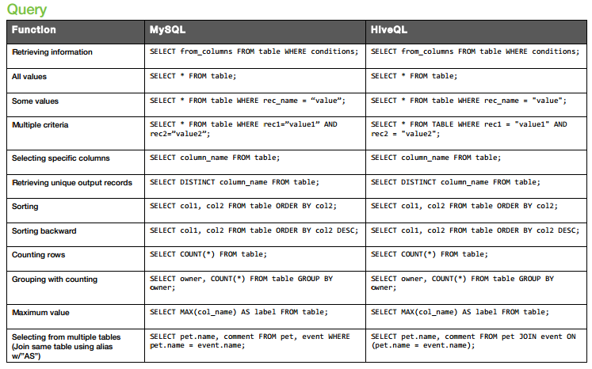
HiveQL Queries

Slide 36
Outline
Introduction to Hadoop
Hadoop Framework Components
Workflow of a Hadoop Cluster
Word Count Code Sample
Hadoop Configuration
Hortonworks Data Platform
Fault Tolerance in Hadoop
Introduction to Hive
HiveQL Queries
Why Hadoop

Slide 37
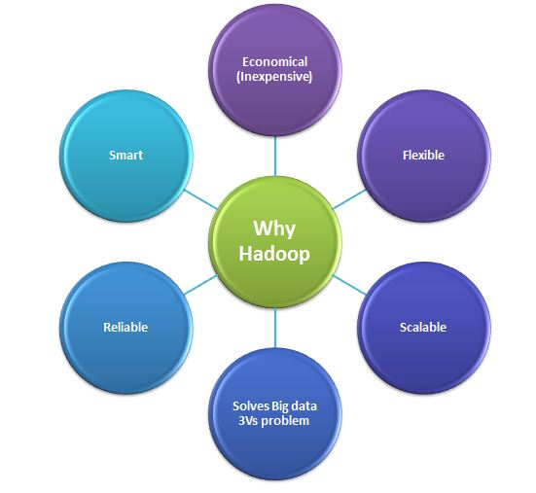
Why Hadoop?
Notes:
Economical (Cost Effective): • No license
• It's an open source framework ,
• If you buy it from Platforms like Hortonworks which are different distributions of Hadoop then also its totally free.
Flexible: • Hadoop is schema-less, and can absorb any type of data, structured or not, from any number of sources.
• Data from multiple sources can be joined enabling deeper analyses than any one system can provide.
Scalable: • New nodes can be added without needing to change data formats, how data is loaded, how jobs are written, or the
applications on top.
• You can add as many number of nodes as you want depending upon the data size and business requirement.
• Can process really large data (petabytes)
Reliable and Fault Tolerant: • When you lose a node, the system redirects work to another location of the data and continues processing without missing a
beat.
• Handles replication
Smart • Optimized Compression
• Query Expression
• Columnar Caching
Solves Big data 3Vs problem: (Volume,Velocity, Variety) ++ (Veracity)
Volume: The benefit gained from the ability to process large amounts of information is the main attraction of big data analytics. More data leads to more accurate analysis. Example: If you could run that forecast taking into account 300 factors rather than 6, could you predict demand better? Turn 12 terabytes of Tweets created each day into improved product sentiment analysis. Convert 350 billion annual meter readings to better predict power consumption Velocity: Sometimes 2 minutes is too late. For time critical applications where Time is the core factor such that catching the frauds, catching the hackers, running status of train, big data must be used as it streams into your enterprise in order to maximize its value. Not only is the volume of data large, it is arriving ever more rapidly. Example: Scrutinize 5 million trade events created each day to identify potential fraud Analyze 500 million daily call detail records in real-time to predict customer churn faster œmachine data  generated on the factory floor or trading data generated by financial markets. Variety: Big data includes both structured and unstructured data such as text, sensor data, audio, video, click streams, log files and more. New insights are found when analyzing these data types together. Example: Monitor 100's of live video feeds from surveillance cameras to target points of interest Exploit the 80% data growth in images, video and documents to improve customer satisfaction.
All these types of data can have a significant effect on a business. Finding out quickly what the data means and understanding its importance provides a business with an ongoing advantage as well as the opportunity to realize competitive benefits. 4th Challenge “ Veracity:
There is a 4th challenge - veracity.  There is one common problem to trust on the data, data accuracy and data sources. Any business should have some basic idea of these (data accuracy and data sources) to make decision where data is one factor. Now the Big Data obviously would amplify and extend this problem due to 3V's i.e. big data contains variety and vast data .

Slide 38
Thank You

