Slide 1
Container based clouds with Kubernetes: An architectural study
CS519 – Distributed Systems Security
Presented By:
Pranjal Mittal
Lakshman Madhav Kollipara

Slide 2
What are containers?
A lighter version of virtual machines

Slide 3
Docker
A tool that makes containers more usable
Easy to deploy services / applications on containers with docker.

Slide 4
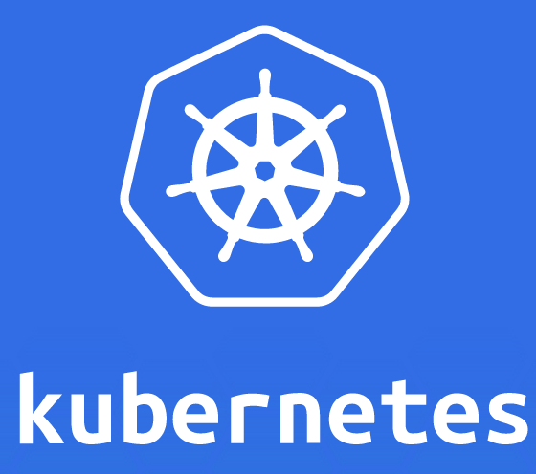
Kubernetes
An orchestration framework for docker containers
Analogies (Openstack:VM :: Kubernetes: ________?)

Slide 5
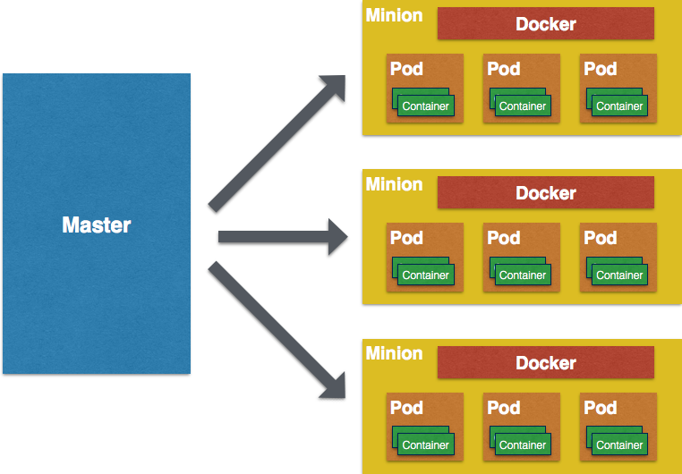
KUBERNETES ARCHITECTURE

Slide 6
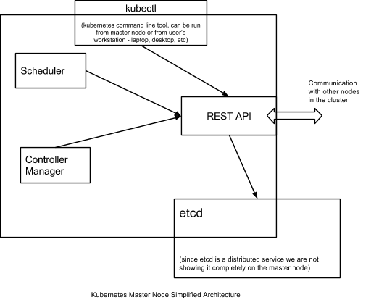
Master Node

Slide 7
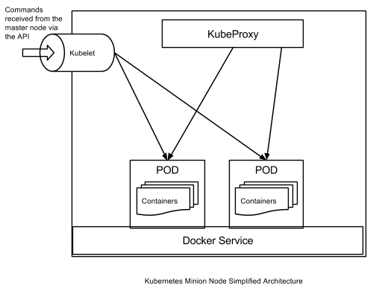
Kubernetes Minion (Simplified)
Notes:
Dockers-Runs encapsulated application containers in a relatively isolated, lightweight operating environment.
Pods-Not exactly a component of minion node.
Collection of docker containers that run on the same minion.
Kubelet-Manages pods and their containers, their images, volumes, etc.
Interacts with etcd to read/write configuration details.
KubeProxy-Manages networking for all these containers via subnets.
Internal subnetting and service availability to external users via Internet.
Simple load balancing (round robin).
Makes networking environment stable and accessible, but
isolated.

Slide 8
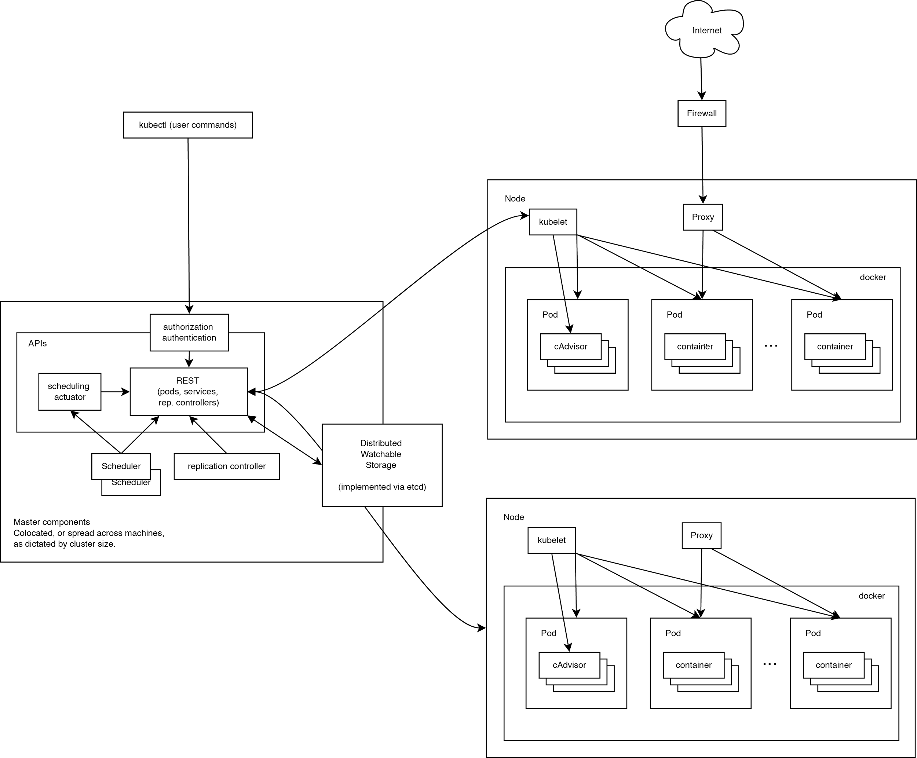
Kubernetes Architecture
Notes:
Isolation between container and underlying hosts
Limiting the container not to impact the infrastructure
Separating users from Administrators
Administrator can delegate few admin functions to users when necessary
MLS- running applications having secret data separate from public data.
Authentication & Authorization
API only will have access to etcd (Data store)
service account - Containers running on cluster communicate with API or other containers using an autonomous authorization process
Containers on cluster run in a security context that isolates from underlying hosts using Linux user security, user namespaces, and permissions.

Slide 9
Demo: Virtual Kubernetes cluster Setup
Go Programming Language
Vagrant (Tool to create VMs for dev environments)
Virtual Box
Boot2Docker (for Windows & Mac)
Kubernetes source code (from GitHub)
Notes:
Isolation between container and underlying hosts
Limiting the container not to impact the infrastructure
Separating users from Administrators
Administrator can delegate few admin functions to users when necessary
MLS- running applications having secret data separate from public data.
Authentication & Authorization
API only will have access to etcd (Data store)
service account - Containers running on cluster communicate with API or other containers using an autonomous authorization process
Containers on cluster run in a security context that isolates from underlying hosts using Linux user security, user namespaces, and permissions.

Slide 10
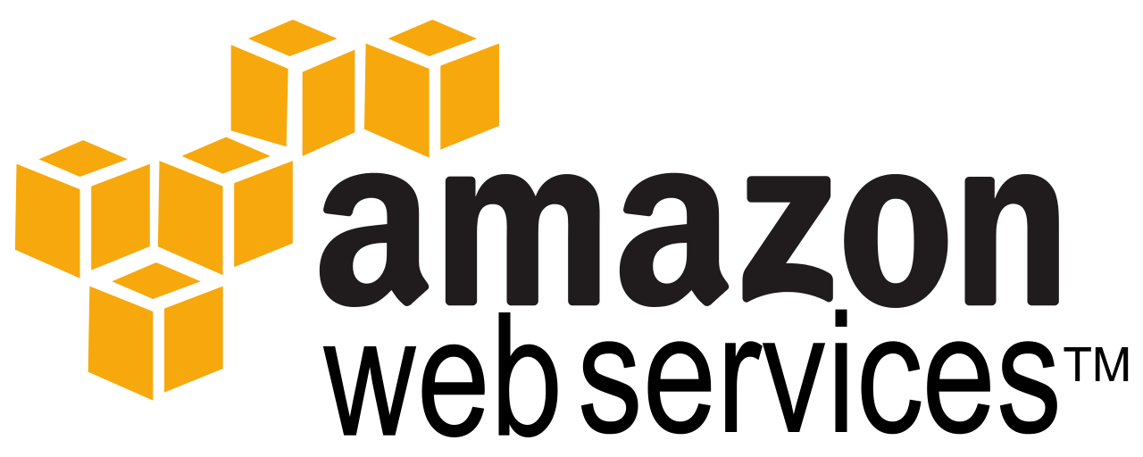
Demo: Setting up a real Kubernetes cluster on AWS
https://52.26.73.41/

Slide 11
THANK YOU
Questions?

