Slide 1
CS519
Towards A Cross-Domain MapReduce Framework
-Nguyen, Gondree & Irvine
PRESENTING BY-
LAKSHMAN MADHAV KOLLIPARA
14-May-2015
Notes:
Published by Naval Postgraduate school at MILCOM 2013

Slide 2
Introduction
What is Hadoop?
MapReduce?
Map: Master node takes the input, divides it into smaller sub-problems, and distributes them to worker nodes
Reduce : Master node then collects the answers to all the sub-problems and combines them in some way to form the output
HDFS :Data in a Hadoop cluster is broken down into smaller pieces (called blocks) and distributed throughout the cluster
Not yet adapted for MLS
1
Notes:
Open source famework from Apache
Provides parallel processing of data
And Distributed Storage
Used to run big data applications- distributed processing among nodes and reduction
HDFS – such that Map reduce jobs can work on smaller subsets
Multi Level secure – Different security classifications exist

Slide 3
Problem Definition
US DoD and US IC collects 4 PB data annually
NSA’s private data cloud uses MapReduce and HDFS for its Intelligence Analytics
Often contains mission-relevant and operational data
Hadoop cant handle Multiple classification of security levels
Developed MLS-aware Cross-domain Hadoop prototype
Using SELinux, Bell-LaPadula confidentiality model
System Architecture, Implementation
4
Notes:
MLS-aware
Making access decisions based on the security level of the data
Reading from resources labeled at the same or lower security levels

Slide 4
SE Linux
Security enhancement to Linux
Implementation of mandatory access controls (MAC)
  ex. Directory “Secret” is owned by “Agent”. “Agent” does not have authority to grant access to others. Only the “Owner” does.
  administrator can differentiate a user from the applications a user runs
  adds finer granularity to access controls
  Specify access to other resources like network resources & IPC
  Permissions are set based on centralized SELinux policy
4

Slide 5
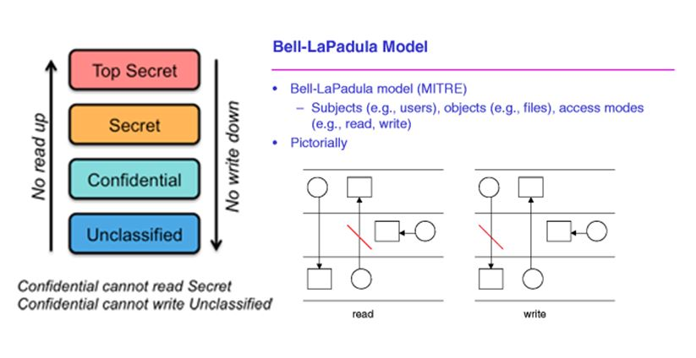
Bell-LaPadula Model
5
Notes:
Confidentiality: preventing disclosure of information.
Integrity: improper modification of data.
Availability: preventing improper denial of service provided by the system.
BIBA- no write up – Nor to contaminate data at higher level
No read down - trust subject from being contaminated by a less trusted data
Lipners- combination of both

Slide 6
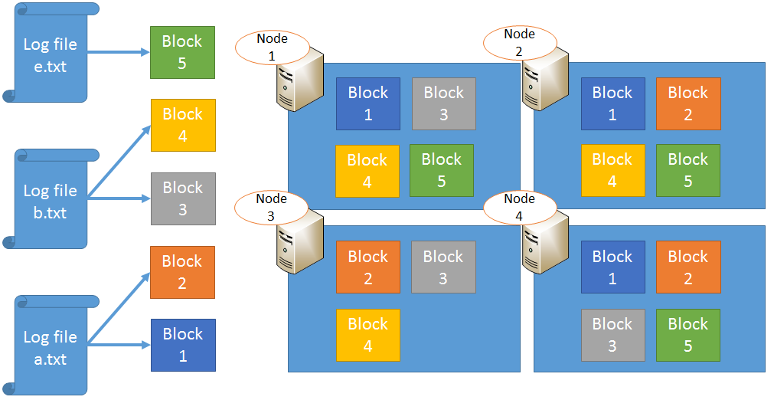
HDFS Architecture
6
Notes:
• HDFS is responsible for distributing the data across the DataNodes
• HDFS does the administrative jobs like addition of the nodes from cluster , removal of the nodes from cluster
• HDFS is also responsible to do the recovery of DataNodes

Slide 7
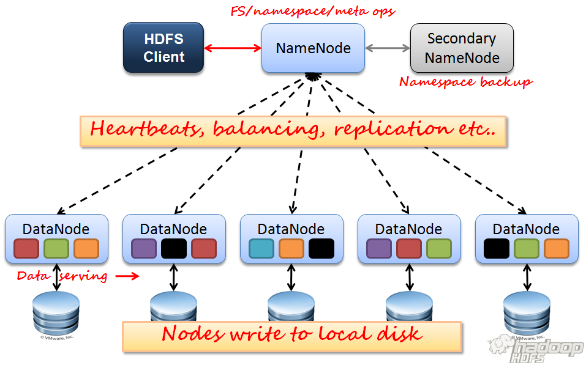
HDFS Architecture
7
Notes:
Name Node:
It is the admin / master of the system.
• It manages the blocks which are present on the Data Node.
• stores the meta-data
• single entry point for any of the failures happening in Hadoop Cluster.
Data Node:
These are the slaves which are deployed on each machine.
• This is the place where actual data is stored.
• responsible for serving read and write requests for the clients.
• processes the part of the data which it holds.
Backup Node:
This is responsible for performing periodic checkpoints. In the event of NameNode failure, you can restart the NameNode using the checkpoint.

Slide 8
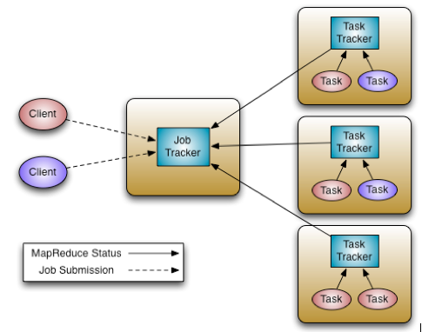
Map-Reduce Architecture
8
Notes:
Client sends job to Job Tracker
JobTracker:
Send map reduce tasks to specific nodes in the cluster, ideally the nodes that have the data, or at least are in the same rack
Monitors progress
TaskTrackers:
TaskTrackers are the slaves which are deployed on each machine.Executes the task, informs status to job tracker

Slide 9
Hadoop Access and File System
Hadoop access control & File System is same as UNIX
But Lacks ability of authenticated user to negotiate session at specific sensitivity level
Establishing session level implicitly by security level of network and TCP/IP port
Hadoop has only one file system. Root is ‘/’
Introduced Multiple file systems: one per sensitivity level
Each level is associated with one SELinux sensitivity levels
Can only write to his session level. But can read objects in lower session level
9
Notes:
Implicitly established by security level of receiving network interface and TCP/IP ports
SELinux Sensitivity Levels - public, internal, confidential and regulatory

Slide 10
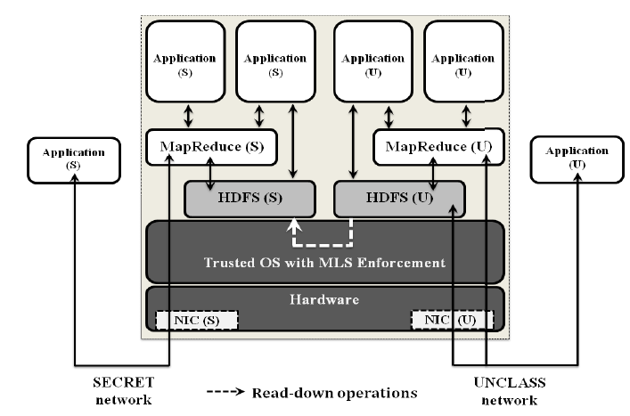
MLS-aware Hadoop Information Flow
10
Notes:
I flow between application ( local and remote) and Hadoop server is constrained by MLS policy
Which means the application can only communicate with processes running at same level as application’s session level

Slide 11
Prototype Design
One physical name node and multiple physical data nodes
Name node consists of separate per-level name nodes
Two types of data nodes: Primary & Surrogate
Primary data node is main handler of blocks
Surrogate data node runs at user session level
Responsible for read-down requests on behalf of primary data node. Why?
Client cannot communicate directly with primary data node if session level doesn’t dominate sensitivity level of block
11
Notes:
Primary – owner of files used to store the blocks in local file system.

Slide 12
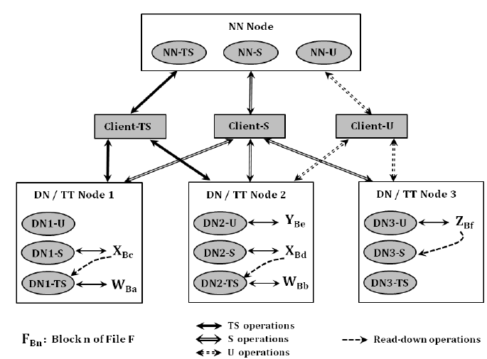
Prototype Design
12
Notes:
When client requests a file -> Namenode will direct client to retrieve data from Data nodes
Read down -> name node must obtain metadata of requested file and storage locations of blocks from name node running at lower level

Slide 13
Implementation_Name node
fsImage – keeps track of current file hierarchy
blockMap – records data node where each block is stored
Introduced 2 additional data structures: Cache-fsImage & Cache-blockMap
Stored in local RAM of each instance of Name node for high sensitivity
Other Instances of Name node communicates with these two to handle read-downs
Cache-fsImage for file permission & Block Allocation & Cache-blockMap to inform clients where blocks are located.
Concurrent access is managed by lock-free multiple reader, single writer integrity mechanism
13
Notes:
Map Reduce jobs keep their internal data structures and files in HDFS.
So, we mainly concentrate on making HDFS MLS-aware
fsImage and blockMap are stored in private memory and not visible to other name node instances
Cache-fsImage & blockMap - look up file meta data and block storage info
Locking – shared exclusive locks

Slide 14
Implementation_Data node
Each block is stored as a block file and metadata file
Maintains a blocks-to-files map to keep track of files used to store data in local
volumeMap – Whenever new blocks are allocated or inaccessible
blockMap – records data node where each block is stored
cache-volumeMap – capture the content of volumeMap on RAM
Uses read-and-retry synchronization to solve concurrency issues
Extended Block ID – 64-bit random number and 4 byte Level ID
14
Notes:
If a client wants to read a file at lower level,
Name node directs the client to contact surrogate data node co-located with primary data node.
To return a block from lower level data node must have access to volumeMap maintained by primary data node
But stored in private memory
Copy to RAM so that all surrogate data nodes can read it while handling read-down requests

Slide 15
Scalability
If we scale number of nodes, size restriction on fsImage and blockMap
HDFS Federation Architecture – Scaling Name Nodes
Also partitions Hadoop file system into multiple namespaces
Memory exhaustion problem still exists.
In MLS-aware, Memory problem is worse
Use separate physical node as cache, one cache per sensitivity level
Using Kerberos for establishing user sessions at different security levels
15
Notes:
Kerberos- CN authentication and authorization protocol
uses basis of 'tickets' to allow nodes communicating over non-secure channel
Provides mutual authentication

Slide 16
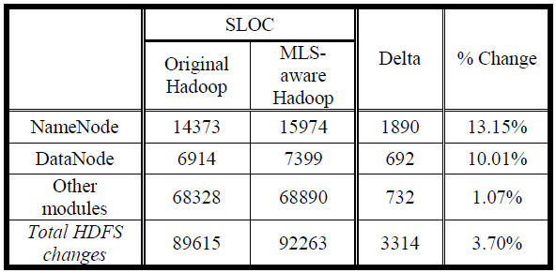
Complexity
16

Slide 17
Performance
Degrades exponentially when number of files increases due to overhead of caching
Impact grows exponentially for read-down requests as data size increases
Feasibility of using Hadoop in MLS environment
First step towards highly secure Map Reduce
Can obtain better performance.
17

Slide 18
THANK YOU
Questions…!!!
Why write-up allowed in BLP?
What if the data is confident between two same sensitivity levels ?
Have A Great Day….!!!!!
18

