Slide 1
CSCI 1101 Intro to Computers
7.2 Learning HTML

Slide 2
HTML document structure
Three parts make a well-structured HTML document: header, body, and footer
The header includes the <HTML>, <HEAD> and <TITLE> tags
The body includes the <BODY> tag
The footer includes the <ADDRESS> tag
HTML tags do not have to appear in caps

Slide 3
HTML tags and categories
Most HTML tags require a matching start and end tags;
  <H1>…</H1>.
A limited number of one-sided tags which do not reguire a closing tag
  <HR> - horizontal rule (line)
  <BR> - hard break in text stream
  A few others

Slide 4
HTML tag nesting
HTML tags may be nested according to this rule:
  first open, last closed; or
  last open, first closed;
    <H1><B><I> …</I></B></H1>

Slide 5
Document structure tags
The basic structure of an HTML file is:
  <HTML>
  <HEAD>
  <TITLE> Title goes here </TITLE>
  </HEAD>
  <BODY>
  Body and content go here
  <ADDRESS>
  footer goes here if used
  </ADDRESS>
  </BODY>
  </HTML>

Slide 6
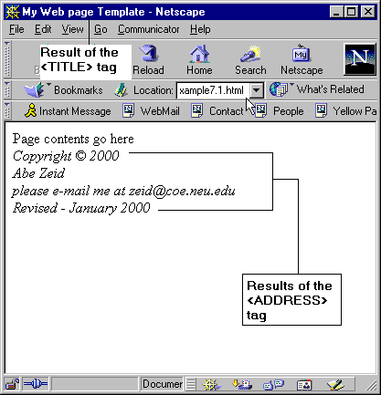
Document structure tags
Example of document structure tags
<HTML>
<HEAD>
<TITLE>My Web page Template</TITLE>
</HEAD>
<BODY>
Page contents go here
<ADDRESS>
Copyright &#169; 2000<BR>
Abe Zeid<BR>
please e-mail me at zeid@coe.neu.edu<BR>
Revised - January 2000<BR>
</ADDRESS>
</BODY>
</HTML>

Slide 7
Text and tags
Text, in general, consists of headings, paragraphs, and words.
  HTML has tags to format each

Slide 8
Heading tags
Heading tags are <H1> through <H6>
  <H1> providing the largest size text, and
  <H6> providing the smallest size.
  All <H#> tags have the ALIGN attribute
    <H1 align="right">
    <H1 align="center">
    <H1 align="left">

Slide 9
Paragraph tags
The <P> tag is the only tag for paragraphs.
  Frequently used as a one-sided tag to insert a hard paragraph break in text.
  HTML standard defines it as a two-sided tag
    <P>The paragraph text goes in here </P>
  When used as a two-sided tag, it has the same align attribute options as the heading tags
The <BR> tag inserts a hard return in the text, without the vertical spacing associated with a <P> break

Slide 10
Tags for formatting words
The tags for words (all two sided) are
  <B> (boldfaced)
  <I> (italicized)
  <U> (underlined)
  <CENTER> (Centers text within the browser window)
  <BLOCKQUOTE> (Long quotation style text indenting on both sides of the browser window)
  <BIG> (Larger text)
  <CITE> (Citation styling for research papers)
  <EM> (generic definition for emphasized text - generally italics)
  <KBD> (keyboard text - uses the fixed-width font defined by the browser)
  <SMALL> (smaller text)
  <STRONG> (generic definition for strong text - generally boldfaced)

Slide 11
Additionally formatting tags
The <FONT> has a large variety of attributes
  COLOR
  SIZE
  ALIGN
  FACE
The <HR> has the attributes
  ALIGN,
  COLOR,
  NOSHADE,
  SIZE, and
  WIDTH

Slide 12
Text and tags
(Results on the next page)
<HTML>
<HEAD>
<TITLE>Heading tags Web page</TITLE>
</HEAD>
<BODY>
<H1>This text is size H1</H1><BR>
<H2 ALIGN = "center">
This text is centered and
size H2</H2><BR>
<H3 ALIGN = "right">
This text is right justified
and size H3
</H3><BR>
<H4>This text is size H4</H4><BR>
<H5>This text is size H5</H5><BR>
<H6>This text is size H6</H6>
</BODY>
</HTML>

Slide 13
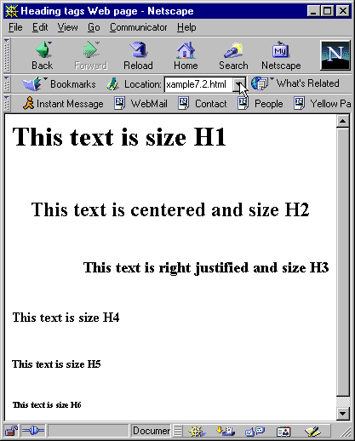
Text and tags
<HTML>
<HEAD>
<TITLE>Heading tags Web page</TITLE>
</HEAD>
<BODY>
<H1>This text is size H1</H1><BR>
<H2 ALIGN = "center">
This text is centered and
size H2</H2><BR>
<H3 ALIGN = "right">
This text is right justified
and size H3
</H3><BR>
<H4>This text is size H4</H4><BR>
<H5>This text is size H5</H5><BR>
<H6>This text is size H6</H6>
</BODY>
</HTML>

Slide 14
Text and tags (results on next page)
Example of the <P> tag
<HTML>
<HEAD>
<TITLE>Paragraph tag Web page</TITLE>
</HEAD>
<BODY>
<P>This page illustrates how to use the paragraph tag to create paragraphs. </P>
<P>When surfers browse the Web, they are accessing and reading home Web pages and pages that are linked to them. These pages are written using a scripting language called HTML (HyperText Mark up Language). We here begin covering HTML and page layout, organization and design. </P>
<P>The markup language is a method to embed special tags that describe the structure as well as the formatting of a document. The markup language allows the non-sequential way of reading HTML documents. The simplicity and power of HTML let anyone create Web documents. Making Web documents is easy and straight forward. The markup nature of HTML is what is behind the incredible breadth and reach of the Web </P>
</BODY>
</HTML>

Slide 15
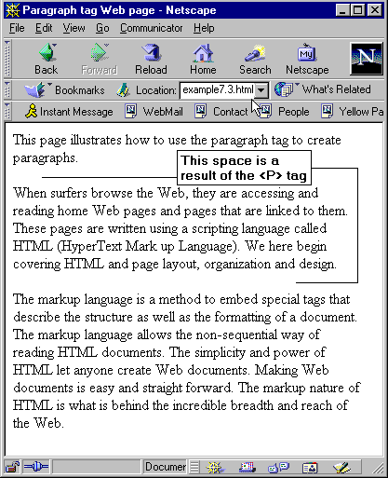
Text and tags

Slide 16
Text and tags
Examples of Word tags
<HTML><HEAD><TITLE>Formatting tags Web page</TITLE>
</HEAD><BODY>
<B>This text uses the Bold tag</B><BR>
<BIG>This text uses the BIG tag</BIG><BR>
<BLOCKQUOTE>This text uses the BLOCKQUOT tag</BLOCKQUOTE><BR>
<CENTER>This text uses the CENTER tag</CENTER><BR>
<CITE>This text uses the CITE tag</CITE><BR>
<CODE>This text uses the CODE tag</CODE><BR>
<EM>This text uses the EM tag</EM><BR>
<FONT SIZE=2 COLOR="green">This text uses the FONT tag</FONT><BR>
<HR SIZE= 5 WIDTH=50% ALIGN="center" NOSHADE>
<I>This text uses the Italic tag</I><BR>
<KBD>This text uses the KBD tag</KBD><BR>
<SMALL>This text uses the SMALL tag</SMALL><BR>
<STRIKE>This text uses the STRIKE tag</STRIKE><BR>
<STRONG>This text uses the STRONG tag</STRONG><BR>
<U>This text uses the Underline tag</U><BR>
</BODY></HTML>

Slide 17
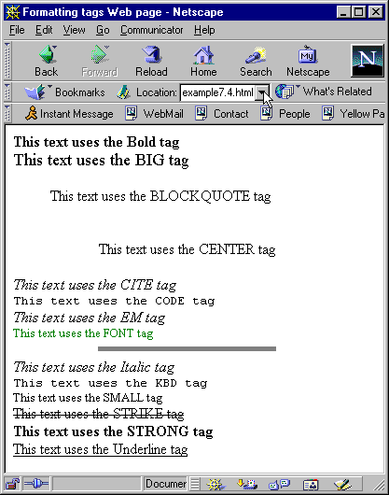
Text and tags

