Slide 1
Introduction to UML:
Unified Modeling Language

Slide 2
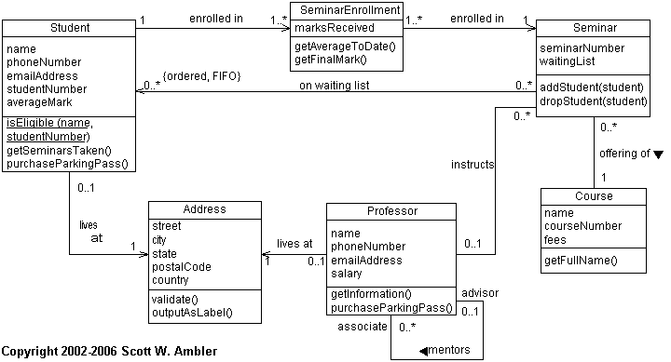
Example UML Class Diagram
http://www.agiledata.org/images/oo101ClassDiagram.gif

Slide 3
UML: Unified Modeling Language
“The Unified Modeling Language (UML) is a family of graphical notations … that help in describing and designing software systems, particularly those built using object-oriented (OO) style” [Martin Fowler in UML Distilled]

Slide 4
History
Design notation of various kinds used since programming began:
  Flow charts, Pseudo code, Structure Diagrams …
With advent of OO, many conflicting notations (1980s , 1990s)
These notations were combined and unified (late 1990’s)
UML extensively taught in universities
(2000 - now).

Slide 5
3 Ways to Use UML
(Both forward & reverse engineering)
Sketch e.g. at white board
  Most common, quick and informal
  Communication & understanding
Blueprint
  Detailed design, implemented by programmer
  May have tools supporting diagramming
Programming Language
  Tools translate diagrams to executable code

Slide 6
Fowler says…
“Almost all the time, my use of the UML is as sketches.”
“I’m not a fan of detailed forward engineered blueprints.”
“I see the UML as a programming language as a nice idea but doubt that it will ever see significant usage.”

Slide 7
Savitch say:
Today’s candidate for a graphical representation formalism is the UML. … It is too early to say whether or not the UML will stand the test of time…” [Savitch, Absolute C++, 3rd Edition]

Slide 8
Software Lifecycle:
UML Can Be Used at Various Stages
Analysis: OOA
  What is system to do? What services is it to provide? Provide requirements for designer.
Design: OOD
  What will be the parts & structure of the system? How will they interact? Provide blueprint for programmer.
Programming: OOP

Slide 9
13 (!!) Kinds of UML Diagrams
Activity
Class
Communication
Component
Component structure
Deployment
Interaction
Object
Package
Sequence
State machine
Timing
Use case

Slide 10
Classification of UML Diagrams
(Part 1 of 2)
Structure
  Class diagram
  Component diagram (cmpts can be independently purchased and replaced)
  Component structure diagram
  Deployment diagram (what goes on what machine & place)
  Object diagram
  Package diagram (pkg = group of classes, e.g. namespace)

Slide 11
Classification of UML Diagrams
(Part 2 of 2)
Behavior
  Activity diagram (flow chart)
  Use Case diagram (scenarios for use of system)
  State Machine diagram
  Sequence diagram
  Communication diagram (data flow diagrams)
  Interaction diagram (activity + sequence diagrams)
  Timing diagram

Slide 12
Class Diagrams

Slide 13
Example UML Class Diagram
http://www.agiledata.org/images/oo101ClassDiagram.gif

Slide 14
Class
Class Name
Attribute : type
Operation (arg list) : return type
Abstract operation
Various parts are optional

Slide 15
Instance Specification
(Object)
ObjectName: Class Name
Attribute : type
Operation (arg list) : return type
Abstract operation
Various parts are optional

Slide 16
Kinds of Edges
Association
Role of B
Class A
Class B
Role of A
Navigability
Role name
Role name
Source
Target
Dependency
Client
Supplier
There are other kinds of edges

Slide 17
Multiplicities on Edges
(Cardinalities)
1 Exactly one
* Many (any number)
0..1 Optional (zero or one)
m..n Specified range
{ordered}* Ordered

Slide 18
Generalization
(Inheritance)
Supertype
Subtype 1
Subtype 2

Slide 19
Note
(Comment)
Some item eg class
Comment about an item

Slide 20
Sequence Diagrams

Slide 21
Example for Sequence Diagram
[Fowler]
We have an order and are going to invoke a command on it to calculate its price. To do that, the order needs to look at all the line items on the order and determine their prices, which are based on the pricing rules of the order line’s products. Having done that for all the line items, the order then needs to compute an overall discount, which is based on rules tied to the customer.

Slide 22
Example for Sequence Diagram
[Fowler]
We have an order and are going to invoke a command on it to calculate its price. To do that, the order needs to look at all the line items on the order and determine their prices, which are based on the pricing rules of the order line’s products. Having done that for all the line items, the order then needs to compute an overall discount, which is based on rules tied to the customer.

Slide 23
Example Sequence Diagram
anOrder
anOrderLine
aProduct
aCustomer
calculatePrice
getQuantity
getProduct
Participant
Lifeline
Found
message
aProduct
Activation
getPricingDetails
Return
getBasePrice
Self call
Message
calculateDiscounts
getDiscountInfo

Slide 24
Elements of Sequence Diagrams
Name: Class
Create
New object
Message
Self-call
Return
Delete
There is also notation for loops, conditions, etc.

Slide 25
Diagram Size
(Cognitive Limit)
Generally, a diagram is not useful if it contains more than about 25 boxes

