Slide 1
UML an overview

Slide 2
Topics covered in this Session
1. Introducing UML.
2. What constitutes the UML.
3. Concepts of UML.

Slide 3
Background
What are object-oriented (OO) methods?
OO methods provide a set of techniques for analyzing, decomposing, and modularizing software system architectures
In general, OO methods are characterized by structuring the system architecture on the basis of its objects (and classes of objects) rather than the actions it performs
What are the benefits of OO?
OO enhances key software quality factors of a system and its constituent components
What is the rationale for using OO?
In general, systems evolve and functionality changes, but objects and classes tend to remain stable over time

Slide 4
Background
Software Quality Factors
Object-oriented techniques enhance key external and internal software quality factors, e.g.,
1. External (visible to end-users)
(a) Correctness
(b) Robustness and reliability
(c) Performance
2. Internal (visible to developers)
(a) Modularity
(b) Flexibility/Extensibility
(c) Reusability
(d) Compatibility (via standard/uniform interfaces)

Slide 5
Background
OOA, OOD, and OOP
Object-oriented methods may be applied to different phases in the software life-cycle
e.g., analysis, design, implementation, etc.
OO analysis (OOA) is a process of discovery
Where a development team models and under-stands the requirements of the system
OO design (OOD) is a process of invention and adaptation
Where the development team creates the abstractions and mechanisms necessary to meet the system's behavioral requirements determined during analysis

Slide 6
Modeling
Modeling is a way of thinking about the problems using models organized around the real world ideas.
A modeling method comprises a language and also a procedure for using the language to construct models.
modeling is the only way to visualize your design and check it against requirements before your crew starts to code.
Refernces
http://www.omg.org/gettingstarted/what_is_uml.htm
http://www.inconcept.com/JCM/April1998/halpin.html

Slide 7
Introduction
What is UML?
Is a language. It is not simply a notation for drawing diagrams, but a complete language for capturing knowledge(semantics) about a subject and expressing knowledge(syntax) regarding the subject for the purpose of communication.
Applies to modeling and systems. Modeling involves a focus on understanding a subject (system) and capturing and being able to communicated in this knowledge.
It is the result of unifying the information systems and technology industry’s best engineering practices (principals, techniques, methods and tools).
Refernces
www.sqae.com/UML.ppt

Slide 8
Unified Modeling Language (UML)
used for both database and software modeling
version 1.1 was adopted in November 1997 by the Object Management Group (OMG) as a standard language for object-oriented analysis and design
Initially based on a combination of the Booch, OMT (Object Modeling Technique) and OOSE (Object-Oriented Software Engineering) methods, UML was refined and extended by a consortium of several companies, and is undergoing minor revisions by the OMG Revision Task Force.
Ivar Jacobson is known as the father of Use Cases.
Refernces
http://www.inconcept.com/JCM/April1998/halpin.html

Slide 9
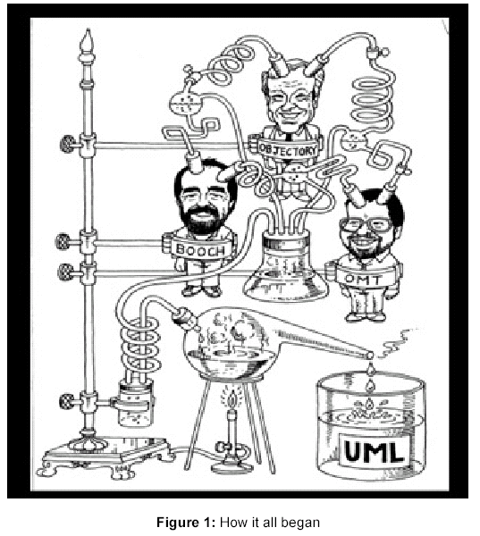

Slide 10
The Unified Modeling Language.
Unification
Specify
Construct
The UML Goal
Visualize
Document
Programming Language
Tools / Repository Specification
Process

Slide 11
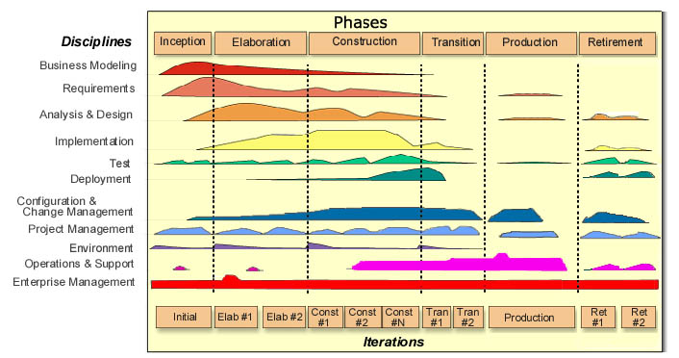

Slide 12
UML Concepts-The 4+1 view
Use Case view
    Understandability
Logical View
    Functionality
Process View
    Performance
    Scalable
    Throughput
Implementation View
    Software management
Deployment View
    System topology
    Delivery
    Installation

Slide 13
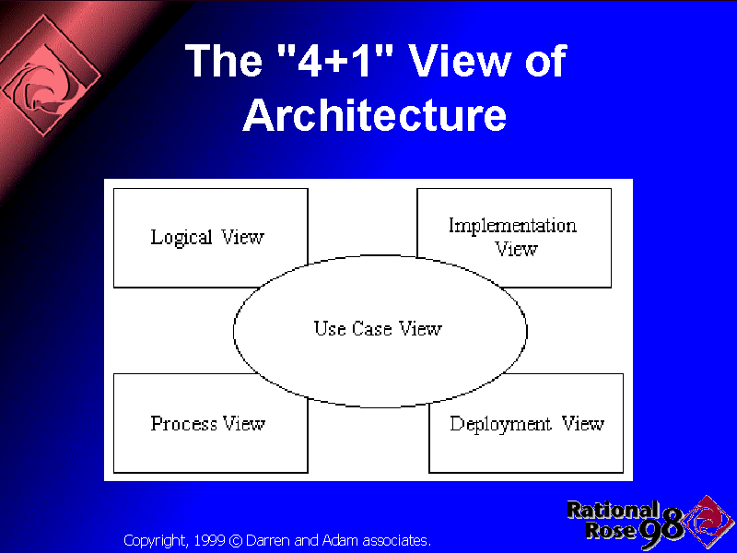

Slide 14
UML Diagrams
UML includes diagrams for
use cases
static structures (class and object diagrams)
behavior (state-chart, activity, sequence and collaboration diagrams)
implementation (component and deployment diagrams).
For data modeling purposes UML uses class diagrams, to which constraints in a textual language may be added

Slide 15
The UML process
There are four kinds of things in the UML.
1. Structural Things.
2. Behavioral Things.
3. Grouping Things.
4. Annotational Things.

Slide 16
Things in UML
Structural Things
Behavioral Things
Grouping Things
Annotational Things
1. Class
1. Interaction
1. Packages
1. Notes
2. Interface
2. State Mechanism
3. Collaboration
4. Use Case
5. Active Class
6. Components
7. Nodes

Slide 17
Diagrams in UML
A Diagram is the graphical presentation of a set of elements, most often rendered as a connected graph of things and relationships. UML includes 9 such diagrams.
1. Class Diagram.
2. Object Diagram.
3. Use Case Diagram.
4. Sequence Diagram.
5. Collaboration Diagram.
6. State Chart Diagram.
7. Activity Diagram.
9. Deployment Diagram.

Slide 18
Use case diagrams
Use Case Diagrams
Use Case Diagrams describe the functionality of a system and users of the system. These diagrams contain the following elements:
Actors, which represent users of a system, including human users and other systems.
Use Cases, which represent functionality or services provided by a system to users.

Slide 19
High Level Use Case Diagram
Manage Resources
Resource Manager
Manage Projects
Project Manager
System Admin
System Administrator

Slide 20
Managing Resources Use Case Diagram
Add Skill
Remove Skill
Find Skill
Update Skill
Resource Manager
Add Resource
Find Resource
Remove Resource
Update Resource
Assign Skill from Resource
Unassign Skill from Resource

Slide 21
Class Diagrams
Class Diagrams describe the static structure of a system, or how it is structured rather than how it behaves. These diagrams contain the following elements.
Classes, which represent entities with common characteristics or features. These features include attributes, operations and associations.
Associations, which represent relationships that relate two or more other classes where the relationships have common characteristics or features. These attributes and operations.

Slide 22
High-Level Resource Class Diagram
Skill
Resource-Skill
Resources
Salaried
Hourly

Slide 23
Detailed Resource Class Diagram
Skill
Name: String
Desc: String
Create(): Skill
setName(): (Name:String)
getName(): String
setDesc(): (Desc:String)
getDesc(): String
destroy()
Resource Skill
Resource
Salaried
Hourly

Slide 24
Object Diagrams
Object Diagrams describe the static structure of a system at a particular time. Whereas a class model describes all possible situations, an object model describes a particular situation. Object diagrams contain the following elements:
Objects, which represent particular entities. These are instances of classes.
Links, which represent particular relationships between objects. These are instances of associations.
.

Slide 25
Sequence Diagrams
Sequence Diagrams describe interactions among classes. These interactions are modeled as exchange of messages. These diagrams focus on classes and the messages they exchange to accomplish some desired behavior. Sequence diagrams are a type of interaction diagrams. Sequence diagrams contain the following elements:
Class roles, which represent roles that objects may play within the interaction.
Lifelines, which represent the existence of an object over a period of time.
Activations, which represent the time during which an object is performing an operation.
Messages, which represent communication between objects.

Slide 26
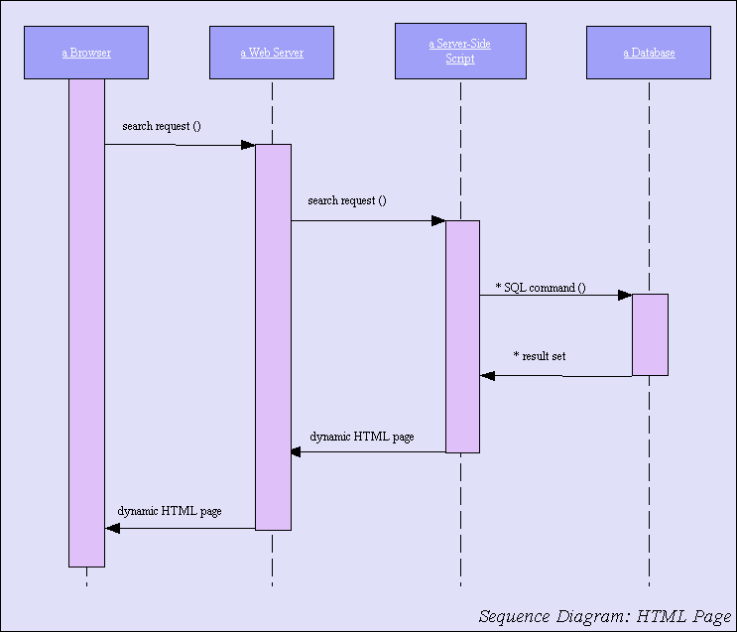
Sequence Diagram

Slide 27
Collaboration Diagrams
Collaboration Diagrams describe interactions among classes and associations. These interactions are modeled as exchanges of messages between classes through their associations. Collaboration diagrams are a type of interaction diagram. Collaboration diagrams contain the following elements.
Class roles, which represent roles that objects may play within the interaction.
Association roles, which represent roles that links may play within the interaction.
Message flows, which represent messages sent between objects via links. Links transport or implement the delivery of the message.

Slide 28
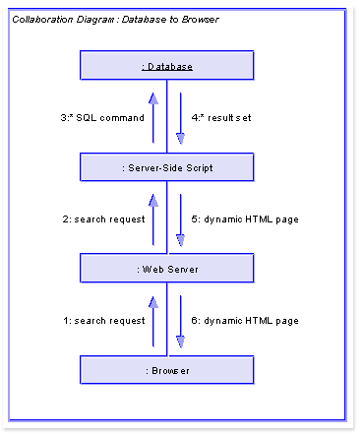

Slide 29
Statechart Diagrams
Statechart (or state) diagrams describe the states and responses of a class. Statechart diagrams describe the behavior of a class in response to external stimuli. These diagrams contain the following elements:
States, which represent the situations during the life of an object in which it satisfies some condition, performs some activity, or waits for some occurrence.
Transitions, which represent relationships between the different states of an object.

Slide 30
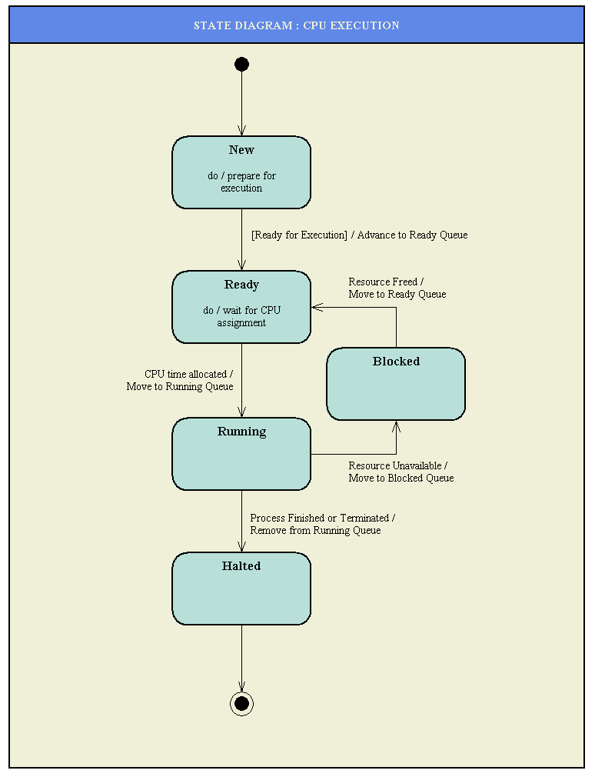
State Chart Diagram

Slide 31
Activity Diagrams
Activity diagrams describe the activities of a class. These diagrams are similar to statechart diagrams and use similar conventions, but activity diagrams describe the behavior of a class in response to internal processing rather than external events as in statechart diagram.
Swimlanes, which represent responsibilities of one or more objects for actions within an overall activity; that is, they divide the activity states into groups and assign these groups to objects that must perform the activities.
Action States, which represent atomic, or noninterruptible, actions of entities or steps in the execution of an algorithm.
Action flows, which represent relationships between the different action states of an entity.

Slide 32
Activity Diagrams (Cont...)
Object flows, which represent the utilization of objects by action states and the influence of action states on objects.

Slide 33
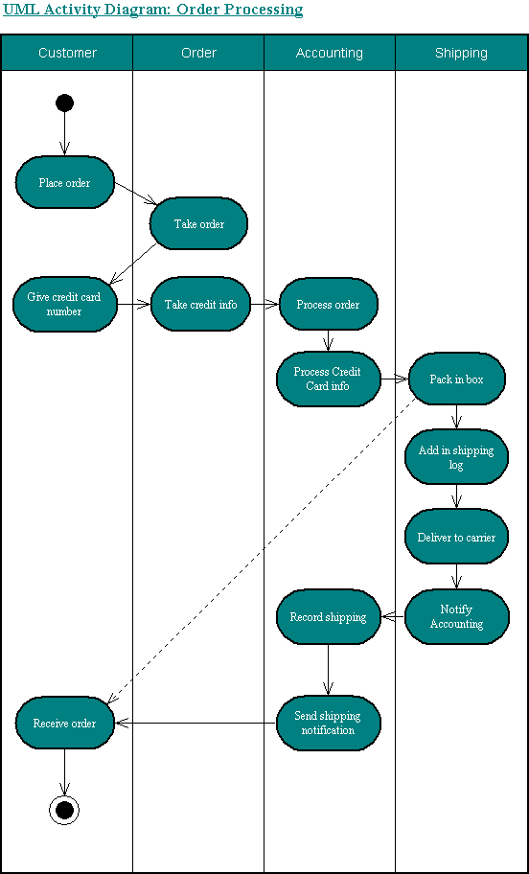
Activity Diagram

Slide 34
Component Diagrams
Component diagrams describe the organization of and dependencies among software implementation components. These diagrams contain components, which represent distributable physical units, including source code, object code, and executable code.

Slide 35
Deployment Diagrams
Deployment diagrams describe the configuration of processing resource elements and the mapping of software implementation components onto them. These diagrams contain components and nodes, which represent processing or computational resources, including computers, printers, etc.

Slide 36
Advantages of UML
You can model just about any type of application, running on any type and combination of hardware, operating system, programming language, and network, in UML.
Used for modeling middleware
Built upon the MOF™ metamodel for OO modeling
UML Profiles (that is, subsets of UML tailored for specific purposes) help you model Transactional, Real-time, and Fault-Tolerant systems in a natural way.
Refernces
http://www.omg.org/gettingstarted/what_is_uml.htm

Slide 37
Advantages of UML
• UML is effective for modeling large, complex software
systems
• It is simple to learn for most developers, but provides
advanced features for expert analysts, designers and architects
• It can specify systems in an implementation-independent manner
• 10-20% of the constructs are used 80-90% of the time
• Structural modeling specifies a skeleton that can be refined
and extended with additional structure and behavior
• Use case modeling specifies the functional requirements of
system in an object-oriented manner

Slide 38
Other uses of UML
analyze existing source code and reverse-engineer it into a set of UML diagrams.
execute UML models, typically in one of two ways:
  execute your model interpretively in a way that lets you confirm that it really does what you want, but without the scalability and speed that you'll need in your deployed application.
  work only within a restricted application domain generate program language code from UML, producing most of a bug-free, deployable application that runs quickly if the code generator incorporates best-practice scalable patterns for,
A number of tools on the market generate Test and Verification Suites from UML models.
Refernces
http://www.omg.org/gettingstarted/what_is_uml.htm

Slide 39
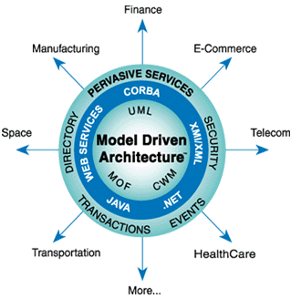
OMG’s Model Driven architecture ™ (MDA™)
Based firmly on OMG standards, MDA aims to separate business or application logic from underlying platform technology. UML forms the foundation of MDA and can be used for PIMs and PSMs.
Refernces
http://www.omg.org/mda/

Slide 40
Thank You !!
Comments and questions

