Slide 1
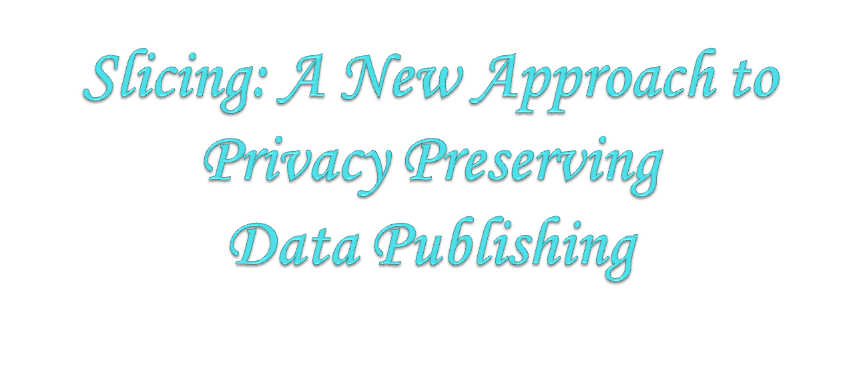
TEAM MEMBERS:
K.Lakshman Madhav BL.EN.U4CSE09075
P.Abinaya BL.EN.U4CSE09002
M.Naga Hitesh BL.EN.U4CSE08061
GUIDE :
B. Sree Vidya
Lecturer
Department of Computer Science

Slide 2
Abstract
Privacy Preserving
Publishing privacy preserving data
    Generalization
    Bucketization
    Slicing

Slide 3
Module Description
Original Data
Generalization
Bucketization
Multiset-based Generalization
One-attribute-per-Column Slicing
Slicing

Slide 4
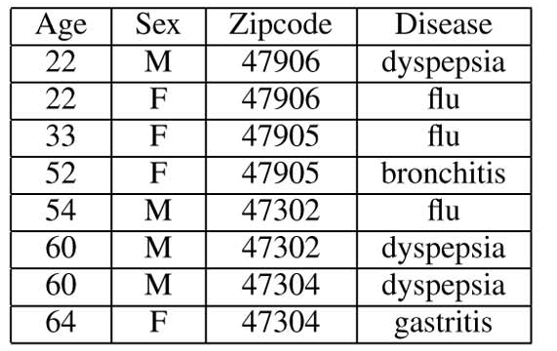
Original Table
Identifiers
Quasi Identifiers(QI)
Sensitive Attributes

Slide 5
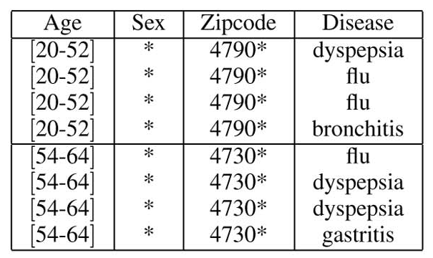
Generalization
Disadvantages-
  Each attribute is generalized separately, correlations between attributes are lost
  Loses considerable amount of data, especially for high dimensional data

Slide 6
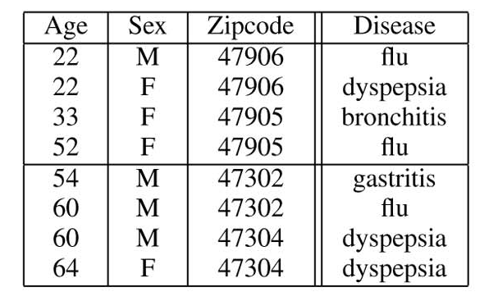
Bucketization
Disadvantages
  Requires a clear separation of QI’s and the SA’s.
  Does not prevent membership disclosure .
  Breaks attribute correlation between QI’s and SA’s

Slide 7
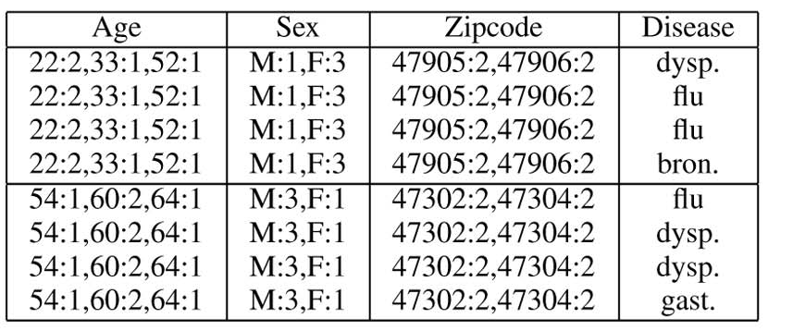
Multiset-based Generalization
A generalised table where each attribute is replaced with the multiset of values in the bucket.

Slide 8
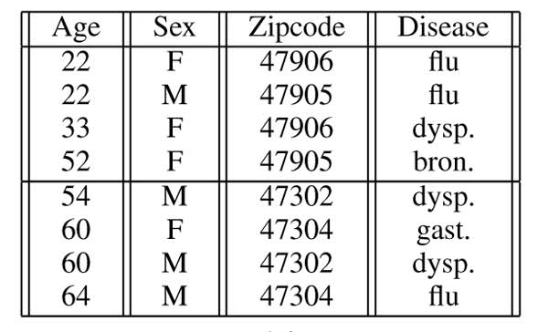
One-attribute-per-Column Slicing
Preserves attribute distributional information
Disadvantage-
Doesn’t prepare attribute correlation, because each attribute is in its own column

Slide 9
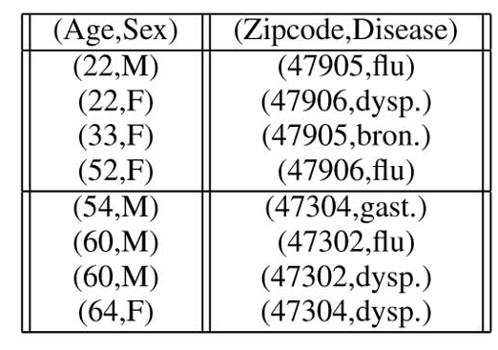
Slicing
Groups correlated attributes together and preserves their correlation
Ability to handle high-dimensional data.
Prevent membership disclosure.

Slide 10
Slicing
Partitions data both horizontally and vertically
Preserves better data utility
Used for membership disclosure protection
Basic idea of slicing is to break the association cross columns, but to preserve the association within each column

Slide 11
Slicing
Preserves correlation between attributes
Protects privacy because breaks associations between uncorrelated attributes
Ensures that for any tuple, there are generally multiple matching buckets

Slide 12
Thank you

