Slide 1

Slicing: A New Approach for Privacy Preserving
Data Publishing

Slide 2
TEAM MEMBERS:
K.Lakshman Madhav BL.EN.U4CSE09075
P.Abinaya BL.EN.U4CSE09002
M.Naga Hitesh BL.EN.U4CSE08061
GUIDE :
B. Sree Vidya
Lecturer
Department of Computer Science

Slide 3
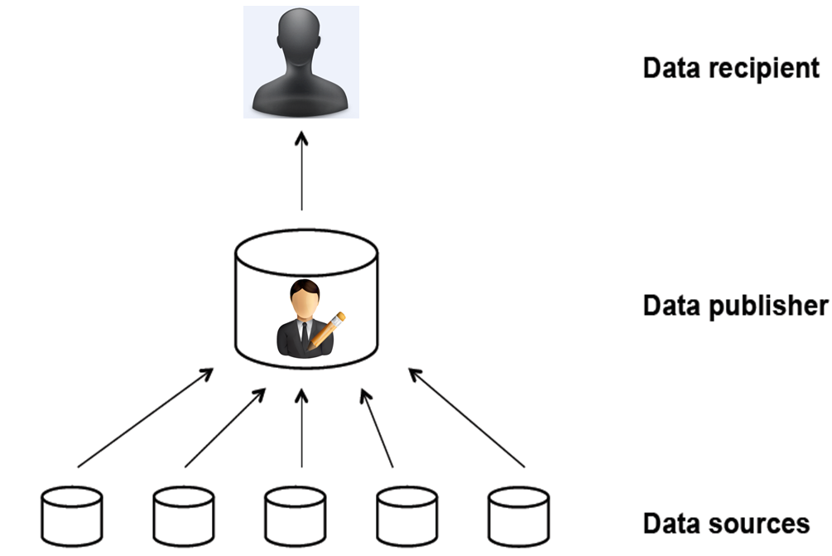
Introduction
Problem Statement- Privacy preserving and Microdata publishing

Slide 4
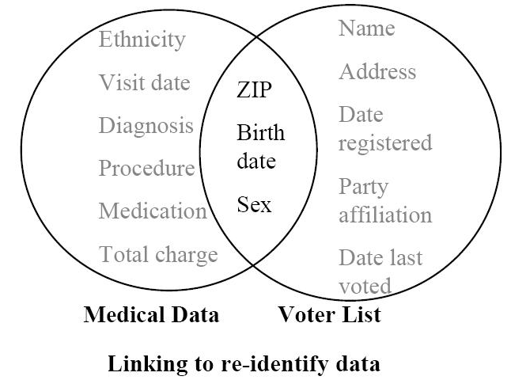
Privacy Threats
Record Linkage
Table Linkage
Attribute Linkage

Slide 5
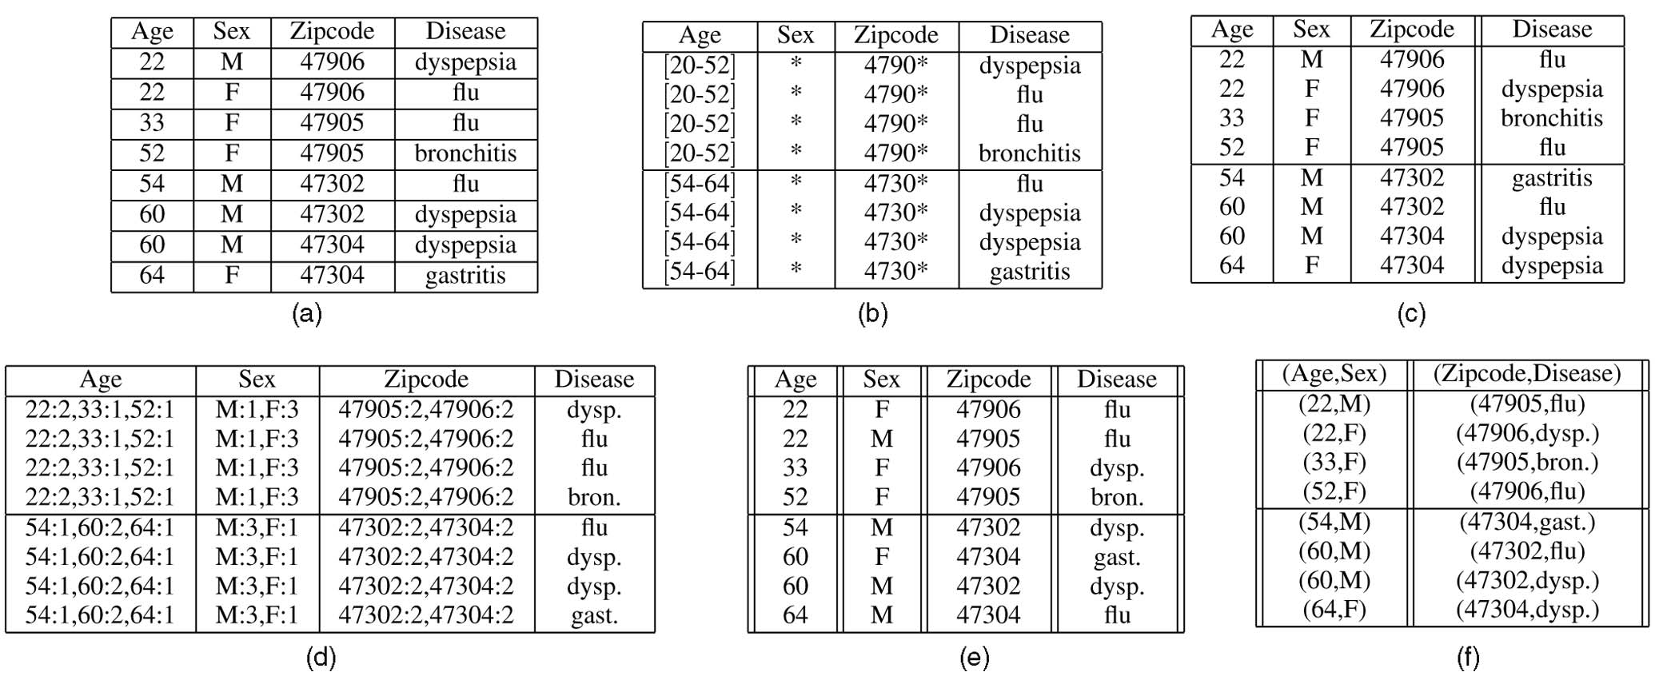
Anonymization Techniques
Generalization
Bucketization
Slicing

Slide 6
Existing System
Generalization(K-anonymity)
Bucketization (l-diversity)
Disadvantages
  Data loss
  Cant handle high dimensional data
  Membership disclosure protection
  Doesn’t preserve Attribute correlations
  Reduces data utility

Slide 7
Proposed System
Slicing
  Partition of data
  High dimensional data
  Membership disclosure
  Attribute disclosure protection
  Better data utility than generalization

Slide 8
Literature Survey
ℓ-Diversity: Privacy Beyond k-Anonymity, 2006
Worst-Case Background Knowledge for Privacy-Preserving Data Publishing, 2007
Privacy-Preserving Data Publishing , 2010
Multi-Attribute Generalization Method in Privacy Preserving Data Publishing,2010
Slicing: A New Approach for Privacy Preserving Data Publishing
By Tiancheng Li, Ninghui Li, Jian Zhang, and Ian Molloy, IEEE TRANSACTIONS ON KNOWLEDGE AND DATA ENGINEERING, VOL. 24, NO. 3, MARCH 2012

Slide 9
Block Diagram
Admin Employee
Home Page
Login
Admin
Employee
View all users
Update user details
Delete users
Original Data
Generalization
Bucketization
Slicing
Logout
View Self details
Logout

Slide 10
Thank You
Dr. K SANGEETA IYER.
Associate Professor
CSE Department
RADHA D
Assistant Professor
CSE Department
SANGITA KHARE
Assistant Professor
CSE Department
SREEVIDYA B
Lecturer
CSE Department

