Slide 1


TEAM MEMBERS:
K.Lakshman Madhav BL.EN.U4CSE09075
P.Abinaya BL.EN.U4CSE09002
M.Naga Hitesh BL.EN.U4CSE08061
GUIDE :
B. Sree Vidya
Lecturer
Department of Computer Science

Slide 2

Generalization
Bucketization
Slicing

Slide 3

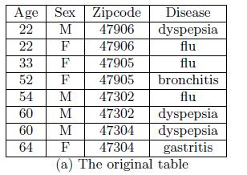
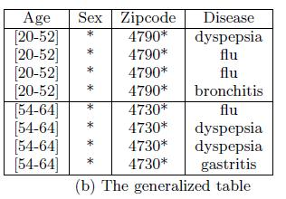
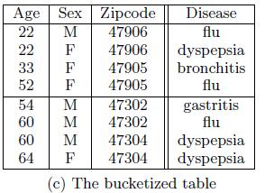
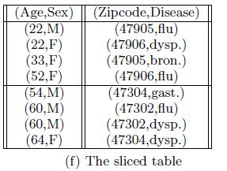

Slide 4

Scenario
Index page for registration and Employee login
Registration form for Employee Registration
Employee page for viewing his self details
Admin page which manages users and performs anonymization techniques
Generalization Anonymization technique

Slide 5

Identifiers are removed from the table
Attribute value is generalised according to its attribute domain hierarchy.
Less specific
Applied generalisation on E-mail id and Salary

Slide 6

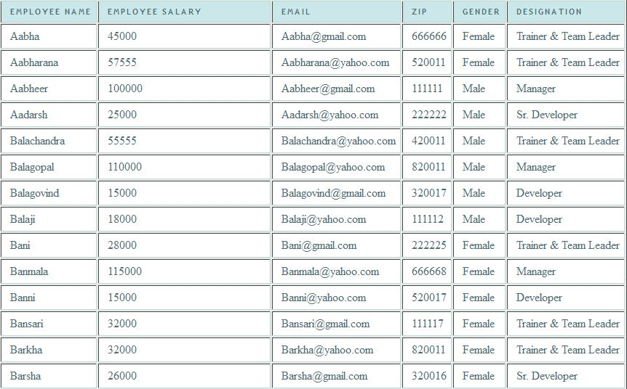

Slide 7

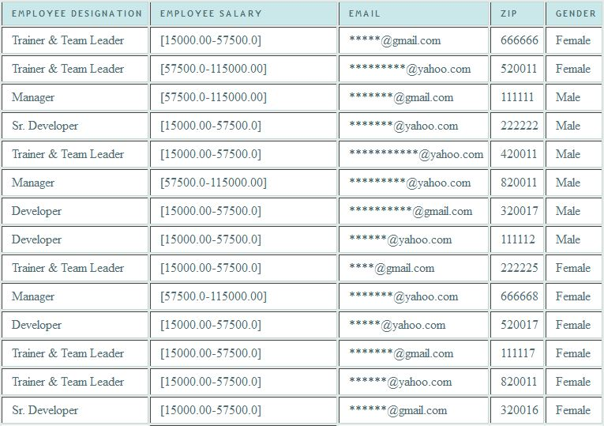

Slide 8

  Homogenety attack
  Loses considerable amount of data
  Each attribute is generalised separately, due to which correlations are lost
  Cannot apply on more than two dimensions

Slide 9
THANK YOU

