Slide 1

SLICING: A NEW APPROACH FOR PRIVACY PRESERVING
DATA PUBLISHING
TEAM MEMBERS:
K.Lakshman Madhav BL.EN.U4CSE09075
P.Abinaya BL.EN.U4CSE09002
M.Naga Hitesh BL.EN.U4CSE08061
GUIDE :
B. Sree Vidya
Lecturer
Department of Computer Science

Slide 2
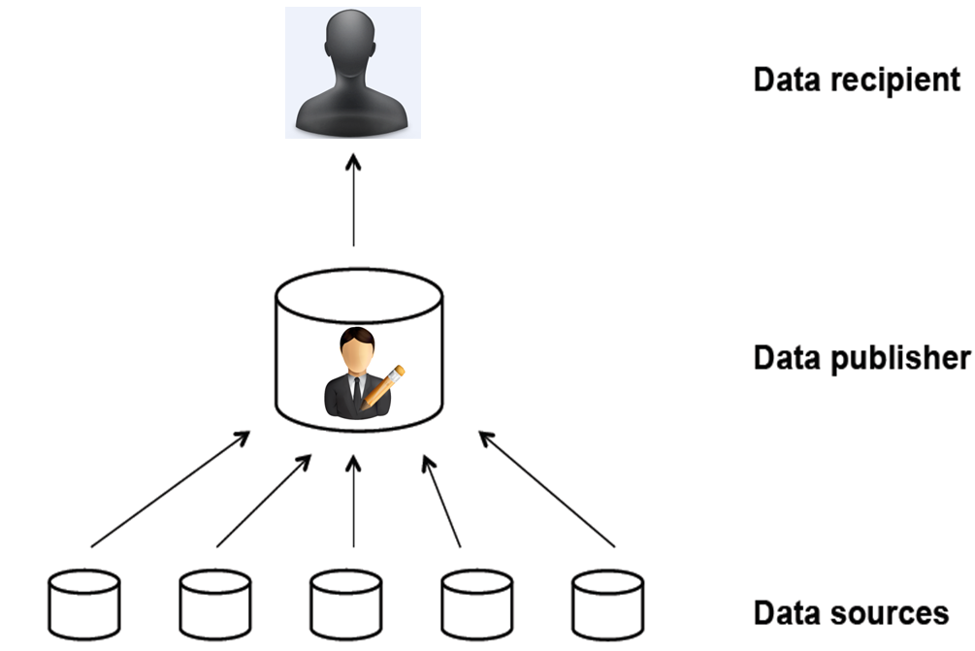
INTRODUCTION
Privacy preserving and Microdata publishing

Slide 3
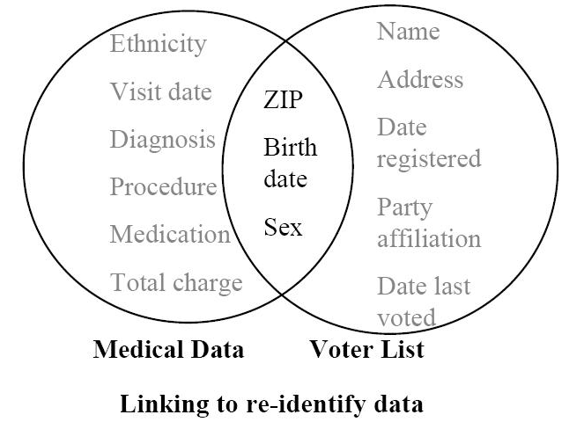
PRIVACY THREATS
Attribute Linkage
Record Linkage
Table Linkage

Slide 4
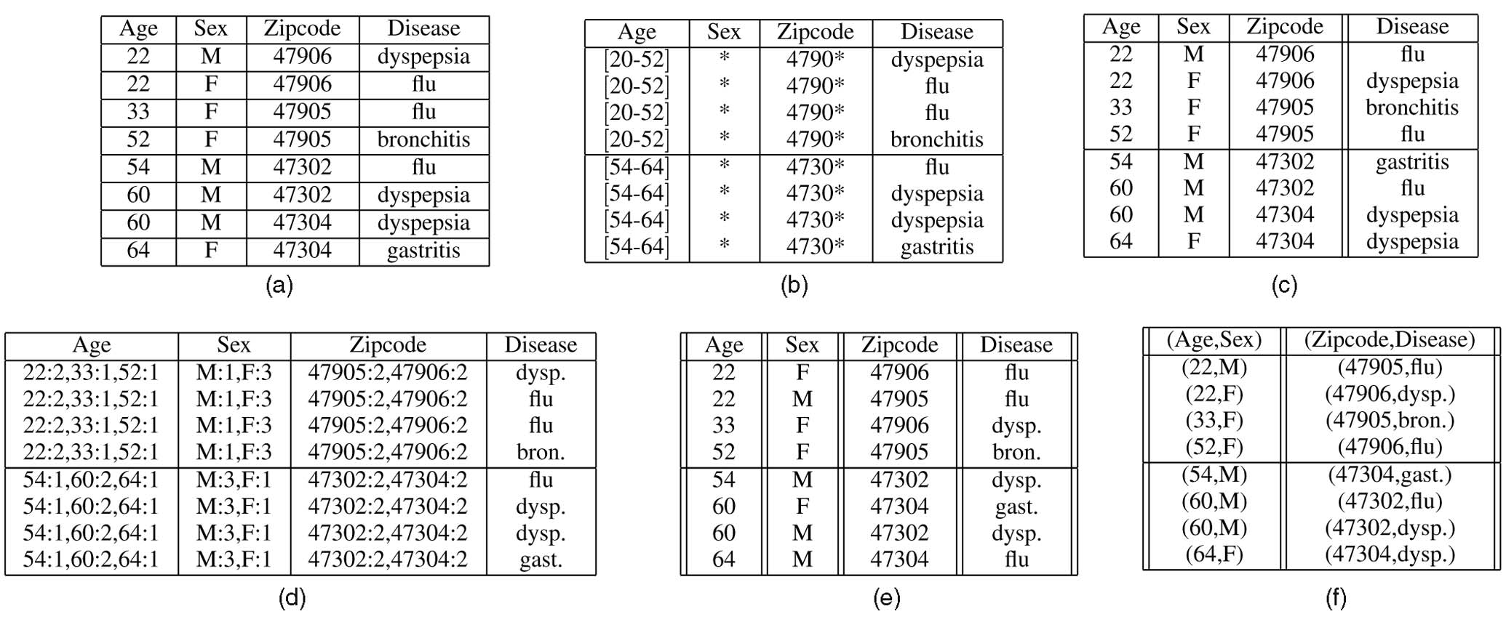
ANONYMIZATION TECHNIQUES
Generalization
Bucketization
Slicing

Slide 5
EXISTING SYSTEM
Generalization(K-anonymity)
Bucketization (l-diversity)
Disadvantages
  Cant handle high dimensional data
  Membership disclosure protection
  Doesn’t preserve Attribute correlations
  Reduces data utility
  Data loss

Slide 6
PROPOSED SYSTEM
Slicing
  Partition of data
  Membership disclosure
  High dimensional data
  Attribute disclosure protection
  Better data utility than generalization

Slide 7
BLOCK DIAGRAM
Admin Employee
Home Page
Login
Admin
Employee
View all users
Update user details
Delete users
Original Data
Generalization
Bucketization
Slicing
Logout
View Self details
Logout

Slide 8
MODULES IMPLEMENTED
Scenario
Index page for Admin and Employee login
Registration form for Employee Registration
Employee page for viewing his self details
Admin page through which admin manages users and performs anonymization techniques

Slide 9
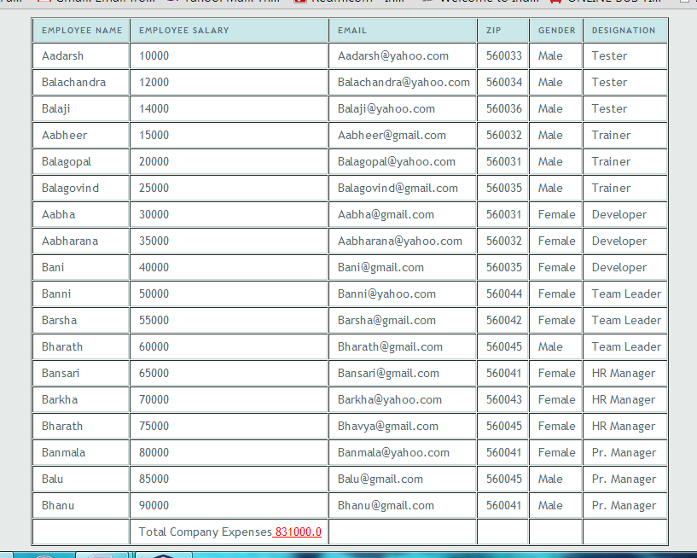
ORIGINAL TABLE

Slide 10
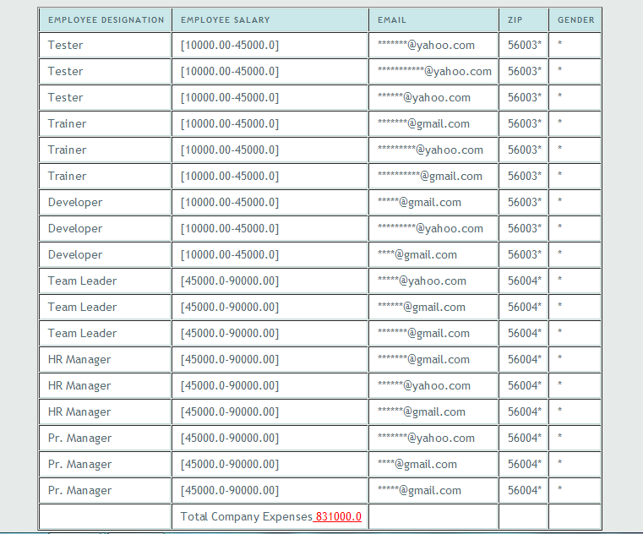
GENERALIZED TABLE

Slide 11
DISADVANTAGES
  Homogenity Attack
  Background Knowledge Attack
  Loses considerable amount of data
  Each attribute is generalized separately: correlations are lost

Slide 12
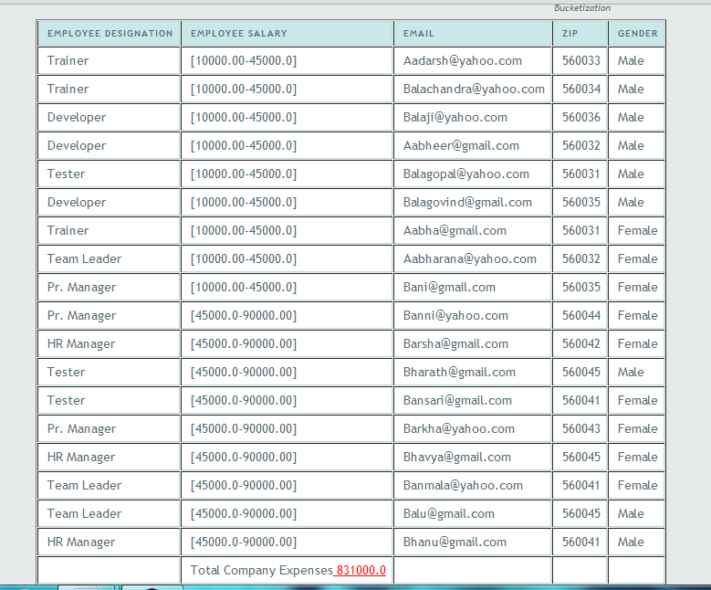
BUCKETIZED TABLE

Slide 13
DISADVANTAGES
  Requires a clear separation of QI’s and the SA’s
  Does not prevent membership disclosure
  Breaks attribute correlation between QI’s and SA’s

Slide 14
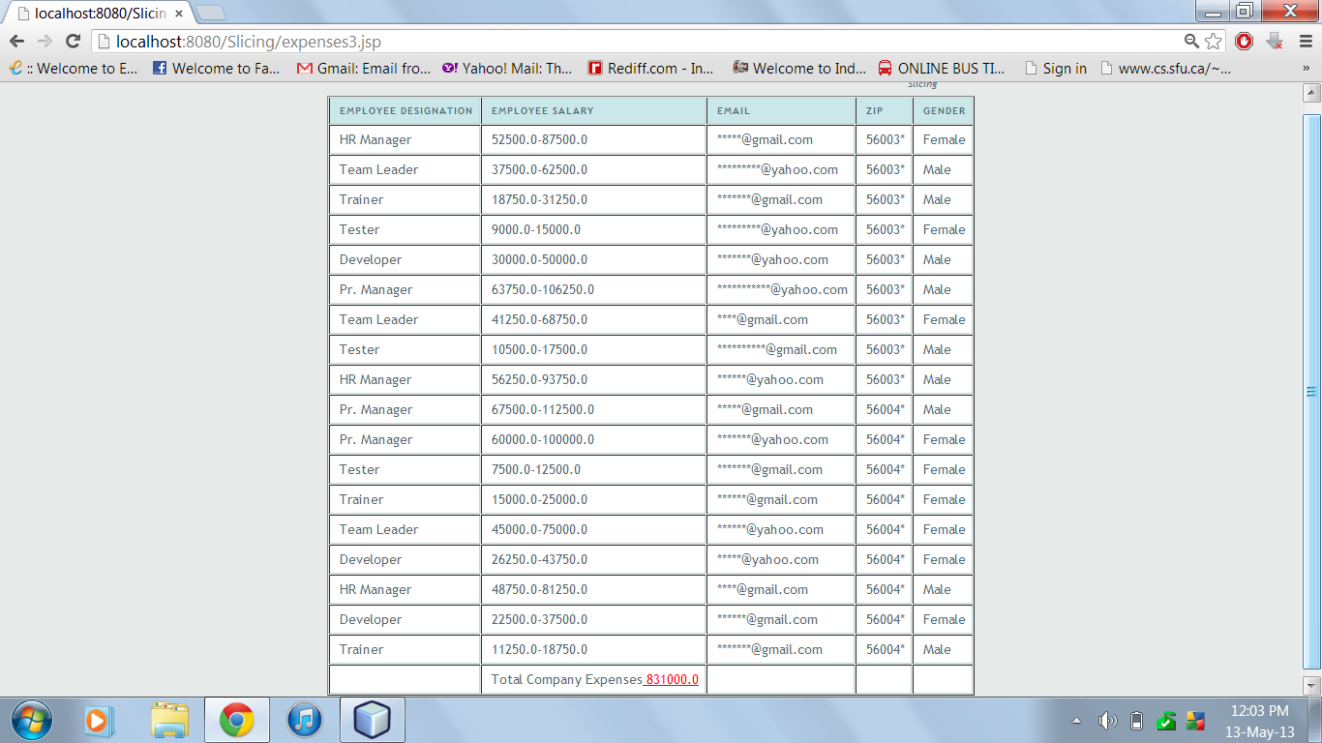
SLICED TABLE

Slide 15
SLICING
Ability to handle high-dimensional data.
Prevents membership disclosure.
Preserves better data utility
Preserves correlation between attributes
Protects privacy because breaks associations between uncorrelated attributes

Slide 16
LITERATURE SURVEY
Privacy-Preserving Data Publishing
By BENJAMIN C. M. FUNG, Concordia University, Montreal
Slicing: A New Approach for Privacy Preserving Data Publishing
By Tiancheng Li, Ninghui Li, Jian Zhang, and Ian Molloy, IEEE TRANSACTIONS ON KNOWLEDGE AND DATA ENGINEERING, VOL. 24, NO. 3, MARCH 2012
Multi-Attribute Generalization Method in Privacy Preserving Data Publishing
By Yu Wen-bing Yu Wen-bing, Lv Pin Lv Pin, Chen Nian-sheng

Slide 17
CONCLUSION
Overcomes the limitations of generalization and bucketization
Preserves better utility while protecting against privacy threats
One can analyze the data characteristics and use these characteristics in data anonymization.
Promising technique for handling high-dimensional data.
Used for anonymizing transaction databases

Slide 18
FUTURE WORK
In this paper, we consider slicing where each attribute is in exactly one column
An extension is the notion of overlapping slicing
Overlapping Slicing: duplicates an attribute in more than one column.
Releases more attribute correlations and provide better data utility
Privacy implications need to be carefully studied
Study the trade-off between privacy and utility

Slide 19
THANK YOU
Dr. K SANGEETA IYER.
Associate Professor
CSE Department
RADHA D
Assistant Professor
CSE Department
SANGITA KHARE
Assistant Professor
CSE Department
SREEVIDYA B
Lecturer
CSE Department

