Slide 1
CS569
Exploiting Traces in Program Analysis
-- Dr. Alex & Rajeev
PRESENTING BY-
LAKSHMAN MADHAV KOLLIPARA
14-May-2015
Notes:
At NASA JPL LaRS at CIT
Published at TACAS 2006 and STTT 2008

Slide 2
Introduction
LOGs : History of execution, limited info
Why LOGs : Analysis of system activity
Restrictions on LOGs : storage, overhead, bandwidth
EVRs : Command to append info to LOG. (Trace elements)
EVRs & Printfs: Used for debugging and checking properties
Disadvantages?
Making difficult to reconstruct the system from traces
1
Notes:
What are logs?
Reducing the program to exactly produce that trace

Slide 3


Problem Definition
sends a stream of EVRs
“Remote Applicaton”
… ending in an error
EVR(start_COMM)
EVR(loc, 18.1, 191)
EVR(seq_END, 12…)
EVR(seq_BEG, 11…)
EVR_FATAL(no_D…)
(e. g., a Mars Rover)
com_buffer = get(p);
EVR(seq_END, 12…);
call_back(&x, pos+1);
req_resource(&x, pos);
x = &com_buffer;
if (x == NULL)
EVR_FATAL(no_D,&c);
– although the actual execution
onboard the rover contains
crucial hidden state...
2

Slide 4
Problem Definition
Goal: Exploit traces to increase scalability of program analysis
Technique to modify the program to produce executions that lead to give trace of events
Given a log of EVRs:
  Produce possible complete executions of the program that could have produced that trace.
    All program variables and inputs, not just those included in EVRs. Complete control flow
Two Techniques:
Add assume to restrict execution compatible to given trace
Slice the program: removing portions of program based on info in trace
Ex. EVR(a): adds a to LOG. assume(log = trace) restricts program to match the given trace.
3

Slide 5
Restricting a Program by a Trace
int f (int input, bool p, bool q) {
x = input;
if (p)
foo();
if (q)
foo();
if (p && q)
bar();
else
foo();
assert ((x+1) == input);
}
void foo() {
x--;
EVR(“foo”,x);
}
And a trace σ:
σ:
foo 2
foo 1
Note that foo and bar always
produce EVRs when executed.
void bar() {
x++;
EVR(“bar”,x);
}
4

Slide 6
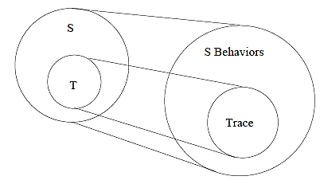
Reducing Program with Respect to Trace
Construct a new statement T from S:
T has all executions of S that produce trace
T has no executions not producing trace
T has no other executions
5
Notes:
1 ensures that we miss no executions that produce trace
2 ensures that no false alarms
3 ensures that we ignore executions that wont produce trace

Slide 7
Slicing the program w.r.t Trace
int f (int input, bool p, bool q) {
x = input;
if (p)
foo();
if (q)
foo();
if (p && q)
bar();
else
foo();
assert ((x+1) == input);
}
Slice S w.r.t. trace.
EVR “bar” does not appear in σ, which guarantees certain code did not execute in the trace.
And a trace σ:
σ:
foo 2
foo 1
Note that foo and bar always
produce EVRs when executed.
void bar() {
x++;
EVR(“bar”,x);
}
6

Slide 8
Adding Assumptions to new Statement T
int f (int input, bool p, bool q) {
x = input;
if (p)
foo();
if (q)
foo();
foo();
assume (log = <“foo 2”,“foo 1”>);
assert ((x+1) == input);
}
void foo() {
x--;
EVR(“foo”,x);
}
T
Add an assumption allowing only executions that produce the right trace.
7

Slide 9
Adding Assumptions to new Statement T
int f (int input, bool p, bool q) {
assume ((p || q) && !(p && q) &&
(input == 3));
x = input;
if (p)
foo();
if (q)
foo();
foo();
assert ((x+1) == input);
}
void foo() {
x--;
EVR(“foo”,x);
}
T
Now push the assume statement to the beginning of T, and remove all explicit mention of the trace.
Analyze T in place of S.
8

Slide 10
Trace Array Approach
Convert EVR statements into assignments to a meta variable array
ex. EVR(“foo”) => log[i++] := “foo”
Add assume statements to S to end up in correct log
T = assume(log =empty); S; assume(log = trace)
Push assumptions to beginning of T or to end of T based on Dijkstra’s wp and sp
Given statement S, precondition P and post condition Q
P = wp(S,Q) – set of states from which all the executions of S terminate in states satisfying Q
Q = sp(S,P) -- any post condition satisfied by the final state of any execution of S, for any initial state satisfying P
9

Slide 11
Trace Array Approach
Remove the variable log: change assumptions on value of log to assumptions under which log will have those values
Slice by removing code whenever an assumption implies the value or condition not taken
if (p)
EVR(“foo”);
else
EVR(“bar”);
assume (log = <“bar”>);
assume(!p);
if (p)
EVR(“foo”);
else
EVR(“bar”);
assume(!p);
if (p)
EVR(“foo”);
else
EVR(“bar”);
assume(!p);
EVR(“bar”);
10
Notes:
Advantage - No extra variables, little computational effort

Slide 12
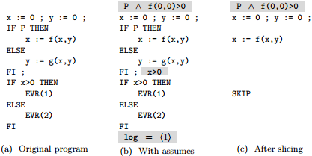
Reducing Program with Respect to Trace
11

Slide 13
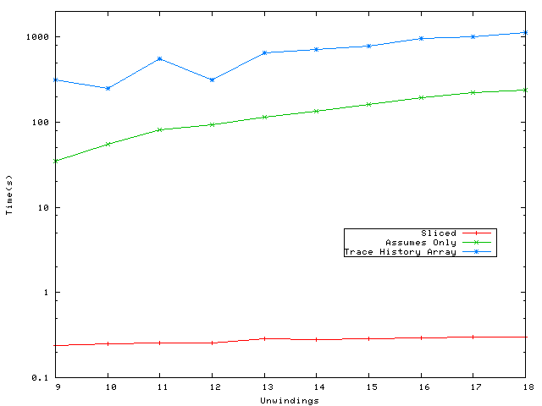
Implementation
Implemented in CBMC
Added an extension which takes EVR trace and gives execution that produces given trace
Applied to a 400 line code of file system in C
Without trace, took 4 hours to find error and with error trace, took 1 second to find counter example
Reduces the size of SAT by 2-3 orders of magnitude
Scale to larger examples, trade off between slicing and trace restriction
12

Slide 14
THANK YOU
Questions ??
Thank You for your Patient listening
Thank You Prof. Alex for support & Slides
Have a great day ahead…..!!
13

