Slide 1

Exploiting Traces in Program Analysis
Alex Groce and Rajeev Joshi
(Work carried out at the Jet Propulsion Laboratory,
California Institute of Technology, under a contract
with the National Aeronautics and Space Administration)

Slide 2
Outline
EVRs and “printf Debugging”
Restricting a Program by a Trace
Implementation & Case Studies
Work in Progress

Slide 3
EVRs and printf Debugging
Many programs produce a log of events:
  Operating system kernels
  File systems
  Web servers
  Spacecraft flight software
Most programmers spend time doing “printf debugging”
  Given a log, reconstruct the actual execution history – what went wrong?

Slide 4
EVRs and printf Debugging
Many programs produce a log of events:
  Operating system kernels
  File systems
  Web servers
  Spacecraft flight software
JPL lingo for event logging in flight software is “EVR” (for EVent Reporting).

Slide 5
Problem Definition
“Remote Applicaton”

Slide 6

Problem Definition
“Remote Applicaton”
(e. g., a Mars Rover)

Slide 7

Problem Definition
“Remote Applicaton”
sends a stream of EVRs
EVR(start_COMM)
EVR(loc, 18.1, 191)
EVR(seq_END, 12…)
EVR(seq_BEG, 11…)
EVR_FATAL(no_D…)
(e. g., a Mars Rover)

Slide 8
Problem Definition
“Remote Applicaton”
sends a stream of EVRs
… ending in an error
EVR(start_COMM)
EVR(loc, 18.1, 191)
EVR(seq_END, 12…)
EVR(seq_BEG, 11…)
EVR_FATAL(no_D…)
(e. g., a Mars Rover)

Slide 9
Problem Definition
“Remote Applicaton”
sends a stream of EVRs
… ending in an error
EVR(start_COMM)
EVR(loc, 18.1, 191)
EVR(seq_END, 12…)
EVR(seq_BEG, 11…)
EVR_FATAL(no_D…)
(e. g., a Mars Rover)
… which must be understood and used
to troubleshoot by programmers a few
million miles away on Earth.

Slide 10
Problem Definition
“Remote Applicaton”
sends a stream of EVRs
… ending in an error
EVR(start_COMM)
EVR(loc, 18.1, 191)
EVR(seq_END, 12…)
EVR(seq_BEG, 11…)
EVR_FATAL(no_D…)
(e. g., a Mars Rover)
com_buffer = get(p);
EVR(seq_END, 12…);
call_back(&x, pos+1);
req_resource(&x, pos);
x = &com_buffer;
if (x == NULL)
EVR_FATAL(no_D,&c);
– although the actual execution
onboard the rover contains
crucial hidden state...

Slide 11
EVRs and printf Debugging
Information in EVRs is limited and does not tell the whole story:
  Bandwidth is limited.
  Memory and disk onboard are limited.
  Instrumentation is computationally expensive.
  “Execution’s greatest hits” rather than a real history of everything that happens

Slide 12
EVRs and printf Debugging
Humans may have to reconstruct the missing pieces to understand why the EVR_FATAL, reboot, or other anomaly happened – and keep it from ending the mission.
One thing humans use in this task: knowledge of components not involved in the failure trace.

Slide 13
EVRs and printf Debugging
Currently very little automated support for this kind of task:
  Rely on human skill (under pressure)
  Likely always going to be the case
  But “post-mortem” (better: post-mysterious reboot) analysis is a science as well as an art –
  So give people better instruments.

Slide 14
EVRs and printf Debugging
Desirable to assist human skill with automated program analysis tools:
  Can we exploit the assumption that a program produced a given EVR trace?
  Maybe we can scale precise analysis?
    If the trace restricts behavior enough
    Can avoid analyzing components we know did not act during trace (as EVRs from that component do not appear)

Slide 15
Problem Definition Revisited
Given a log of EVRs:
  Produce possible complete executions of the program that could have produced that trace.
    All program variables and inputs, not just those included in EVRs
    Complete control flow
  May detect errors before anomaly appears – e.g., program analysis detects that memory was corrupted during execution
  Can extend to partial logs

Slide 16
Related Work
Program slicing:
  Neither static nor dynamic slicing: a hybrid criteria based on some, but not all, executions. Other explorations of this:
    Parametric program slicing (Field, Ramalingam, Tip)
      Different slicing criteria (not conformance to a trace)
    Path slicing (Jhala, Majumdar)
      Based on abstract executions, no trace-conformance
Backtrace/postmortem analysis:
  Building a better backtrace (Liblit, Aiken)
    Tries to find all CFL-reachable paths, not find concrete feasible executions
  Postmortem Symbolic Evaluation (PSE) (Manevich et al.)
    Uses only location of failure to generate traces

Slide 17
Restricting a Program by a Trace
int f (int input, bool p, bool q) {
x = input;
if (p)
foo();
if (q)
foo();
if (p && q)
bar();
else
foo();
assert ((x+1) == input);
}
void foo() {
x--;
EVR(“foo”,x);
}
(Traditional Toy Example)
void bar() {
x++;
EVR(“bar”,x);
}

Slide 18
Restricting a Program by a Trace
int f (int input, bool p, bool q) {
x = input;
if (p)
foo();
if (q)
foo();
if (p && q)
bar();
else
foo();
assert ((x+1) == input);
}
Given a program S:
void foo() {
x--;
EVR(“foo”,x);
}
void bar() {
x++;
EVR(“bar”,x);
}

Slide 19
Restricting a Program by a Trace
int f (int input, bool p, bool q) {
x = input;
if (p)
foo();
if (q)
foo();
if (p && q)
bar();
else
foo();
assert ((x+1) == input);
}
void foo() {
x--;
EVR(“foo”,x);
}
And a trace σ:
σ:
foo 2
foo 1
void bar() {
x++;
EVR(“bar”,x);
}

Slide 20
Restricting a Program by a Trace
int f (int input, bool p, bool q) {
x = input;
if (p)
foo();
if (q)
foo();
if (p && q)
bar();
else
foo();
assert ((x+1) == input);
}
void foo() {
x--;
EVR(“foo”,x);
}
And a trace σ:
σ:
foo 2
foo 1
Note that foo and bar always
produce EVRs when executed.
void bar() {
x++;
EVR(“bar”,x);
}

Slide 21
Restricting a Program by a Trace
int f (int input, bool p, bool q) {
x = input;
if (p)
foo();
if (q)
foo();
if (p && q)
bar();
else
foo();
assert ((x+1) == input);
}
S executions
We can analyze a
smaller program
T such that:
T has all executions of S that produce σ.
T has no executions not producing σ.
T has no other executions.
void foo() {
x--;
EVR(“foo”,x);
}
σ executions
T executions
void bar() {
x++;
EVR(“bar”,x);
}

Slide 22
Restricting a Program by a Trace
int f (int input, bool p, bool q) {
x = input;
if (p)
foo();
if (q)
foo();
if (p && q)
bar();
else
foo();
assert ((x+1) == input);
}
Slice S w.r.t. trace.
EVR “bar” does not appear in σ, which guarantees certain code did not execute in the trace.
void foo() {
x--;
EVR(“foo”,x);
}
void bar() {
x++;
EVR(“bar”,x);
}

Slide 23
Restricting a Program by a Trace
int f (int input, bool p, bool q) {
x = input;
if (p)
foo();
if (q)
foo();
if (p && q)
bar();
else
foo();
assert ((x+1) == input);
}
Slice S w.r.t. trace.
EVR “bar” does not appear in σ, which guarantees certain code did not execute in the trace.
void foo() {
x--;
EVR(“foo”,x);
}
void bar() {
x++;
EVR(“bar”,x);
}

Slide 24
Restricting a Program by a Trace
int f (int input, bool p, bool q) {
x = input;
if (p)
foo();
if (q)
foo();
foo();
assume (log = <“foo 2”,“foo 1”>);
assert ((x+1) == input);
}
T
void foo() {
x--;
EVR(“foo”,x);
}
Add an assumption allowing only executions that produce the right trace.

Slide 25
Restricting a Program by a Trace
int f (int input, bool p, bool q) {
x = input;
if (p)
foo();
if (q)
foo();
foo();
assume (log = <“foo 2”,“foo 1”>);
assert ((x+1) == input);
}
void foo() {
x--;
EVR(“foo”,x);
}
T is a smaller program, as the sliced-away code in S has been removed. If bar were a complex error-handling subsytem, size change could be very large.
void bar() {
x++;
EVR(“bar”,x);
}

Slide 26
Restricting a Program by a Trace
int f (int input, bool p, bool q) {
assume ((p || q) && !(p && q) &&
(input == 3));
x = input;
if (p)
foo();
if (q)
foo();
foo();
assert ((x+1) == input);
}
void foo() {
x--;
EVR(“foo”,x);
}
Now push the assume statement to the beginning of T, and remove all explicit mention of the trace.

Slide 27
Restricting a Program by a Trace
int f (int input, bool p, bool q) {
assume ((p || q) && !(p && q) &&
(input == 3));
x = input;
if (p)
foo();
if (q)
foo();
foo();
assert ((x+1) == input);
}
void foo() {
x--;
EVR(“foo”,x);
}
Analyze T in place of S.

Slide 28
Naïve “Trace Array” Approach
Program reduction:
  Convert EVR statements into assignments to a metavariable array log:
    EVR(“foo”) =>
    log[i++] := “foo”
  Add assume statements to S to ensure correct log:
    S =>
    assume (log = <>);
    S;
    assume (log = <“foo”,“baz”>);

Slide 29
Naïve “Trace Array” Approach
Steps 1-2 produce a program that will produce the correct trace.
Why not stop here?
  No slicing!
  Have added a new variable (the trace array log) to the program state
  Extra state variable + no slicing = insufficient advantage to scale to large programs
Fortunately, we can avoid these problems…

Slide 30
Beyond the Naïve Approach
  “Push” assumptions to beginning of T (by computing Dijkstra’s wlp) or to end of T (translate to passive form and use strongest postconditions).

Slide 31
Beyond the Naïve Approach
  Remove the variable log:
    While pushing the assumptions through the program, change assumptions on value of log into assumptions under which log will have those values:
if (p)
EVR(“foo”);
else
EVR(“bar”);
assume (log = <“bar”>);
assume(!p);
if (p)
EVR(“foo”);
else
EVR(“bar”);

Slide 32
Beyond the Naïve Approach
  Slice by removing code whenever an assumption implies the value of a program guard.
assume(!p);
if (p)
EVR(“foo”);
else
EVR(“bar”);
assume(!p);
EVR(“bar”);

Slide 33
Advantages of this Method
Does not make use of extra history variables to track the log
Allows as much or as little computational effort to be spent on slicing as is desired/necessary
Requirements for computing wlp or sp no worse than those for bounded model checking in general – determinization of inputs, conversion to passive form

Slide 34
Specification Language
Traces (+ wildcards) make a good specification language, e.g. –
  Find any file system trace matching:
    <initialize> <success>
    <creat> <success>
    <write> <success>
    <close> <success>
    <-delete,-creat> <*>
    <reset>
    <-delete,-creat> <*>
    <open> <success>
    <read> <fail>
Wildcard
(To find an error where
data is lost during reset)
(Any action except delete or creat)

Slide 35
Implementation
Implemented in bounded model checker for ANSI-C programs, CBMC.
CBMC takes a program and a bound for loop unrollings, solves a SAT problem to determine if error can occur.
Our extension can also take an EVR trace and find an execution that produces the given trace.

Slide 36
Case Study: File System Model
Applied to a small (~ 400 line) model of a basic file system written in C:
  Used traces as a specification mechanism: after reboot, written files should be readable.
  Without a trace, finding an error took nearly 17,000 seconds (over 4 hours).
  With an error trace, finding a counterexample took less than 1 second.

Slide 37
Case Study: File System Model
Reduced sizes of SAT instances by two-three orders of magnitude
Our full, slicing-based technique improved on a naïve “trace-array” implementation by two orders of magnitude.
Good results for suffixes of traces, proving that no path can exist matching a given trace, etc.

Slide 38
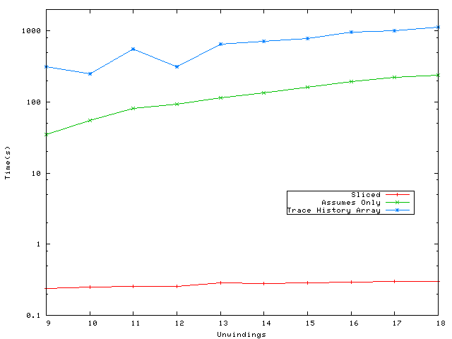
Results for File System

Slide 39
Case Study: Arbiter Model
Also applied to a model of the core of the resource arbitration algorithm used in the Mars Exploration Rovers
  Smaller but still > order of magnitude improvements in running times

Slide 40
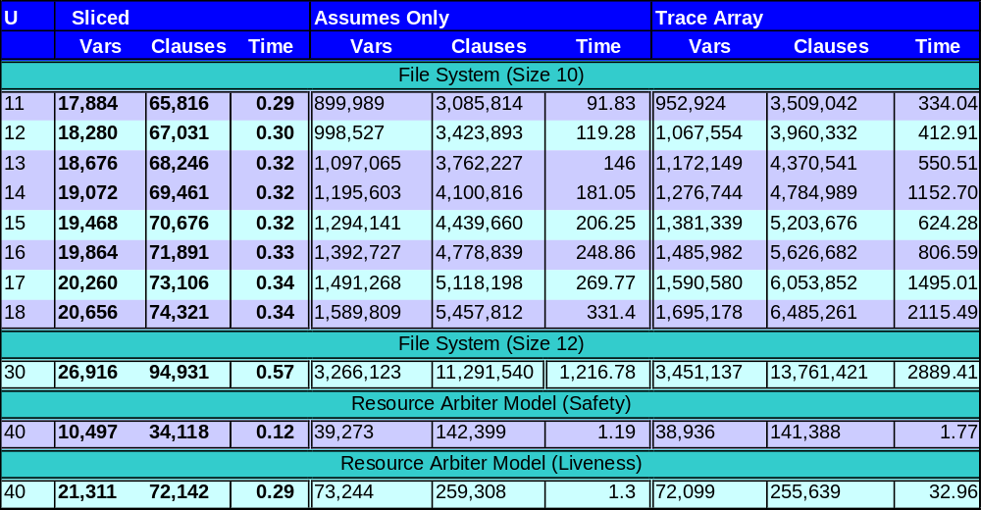
Experimental Results
Smallest configuration
Largest configuration
All under 1 second!

Slide 41
Work in Progress
Apply to (flight-ready) file system in development at LaRS, for verification of error handling routines
Scale to larger examples, mission code
Investigate trade-offs between aggressive slicing and increased computational effort in trace restriction:
  Some work is best done by the SAT solver, even at a small memory cost

Slide 42
Work in Progress
Investigate principles for EVR placement
  How to maximize power of automated analysis and assist in human understanding?

Slide 43
Questions?

