Slide 1
Random Testing: Not Just for Unit Tests

Slide 2
Random Testing: How Good is It?
Random testing is clearly sometimes both easy and effective
For what are essentially unit tests of a small piece of code
Can it work on larger pieces of software?
YES!

Slide 3
Random Testing in the Real World
Random testing (usually called “fuzzing” in this context) is highly effective
Mozilla and Google use random testing to detect critical security flaws in JavaScript engines and browsers
Search for Google’s “ClusterFuzz”
Extremely effective for finding bugs in C compilers, including over 400 in GCC and LLVM
Search for the Csmith compiler testing project
Used to find bugs in Apache commons, Java core libraries, other widely used code
At NASA, random testing is used to test file systems for missions with costs well over $100M

Slide 4
Industrial Strength Random Testing
No longer a quick afternoon’s effort
Engineering random testers for compilers, interpreters, large libraries is a major undertaking
Requires testing expertise and domain expertise
Have to consider new issues such as:
How long should tests be?
How much to test each API call or function?
How to identify different bugs when an overnight testing run produces 5,000+ failing tests?
But there are only 20 different bugs
Can developers debug test cases consisting of thousands of random operations, mostly irrelevant?

Slide 5
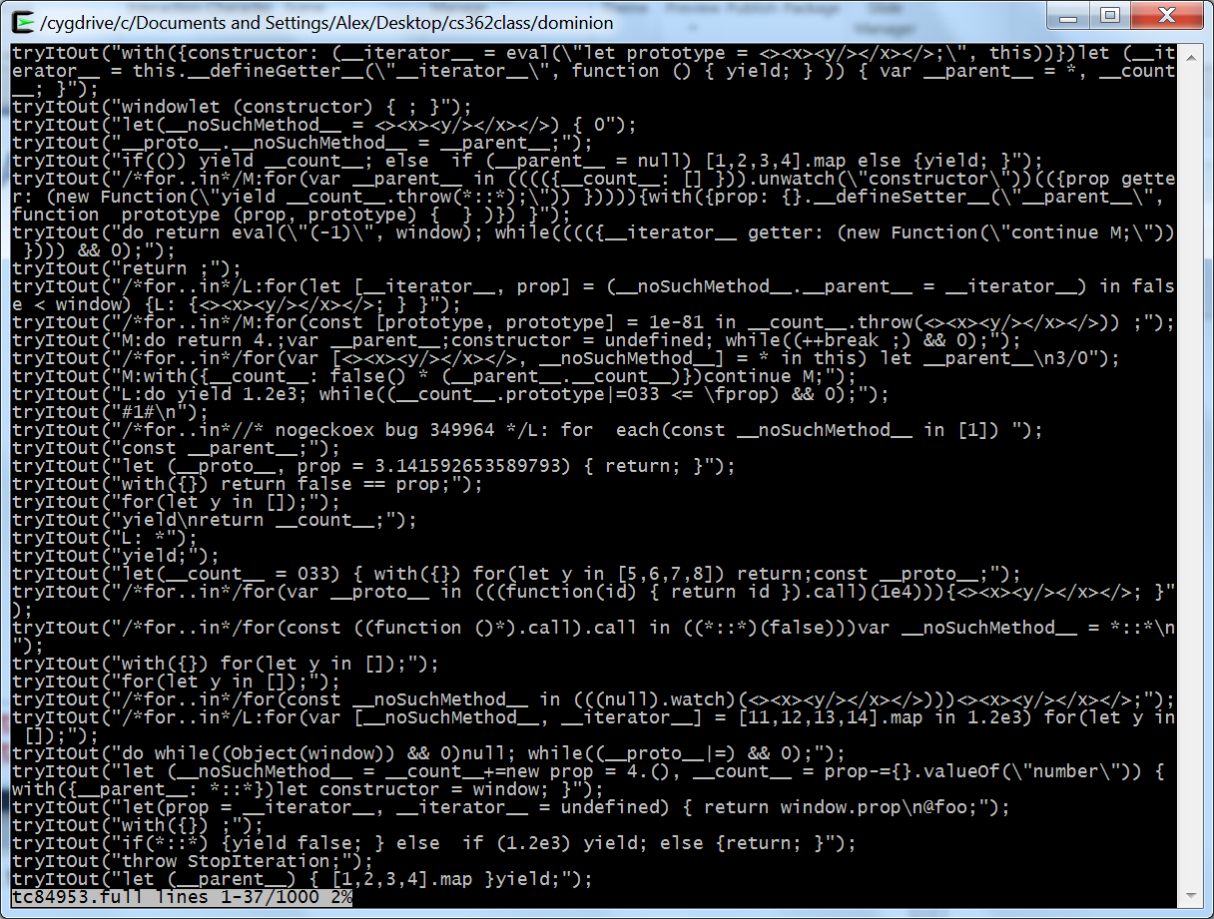
A Very Bad Test Case
tryItOut("do;while(__parent__)__proto__=__parent__") tryItOut("while(Error(this)){}")

Slide 6
Test Case Minimization
Solution: automatic minimization of test cases as they are generated
Minimized test case: subset of original sequence of operations such that
Test case still fails
Removing any one operation makes the test case successful
Typical improvement: order of magnitude or greater reduction in length of a test case
Highly effective technique, essential for quick debugging

Slide 7
Test Case Minimization
Based on Zeller’s delta-debugging tools
Automated debugging state-of-the-art
Set of Python scripts easily modified to automatically minimize tests in different settings
Requires that you be able to
Play back test cases and determine success or failure automatically
Define the subsets of a test case – provide a test case decomposition
REMEMBER DELTA DEBUGGING: IT CAN SAVE YOU ENDLESS HOURS OF EFFORT

Slide 8
Test Case Minimization
Based on a clever modification of a “binary search” strategy
Original
Test
Case
First half
First half
First three
fourths
Second half
Last three
fourths
First half
Second half

