Slide 1
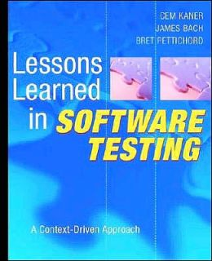
Theme 5: Planning and Strategy

Slide 2
Planning and Strategy
Lesson 274: “Three basic questions to ask about test strategy are ‘why bother?’, ‘who cares?’, and ‘how much?’”
Why is this testing being done?
Who is the customer for test results?
How much is needed?

Slide 3
Planning and Strategy
Lesson 277: “Design your test plan to fit your context”

Slide 4
Planning and Strategy
Lesson 278: “Use the test plan to express choices about strategy, logistics, and work products”
The test plan expresses goals
It is only valuable in that it helps organize and get testing done
Not useful in and of itself

Slide 5
Planning and Strategy
Lesson 282: “Your test strategy explains your testing”
Tests don’t exist in a vacuum
Need a rationale for “why these tests, not others”
A test strategy serves that purpose

