Slide 1
Causality
When a test case fails we start debugging
We assume that the fault (what we’re really after) causes the failure
Remember RIP (Reachability, Infection, Propagation)?
What do we mean when we say that
“A causes B”?

Slide 2
Causality
We don’t know
Though it is central to everyday life – and to the aims of science
A real understanding of causality eludes us to this day
Still no non-controversial way to answer the question “does A cause B”?

Slide 3
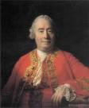
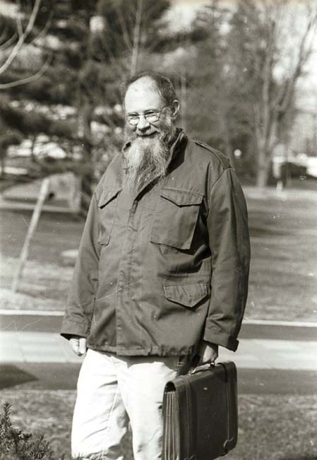
Causality
Philosophy of causality is a fairly active area, back to Aristotle, and (more modern approaches) Hume
General agreement that a cause is something that “makes a difference” – if the cause had not been, then the effect wouldn’t have been
One theory that is rather popular with computer scientists is David Lewis’ counterfactual approach
Probably because it (and probabilistic or statistical approaches) are amenable to mathematical treatment and automation

Slide 4
Causality (According to Lewis)
For Lewis (roughly – I’m conflating his counterfactual dependency and causal dependency)
A causes B (in world w) iff
In all possible worlds that are maximally similar to w, and in which A does not take place, B also does not take place

Slide 5


Causality (According to Lewis)
Causality does not depend on
B being impossible without A
Seems reasonable: we don’t, when asking “Was Larry slipping on the banana peel causally dependent on Curly dropping it?” consider worlds in which new circumstances (Moe dropping a banana peel) are introduced

Slide 6

Causality (According to Lewis)
Many objections to Lewis in the literature
e.g. cause precedes the event in time seems to not be required by his approach
One is not a problem for our purposes
Distance metrics (how similar is world w to world w’) are problematic for “worlds”
Counterfactuals are tricky
Not a problem for program executions
May be details to handle, but no one has in-principle objections to asking how similar two program executions are
Or philosophical problems with multiple executions (no run is “privileged by actuality”)

Slide 7
Causality (According to Lewis)
A
d
d’
B
A
B
Yes! d < d’
d
d’
B
No. d > d’
Did A cause B in this program execution?

Slide 8
Formally
A predicate e is causally dependent on a predicate c in an execution a iff:
c(a) ∧ e(a)
∃b . (¬c(b) ∧ ¬e(b) ∧ (∀b’ . (¬c(b’) ∧ e(b’)) ⇒ (d(a, b) < d(a, b’))))

Slide 9
What does this have to do with automated debugging??
A fault is an incorrect part of a program
In a failing test case, some fault is reached and executes
Causing the state of the program to be corrupted (error)
This incorrect state is propagated through the program (propagation is a series of “A causes B”s)
Finally, bad state is observable as a failure – caused by the fault

Slide 10
Fault Localization
Fault localization, then, is:
An effort to automatically find (one of the) causes of an observable failure
It is inherently difficult because there are many causes of the failure that are not the fault
We don’t mind seeing the chain of cause and effect reaching back to the fault
But the fact that we reached the fault at all is also a cause!

