Slide 1

Renieris and Reiss’ Localization
Basic idea (over-simplified)
We have lots of test cases
Some fail
A much larger number pass
Pick a failure
Find most similar successful test case
Report differences as our fault localization
“nearest neighbor”

Slide 2
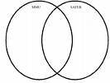
Renieris and Reiss’ Localization
Collect spectra of executions, rather than the full executions
For example, just count the number of times each source statement executed
Previous work on using spectra for localization basically amounted to set difference/union – for example, find features unique to (or lacking in) the failing run(s)
Problem: many failing runs have no such features – many successful test cases have R (and maybe I) but not P!
Otherwise, localization would be very easy

Slide 3
Renieris and Reiss’ Localization
Some obvious and not so obvious points to think about
Technique makes intuitive sense
But what if there are no successful runs that are very similar?
Random testing might produce runs that all differ in various accidental ways
Is this approach over-dependent on test suite quality?

Slide 4
Renieris and Reiss’ Localization
Some obvious and not so obvious points to think about
What if we minimize the failing run using delta-debugging?
Now lots of differences with original successful runs just due to length!
We could produce a very similar run by using delta-debugging to get a 1-change run that succeeds (there will actually be many of these)
Can still use Renieris and Reiss’ approach – because delta-debugging works over the inputs, not the program behavior, spectra for these runs will be more or less similar to the failing test case

Slide 5
Renieris and Reiss’ Localization
Many details (see the paper):
Choice of spectra
Choice of distance metric
How to handle equal spectra for failing/passing tests?
Basic idea is nonetheless straightforward

Slide 6

The Tarantula Approach
Jones, Harrold (and Stasko): Tarantula
Not based on distance metrics or a Lewis-like assumption
A “statistical” approach to fault localization
Originally conceived of as a visualization approach: produces a picture of all source in program, colored according to how “suspicious” it is
Green: not likely to be faulty
Yellow: hrm, a little suspicious
Red: very suspicious, likely fault

Slide 7
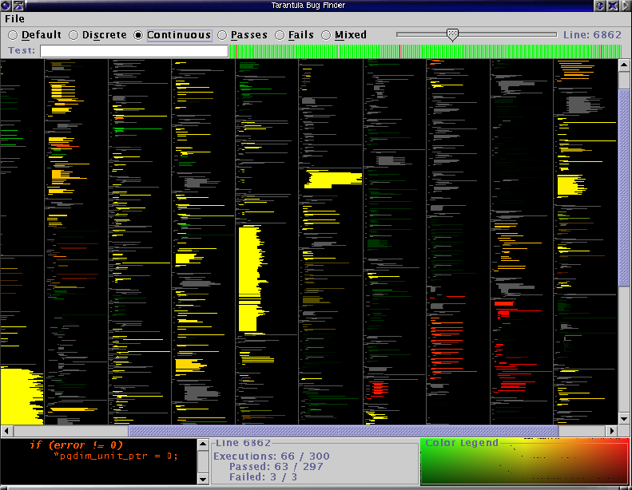
The Tarantula Approach

Slide 8

The Tarantula Approach
How do we score a statement in this approach? (where do all those colors come from?)
Again, assume we have a large set of tests, some passing, some failing
“Coverage entity” e (e.g., statement)
failed(e) = # tests covering e that fail
passed(e) = # tests covering e that pass
totalfailed, totalpassed = what you’d expect

Slide 9
The Tarantula Approach
How do we score a statement in this approach? (where do all those colors come from?)

Slide 10
The Tarantula Approach
Not very suspicious: appears in almost every passing test and almost every failing test
Highly suspicious: appears much more frequently in failing than passing tests

Slide 11
The Tarantula Approach
mid() int x, y, z, m; 1 read (x, y, z); 2 m = z; 3 if (y < z) 4 if (x < y) 5 m = y; 6 else if (x < z) 7 m = y; 8 else 9 if (x > y) 10 m = y; 11 else if (x > z) 12 m = x; 13 print (m);
Simple program to compute the middle of three inputs, with a fault.

Slide 12
The Tarantula Approach
Run some tests. . .
Look at whether they pass or fail
Look at coverage of entities
mid() int x, y, z, m; 1 read (x, y, z); 2 m = z; 3 if (y < z) 4 if (x < y) 5 m = y; 6 else if (x < z) 7 m = y; 8 else 9 if (x > y) 10 m = y; 11 else if (x > z) 12 m = x; 13 print (m);
0.5 0.5 0.5 0.63 0.0 0.71 0.83 0.0 0.0 0.0 0.0 0.0 0.5
(3,3,5) (1,2,3) (3,2,1) (5,5,5) (5,3,4) (2,1,3)
Compute suspiciousness using the formula
Fault is indeed most suspicious!

Slide 13

The Tarantula Approach
Obvious benefits:
No problem if the fault is reached in some successful test cases
Doesn’t depend on having any successful tests that are similar to the failing test(s)
Provides a ranking of every statement, instead of just a set of nodes – directions on where to look next
Numerical, even – how much more suspicious is X than Y?
The pretty visualization may be quite helpful in seeing relationships between suspicious statements
Is it less sensitive to accidental features of random tests, and to test suite quality in general?
What about minimized failing tests here?

Slide 14

Evaluating Fault Localization Approaches
So, how do the techniques stack up?
Tarantula seems to be the best of the test suite based techniques
Next best is the Cause Transitions approach of Cleve and Zeller (see their paper), but it sometimes uses programmer knowledge
Two different Nearest-Neighbor approaches are next best
Set-intersection and set-union are worst
For details, see the Tarantula paper

