Slide 1
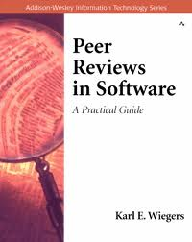
One Last Book, One Last Topic
Code reviews / software inspections

Slide 2
What is a Software Peer Review?
Having other people read the code
Why do that?
Because, in many studies, it is the single most effective way to find and fix bugs
Human beings are pretty smart
Open source theory “many eyes make for shallow bugs”

Slide 3
What Kind of Review?
Ad hoc “look at this”
Peer deskcheck / “pass around”
Pair programming
Walkthrough
Team Review
Formal Inspection

Slide 4
Differences?
Vary in amount of planning required, amount of formality, number of people and number of roles
More heavyweight tend to be more effective, and more efficient (“more bugs for your buck”) but sometimes aren’t possible

Slide 5
Formal Inspections
Include all of the following:
Planning
Preparation
An actual meeting
Correction of found defects
Verification of correction
Role of moderator/reader is not given to the person/people who created the code in a formal inspection

Slide 6
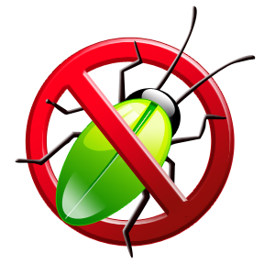
What Have We Learned?
Software engineering is like other engineering disciplines
But it is also unlike other engineering disciplines
The way we do testing is one key difference
Testing requires a special kind of thinking
Testing is applied epistemology
How to find out things about a program
Most common way to find out is by having a test case that makes the program fail

Slide 7
What Have We Learned?
There are many kinds of testing
There is no one “right way to test”
Manual and automated testing both have a role
Random testing is an especially useful automated testing technique
Coverage metrics help us measure what we have and have not tested
Debugging is like the scientific method
Formulate hypotheses about what is wrong
Divide and conquer to narrow down the problem
Use evidence (tests and examining executions) to drive your hypothesis making

