Slide 1
Topics for this Lecture
Software maintenance in general
Source control systems (intro to svn)

Slide 2
Topic 1: Software Maintenance
This is not how software engineering works:
First, design happens,
Second, implementation happens,
Third, testing confirms implementation and design were successful
Fourth, the entire thing is frozen in carbonite forever and released to customers

Slide 3
Software Maintenance
A second false idea is that the process of generating a working system is much more complicated than that, but
At some point “the working version” is complete, and after that most changes are (small) bug fixes.
This is the “software maintenance is like an oil change” theory: once in a while you have to make a small corrective action, but that’s it

Slide 4
Software Maintenance
In fact, up to 80% of maintenance efforts are not bug fixes
Software systems that are not used simply die
Software systems that are used evolve to match their user environment
Adding features
Adding features adds complexity
Adding complexity requires occasional re-factoring unless you want to end up with code that requires a “software archaeologist” to understand

Slide 5

Topic 2: Source Control
How do we manage all these changes?
Real-world projects are not a set of three .java files, or two .c files and two .h files
Real-world systems are complicated trees of source files, support files, documentation, test cases, and configuration files
Multiple developers work on the tree and make changes to it
May want to go back to an old version
May want to work on a file when you don’t have access to a shared network location
Dropbox/copying around a zipped version is clumsy and prone to disaster

Slide 6
Source Control Systems
Use source control systems (also known as revision control or version control)
Common examples:
rcs
cvs
svn (subversion)
git
We’re going to use a small subset of svn, which I will introduce on the next few slides
svn is widely available and has a simple model
svn is one of the options that code.google provides

Slide 7
Intro to svn
All source control systems:
Track changes made to a software system
Allow merging of changes to a part of a system
Allow the development of multiple versions of a system
We’re going to look at just three operations:
Checking out a project
Checking changes into a project
Updating a project to get the latest changes made by others
Also look at the web interface to svn provided by code.google

Slide 8
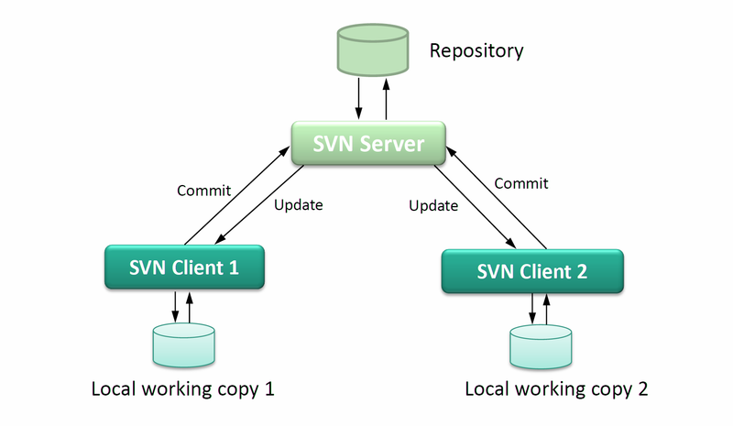
Intro to svn

Slide 9
Getting Started with svn
Log in to code.google at http://code.google.com (use a google account)
Go to http://code.google.com/cs362w14
Go to a command prompt (cygwin or unix/linux)
Navigate till your current directory is a location you want to store your class code repository
svn co http://cs362w14.googlecode.com/svn/trunk/ cs362w14-read-only
A new directory will be created below your current directory location, containing all the cs362 material
This is the contents of the repository

Slide 10
Creating Your Own Project Space
Navigate into the cs362 class directory projects section
cd cs362w14-read-only/projects
Create your own directory for your code and tests:
mkdir <onid username>
Is your code in the repository where everyone can see it now?
We can check by going to http://code.google.com/p/cs362w14/source/browse
Navigate in your web browser to the projects directory
Of course not.

Slide 11
Getting Started with svn, for real
Need to check out a non read only version. You need my permission to do that.
Let’s add some names now. Then:
svn checkout https://cs362w14.googlecode.com/svn/trunk/ cs362w14 --username agroce@gmail.com
Only YOUR google ID, not mine
Password will not be your normal google password, but one that you can find on code.google.com – I’ll show you how

Slide 12
Creating Your Own Project Space
Navigate into the cs362 class directory projects section
cd cs362w14/projects
Create your own directory for your code and tests:
mkdir <onid username>
Is your code in the repository where everyone can see it now?
We can check by going to http://code.google.com/p/cs362w14/source/browse
Navigate in your web browser to the projects directory
No, still not there.

Slide 13

Making Your Work Visible to Others
How do you add your directory to the repository?
svn add <onid username>
Is your code in the repository now?
Why not??
Adding a directory or file doesn’t actually put it in the repository, it just tells svn you will eventually check it in
I’ve personally held up a Mars mission by forgetting this fact!
One more step:
svn ci <onid username> -m “Initial checkin”

Slide 14

Failed Permissions?
If this didn’t work, we’ll troubleshoot

Slide 15
Seeing the Work of Other People
Other people may change their files, add files, etc.
How do you get the latest version of everything?
Navigate to the top of the repository (or where ever you want to update everything below) and try:
svn update

Slide 16

SVN REMINDERS
You can look on code.google.com to see if your code is actually checked in, and what version it is
You need to add every file and directory you want other people to be able to look at
If you add a directory svn will automatically try to add all the files in that directory
Just adding things doesn’t actually put it in the repository
You have to check in your changes

