Slide 1
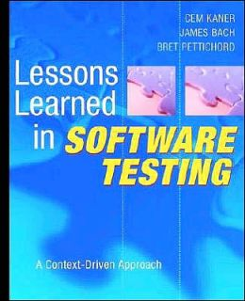
Lessons Learned in Software Testing
An excellent book covering a range of testing topics
Practical rather than academic
In the next few lectures, we’ll discuss some of the key “lessons” from this book, and how they apply to all testing efforts
Focus on the practicalities of testing, not the technical details: testing is more about a state of mind than a particular “kind of programming”

Slide 2
Testing: What, Not How
The technical side of testing usually depends on what you are testing
To test a file system, you need to understand file systems
To test Java code, you probably want to know Java well
Test programs aren’t “special” programs
Often just use a standard scripting language or the language of the program you are testing
The big difference is the goal
In typical programming, you want to produce a program that, given input X produces output Y
In testing, there is no such simple goal
Many radically different solutions
You have to THINK more than in most coding

Slide 3
How to Test Software
Five major themes
The testing role
What does a tester really do?
Thinking like a tester
Are there differences between thinking like a programmer/developer and thinking like a tester?
Testing techniques
Reporting bugs and working with others
If a tree falls in the forest and no one hears it, can the bug possibly be fixed?
Planning and strategy

Slide 4
Theme 1: The Testing Role

Slide 5

The Testing Role
Lesson 1: “You are the headlights of the project”
A software project is like driving off-road in rugged terrain, at night
The tester lights the way!
Testing is about finding information

Slide 6
The Testing Role
Lesson 2: “Your mission drives everything you do”
Testing depends on the project
Goal could be “find every bug, at any cost”
Or “satisfy this FAA requirement”
Or “knock this into shape for beta release”
Or “keep costs minimal without making the initial version too embarrassing”
Or “find out if this program we’re considering buying is worth paying for”
Or just “Satisfy the client”

Slide 7
The Testing Role
Lesson 5: “Find important bugs fast”
In most cases, finding “killer” bugs is part of the tester’s key mission
Test changed code before stable code
Test critical functions before rarely used things
Test for catastrophic problems before problems users can work around
Test things someone will definitely care about before you test things you aren’t sure anyone will care about at all

Slide 8

The Testing Role
Lesson 7: “Question everything, but not necessarily out loud”
Testing well requires skepticism and even a touch of paranoia
Being skeptical and paranoid all the time can put programmers and managers “on defense”
Be helpful, don’t be a pest
Use things you keep to yourself to guide testing, though!
“Trust no one”

Slide 9

The Testing Role
Lesson 14: “Beware of becoming a process improvement group”
Tempting to say “I’m tired of finding bugs, let’s make sure these clowns quit introducing so many bugs”
It would be nice if programmers worked more carefully, sure
But that’s usually not your job
Even with management support, testing is seldom a good “home” for a development process criticism society
How testers see programmers

Slide 10
Theme 2: Thinking Like a Tester

Slide 11
Thinking Like a Tester
Lesson 16: “Testing is applied epistemology”
What the heck is epistemology?
The branch of philosophy that covers evidence and reasoning
“How we know what we know”
The key questions of testing:
“How do you know the software is good enough?”
“How would you know if it wasn’t good enough?”
“How do you know you’ve tested enough?”

Slide 12
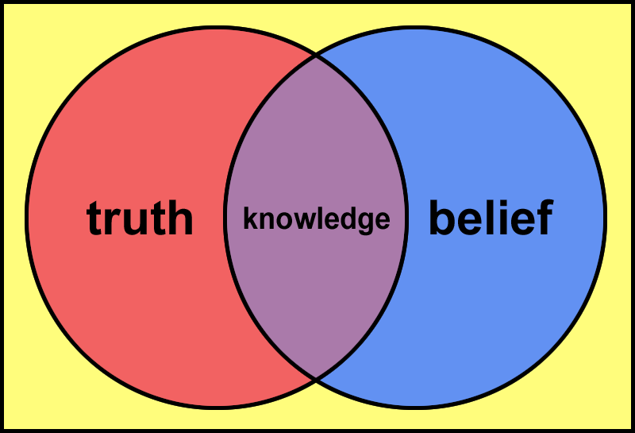
Thinking Like a Tester
Lesson 17: “Studying epistemology helps you test better”
Key topics in epistemology:
Gathering/assessing evidence (tests!)
Making valid inferences (if this works, that probably also works)
Justification of beliefs:
How do you know Antarctica is there?
How do you know your brakes work?
Avoiding fallacies in informal reasoning
Using knowledge to make decisions

Slide 13
Thinking Like a Tester
We’ll continue with ways to “think like a tester” next time – in the meantime, it’s worth considering this general question of the mindset of testing

