Slide 1
HELMET DETECTION
ANNOTATION CLASSES:
driver_with_automobile_helmet
driver_without_automobile_helmet
driver_with_bare_head
non_driver_with_automobile_helmet
non_driver_without_automobile_helmet
non_driver_with_bare_head
Just_ automobile_helmet
Just_ non_automobile_helmet
VARIATIONS:
with_automobile_helmet
Bike helmet
Full face helmet
Half helmet (Skull cap helmet)
Off-road helmet
Three quarter helmet
Dual sport helmet
Modular helmet
without_automobile_helmet
Cap
Scarf bandana
Sikh turban
Cycle helmet
Construction helmet
Welding helmet

Slide 2
with_bare_head
With hair
Bald head
Just_ automobile_helmet
Bike helmet
Full face helmet
Half helmet (Skull cap helmet)
Off-road helmet
Three quarter helmet
Dual sport helmet
Modular helmet
Just_ non_automobile_helmet
Cap
Scarf bandana
Sikh turban
Cycle helmet
Construction helmet
Welding helmet

Slide 3
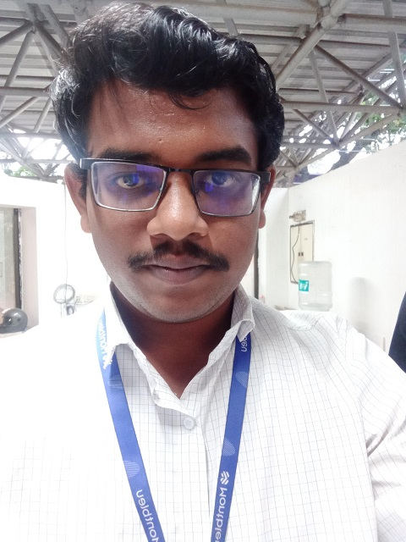
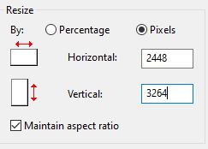
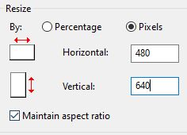
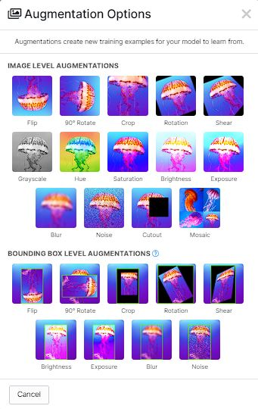
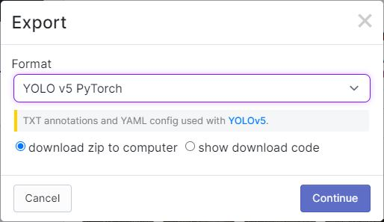
REQUIREMENTS:
Image capturing – Only “Potrait” selfie images.
Maintain selfies at this zoom
level
Image resolution – Capture at those particular pixel size, when resizing
(keeping the aspect ratio enabled) the pixel should
be 480 x 640
Use resized 480 x 640 images for segmentation in roboflow
If possible use Augmentation options
like “rotation”, “rotate by angle”,
“shear” etc, before zipping it
Export by zipping it under the format
“YOLO v5 PyTorch”
Eg:

Slide 4
BUFIRCATION DETAILS:
Selfies by male and female
Helmet with different colors
Lighting conditions - Sunlight, dawn, dusk, twilight, etc
Indoor and outdoors
With rain
Selfies with helmet visor (tinted glass or non-tinted glass shield) opened, closed, half opened, etc
Selfie zone
Racial selection: Indians only
Home Isolated selfie
Crowded place Office School Hospital etc…..

Slide 5
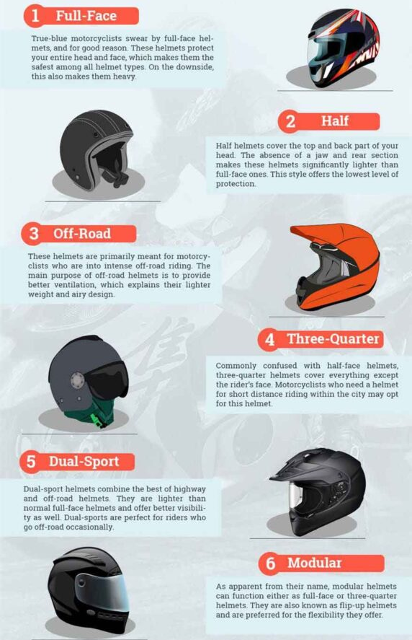
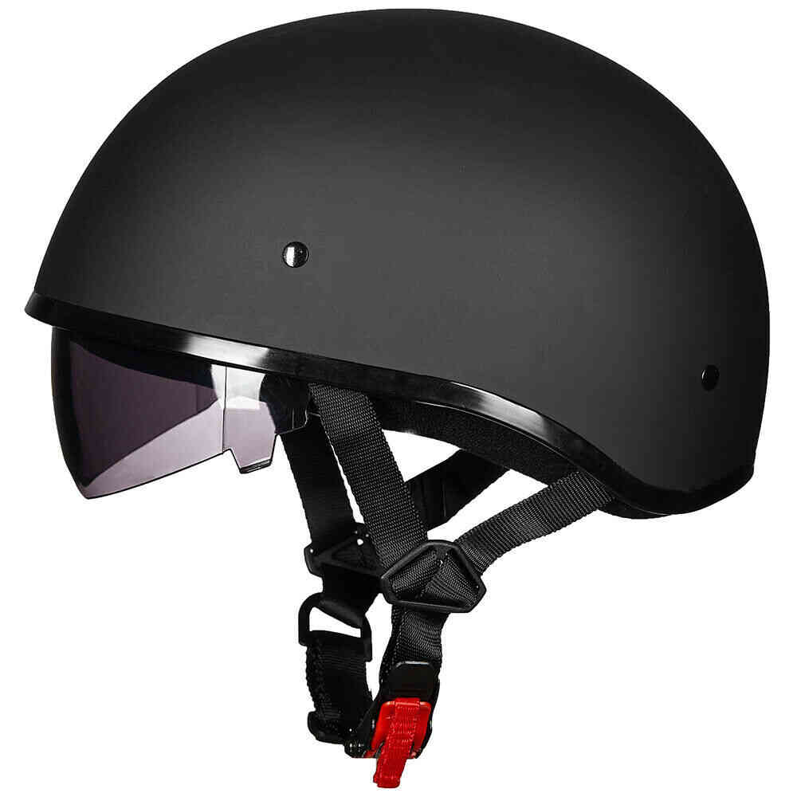
HELMET TYPES:

Slide 6
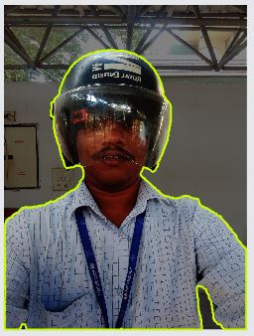
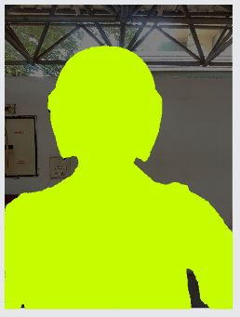
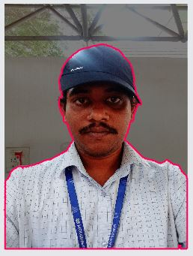
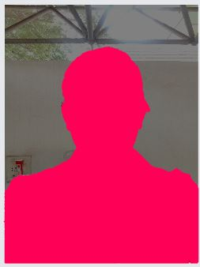
driver_with_automobile_helmet:
driver_without_automobile_helmet:

Slide 7
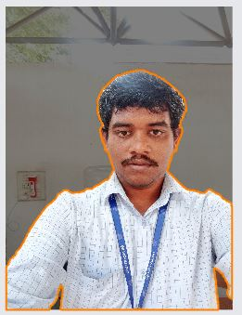
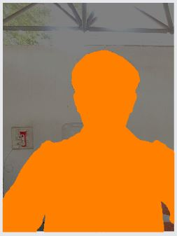
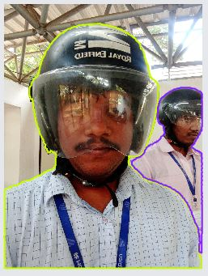
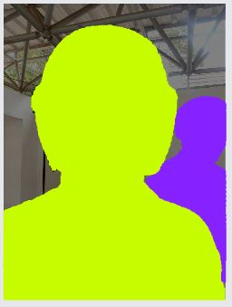
driver_with_bare_head:
non_driver_with_automobile_helmet:

Slide 8
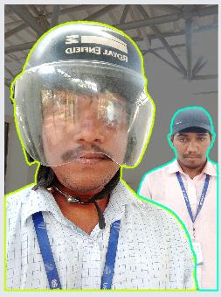
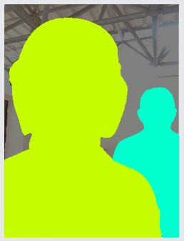
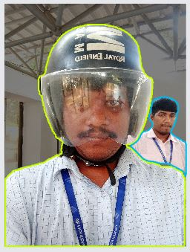
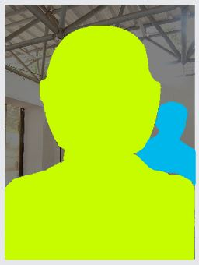
non_driver_without_automobile_helmet:
non_driver_with_bare_head:

Slide 9
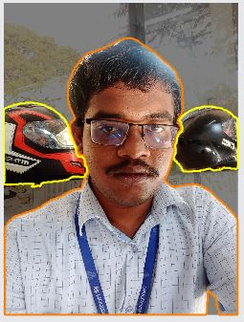
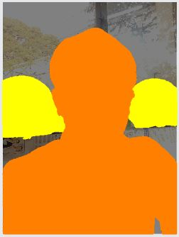
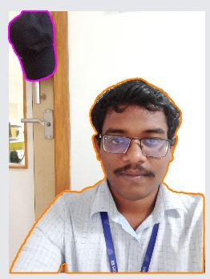
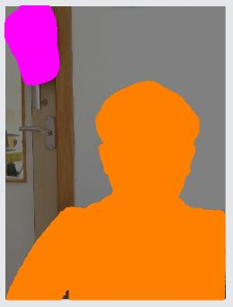
Just_automobile_helmet:
Just_non_automobile_helmet:

