Slide 1
Low-code careers
and future directions
Experiment 15
Lakshman Rithesh R - (241501096)
1
Notes:
Introduce low-code as one approach to building business applications. This talk uses our insurance application to explain useful career skills. It makes no salary or employment guarantee. References: https://www.zoho.com/creator/training/ https://www.zoho.com/creator/certification.html

Slide 2
Loan Application Management System
Application Developer
Build loan application forms and reports
Design dashboards and approval workflows
Integration Developer
Connect external services using APIs
Handle errors and failed requests
Process Analyst / Platform Administrator
Define loan processing requirements
Manage user roles, permissions and security
2
Notes:
These are illustrative role pathways, not a survey of vacancies. Explain that job titles vary between employers. A student can demonstrate each area with a concrete project artifact. Reference: https://www.zoho.com/creator/training/

Slide 3
Skills behind the platform
Data Modelling and Management
Design loan application forms, organize applicant details, validate inputs and calculate financial values accurately.
Deluge Scripting and API Integration
Develop reusable custom functions, automate loan approval workflows, connect external services through APIs and handle errors securely.
Testing, Security and Governance
Perform independent user testing, configure role-based access control, review application permissions, maintain data accuracy and verify recovery procedures.
3
Notes:
Explain why a drag-and-drop interface still requires engineering judgment. Our high-value review and reminder tests show the need for validation. Role separation and recovery testing remain areas to complete. References: https://www.zoho.com/creator/training/ https://help.zoho.com/portal/en/kb/creator/developer-guide/others/platform-performance/articles/platform-performance

Slide 4
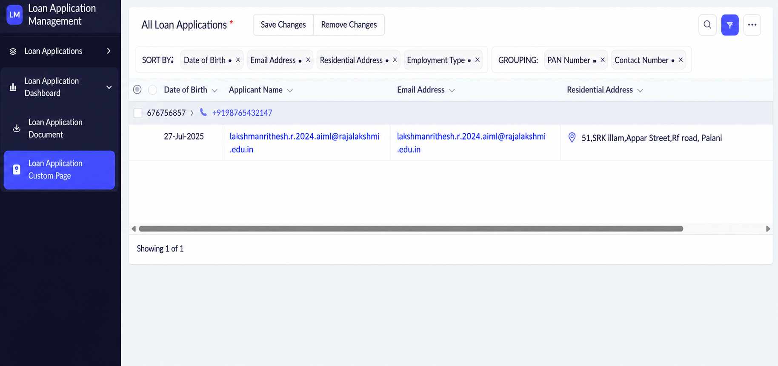
Portfolio evidence
Application Forms and Reports
Loan application forms, applicant details, status reports and dashboards for tracking applications.
Deluge Workflows and Test Results
Automated validation, debt-to-income calculations, status updates, and documented test cases with expected results.
Clear Labels for Simulated Loan Decisions
Clearly identify sample approval decisions and calculated values as demonstrations, not actual financial approvals.
Reproducible Demo and Stated Limitations
Provide sample records, a step-by-step demonstration, and documented limitations covering integrations, security, and real-world loan processing.
All Loan Applications report
4
Notes:
The screenshot shows the All Loan Applications report with sorting and grouping. It represents capture-time records, not current totals. Explain one form relationship and one tested workflow. Do not claim real payout integration or a completed production release.

Slide 5
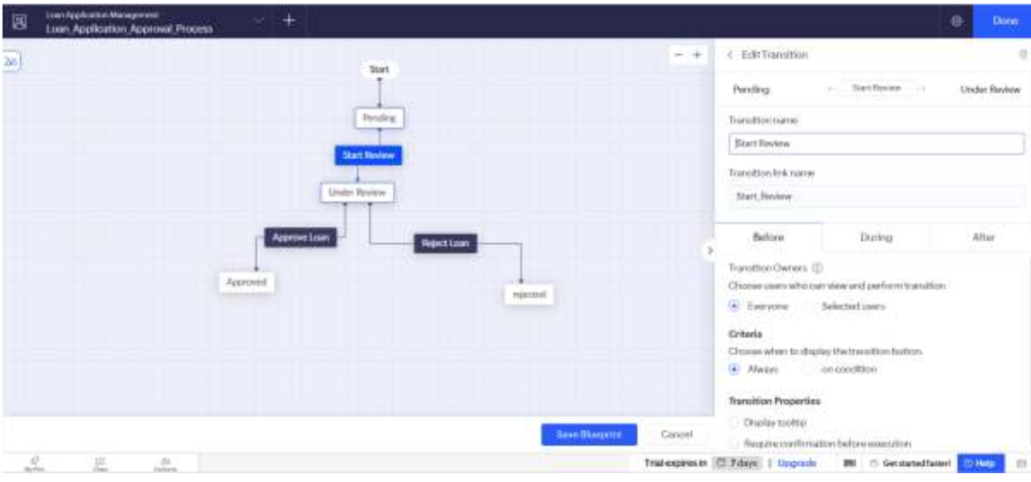
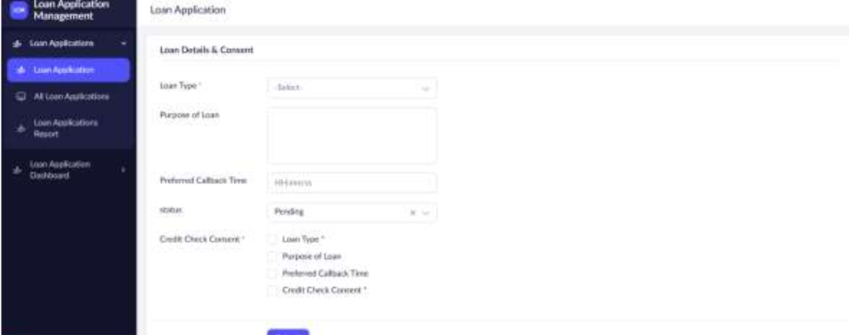
Forms and approval workflow
Loan application form
Approval blueprint
5

Slide 6
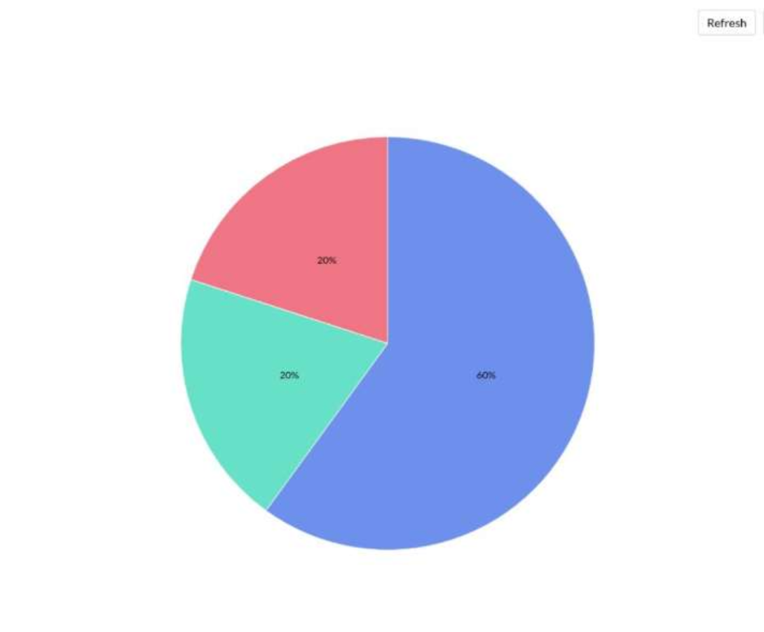
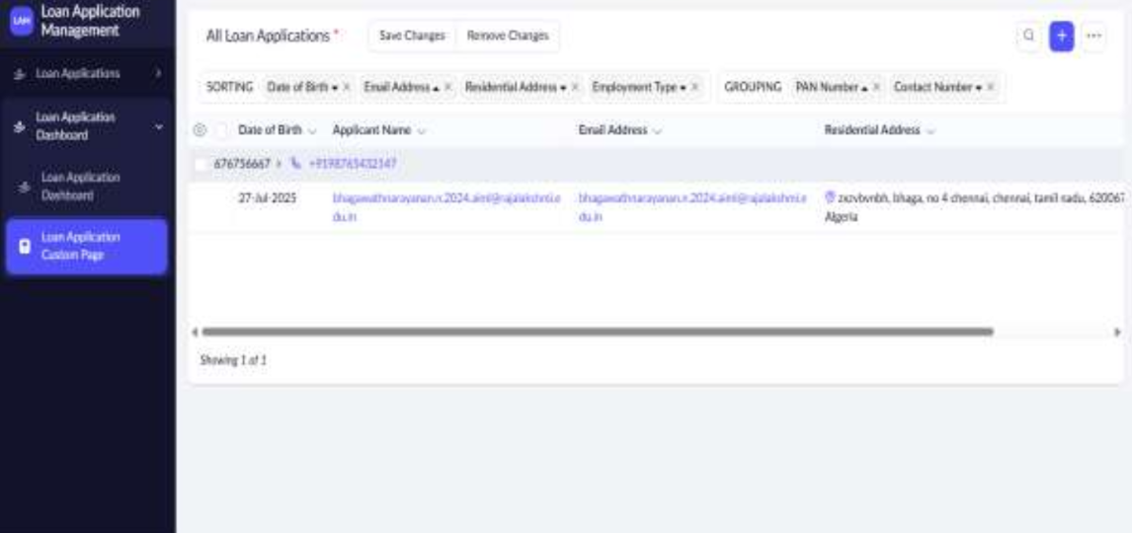
Reports and charts
Report with sorting and grouping
Application status chart
6

Slide 7
AI-Assisted Development
Current Capability
Zia assists with application design, form creation, Deluge scripting and workflow automation in Zoho Creator.
Developer Responsibility
Review the generated forms, field names, scripts, and business logic. Test validations, calculations and workflows before using them.
Observed Lesson
Our earlier AI-generated script failed validation because of incorrect field references and logic errors, highlighting the need for manual review and testing.
7
Notes:
Zia capabilities depend on configuration and availability. Our earlier Build Agent attempt reported validation errors, so successful generation is not claimed. Future judgment: AI assistance may reduce repetitive construction while increasing the importance of review. Reference: https://help.zoho.com/portal/en/kb/creator/developer-guide/operations/zia/articles/ai-capabilities-in-creator-powered-by-zia

Slide 8
Custom code and hybrid systems
Zoho Creator as the Operations Interface
Manage loan application forms, processing queues, reports and controlled reviews through a centralized interface.
Custom Functions for Business Logic
Use reusable Deluge functions to validate applicant details, calculate debt-to-income ratios, and manage application status across multiple workflows.
External Services and Error Handling
Integrate external services through APIs and test provider errors, duplicate requests, failed transactions, and recovery procedures to ensure reliable processing.
8
Notes:
This is an architectural recommendation drawn from the laboratory use case. A sequential payout simulation does not establish concurrent transaction safety. Reference: https://help.zoho.com/portal/en/kb/creator/developer-guide/others/platform-performance/articles/platform-performance https://help.zoho.com/portal/en/kb/creator/developer-guide/workflows/functions/articles/create-new-deluge-function

Slide 9
An eight-week learning plan
Weeks 1–2: Data Modelling and Validation
Refine loan application forms, verify field relationships, improve Deluge validation and test financial calculations.
Weeks 3–4: API Integration and Automation
Implement one authenticated API integration, improve custom functions, and handle failed requests and duplicate submissions.
Weeks 5–6: Security Testing and Deployment
Test Administrator, Loan Officer, and Applicant roles, verify access permissions, debug workflows, and prepare a production release.
Weeks 7–8: Documentation and Demonstration
Complete project documentation, prepare test results and screenshots, publish the case study and rehearse the final project demonstration.
9
Notes:
This is a proposed personal learning plan. It is not completed training. Use the existing application as the portfolio project and close one verified gap at a time. Reference for learning options: https://www.zoho.com/creator/training/

Slide 10
Professional readiness
Demonstrate application features and business requirements.
Show successful tests and error handling.
Clearly explain project limitations and future improvements.
Support practical experience with relevant certifications.
10
Notes:
Conclude that certification can structure learning, while a runnable project and evidence help explain actual skills. Certification does not guarantee employment. Viva prompt: which role interests you most, and which project gap will you close next? Reference: https://www.zoho.com/creator/certification.html

