Slide 1






Parking Management
System
Abstract
This project builds a relational database that replaces manual parking registers. Four linked tables store customers, vehicles, parking slots and parking records. Keys and constraints keep the data consistent, while SQL queries, JOINs and views retrieve complete parking details, show available slots and calculate total revenue, all executed in MySQL 5.5.
Subject
Database Management Systems (DBMS)
Student
Laxmi Panjwani -1262252366
Gargi Chincholikar- 1262253218
Namya Baranwal- 12262252097
Archita Suman-1262252977
→
→
←
Customers
Vehicles
Parking slots
Parking records

Slide 2






Introduction & Application
What is implemented
The Problem
Customer and vehicle registration records
Parking-slot management
  Manual registers are slow to search
  Records can be lost, duplicated or inconsistent
  No quick view of free slots or total revenue
Parking-record storage
Searching vehicles and checking slot availability
Objectives
  Store customers, vehicles, slots and parking records in one database
  Avoid duplicates and broken links using keys and constraints
  Retrieve combined details with JOIN queries
  Summarise revenue with aggregate functions
Retrieving complete details using JOIN queries
Calculating revenue using aggregate functions
Using SQL commands and database views
Scope: a database project run in the MySQL Command Line Client, not a complete graphical application.
Parking Management System | DBMS Mini Project | MySQL 5.5
2

Slide 3
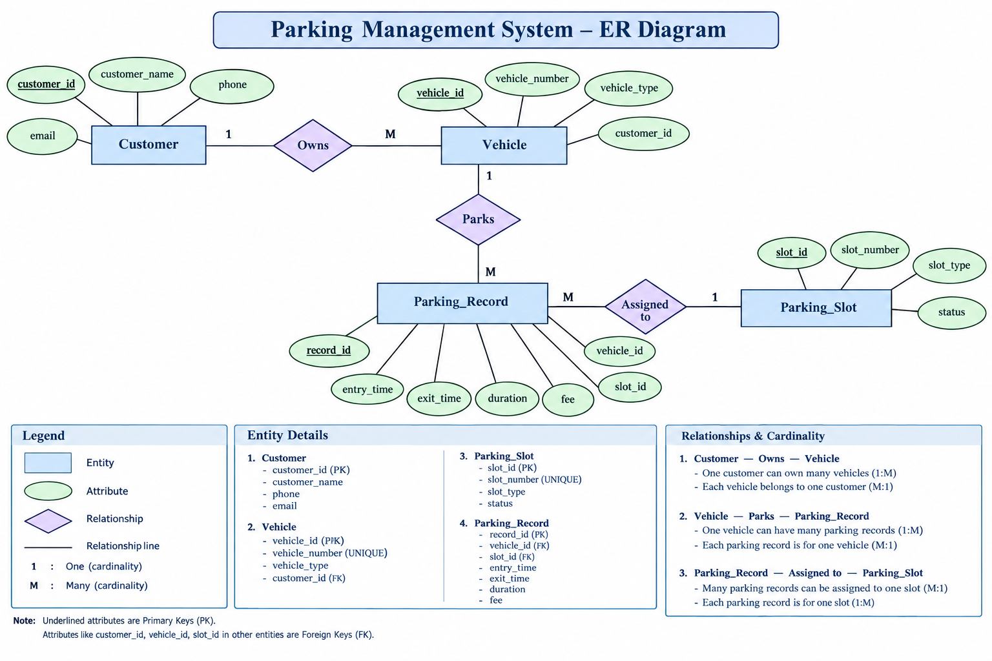
ER Diagram
Parking Management System | DBMS Mini Project | MySQL 5.5
3

Slide 4
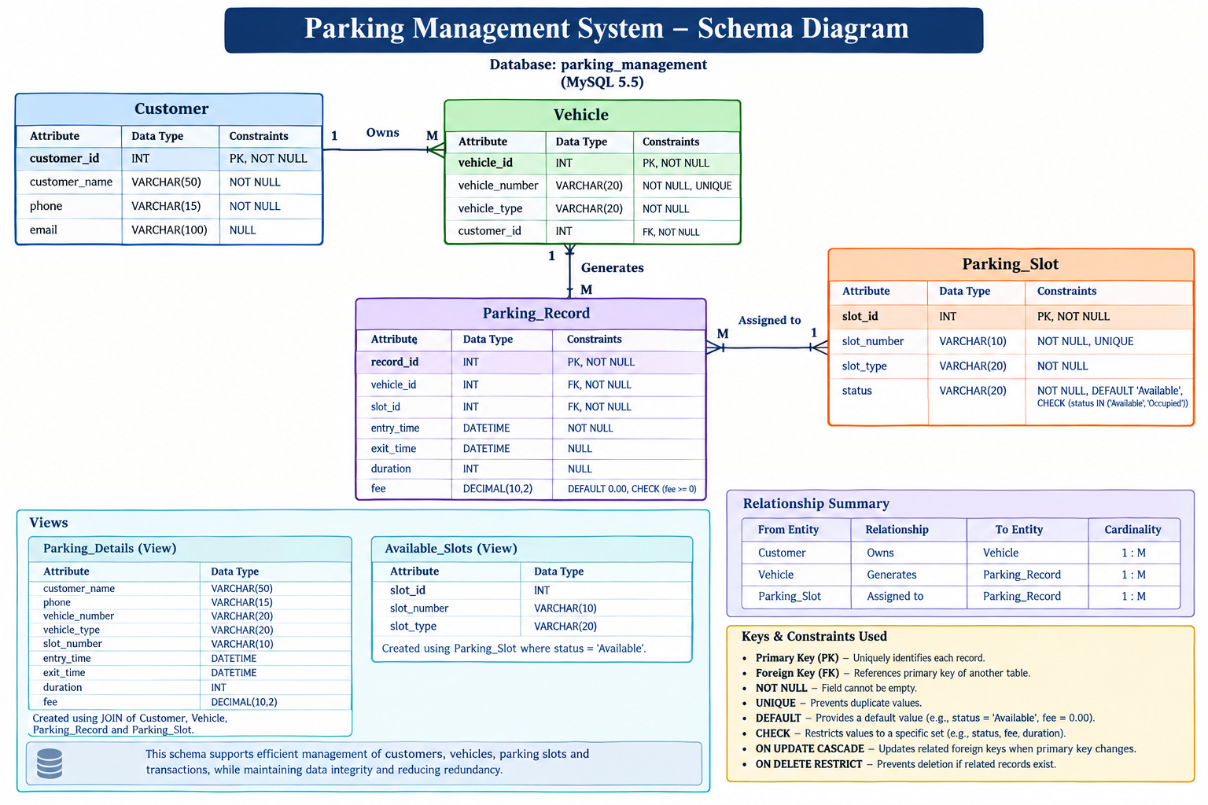

Slide 5

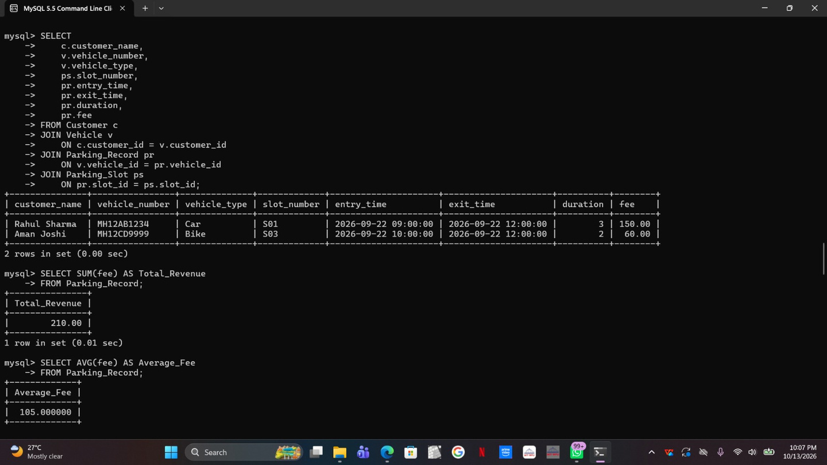
Snapshots of Queries
Parking Management System | DBMS Mini Project | MySQL 5.5
5

Slide 6


Snapshots of Queries
Parking Management System | DBMS Mini Project | MySQL 5.5
5

Slide 7
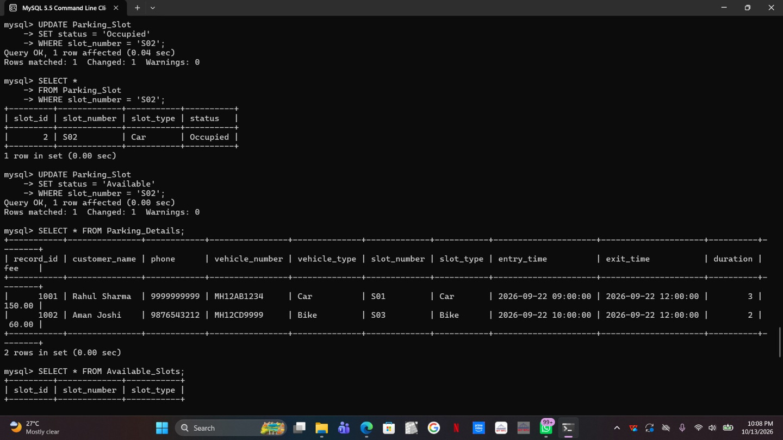

Snapshots of Queries
Parking Management System | DBMS Mini Project | MySQL 5.5
5

Slide 8
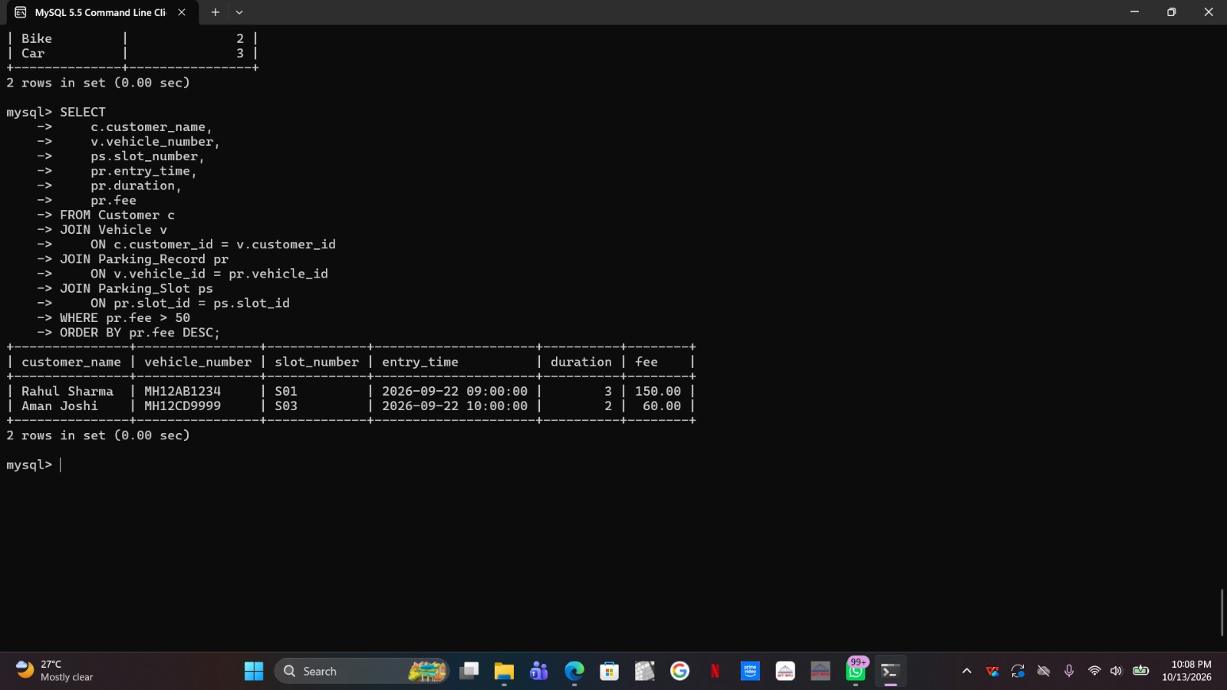
Snapshots of Queries
Parking Management System | DBMS Mini Project | MySQL 5.5
5

Slide 9



Future Scope, Conclusion & References
Future Improvements
Conclusion
References
PROPOSED, NOT IMPLEMENTED
The project applies core DBMS concepts:
  Relational design with four related tables
  Primary keys, foreign keys and constraints for integrity
  SQL queries and JOINs across tables
  Aggregate functions for revenue
MySQL 5.5 Reference Manual. Oracle Corporation.
https://dev.mysql.com/doc/refman/5.5/en/
Silberschatz, Korth & Sudarshan. Database System Concepts, 7th ed. McGraw-Hill, 2019.
https://www.db-book.com/
Elmasri & Navathe. Fundamentals of Database Systems, 7th ed. Pearson, 2016.
Ramakrishnan & Gehrke. Database Management Systems, 3rd ed. McGraw-Hill, 2003.
1
Automatic parking-fee calculation
2
Automatic slot-status updates
3
Real-time slot availability
4
Web or desktop interface
4
3
5
Automated entry and exit recording
Tables
Relationships
Parking Management System | DBMS Mini Project | MySQL 5.5
6

