Slide 1
Welcome Closers
Byte Academy 2015

Slide 2
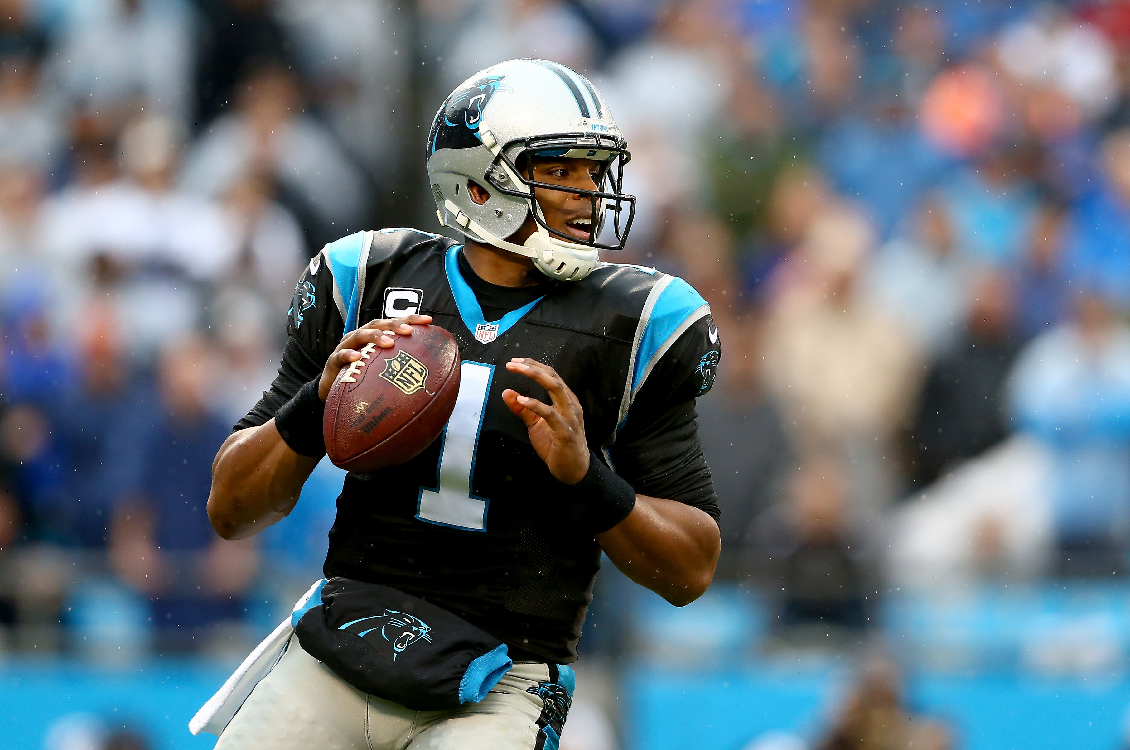
Cam Newton

Slide 3
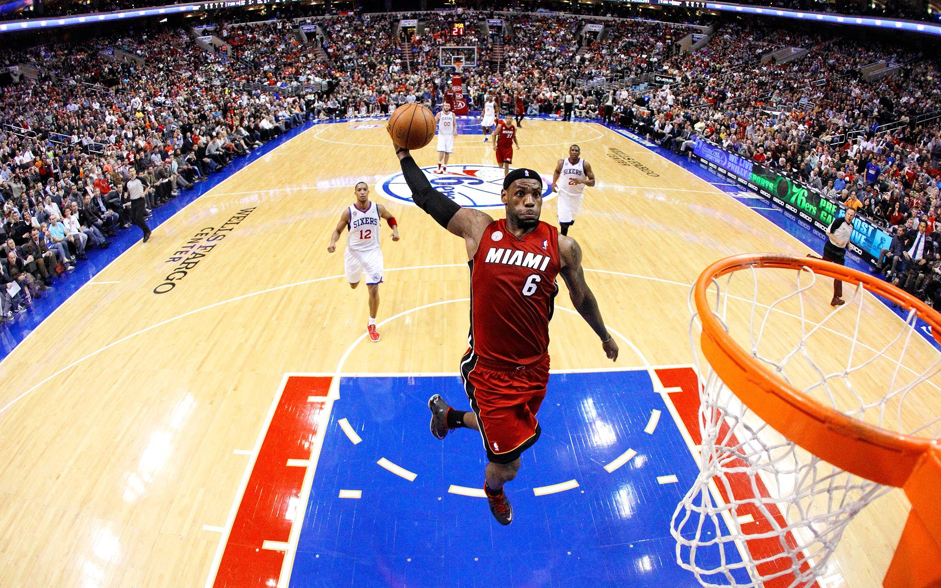
Lebron James

Slide 4
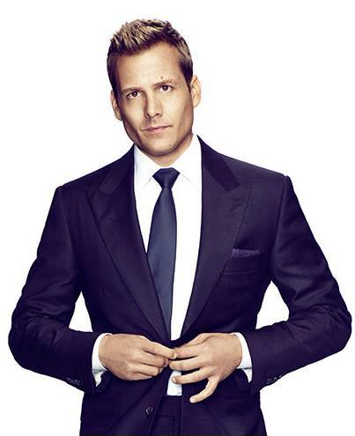
Harvey Specter

Slide 5
Your Instructional Team
Jason Ng
Team: Closers
Thomas Harvey
Team: Caveat emptors
William Mantly
Instructional Lead

Slide 6
Some Introductions
Introduce yourself
  What is your name?
  What did you do before this?
  Why did you choose to learn programming?
  What is your third favorite movie?
  If you could have a super power what would it be?

Slide 7
Your Learning Experience

Slide 8


Slide 9
Pseudo Learning Experience
Work together for the next 5-10 minutes
Your goal is to prepare and complete an iron man marathon
How would you go about doing this, as a team

Slide 10
Processes and Answers
Account for different backgrounds
What does growth look like
How do you define success
Do you have roles? Guides? Coaches?

Slide 11
ALRIGHT BREAK!

Slide 12
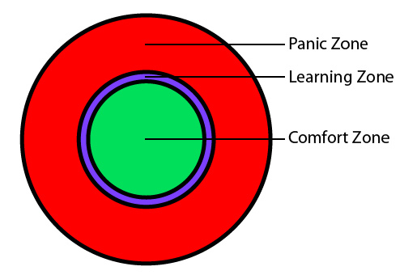

Slide 13
The Bootcamp experience
The end goal is to teach you how to teach yourself
The schedule of the course
  10 – 6 every day
  2 weeks off for vacation
    Dec 18 - last class before vacation
    Jan 4 – first class in the new year
Rules
  Be respectful of each other
  Leave your ego at the door
  Positive criticisms

Slide 14

Take Care Of Yourself

Slide 15
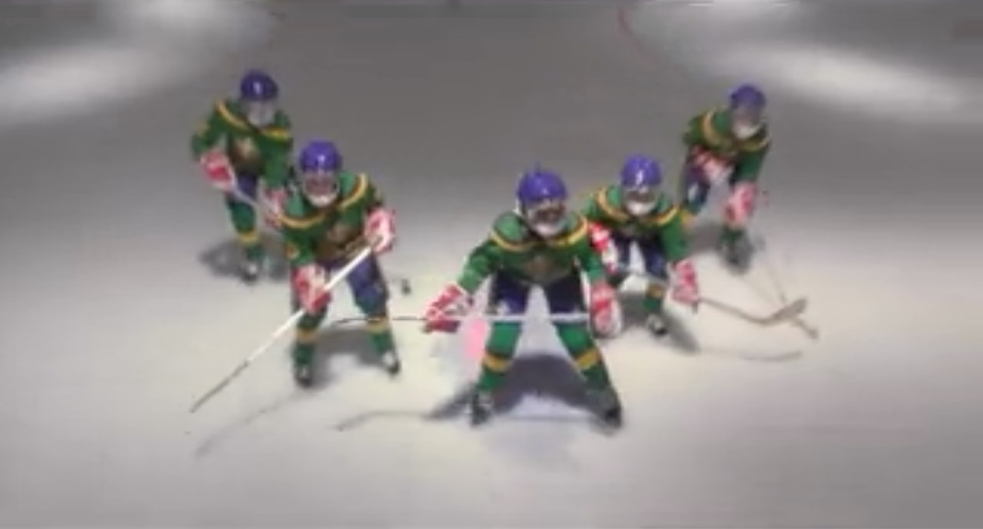
Take Care of Each Other

Slide 16
Your Learning Experience
Driving a Car vs building a car
Comfort Zone vs. Being uncomfortable
Take care of each other
Take care of yourself

Slide 17
Another tiny ice breaker?
Do a team bonding one?
Work together to solve something?
Talk about pseudo learning experience

Slide 18
Closing Statements

