Slide 1
Byte Academy
Career Outcomes

Slide 2
Topics
The different application processes
How to write your resume
How to set up your LinkedIn profile
What to do for networking
What to do for interviews

Slide 3
Types of Applications
Online / Recruiter / Referral

Slide 4
Disadvantages
Applying For Jobs On-The-Line
advantages
You can apply to MANY jobs quickly
You can apply at your convenience.
You will not stand out from the other applications
It’s hard to track your progress for that application
It’s hard to follow up
Should be doing some research for each company you are applying to
FOLLOW UP
Follow up in 3-5 business days
Follow up via email
Only once!

Slide 5
Disadvantages
Applying For Jobs Through Recruiter
advantages
You will not have any control over the application for this position
You will not get proper feedback
Who will be paying the recruiter fee?
Is there another candidate the recruiter has for that position?
More Inside Info
A Recruiter will be selling you
Easier to follow up with a recruiter
Cover Letters aren’t required as much
FOLLOW UP
Wait 1-2 business days to follow up
Follow up with Recruiter via call
Follow up with Recruiter via email after call if needed

Slide 6
Disadvantages
Applying For Jobs Through Referral
advantages
Not too many disadvantages.
Approach with caution as to not insult your referral or yourself
Access to reliable insider information
If you are referred through an employee, their opinion has more weight
More likely to get in the door, even without a resume or cover letter
FOLLOW UP
Follow up in 2-4 business days
Follow up with the person you were put into contact with.
Ideally only one follow up, use own judgment if more

Slide 7
Resume / Linkedin / online presence

Slide 8
Resume Writing

Slide 9
Your Highlight Reel
Employers take SEVEN seconds to look at your resume
Your Resume is meant to get you in the door, in front of a human being
You will have multiple versions of your resume
Keep your resume to one page.
Send your resume in pdf format
Your name should be in the name of the file.
Jason_Ng_Resume.pdf

Slide 10
Organization and consistency
Organization
Consistency
Most relevant skills for that position at top
Use common words in job description
Name and contact information at the top
Email, Phone, Address, Github, Portfolio
Education/Skills on the side or the bottom
RELEVANT experiences
Position Title, Company, Dates of employment, Location
Related Responsibilities / accomplishments
Position best content at the top
The proportion of page taken should represent the importance in the experience or the amount of time spent at a job
Fonts
Use the same font for the same tasks
One font for headers / titles
One font for bullets / descriptions
Keep the font size the same
All wording of same type should be the same.
If one job title is underlined, all job titles are underlined
Use the same bullets throughout the whole resume
Decide whether you are using periods or not
Keep all tenses the same (IN THE PAST)

Slide 11
Describing Your Byte experience
How can we appeal to a broad range of readers? It could be a:
HR administrator, technical recruiter, or a developer
You’ll want to keep your bullets short and to the point
Action Verb → What You Did → How You Did It
“Developed a RESTful whiskey api using Express.js, and SQLite3”
“Built a chat application using Socket.io, Django, Html, CSS, jQuery”

Slide 12
Describing Your non-technical experience
Keep bullets short
Use numbers wherever possible
Describe your experience using an action tense. Do not describe them based on your “duties” or “responsibilities”
DO NOT! → “Responsible for building the api for a Django application about cars”
Action Verb → What You Did → How You Did It
“Implemented a CMS workflow that targeted At Risk Students within one month of the symester”
“Developed advisement survey system that increased retention of first year students by 30%”

Slide 13
LinkedIn

Slide 14
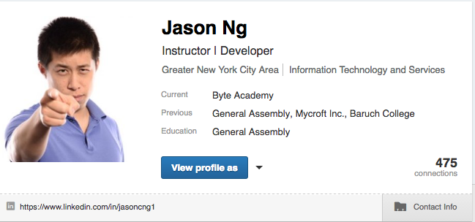
Your First Impression
Headshot
Name
Headline
City
Industry
Contact Information
Personal URL

Slide 15
Your Headshot
Your headline
This is the first thing people will see when visiting your profile
Get an image that just shows your head and shoulders
If it’s a more creative image feel free to use that
Make sure to wear nice clothing
Clean clothing
Ironed clothing
No deep v-necks
Be Creative
Do NOT write “Student”
Show what you’re interested in
This should definitely include something about programming
Can also including something not about programming

Slide 16
City and Industry
Where are you looking for a job?
Put the city or state where you want to get a job
If you are open to moving around then you can leave it blank
What industry are you looking for?
Include all industries that are related to your field

Slide 17
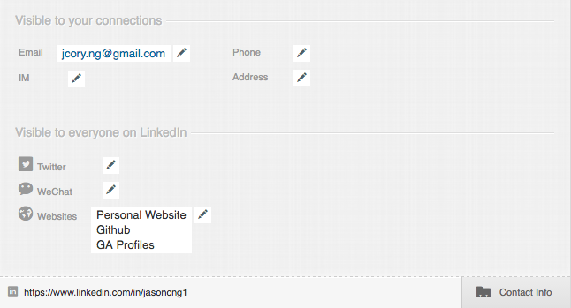
Your Personal URL
Your Contact Information
SET YOUR URL!!!
Do not use the default one LinkedIn URL
Make it as close to your name as possible
This will be the URL you share to employers and recruiters
Use a professional email address.
Make your email public
Put up your Github link
Any other sites, such as a personal portfolio include
Do NOT use any social media accounts unless they are relevant to work, or the industry you hope to join

Slide 18
Your Summary
Who are you?
What did you use to do?
What are you currently doing?
Where do you want to go? What are you looking for?
Write this in first person
Keep it short, creative, funny?
Emphasize important aspects of your experience

Slide 19
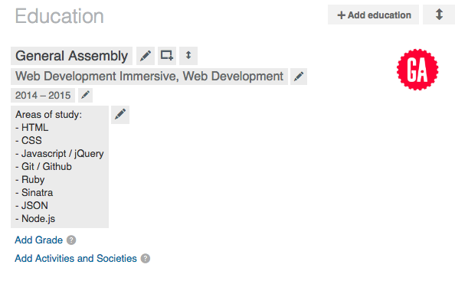
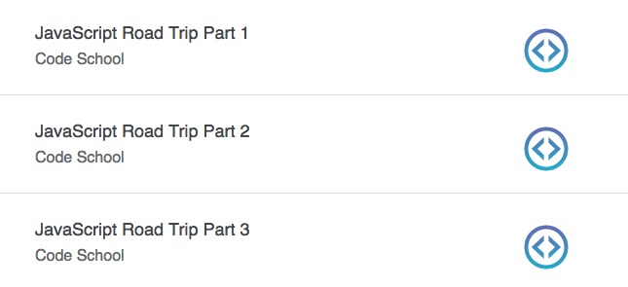
Your Byte Education
Include Byte in the education section
Write a paragraph about your Byte experience.
What languages you used, what projects you worked on, pair programming, and the like
You can also just list this out.
However, a paragraph is more descriptive, and since LinkedIn gives you the room for it you might as well use it
Education should also include other schooling and/or certificate courses.
Example: Code School allows you to put completed courses on LinkedIn

Slide 20
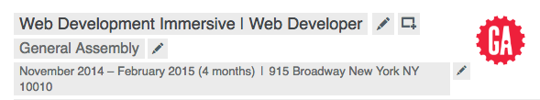
Your Byte Experience
You can include “Student” in the title
Write a summary of your experience
Write bullets for your projects and languages used
“Developed a political web application using Express, AJAX, and APIs to pull information regarding donations to legislators and the bills they sponsored.”
Upload images and projects using the square box with a plus sign at the top right
Include Other Experiences
Full Time / Part Time / Volunteer
Emphasize soft skills
Collaboration, taking initiative, and the like.
Emphasize accomplishments,
If possible try to tailor them to the industry you want to move towards

Slide 21
Skills / connections / Following
Skills
Connections
Following
Put down all the skills!
Move the most relevant skills to the top
Endorse your classmates for everything
The more endorsements you have for a particular language the higher priority you will have for people searching for that skill
Do not feel the need to accept people you don’t know
If you want to connect with somebody do not use a default message
Write a personalized note
Accept a connection within one business day
Follow groups that you like and/or are relevant to your industry
Follow companies that you like
Follow leaders in your industry

Slide 22
Application Work Flow

Slide 23
Trello Board
Make a Trello Board for your application process
Columns for each of the following
Profiles, Places to Consider, Position to Apply, Applied, Interview, Offers, Rejections / Did Not Want
Use Trello’s Cards
Make a checklist (resume sent / cover letter sent / thank you email / etc.)
Save a link to the job posting
Make a due date

Slide 24
Networking Interviewing

Slide 25
Networking
Elevator Pitch
Unique New York

Slide 26
Cover Letters
Keep it short
Give a detailed account of why you are qualified
Talk about your skills, previous experiences, relatable soft skills
Show your interest in that position and the company

Slide 27
Thank You Notes
Follow up quickly. 1-2 business days
Address anything that you felt you did poorly on during the interview
Mention something you did great on during the interview
Make sure to actually write thank you

Slide 28
Resources

Slide 29
Job Sites
Dice
Angel.co
Glassdoor
CyberCoders
Misc Resources
Creddle.io
Trello

