Slide 1
Fraudulent_Claim_Detection
Authors: LakshmiSagar SP, Karthik R L, Anish Khosla

Slide 2
Overview
Global Insure, a leading insurance company, processes thousands of claims annually. However, a significant percentage of these claims turn out to be fraudulent, resulting in considerable financial losses. The company’s current process for identifying fraudulent claims involves manual inspections, which are time-consuming and inefficient. Fraudulent claims are often detected too late in the process, after the company has already paid out significant amounts.
Problem Statement
Global Insure wants to improve its fraud detection process using data-driven insights to classify claims as fraudulent or legitimate early in the approval process. This would minimize financial losses and optimize the overall claims handling process.
Objective
To build a model to classify insurance claims as either fraudulent or legitimate based on historical claim details and customer profiles. By using features like claim amounts, customer profiles and claim types, the company aims to predict which claims are likely to be fraudulent before they are approved.

Slide 3
Dataset
The Insurance_Claims data provided has 1000 rows and 40 columns.
Data Clean-up
1. Column “authorities_contacted” has 91 rows which have null value, these have been replaced with the value “Unkown”.
2. Column “_c39” with entirely null_values” which have been dropped completely.
3. Columns “property_damage” and “police_report_available” had “?” which have been replaced with “Unknown”.
4. Following columns have been dropped to streamline the data and make prediction accurate “policy_number”, “insured_zip”, “incident_location”, “insured_hobbies”, “auto_make”, “auto_model”, and “auto_year”.
5. Columns “policy_bind_date” and “incident_date” have had the datatype correction to appear as datetime.
6. Column “policy_annual_premium” has been updated to datatype Integer from Float

Slide 4
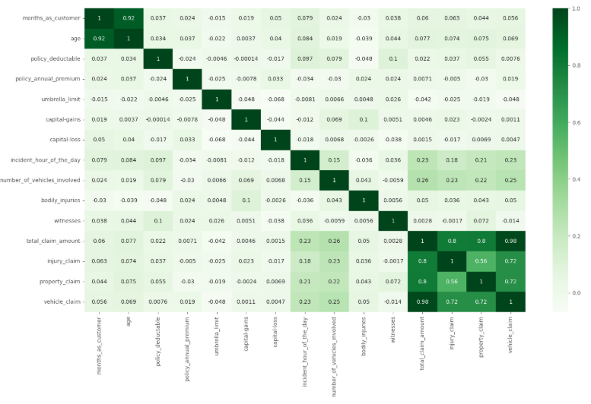
Heatmap
Age and Months as Customer have high correlation.

Slide 5
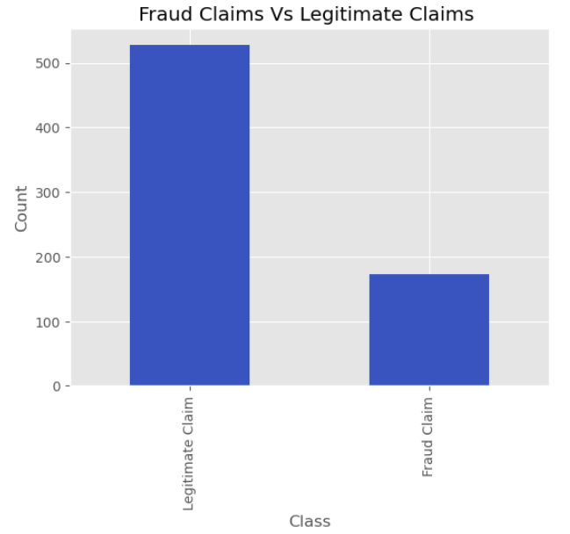
Fraud Claims Vs Legitimate Claims
Approximately 24% of the claims seem to be Fraud claims as per the data.
Class imbalance is seen in the dataset which is treated using Random over sampling.

Slide 6
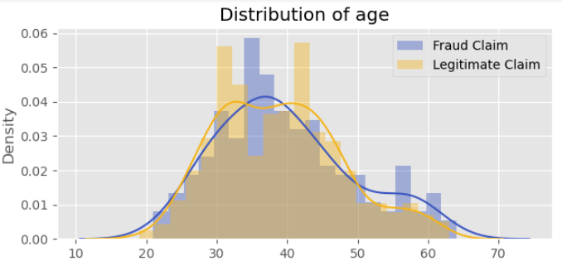
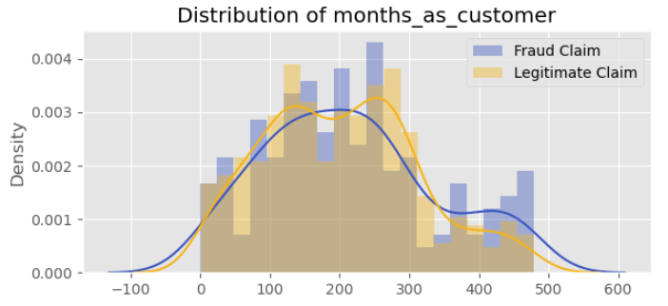
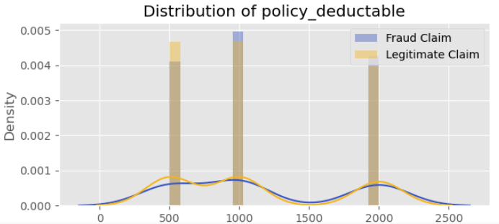
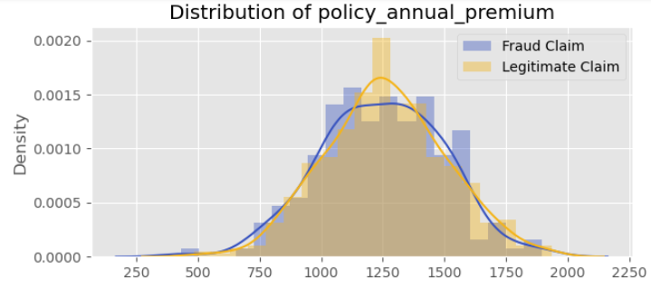
Relationship between Numerical features and Target Variable
Fraud claims trend toward customers with fewer months on record, hinting that newer policyholders may pose a higher fraud risk.
Fraud claims tend to cluster around premium ranges, hinting that certain policy costs may correlate with fraudulent behavior.
Fraud claims have the tendency to be from the age group ranging from 30-40 years.

Slide 7
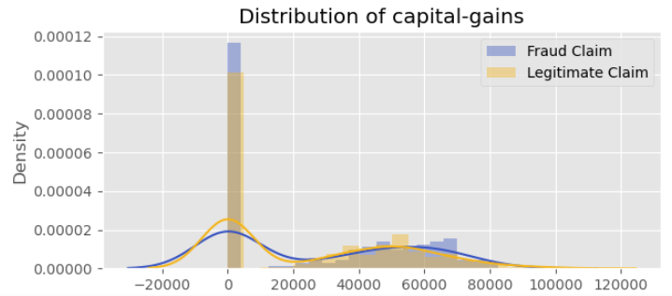
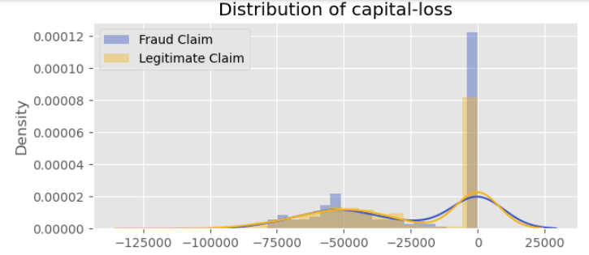
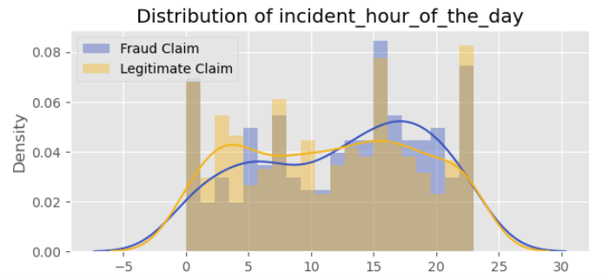
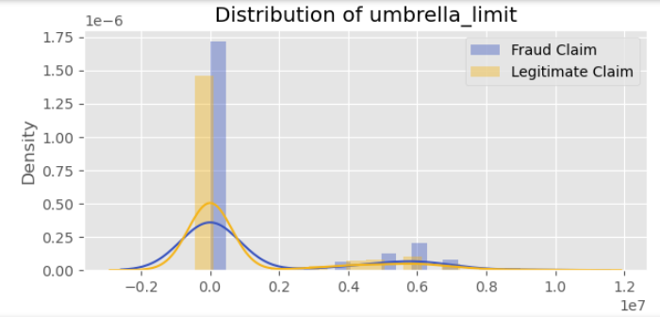
Fraud claims are more prevalent during specific hours, hinting at suspicious timing patterns or higher-risk reporting windows for fraudulent activity.

Slide 8
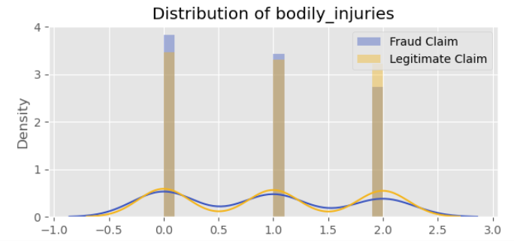
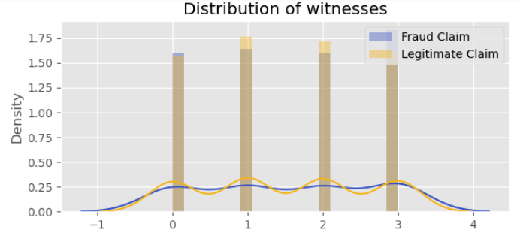
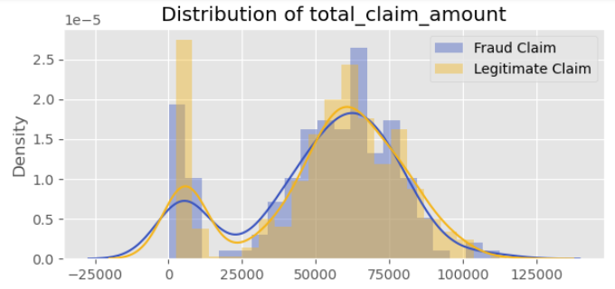
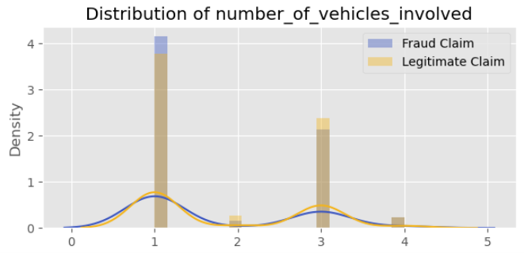
Fraud claims skew toward higher total amounts, suggesting possible inflation or exaggerated damage. Fraud cases often show inflated or repeated injury amounts, indicating overstated medical costs.

Slide 9
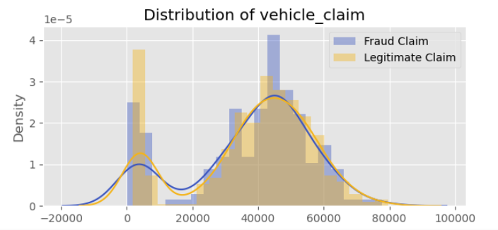
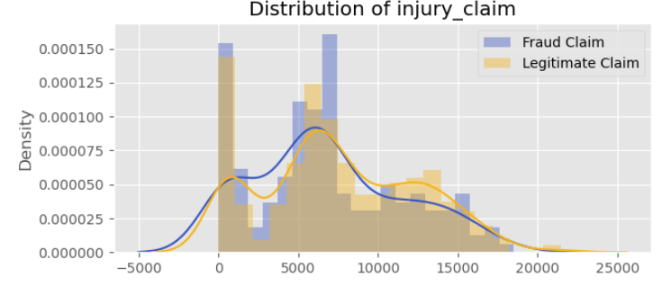
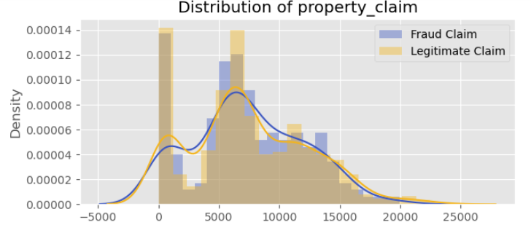
Fraud claims often appear at higher claim values or cluster around specific amounts, pointing to possible repair-cost inflation or misrepresentation.

Slide 10
Methodology and Approach
Random Over Sampling methodology was used in handling class imbalance.
This was possible by dropping few of the redundant columns related to date time formats as they do not add value to the prediction.
Dummy variables were created using One-hot encoding.
The features were scaled using the standard scaler as this suits best for the classification problems.
Logistical Regression and Random forest models were built and evaluated to choose the appropriate approach.
RFECV was used to select the features for the Logistical Regression model.
Importance score was used to select the features for the Random forest model.

Slide 11
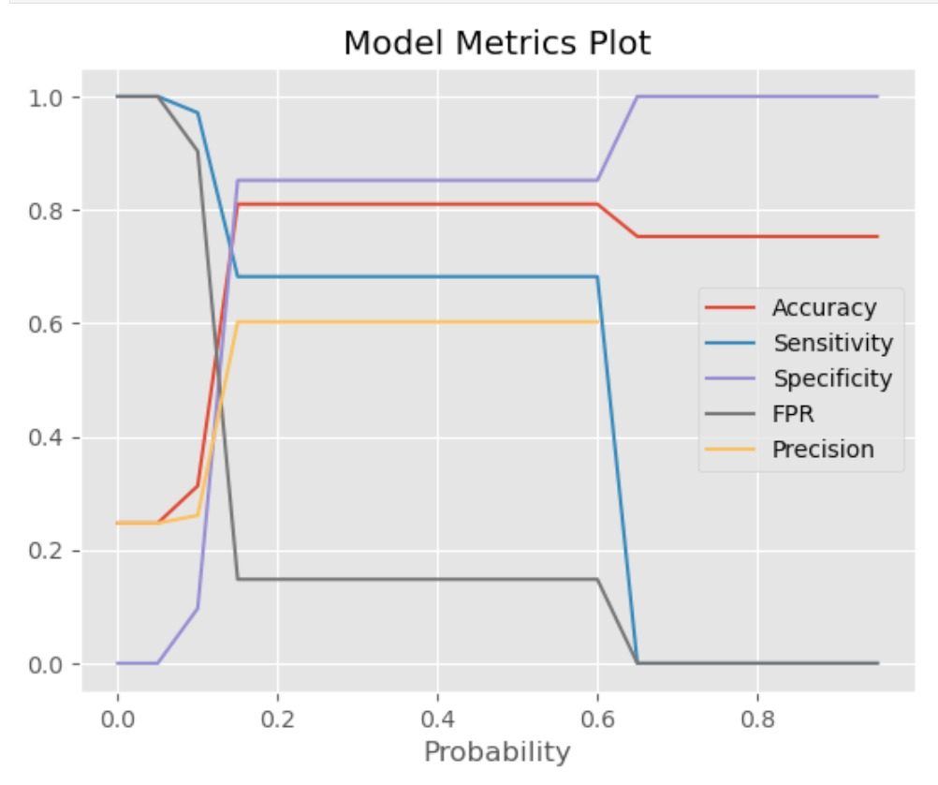
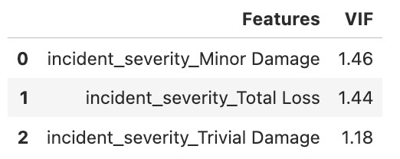
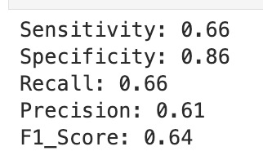
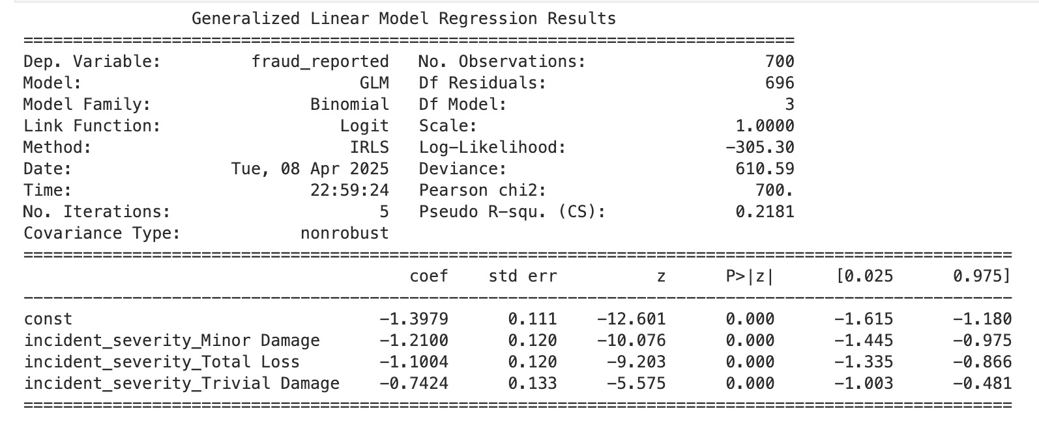
Logistics Regression
Findings
The Logistic regression model gave the Test accuracy of 81.3%.
We are able to capture 66% of actual frauds.

Slide 12
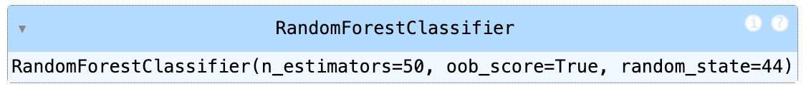
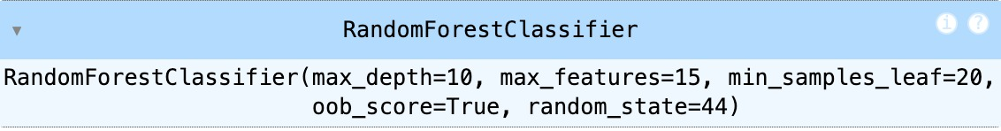
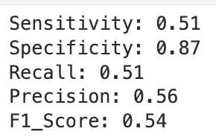
Random Forest
The base model gave the Training accuracy of 1.0.
The Sensitivity, Specificity, Recall, Precision and F1_Score is also 1.0.
This suggests that the model was clearly overfitting the data.
Importance score was used to select the top 20 features and hyper parameter tuning was done.
Based on Hyper parameter tuning was done to find best parameters
The Tuned model gave a test accuracy of 78%.
Base Model
Tuned Model
Tuned Model Matrix

Slide 13
Conclusion
The Logistic Regression model performed better than the Radom forest model.
Model selection methods helped in selecting the better model.
Shorter tenures often correlate with higher fraud risk.
Policy Deductible, Policy Annual Premium, Umbrella Limit: Certain coverage or cost thresholds seem to attract more fraud.
Total Claim Amount, Vehicle Claim, Injury Claim, Property Claim: Fraudsters frequently inflate or bundle extra costs into claims.
Some age groups appear to file suspiciously high or frequent claims.

Slide 14
Questions
How can we analyze historical claim data to detect patterns that indicate fraudulent claims?
Ans: We need to analyze categorical and numerical historical data to find fraud patterns, use statistical methods like box or density plots to identify trends, use heat maps to identify unusual associations.
2. Which features are most predictive of fraudulent behavior?
Ans: Features like “Months as Customer”, “Age”, “Total Claim Amount” reveal risk factors associated with fraudulent behavior. “Type of incident” has the most predictive value.
3. Can we predict the likelihood of fraud for an incoming claim, based on past data?
Ans: Yes, by building predictive model selection techniques and predicted probabilities a good prediction can on the likelihood can be made.
4. What insights can be drawn from the model that can help in improving the fraud detection process?
Ans: Shorter tenures often correlate with higher fraud risk. Hence, the longer tenure should be preferred and have extra vigilance during shorter tenure claims.
Policy Deductible, Policy Annual Premium, Umbrella Limit: Certain coverage or cost thresholds seem to attract more fraud. Hence these should be taken into consideration while setting the claims.

