Slide 1
Interactive Business Intelligence Dashboard using Microsoft Power BI
Apple Financial Dashboard (2009–2024)
Project Overview • Financial Performance Analysis • KPI Monitoring • Interactive Visualizations • Business Decision Support Tools: • Power BI • Power Query • DAX • CSV Dataset College / Organization Submission Date

Slide 2
Objective
• Analyze Apple's financial performance.
• Track KPIs such as Revenue, Net Income, EBITDA, Assets, Liabilities and Employees.
• Identify year-over-year growth and long-term financial trends using time- series analysis.
• Compare financial metrics to understand Apple's profitability and business performance.
• Build an interactive Power BI dashboard with KPI cards, charts, and slicers for easy analysis
• Enable business stakeholders to make informed, data-driven decisions through visual insights.

Slide 3
Dataset
• Source: Apple Financial Data (2009–2024)
• 16 columns with yearly financial metrics.
• Analyze Apple's financial performance and business growth over time.
• Imported the CSV file into Power BI.
• Cleaned the data using Power Query.
• Removed symbols such as $, commas (,), and %.
• Converted columns to appropriate numeric data types.
• Validated data for accurate analysis and visualization.

Slide 4
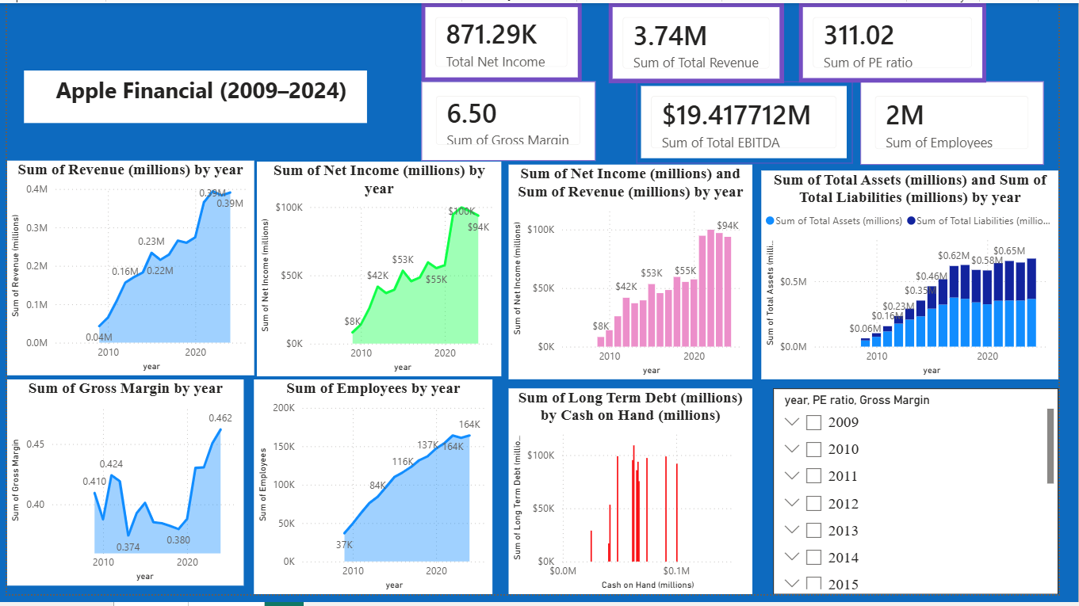
Dashboard
• KPI Cards
• Revenue Trend
• Profit Trend
• Assets vs Liabilities
• Cash vs Debt
• Employee Growth
• Year Slicer

Slide 5
Key Insights
• Revenue and profits increased over time.
• Gross margins remained healthy.
• Assets grew significantly.
• Employee count expanded.
• Strong overall financial performance.

Slide 6
Conclusion
Power BI transformed raw financial data into an interactive dashboard that helps business
stakeholders monitor performance, identify trends, and support informed decision-making.
Assignment Checklist:
✔ KPI Cards
✔ Slicers / Filters
✔ Time-Series Analysis
✔ Summary Cards
✔ Consistent Color Theme
✔ Navigation (Optional)

