Slide 1
Amazon Web Services ( aws )
Sunil Koppavarapu
Tue, 10 Aug 2021
Notes:
This template can be used as a starter file for presenting training materials in a group setting.
Sections
Right-click on a slide to add sections. Sections can help to organize your slides or facilitate collaboration between multiple authors.
Notes
Use the Notes section for delivery notes or to provide additional details for the audience. View these notes in Presentation View during your presentation.
Keep in mind the font size (important for accessibility, visibility, videotaping, and online production)
Coordinated colors
Pay particular attention to the graphs, charts, and text boxes.
Consider that attendees will print in black and white or grayscale. Run a test print to make sure your colors work when printed in pure black and white and grayscale.
Graphics, tables, and graphs
Keep it simple: If possible, use consistent, non-distracting styles and colors.
Label all graphs and tables.

Slide 2
Agenda
Introduction
What is AWS?
What is Cloud Platform? Its Advantages
Understanding the Course Contents.
Target audience
Notes:
Give a brief overview of the presentation. Describe the major focus of the presentation and why it is important.
Introduce each of the major topics.
To provide a road map for the audience, you can repeat this Overview slide throughout the presentation, highlighting the particular topic you will discuss next.

Slide 3

Introduction
Notes:
This is another option for an Overview slides using transitions.

Slide 4
What is Amazon
American multibillion dollar company with headquarters in Seattle, Washington, USA.
Started in 1995 by Jeff Bezos as an online bookstore.
but soon diversified, selling DVDs, VHSs, CDs, video and MP3 downloads/streaming, software, video games, electronics.
The company also produces consumer electronics: Kindle e-book reader
In 2006, Amazon officially launched the Amazon Web Services (AWS) to became a major provider of cloud computing services.
Notes:
Give a brief overview of the presentation. Describe the major focus of the presentation and why it is important.
Introduce each of the major topics.
To provide a road map for the audience, you can repeat this Overview slide throughout the presentation, highlighting the particular topic you will discuss next.

Slide 5
What is AWS
Amazon Web Services (AWS) is a collection of remote computing services (web services) that together make up a cloud computing platform, offered over the Internet by Amazon.com.
Website: http://aws.amazon.com
AWS is located in 25 geographical 'Regions‘. Each Region is wholly contained within a single country
Search for AWS global Infrastructure Map
Notes:
Give a brief overview of the presentation. Describe the major focus of the presentation and why it is important.
Introduce each of the major topics.
To provide a road map for the audience, you can repeat this Overview slide throughout the presentation, highlighting the particular topic you will discuss next.

Slide 6
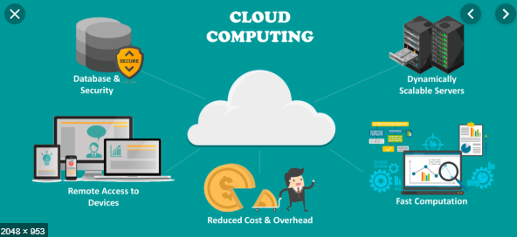
What AWS Offer?
Availability
Scalability
Pay-as-you-go

Slide 7

Availability
AWS promises - 11 9's of availability 99.999999999

Slide 8

scalability
Ability to grow in size
Instant Elasticity (scaling up and down)
Eliminate guessing on your infrastructure capacity needs.

Slide 9

Pay-as-you-go
Low Ongoing Cost:, pay-as-you-go pricing with no up-front expenses or long-term commitments.

Slide 10
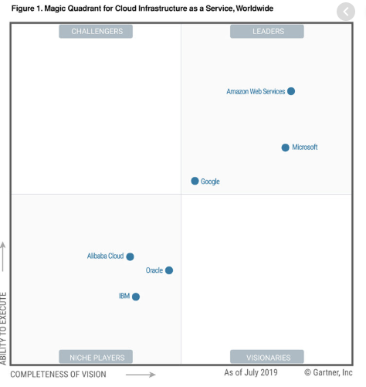
Gartner Magic Quadrant
Notes:
Use a section header for each of the topics, so there is a clear transition to the audience.

Slide 11
List of Services
1) EC2
2) S3
3) IAM
4) ELB
5) AS
6) VPC
7) Route 53
8) RDS
9) Elastic Beanstalk
10) Cloud Trail
11) SES
12) SQS
13) SNS
14) Cloud Formation
15) Cloud Front
16) Cloud Watch
Duration: 25 Days
Each Session: 1 Hr
Session Timings: 11:00 AM to 12:00 Noon IST
Each Session is recorded
Notes:
Give a brief overview of the presentation. Describe the major focus of the presentation and why it is important.
Introduce each of the major topics.
To provide a road map for the audience, you can repeat this Overview slide throughout the presentation, highlighting the particular topic you will discuss next.

Slide 12
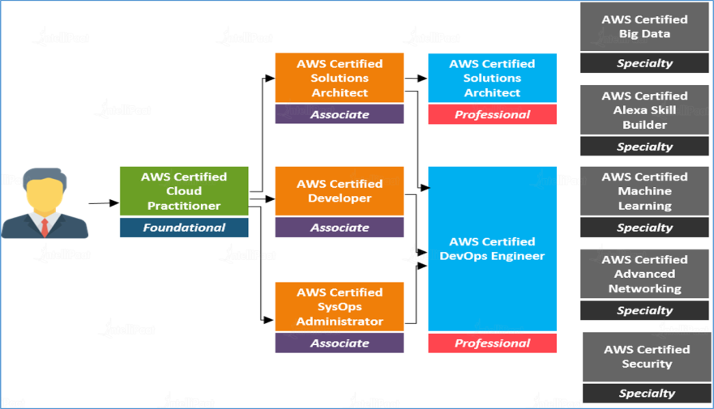
What about certification ?

Slide 13

Q&A
Give a Missed Call to 080-35375141 ( Prefix 0 )

